Slide 1
Data Structure
CHAPTER 6
GRAPHS

Slide 2
HomeWorks-6-5
Given a directed graph G using the adjacency list representation. Write a program to determine a topological sort in G.

Slide 3
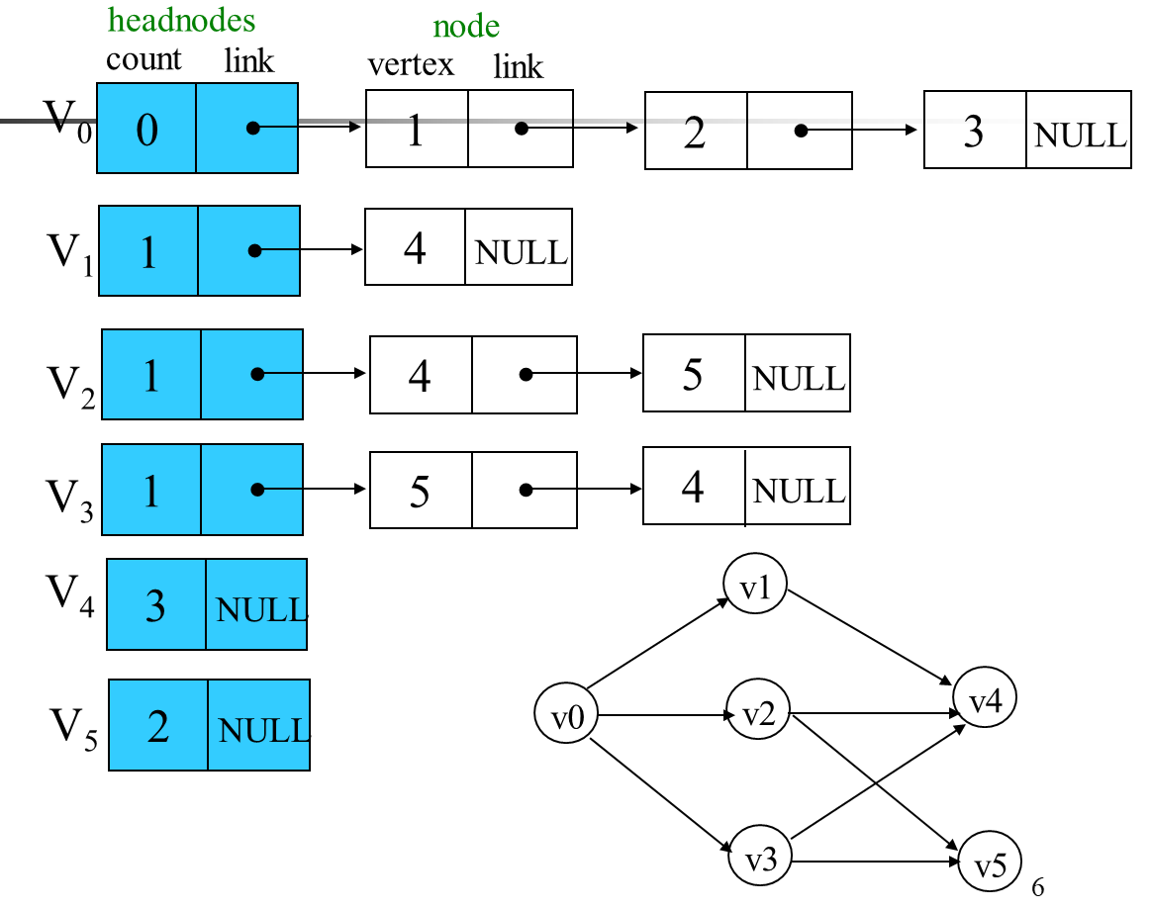
Adjacency list representation
⇒V₀, V₁, V₂, V₃, V₄, V₅

