Slide 1
Data Structure
CHAPTER 1
BASIC CONCEPT

Slide 2
Towers of Hanoi
There are three towers and 64 disks of different diameters placed on the first tower. The disks are in order of decreasing diameter as one scans up the tower. Monks were reputedly supposed to move the disk from tower 1 to tower 3 obeying the rules:
(a) Only one disk can be moved at any time.
(b) No disk can be placed on top of a disk with a smaller diameter.
Write a recursive function that prints out the sequence of moves needed to accomplish this task.

Slide 3
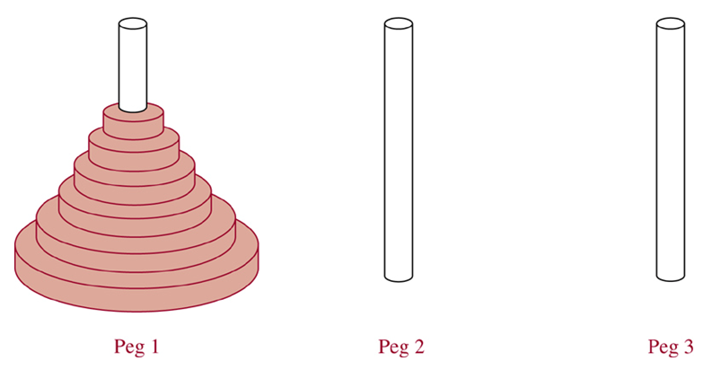
The Tower of Hanoi
Ex.5:
From McGraw-Hill

Slide 4
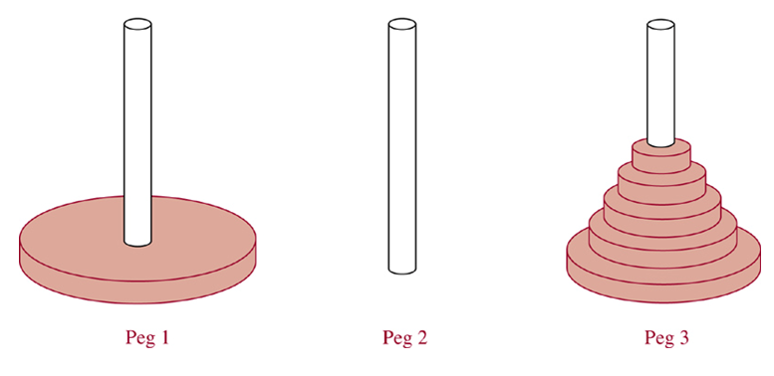
The Tower of Hanoi
Ex.5: An Intermediate Position
From McGraw-Hill

Slide 5
n-1
n-th

