Slide 1
CREATIVE
PORTFOLIO
Instagram & Facebook
Image Creatives
SHENBAGA DEVI C
Social Media Graphic Designer
SELECTED CLIENT WORK • AQUA TECH • REAL ESTATE • SIDDHA HOSPITAL
SHENBAGA DEVI / SOCIAL MEDIA DESIGN
01

Slide 2
01 / OVERVIEW
A portfolio built around real client work
A curated selection of Instagram and Facebook creative designs.
01
02
03
Aqua Tech
Real Estate
Siddha Hospital
Sales & service business
Property-focused client creatives
Healthcare client creatives
WHAT THIS PORTFOLIO SHOWCASES
Visual communication • Social-first layouts • Creative work across industries
SHENBAGA DEVI / SOCIAL MEDIA DESIGN
02

Slide 3
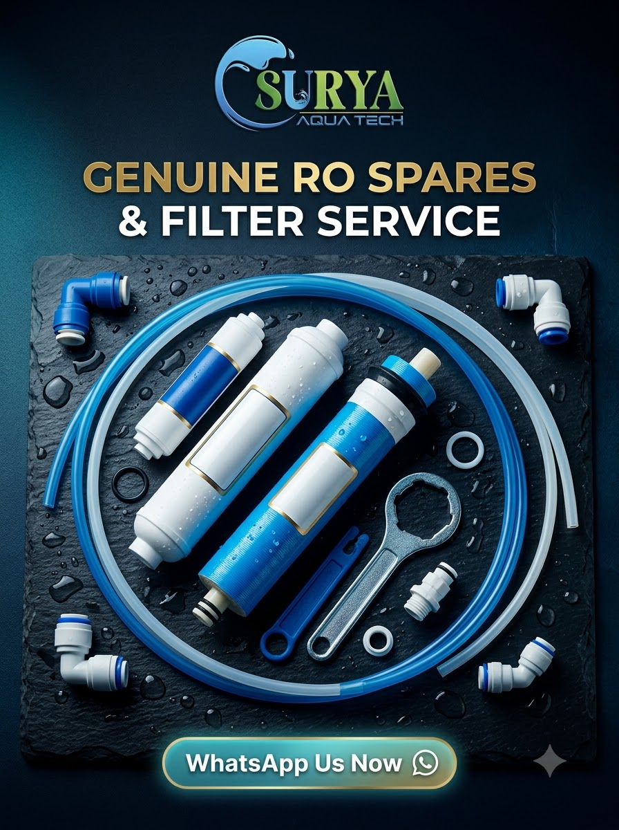


02 / CLIENT PROJECT
Aqua Tech
Sales & service business | Instagram and Facebook creative samples
PROJECT NOTE
Creative examples for a sales and service business.
SHENBAGA DEVI / SOCIAL MEDIA DESIGN
03

Slide 4
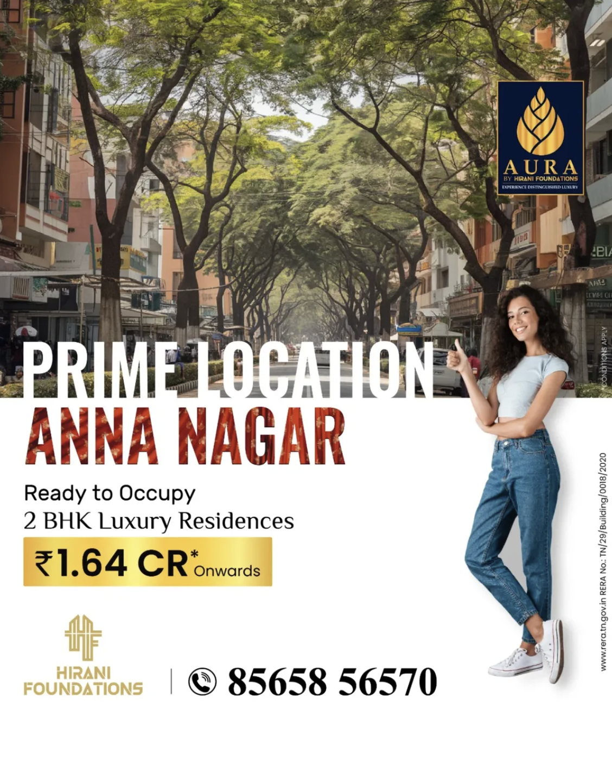

03 / CLIENT PROJECT
Real Estate
Selected property-sector creatives
PROJECT NOTE
A selection of social media designs created for a real estate client.
SHENBAGA DEVI / SOCIAL MEDIA DESIGN
04

Slide 5

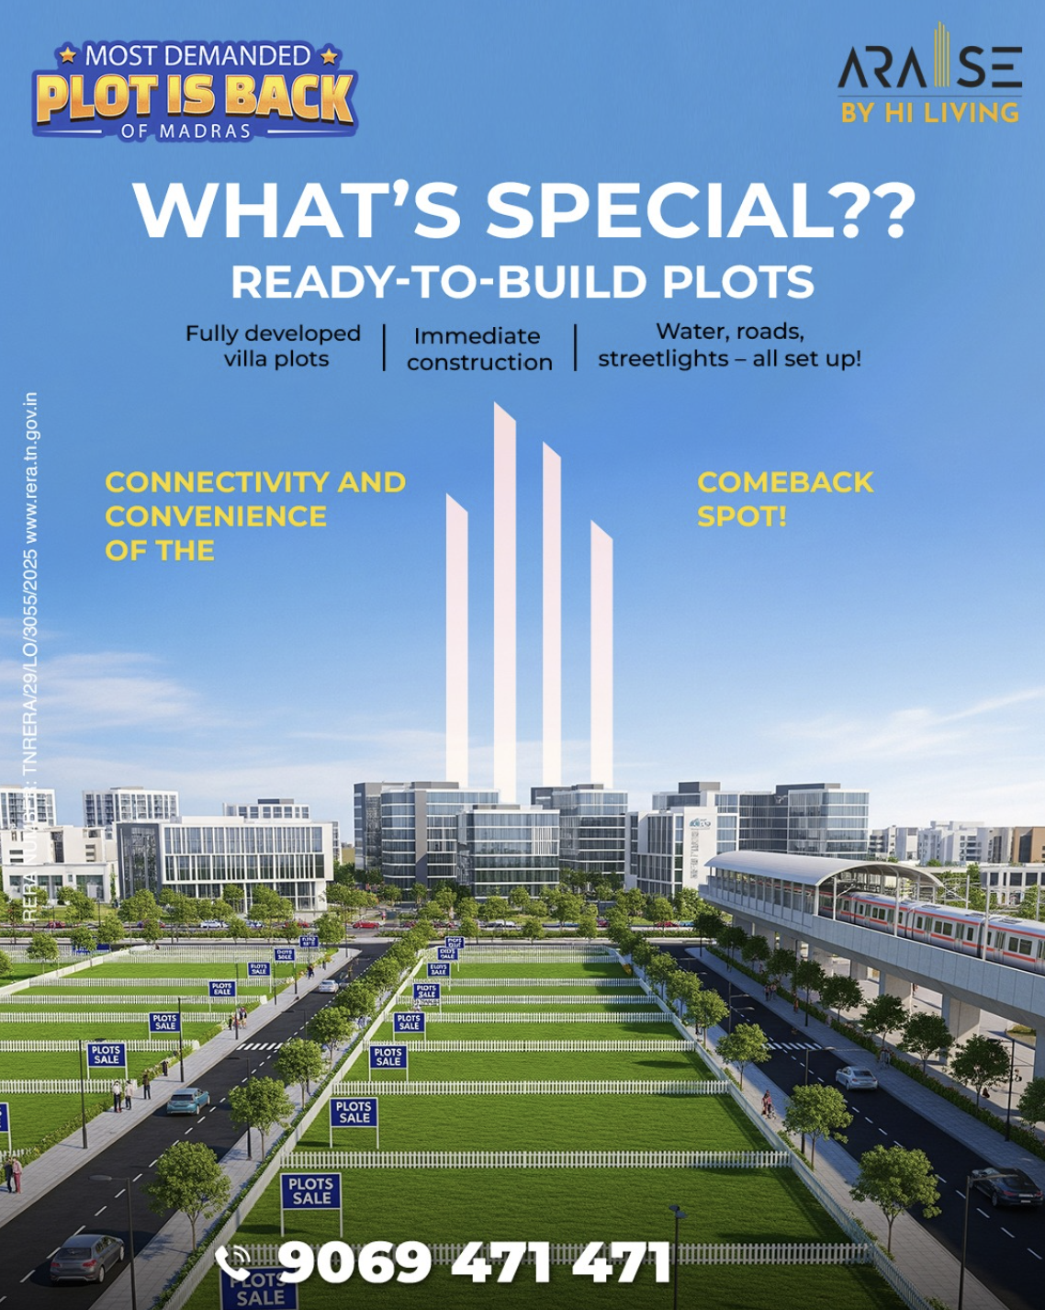
03 / CLIENT PROJECT
Real Estate — more creative work
Additional designs from the real estate client section
SHENBAGA DEVI / SOCIAL MEDIA DESIGN
05

Slide 6


04 / CLIENT PROJECT
Siddha Hospital
Selected healthcare-sector social media creatives
PROJECT NOTE
Creative samples prepared for a Siddha hospital client.
SHENBAGA DEVI / SOCIAL MEDIA DESIGN
06

Slide 7
LET'S WORK
TOGETHER
CONTACT
Shenbaga Devi C
Have a project in mind? Get in touch to discuss social media design needs.
Email: [Add professional email]
Phone: [Add contact number]
Portfolio / Instagram: [Add link]
Replace the bracketed fields before sharing.
THANK YOU
SHENBAGA DEVI / SOCIAL MEDIA DESIGN
07

