Slide 1

CREATOR!📝
-CHAMPS🏆

Slide 2

TEAM MEMBERS:-
Shenbaga Bharathi G
Thanushiya S
Vishnu U
Yokesh G K
Shalini S
Vishaanth Adhitya C T
Sreenath M K

Slide 3




Introduction
In this application , we try to make the engineering students to access information regarding their courses, curriculum, scope of the course etc..
After this , we will also try to implement contents for the particular courses In all forms such as video clippings , textbooks, mock Tests , revision papers etc.

Slide 4
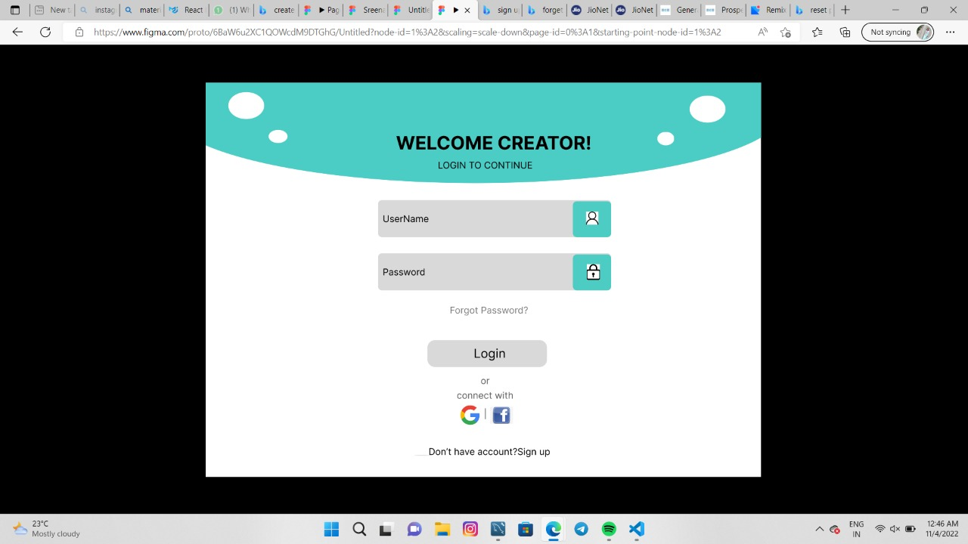
Slide 1:-
Subtitle

Slide 5
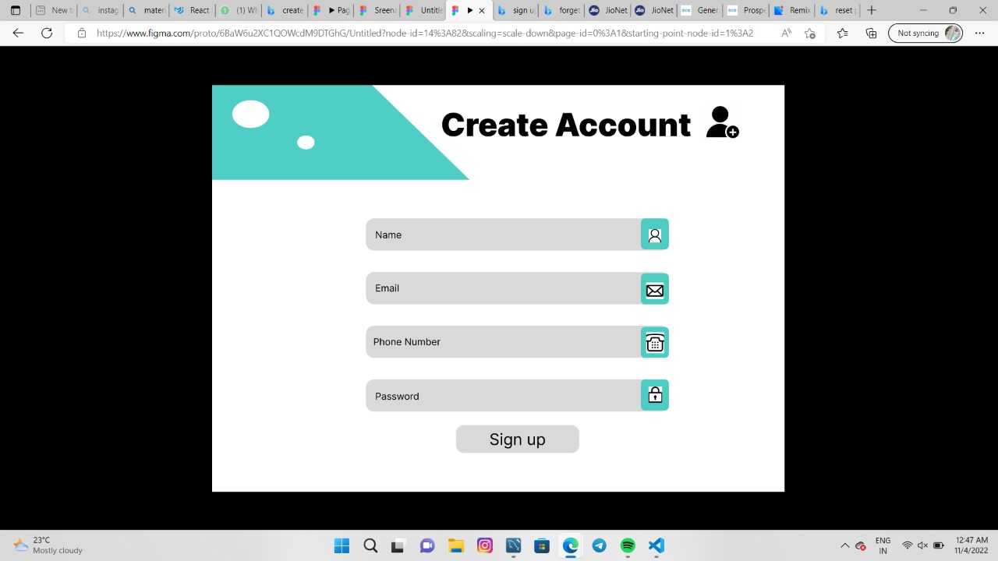
Slide 2:-
Subtitle

Slide 6
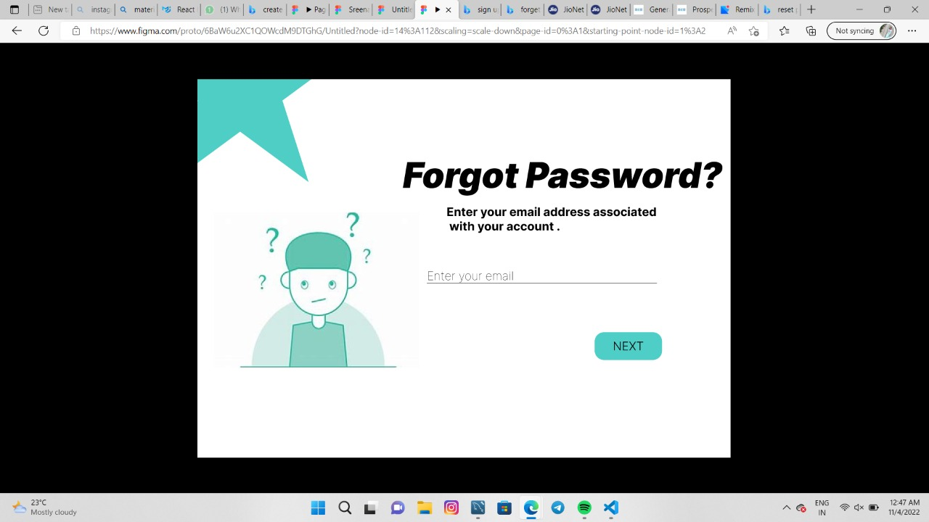
Slide 3:-
Subtitle

Slide 7
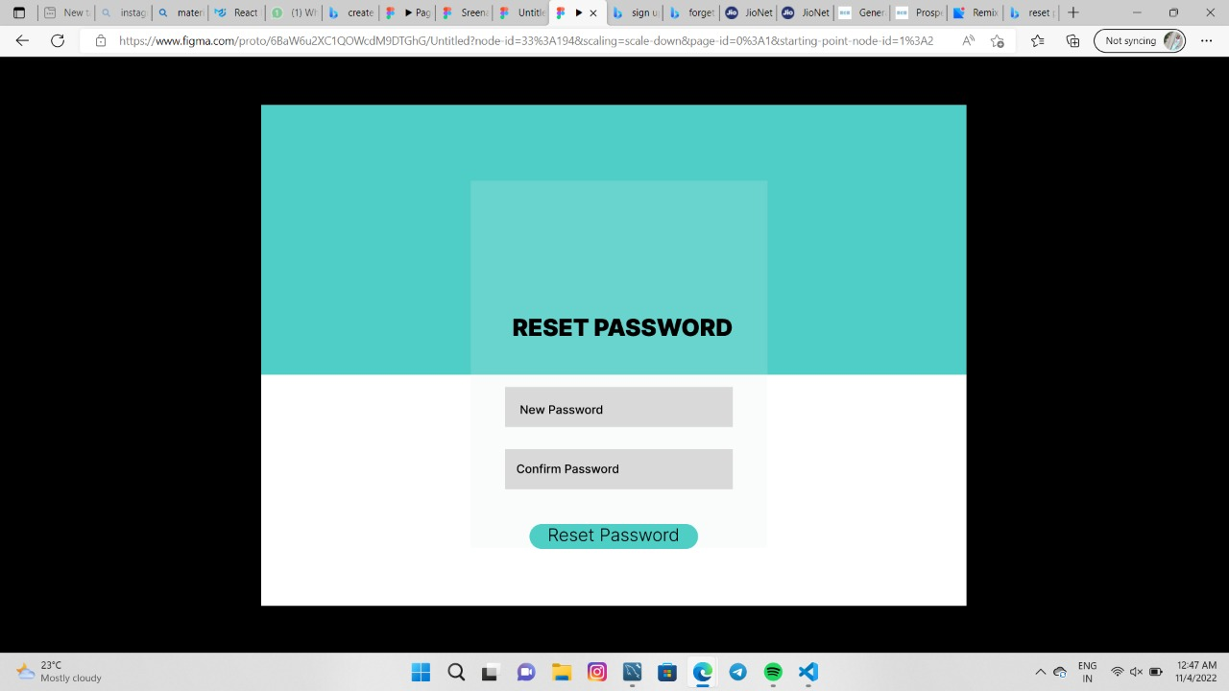
Slide 4:-
Subtitle

Slide 8
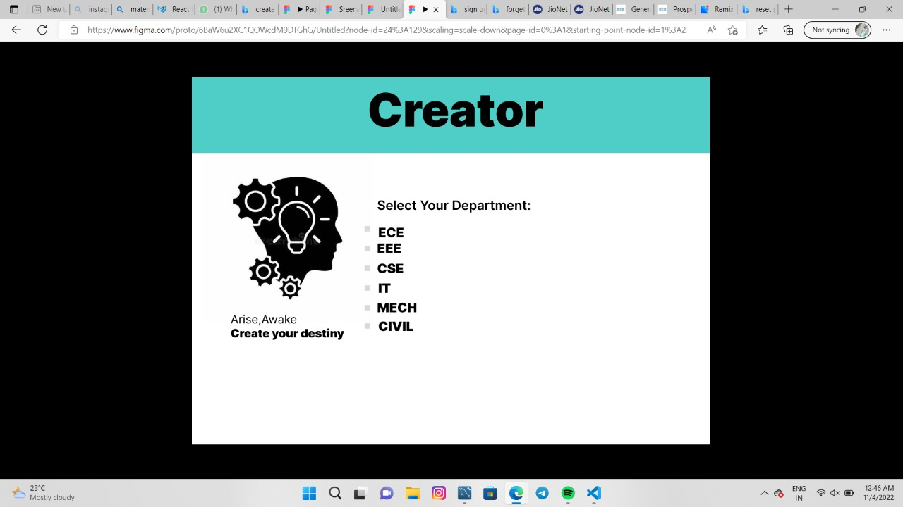
Slide 5:-
Subtitle

Slide 9
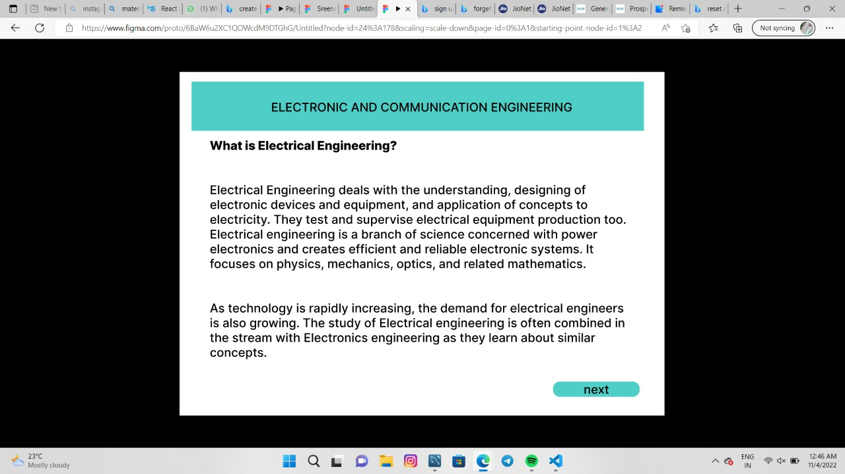
Slide 6:-
Subtitle

Slide 10
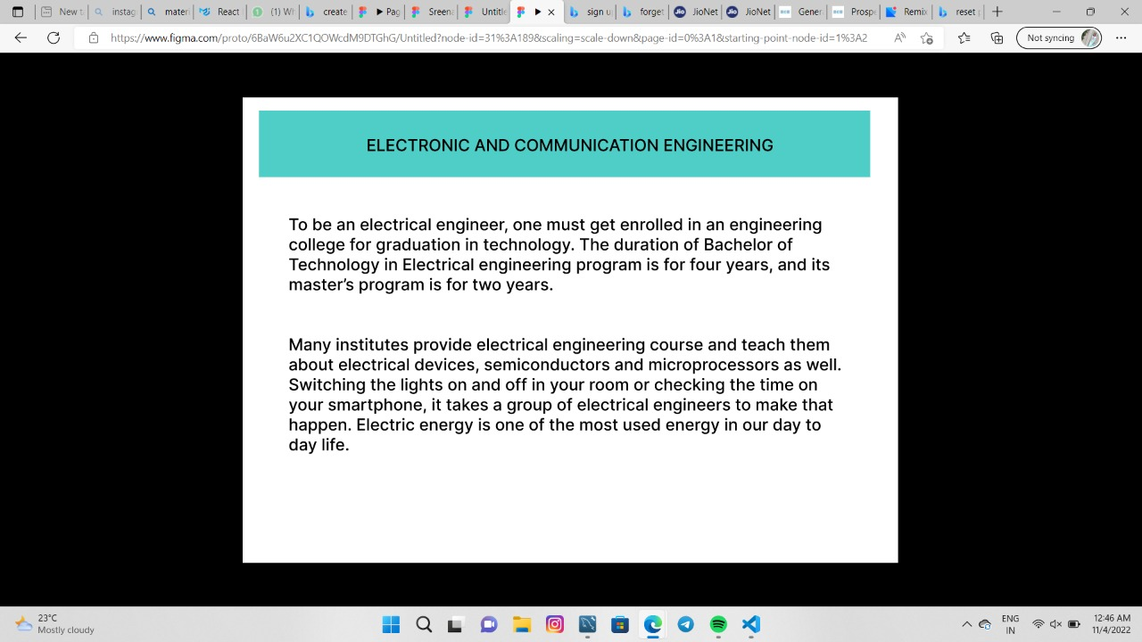
Slide 7:-
Subtitle

Slide 11

FURTHER REFERENCE:
https://www.figma.com/file/6BaW6u2XC1QOWcdM9DTGhG/Untitled?node-id=0%3A1
https://github.com/shenbagabharathi

Slide 12
Thank You!🙌

