Slide 1
Java高级编程
第六章 模型 II
2018

Slide 2
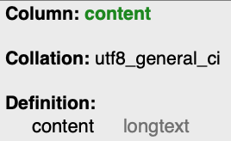

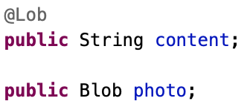
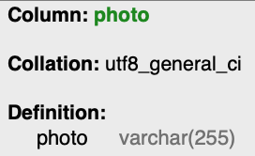
大对象
用户的简历
  文本、图片
LOB（Large Object）

Slide 3
大对象
@Test
public void blobTest() {
User user = new User("bb@aa.com", "123", "Lisi");
user.content = "Establishing SSL connection without server's identity ......";
File photo = new File("D:\\test.jpg");
user.photo = new Blob();
try {
user.photo.set(new FileInputStream(photo), MimeTypes.getContentType(photo.getName()));
} catch (FileNotFoundException e) {
e.printStackTrace();
}
user.save();
User b = User.find("byEmail", "bb@aa.com").first();
assertEquals(b.fullname, "Lisi");
}

Slide 4
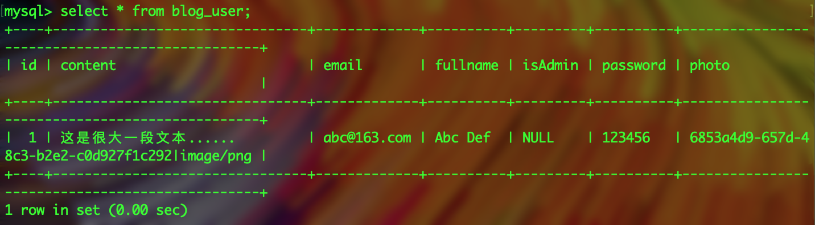

大对象
play.db.jpa.Blob
  数据存储在数据库之外
  与Java.sql.Blob类型不同，不能加@Lob

Slide 5
简易博客
多个用户(User)
每个用户可以有多篇文章(Post)
每篇文章可以有多个留言(Comment)

Slide 6
User
删除User类中的content和photo
  删除相应的单元测试代码

Slide 7
Post
package models;
import java.util.*;
import javax.persistence.*;
import play.db.jpa.*;
@Entity
public class Post extends Model {
public String title;
public Date postedAt;
@Lob
public String content;
@ManyToOne
public User author;
public Post(User author, String title, String content) {
this.author = author;
this.title = title;
this.content = content;
this.postedAt = new Date();
}
}
标题(title)
发布日期(postedAt)
内容(content : Lob)
作者 (author)
ManyToOne
  试着删除一下User表

Slide 8
Post单元测试
新增一个测试createPost
@Test
public void createPost() {
// Create a new user and save it
User bob = new User("bob@gmail.com", "secret", "Bob").save();
// Create a new post
new Post(bob, "My first post", "Hello world").save();
// Test that the post has been created
assertEquals(1, Post.count());
// Retrieve all posts created by Bob
List<Post> bobPosts = Post.find("byAuthor", bob).fetch();
// Tests
assertEquals(1, bobPosts.size());
Post firstPost = bobPosts.get(0);
assertNotNull(firstPost);
assertEquals(bob, firstPost.author);
assertEquals("My first post", firstPost.title);
assertEquals("Hello world", firstPost.content);
assertNotNull(firstPost.postedAt);
}

Slide 9
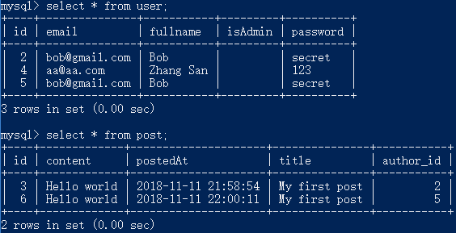

Post单元测试
第一次执行单元测试正常，但第二次执行时错误
看来byAuthor不是按ID

Slide 10
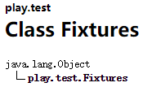
Post单元测试
希望执行每个单元测试函数前清空之前的测试数据
@Before
setup()
Fixtures
public class BasicTest extends UnitTest {
@Before
public void setup() {
Fixtures.deleteAllModels();
}

Slide 11
Comment
package models;
import java.util.*;
import javax.persistence.*;
import play.db.jpa.*;
@Entity
public class Comment extends Model {
public String author;
public Date postedAt;
@Lob
public String content;
@ManyToOne
public Post post;
public Comment(Post post, String author, String content) {
this.post = post;
this.author = author;
this.content = content;
this.postedAt = new Date();
}
}
一个Post可以有多个Comment
  ManyToOne

Slide 12

Comment单元测试
@Test
public void postComments() {
// Create a new user and save it
User bob = new User("bob@gmail.com", "secret", "Bob").save();
// Create a new post
Post bobPost = new Post(bob, "My first post", "Hello world").save();
// Post a first comment
new Comment(bobPost, "Jeff", "Nice post").save();
new Comment(bobPost, "Tom", "I knew that !").save();
// Retrieve all comments
List<Comment> bobPostComments = Comment.find("byPost", bobPost).fetch();
// Tests
assertEquals(2, bobPostComments.size());
Comment firstComment = bobPostComments.get(0);
assertNotNull(firstComment);
assertEquals("Jeff", firstComment.author);
assertEquals("Nice post", firstComment.content);
assertNotNull(firstComment.postedAt);
Comment secondComment = bobPostComments.get(1);
assertNotNull(secondComment);
assertEquals("Tom", secondComment.author);
assertEquals("I knew that !", secondComment.content);
assertNotNull(secondComment.postedAt);
}

Slide 13
业务逻辑中获取Comment不方便
为了获取一个Post的Comments，需要查询这个Post上的所有Comment
更好的方式
  为ManyToOne关系的Post侧设定OneToMany
  mappedBy
    Comment类中的post属性是关系的另一侧
  Cascade
    级联方式，如果删除一个post，那么与它相关的comments也将会删除
@OneToMany(mappedBy="post", cascade=CascadeType.ALL)
public List<Comment> comments;
public Post(User author, String title, String content) {
this.comments = new ArrayList<Comment>();
this.author = author;
this.title = title;
this.content = content;
this.postedAt = new Date();
}

Slide 14
双向关系谁来维护？
Comment属于Post，所以由Post来维护
  Post增加一个addComment方法
public Post addComment(String author, String content) {
Comment newComment = new Comment(this, author, content).save();
this.comments.add(newComment);
this.save();
return this;
}

Slide 15
测试为Post添加Comment
@Test
public void useTheCommentsRelation() {
// Create a new user and save it
User bob = new User("bob@gmail.com", "secret", "Bob").save();
// Create a new post
Post bobPost = new Post(bob, "My first post", "Hello world").save();
// Post a first comment
bobPost.addComment("Jeff", "Nice post");
bobPost.addComment("Tom", "I knew that !");
// Count things
assertEquals(1, User.count());
assertEquals(1, Post.count());
assertEquals(2, Comment.count());
// Retrieve Bob's post
bobPost = Post.find("byAuthor", bob).first();
assertNotNull(bobPost);
// Navigate to comments
assertEquals(2, bobPost.comments.size());
assertEquals("Jeff", bobPost.comments.get(0).author);
// Delete the post
bobPost.delete();
// Check that all comments have been deleted
assertEquals(1, User.count());
assertEquals(0, Post.count());
assertEquals(0, Comment.count());
}

Slide 16
完整的测试
Fixtures载入用YAML描述的数据
  新建/编辑 test/data.yml 文件
为User增加connect方法
public static User connect(String email, String password) {
return find("byEmailAndPassword", email, password).first();
}

Slide 17
完整的测试
@Test
public void fullTest() {
Fixtures.loadModels("data.yml");
// Count things
assertEquals(2, User.count());
assertEquals(3, Post.count());
assertEquals(3, Comment.count());
// Try to connect as users
assertNotNull(User.connect("bob@gmail.com", "secret"));
assertNotNull(User.connect("jeff@gmail.com", "secret"));
assertNull(User.connect("jeff@gmail.com", "badpassword"));
assertNull(User.connect("tom@gmail.com", "secret"));
// Find all of Bob's posts
List<Post> bobPosts = Post.find("author.email", "bob@gmail.com").fetch();
assertEquals(2, bobPosts.size());
// Find all comments related to Bob's posts
List<Comment> bobComments = Comment.find("post.author.email", "bob@gmail.com").fetch();
assertEquals(3, bobComments.size());
// Find the most recent post
Post frontPost = Post.find("order by postedAt desc").first();
assertNotNull(frontPost);
assertEquals("About the model layer", frontPost.title);
// Check that this post has two comments
assertEquals(2, frontPost.comments.size());
// Post a new comment
frontPost.addComment("Jim", "Hello guys");
assertEquals(3, frontPost.comments.size());
assertEquals(4, Comment.count());
}

