Slide 1
工作汇报
吴 迪
2019.9.16

Slide 2
Processing boxes
Traditional detection method and deep learning method were used to detect images respectively.
First method (this is better)
Screening yolo_boxes(model detection results) based the rule: delete the yolo_box when it was compared with the traditional method, the IOU was less than 0.2 and greater than 0.8.
Second method
Screening tr_boxes(traditional method detctions) based the rule: delete the tr_box when it was compared with the deeplearning method, the IOU was less than 0.8.
Screening yolo_boxes(model detection results) based the rule: delete the yolo_box when it was compared with the traditional method, the IOU was greater than 0.8.
Other IOU threshold: 0.75 0.9

Slide 3
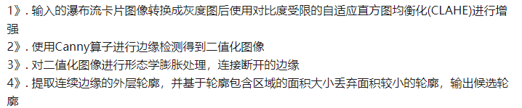
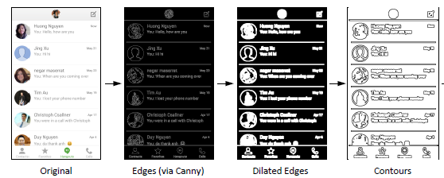
Computer vision
RGB2GRAY--CLAHE--Canny--Dilate--find contours

Slide 4
Processing text with OCR
Detect text with Tesserocr at text level and line level.
Delete text boxes that intersect with the detection results of traditional method and deeplearning method.
error detection

Slide 5

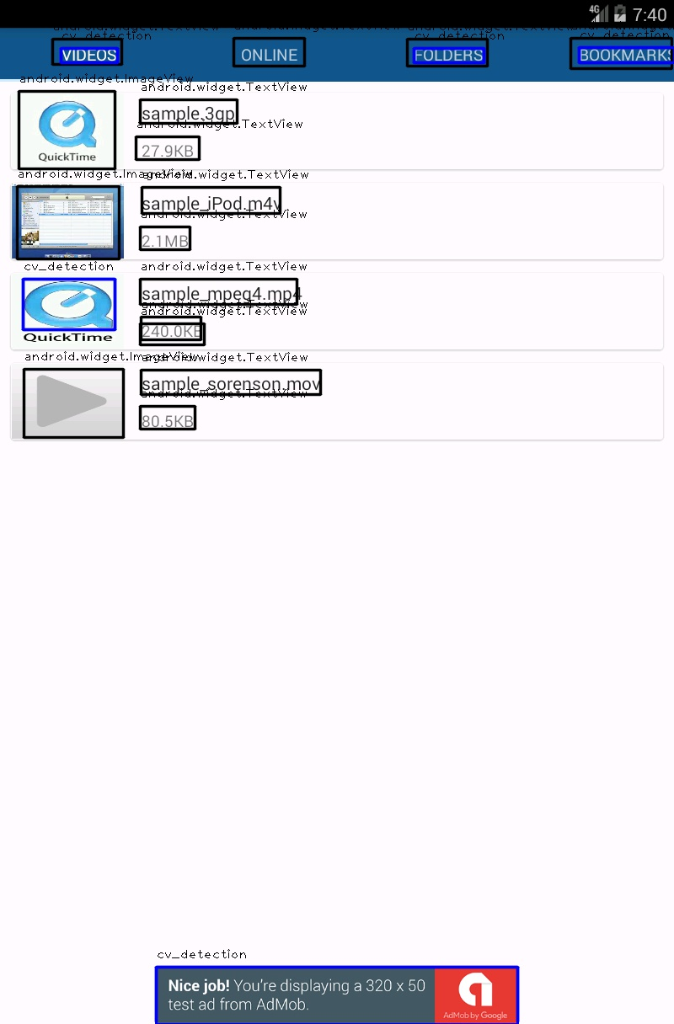
Examples (OCR is detected at the text level)

Slide 6
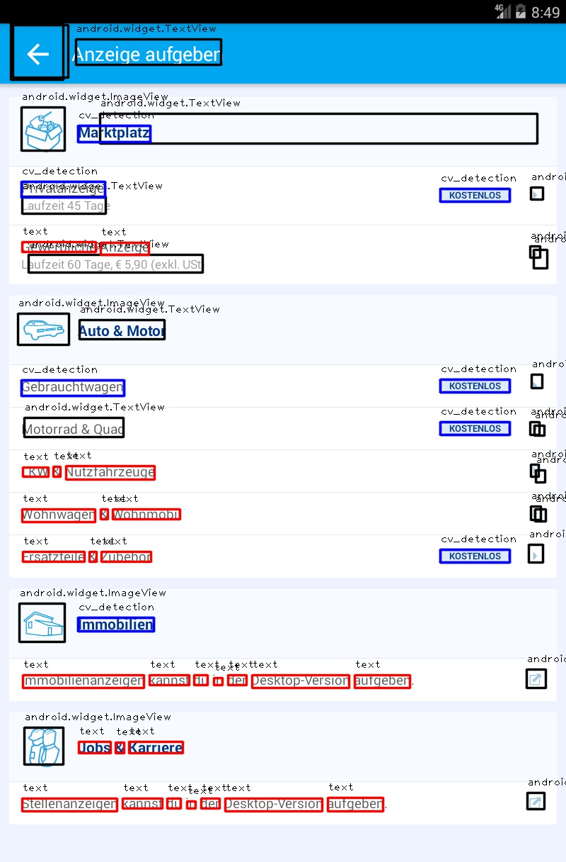

Examples (OCR is detected at the text level)

Slide 7
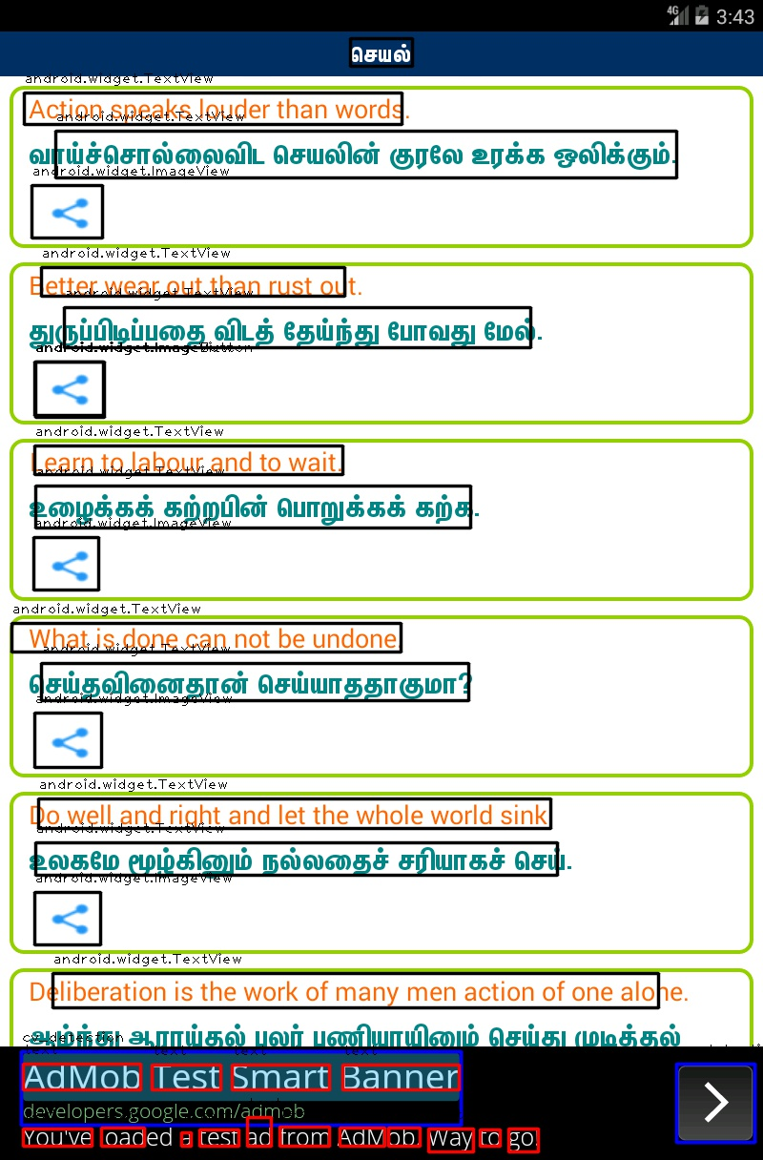
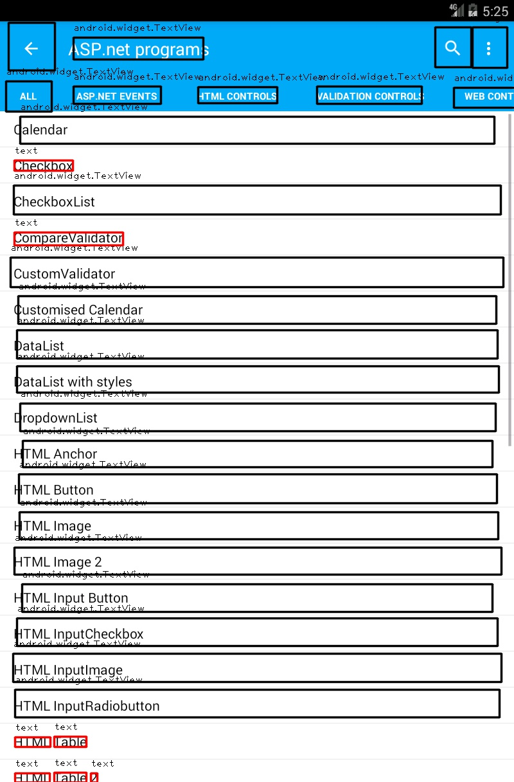
Examples(OCR is detected at the text level)

Slide 8
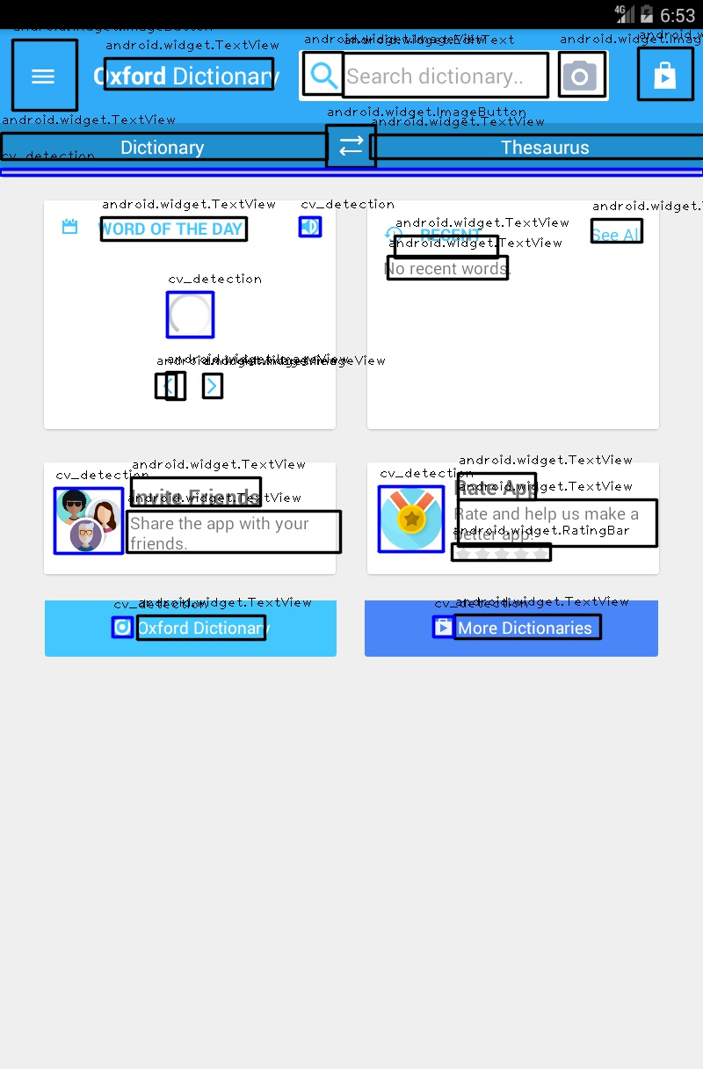
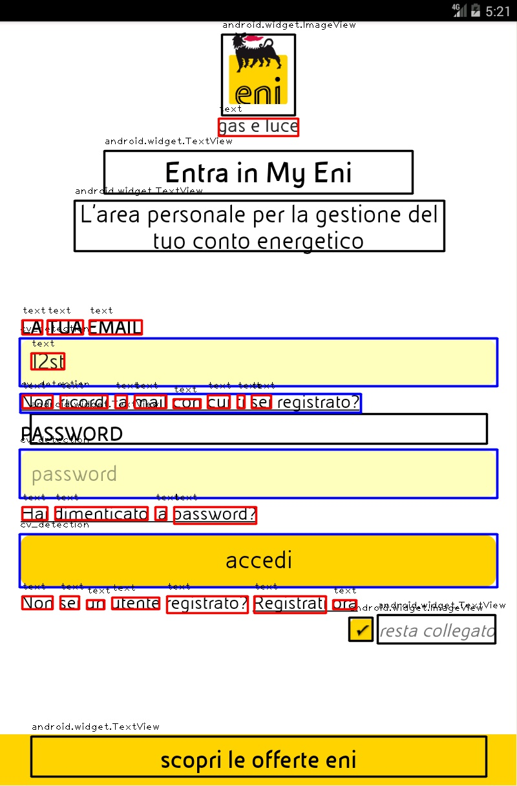
Examples(OCR is detected at the text level)

Slide 9

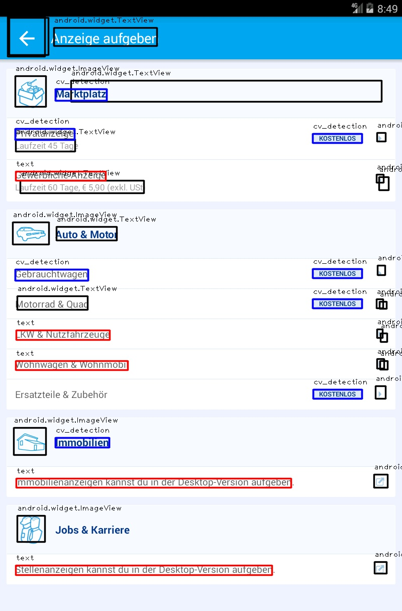
Examples (OCR is detected at the line level)

Slide 10
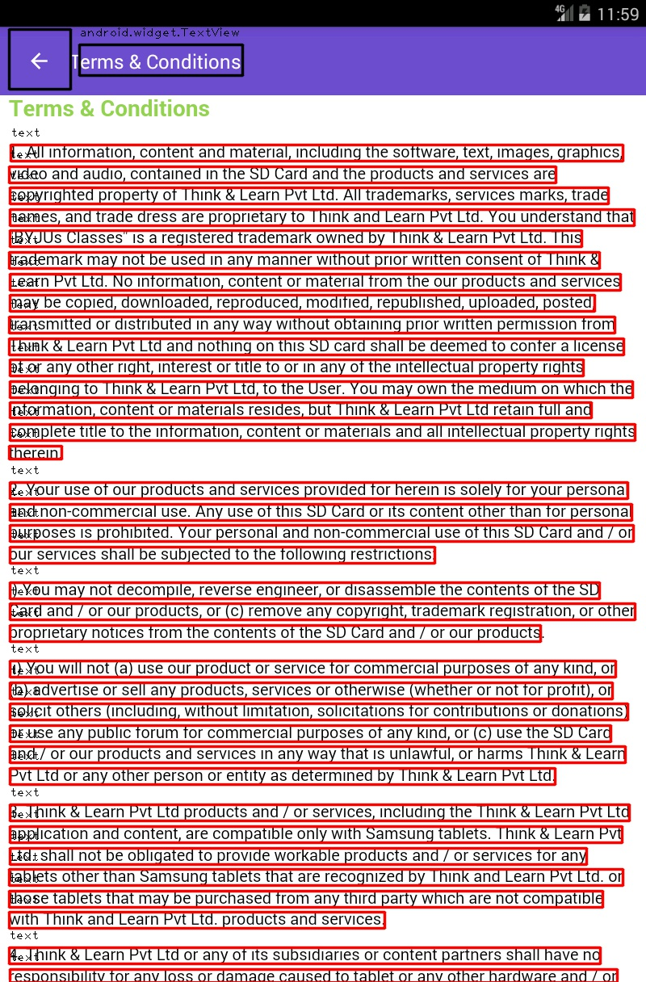
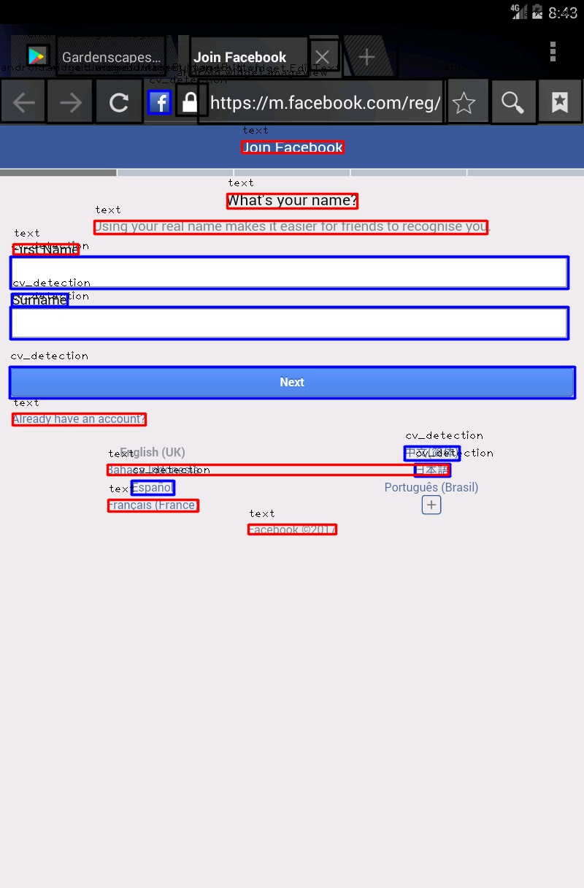
Examples (OCR is detected at the line level)

Slide 11
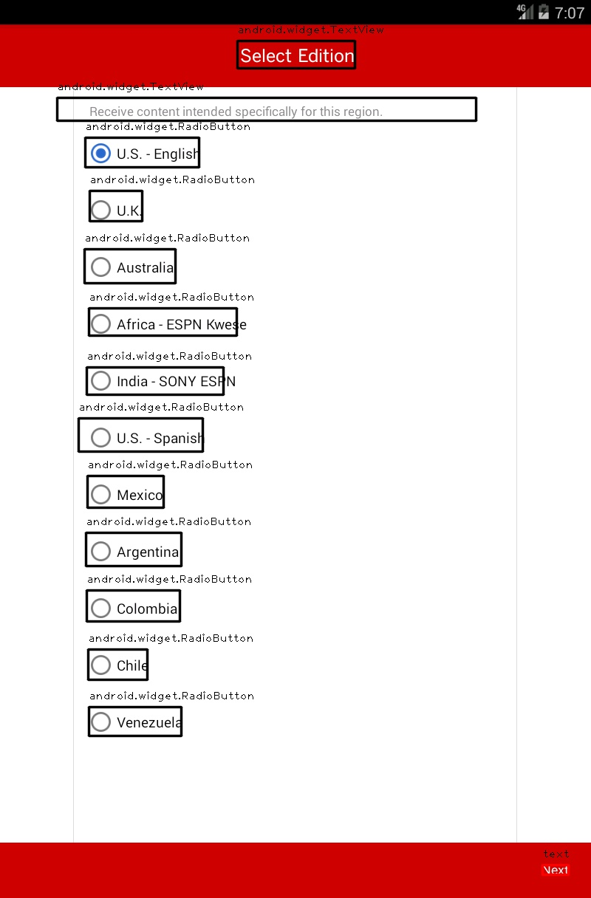
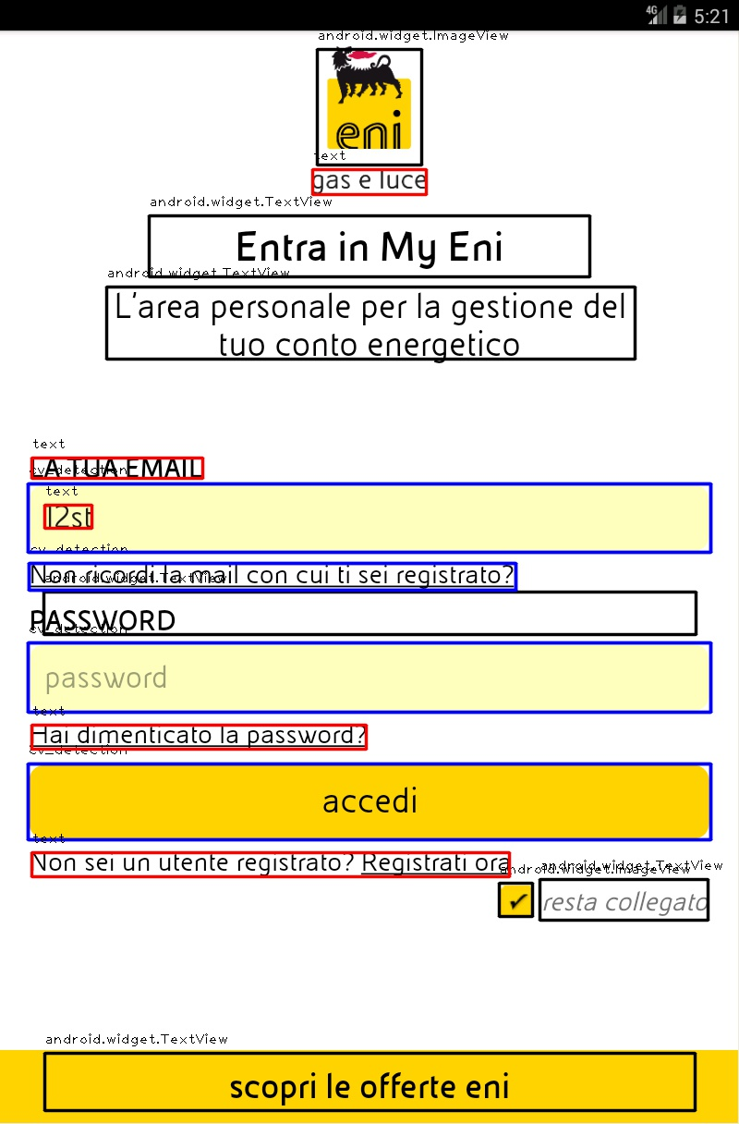
Examples (OCR is detected at the line level)

Slide 12
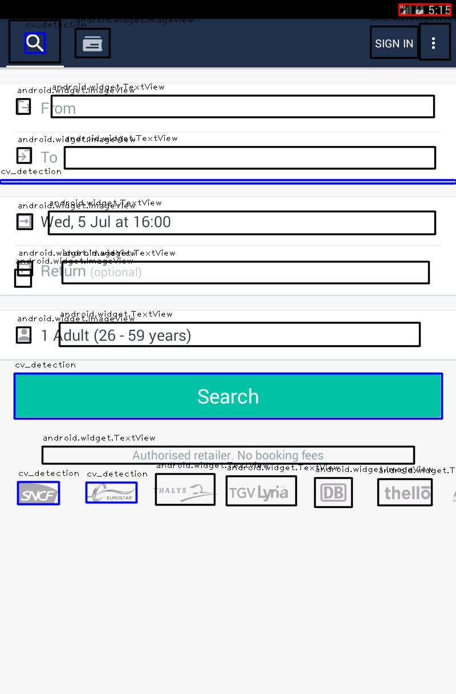
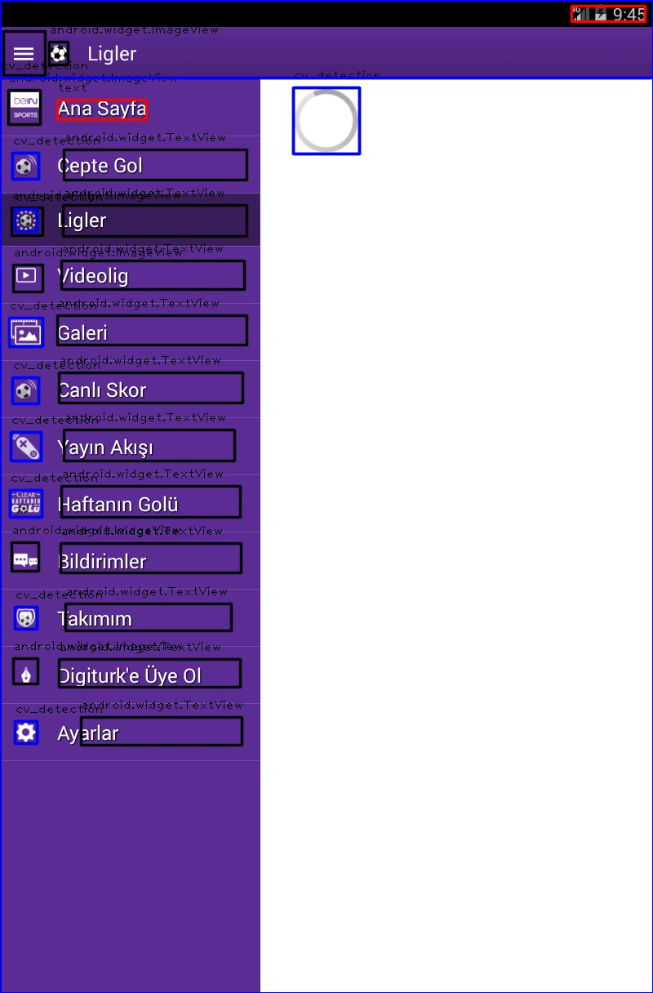
Examples (OCR is detected at the line level)

