Slide 1
工作汇报
吴 迪
2019.6.10

Slide 2
Data
23853 UIs (80%) for training
2983 UIs (10%) for testing
2981 UIs (10%) for validation
Cut images (800,1216,3)
Fixed the negative coordinates to 0

Slide 3
Centernet
"input_size": [511,511],
"batch_size": 2,
"decay_rate": 10,
"learning_rate": 0.00025,
"iter": 115000, (epoch=9)
"categories": 76,

Slide 4

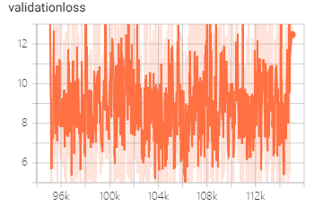
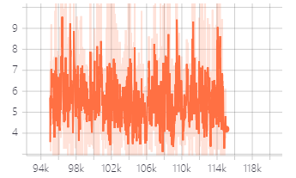
testing result
AP & AR : iou=0.5, 0.75, 0.5:0.95

Slide 5
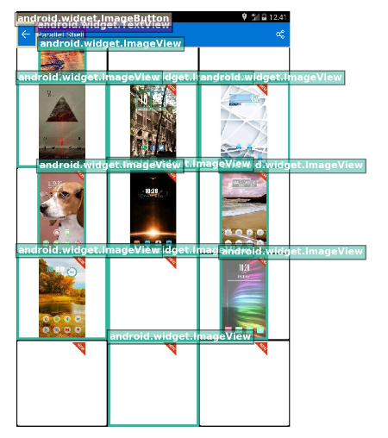

Testing result

Slide 6
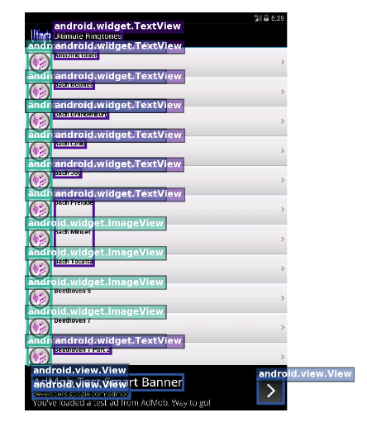
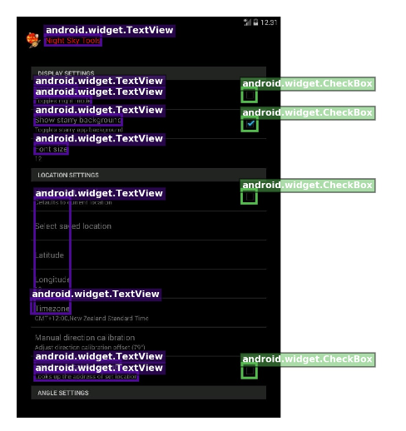
Testing result

Slide 7
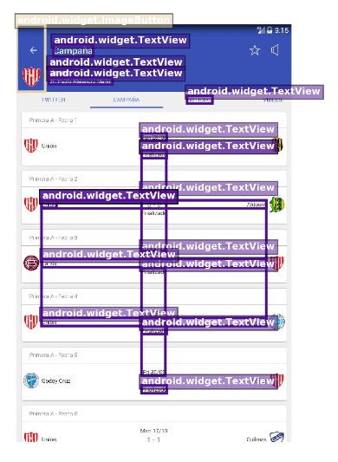
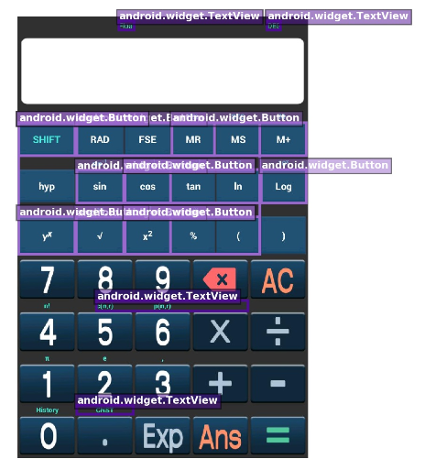
Testing result

Slide 8
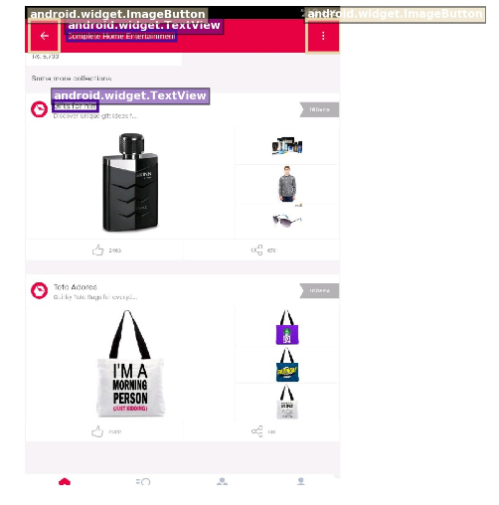
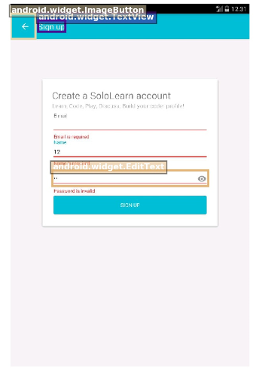
Testing result

