Slide 1
Weekly work
shencz

Slide 2
Data processing
For docString
Remove data that contains non-English word
Change Camel case to space
Remove special char include “<p>|</p>|\(|\)|:|\*|/|\r|\n|\”|\{|\}|\\|=|,|\.|_|-|/”
Remove parameter list and return value list
For code
Remove “_,-”
Change Camel case to space
Tokenize
Build three vocabulary for method name, method context and method comment
Pad in each batch

Slide 3
Model
H
LSTM1
embedding1
y1
y2
y3
y4
…
e
Encoder 1
LSTM2
+
LSTM4
embedding2
embedding4
Encoder 2
C
s
y1
y2
y3
y4
…
LSTM3
Encoder 3
embedding3

Slide 4
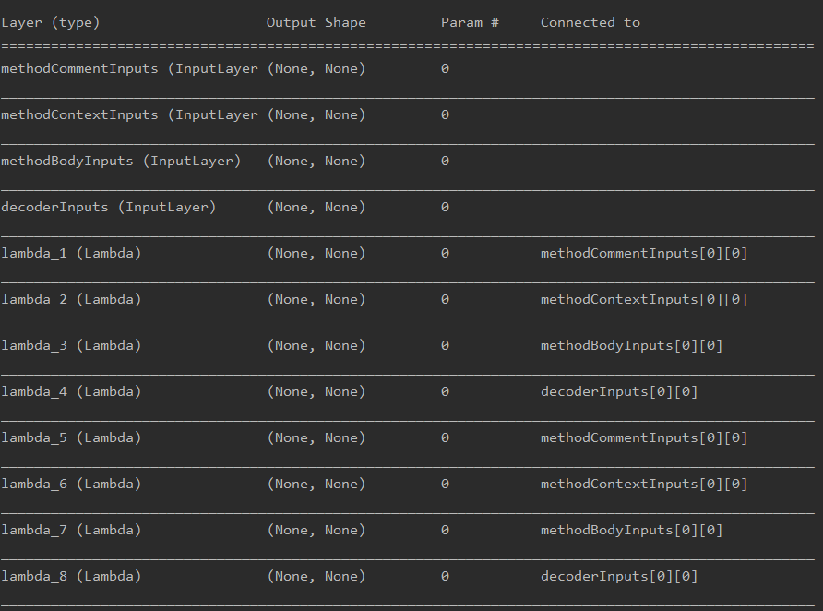
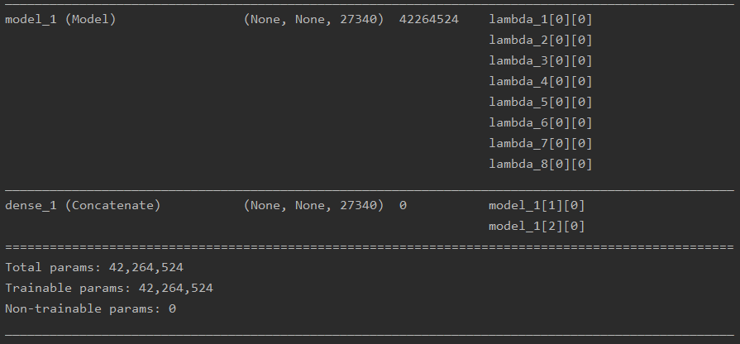
Batch size: 64
Epoch:2
Units of LSTM1\2\3: 32
Units of LSTM 4: 96
H:Tensor("lstm_1/while/Exit_3:0", shape=(?, 32), dtype=float32) C:Tensor("lstm_1/while/Exit_2:0", shape=(?, 32), dtype=float32)
Input data:360000 for train and 40000 for val
Output data: one hot

Slide 5
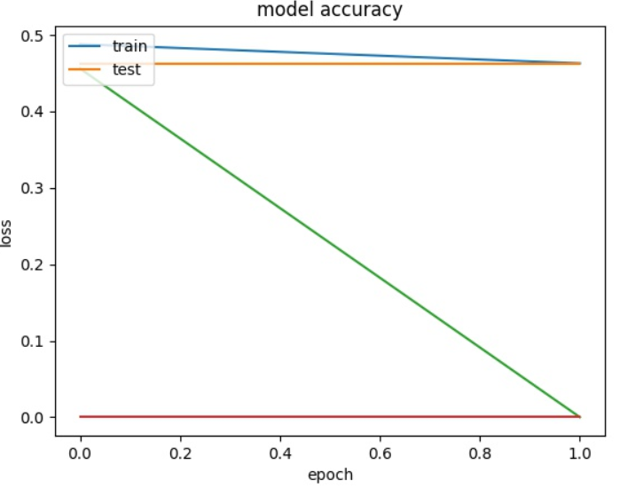
Train accuracy
Test accuracy
Train loss
Test loss

Slide 6
Question
measurement test
Next experiment

