Slide 1
Android UI design
Jilin University

Slide 2
Main work--sunht
1、data collection
2、data processing
3、configuration environment
4、Model training and testing

Slide 3
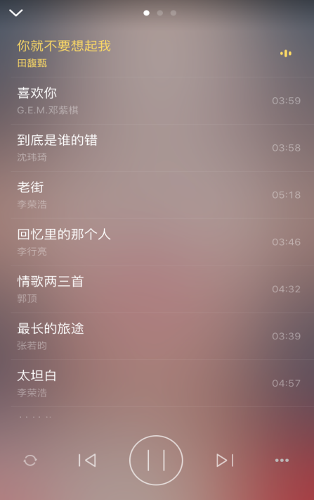
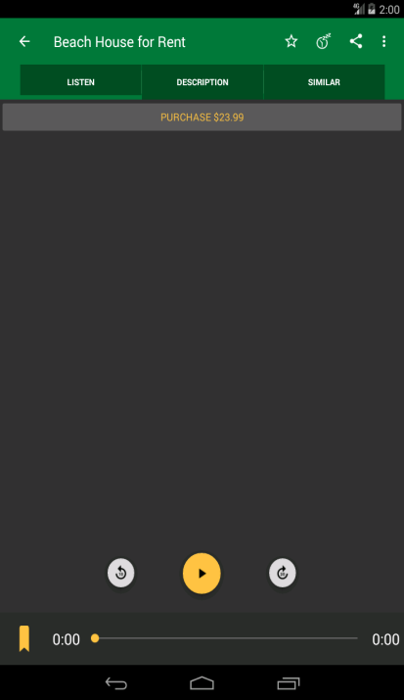
data collection
Work progress last week ：
（1）Install a PC version of android emulator
（2）collection UI

Slide 4
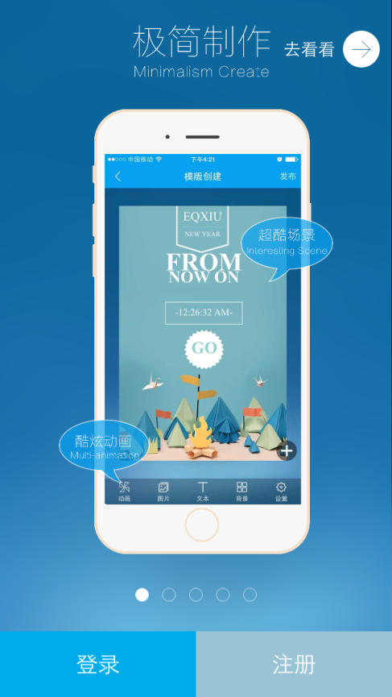
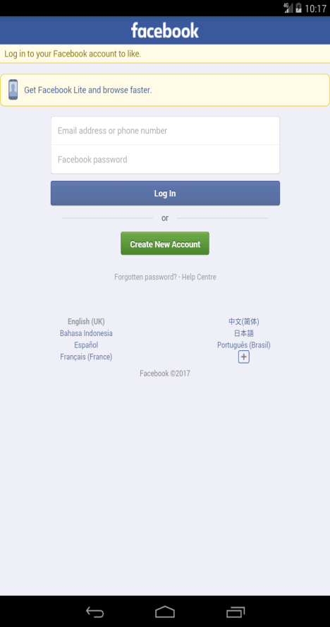
data collection

Slide 5
data processing
Work progress last week ：
（1）Crop the invalid edges of the collected images
Remove the image's wireless edges using Photoshop

Slide 6
configuration environment
Work progress this week：
（1）Installed version
Installation version：tensorflow-gpu v1.9.0 | cuda9.0 | cuDNN7.1.4
（2）Problems have been documented

Slide 7
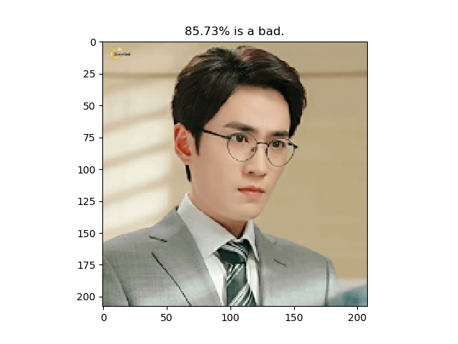
Model training and testing
Work progress last week ：
（1）output result

Slide 8
Main work--jiangxue
1. Find Ugly UI
2. image clustering

Slide 9
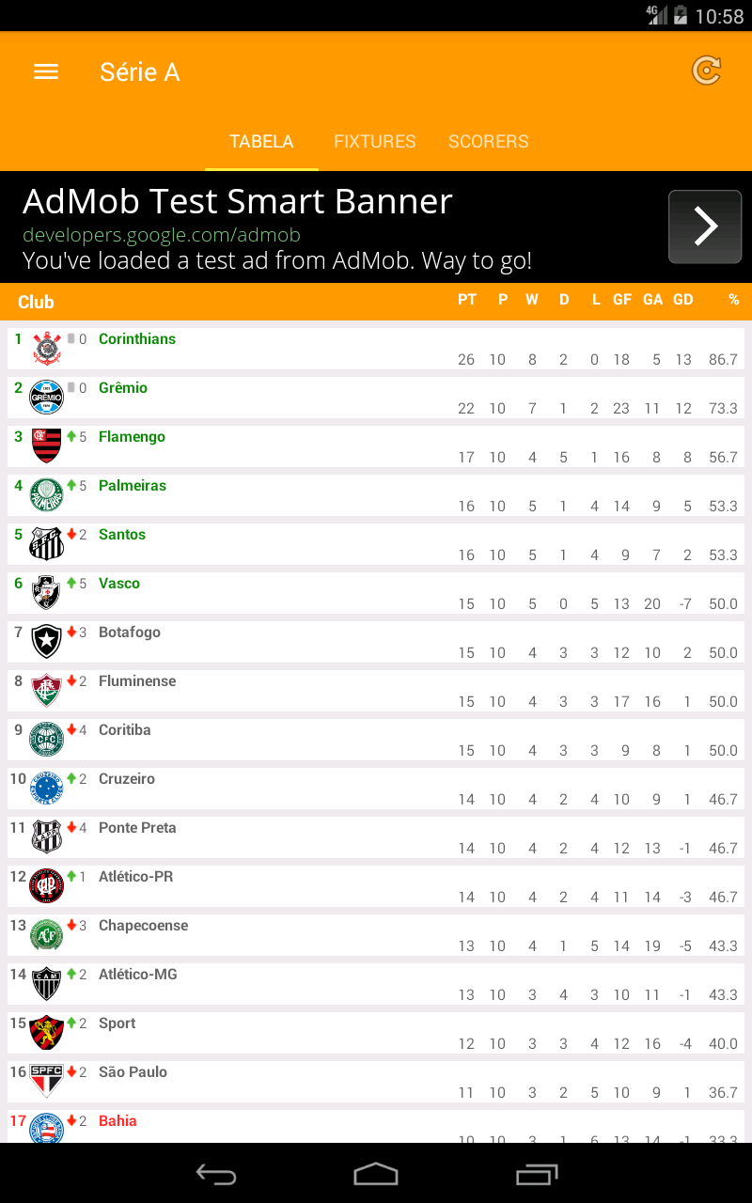
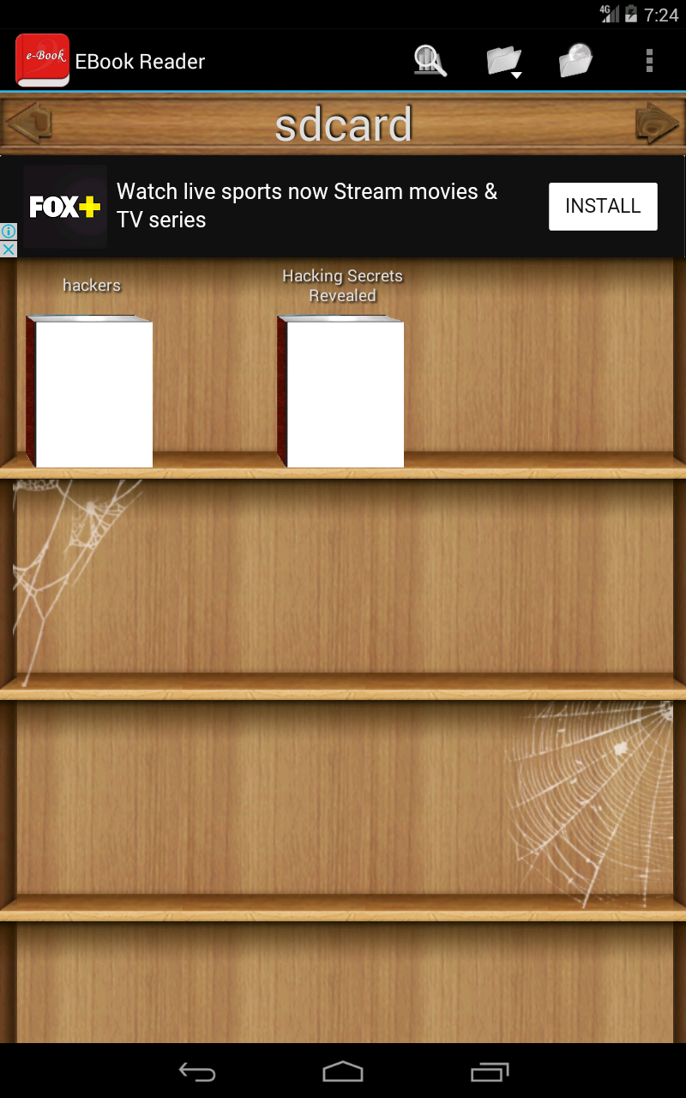
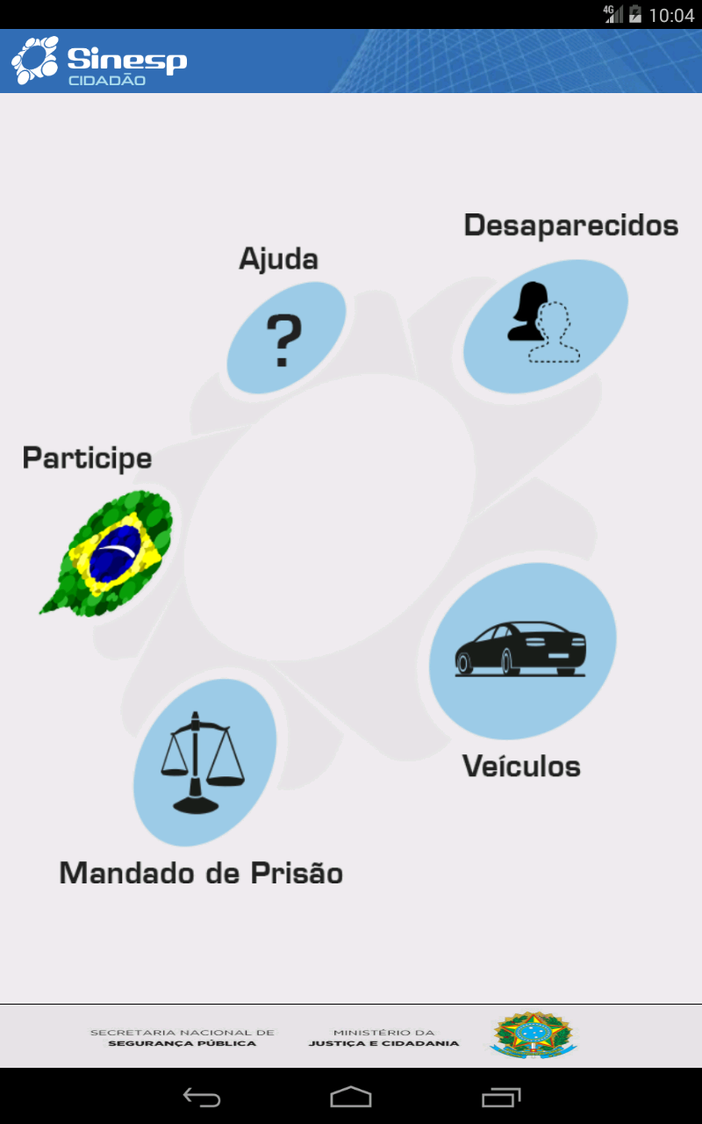
Reporting on work--jiangxue
Find Ugly UI

Slide 10
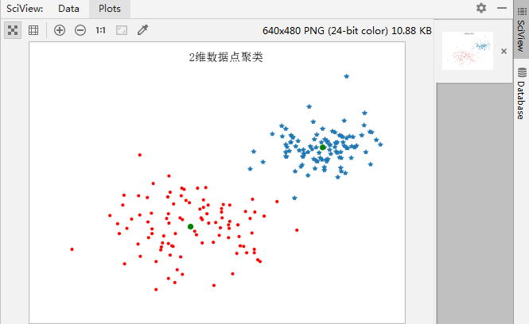
image clustering——K-means

Slide 11
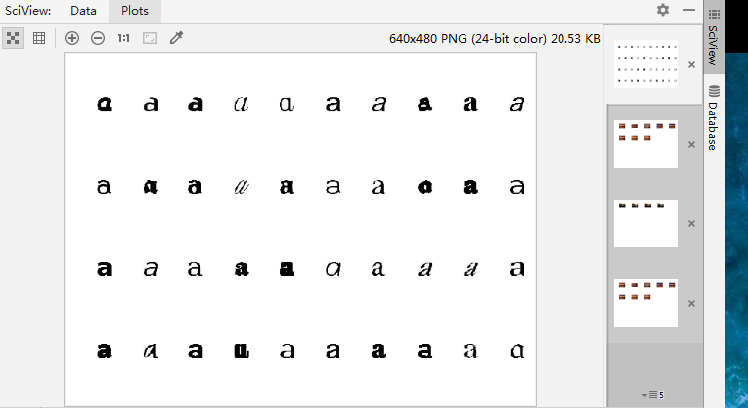
image clustering——K-means

Slide 12
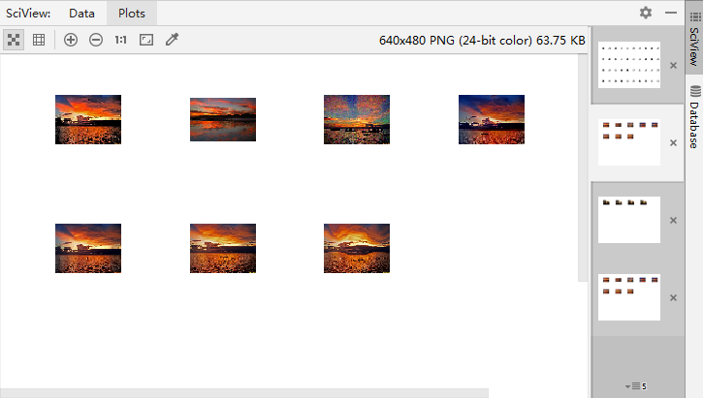
Image Clustering -- Hierarchical Clustering

Slide 13
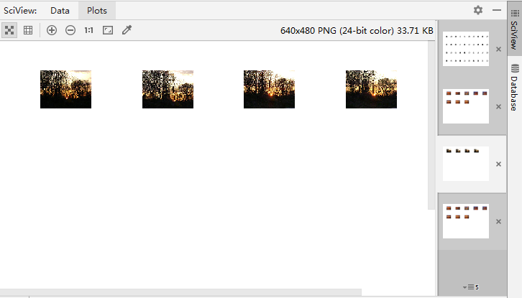
Image Clustering -- Hierarchical Clustering

Slide 14
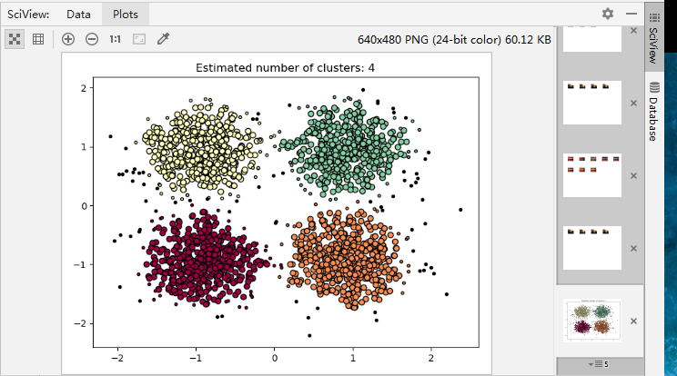
Image Clustering——DBscan

Slide 15
Main work--liuwt
1、paper code
2、plugin for sketch

Slide 16
Paper code
1.problem
(1)The method used is out of date. For example: Tesseract OCR
(2)Many packages are not compatible with python3, It's too difficult to configure the environment according to it.
2.work
(1) Use baidu-aip for text recognition ， the recognition effect is very good.
(2) Part of Computer vision is performed canny edge detection

Slide 17
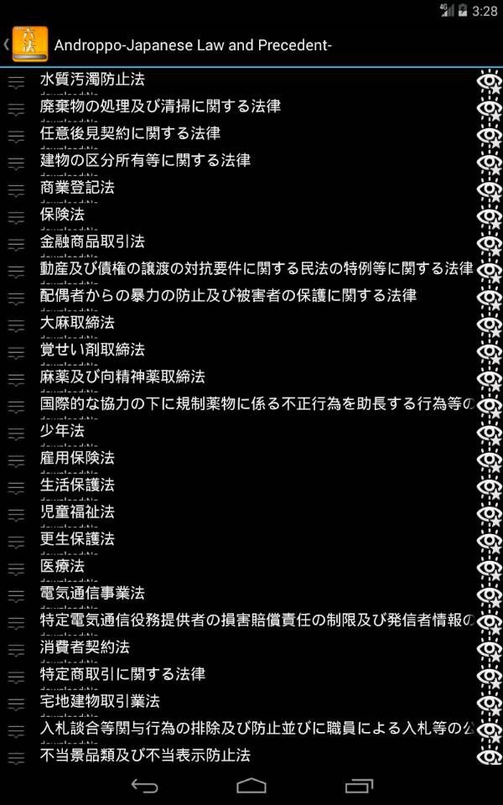
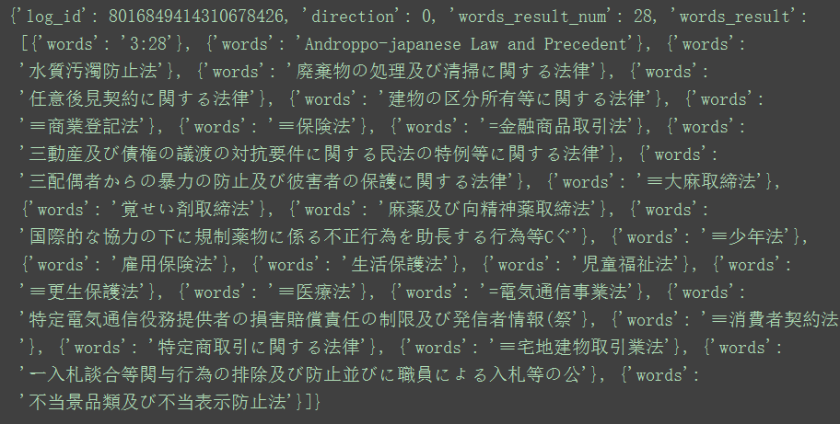
Api ocr

Slide 18
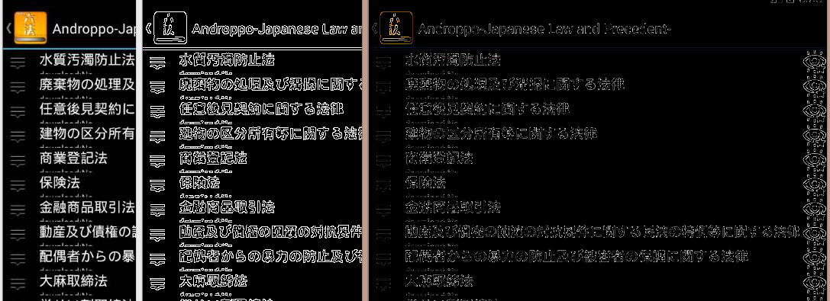
Canny

Slide 19
Plugin for sketch
1.work
Found a simple plugin code to see from blog
2. subsequent work
Try writing plug-in on run script of sketch first？

