Slide 1
工作汇报
吴 迪
2019.10.7

Slide 2
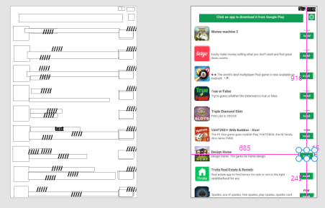
Plugin
Generate ArtBoard based on coordinates.
Generate wireframes.
Images of different sizes can be generated to artboard according to their original size.
The generated components can be manually composed into groups in the XD.

Slide 3
Questions
How to supplement the undetected part？
How do you analyze hierarchies? Using XML files? Using the coordinates of the test?

