Slide 1
工作汇报
吴 迪
2018.12.25

Slide 2
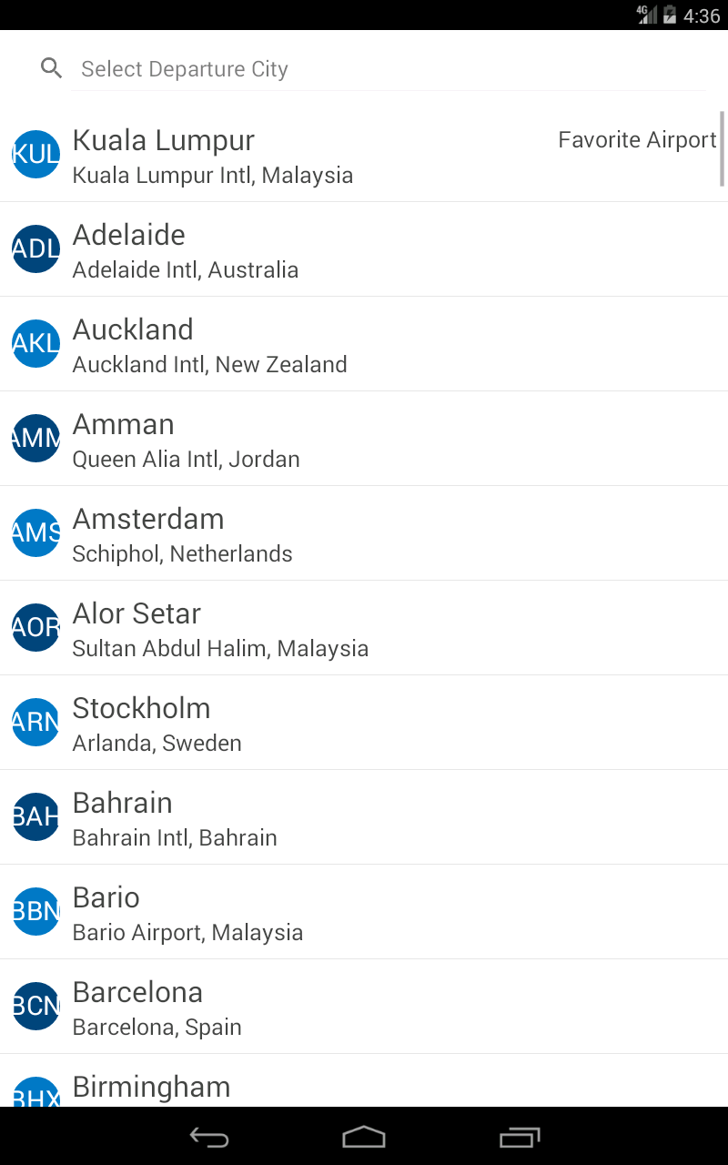
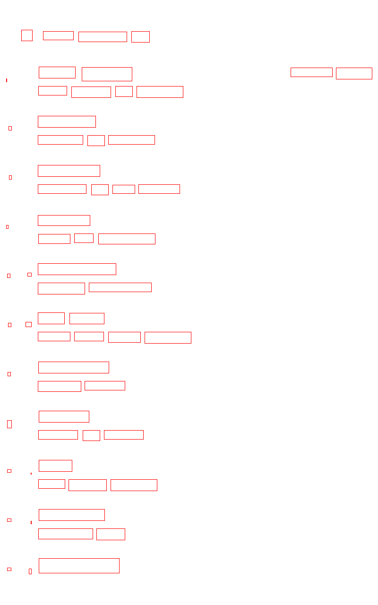

Blocks
Combine words and lines detected by OCR into blocks
words level
lines level

Slide 3
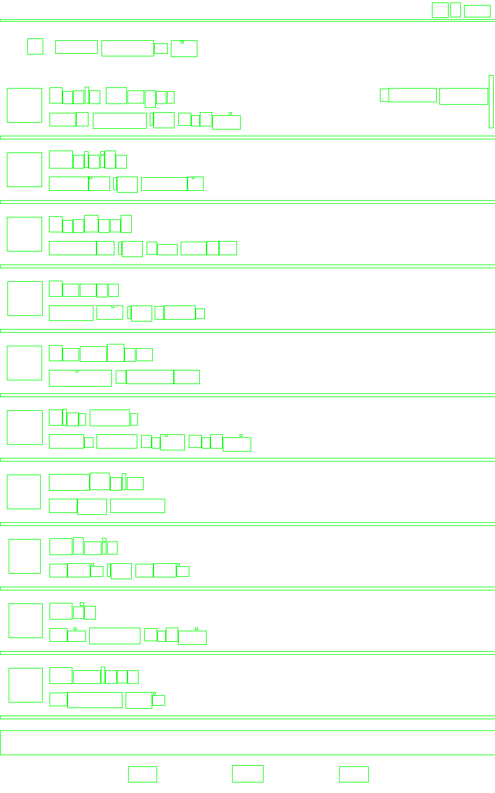

Merge
Combine the computer vision results of a screenshot with the OCR text detection results.
Hierarchy of the contours’ bounding boxes
Text blocks

Slide 4
Merge
This is the process of removing the contours of what should be text from the hierarchy and marking them as text.
To see if OpenCV, which is the outline of the hierarchy, if it intersects the blocks box,and whether the contour bounding box contains text.
Intersecting and not containing text indicates that the outline box overlaps the text box and that the outline box needs to be removed.
In this way, the outline enclosing box that needs to be removed is found and recorded. Just remove them.

Slide 5
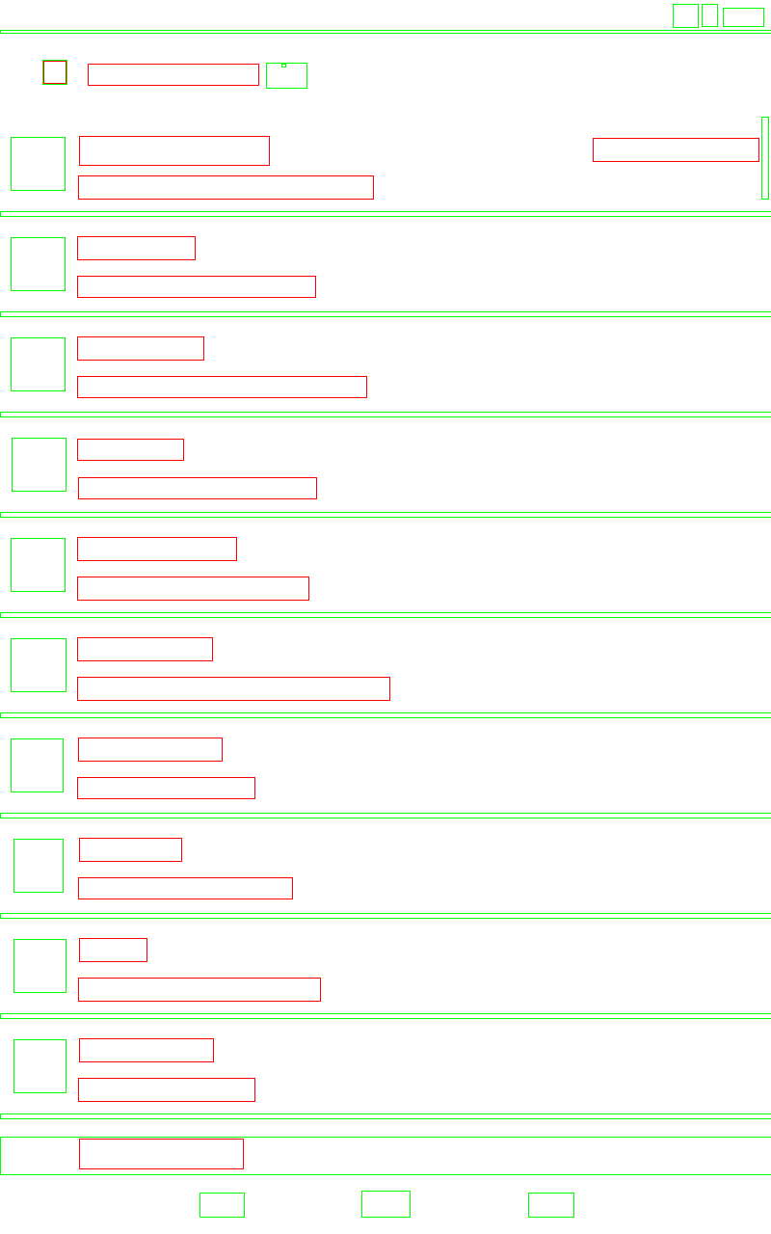
Example

Slide 6
Questions
Some images are processed better than others, for example, small ICONS are marked as legal text content in OCR recognition.
What do I need to do next?

Slide 7
