Slide 1
工作汇报
吴 迪
2019.7.22

Slide 2
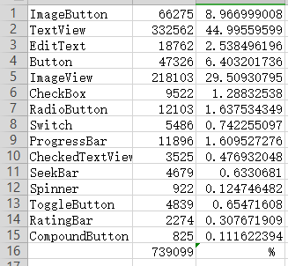
Components
The training datasets
Notes:
90%

Slide 3
Data
32280 UIs (91.27%) for training
1247 UIs (3.52%) for testing
1842 UIs (5.21%) for validation
Cut images (800,1216,3)
Fixed the negative coordinates to 0

Slide 4
Faster RCNN
"batch_size": 128,
"decay”=False,
"learning_rate":0.0001,
"iters"=13000,
"categories": 15,

Slide 5
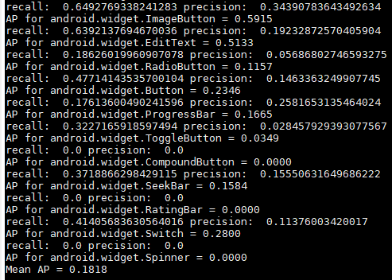
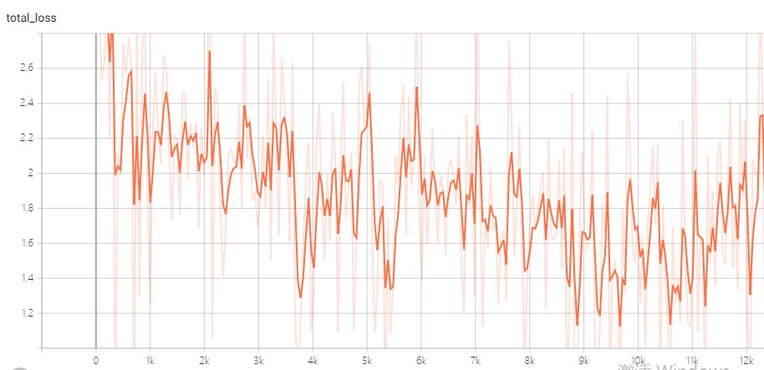
Result
total loss

Slide 6





Metrics
Average Precision: The 11-point interpolation tries to summarize the shape of the Precision x Recall curve by averaging the precision at a set of eleven equally spaced recall levels [0, 0.1, 0.2, ... , 1]:
Notes:
recall>=r max Precision

Slide 7
YOLOv3
"input_size": [416,416],
"batch_size": 8,
"decay”=0.0005,
"learning_rate":0.0001,
"epoch": 50,
"categories": 15,

Slide 8
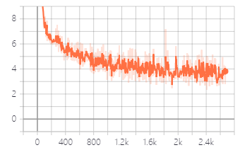

Testing result
iou = 0.5

Slide 9
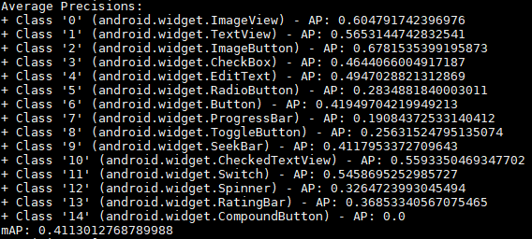
Testing result
Average precision for each category
Notes:
epoch 43

Slide 10
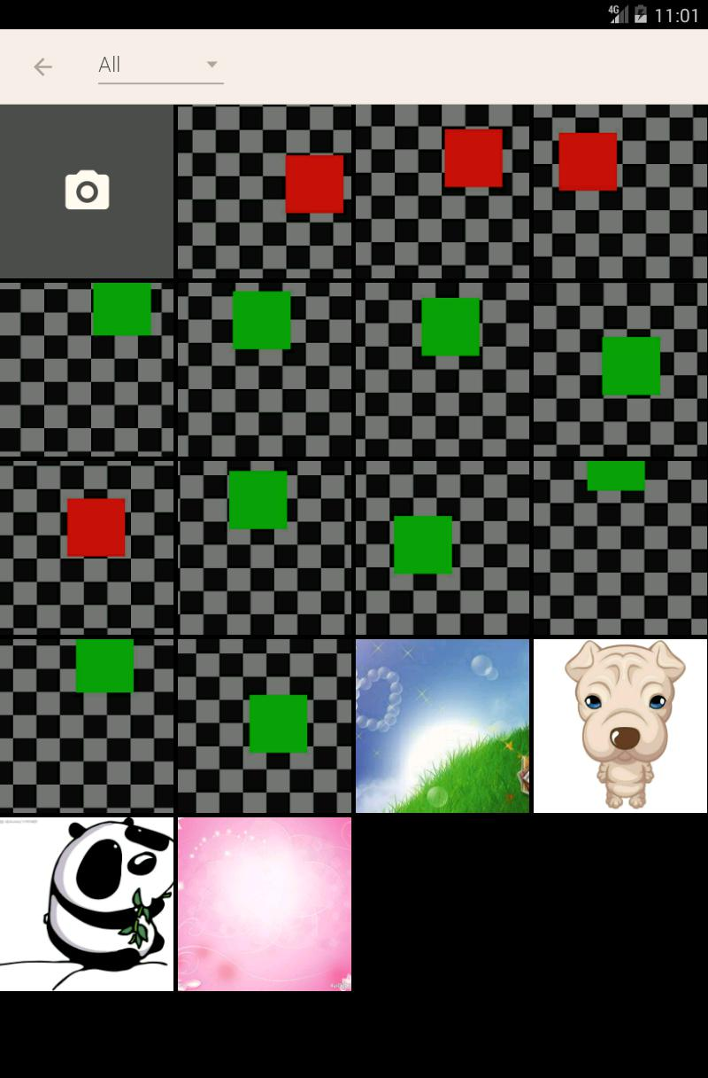
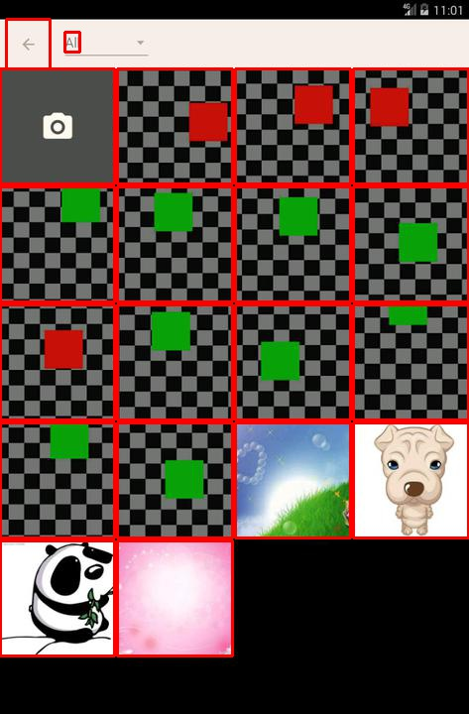
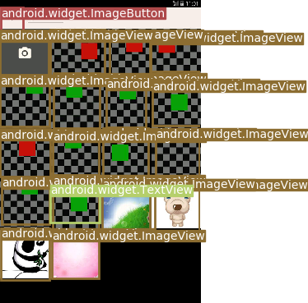
Testing result

Slide 11
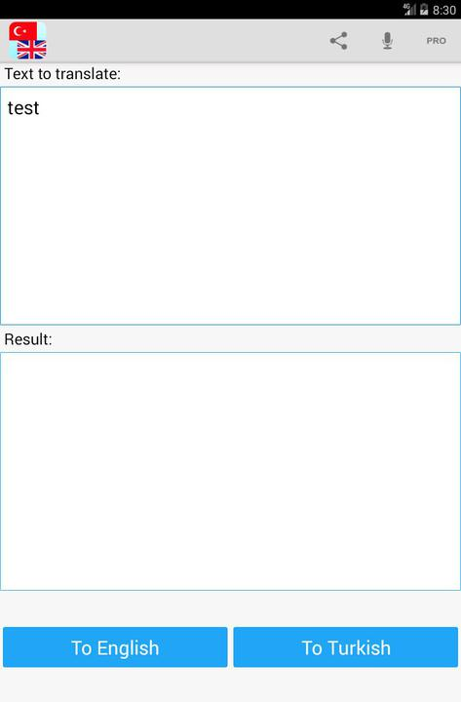
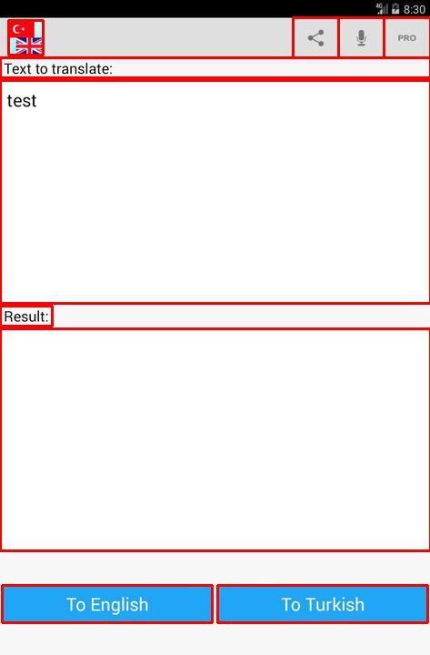
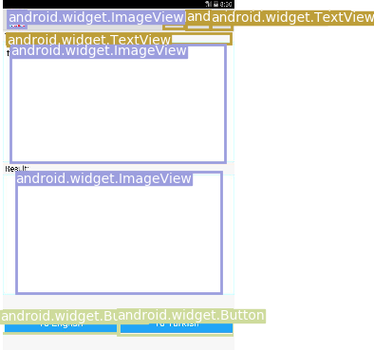
Testing result

Slide 12
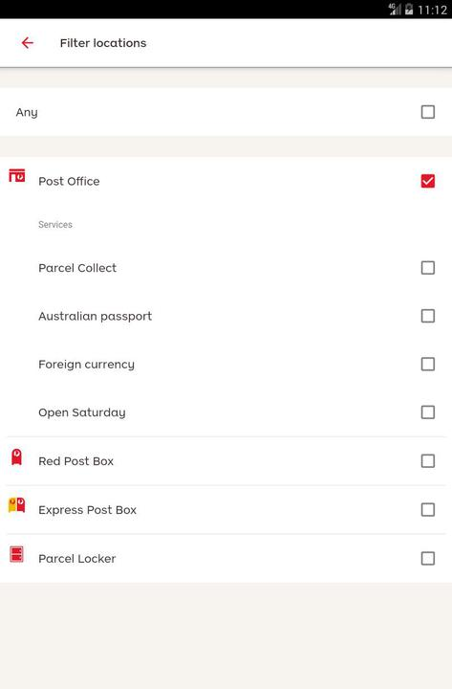
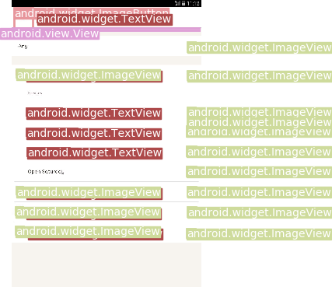
Testing result

Slide 13
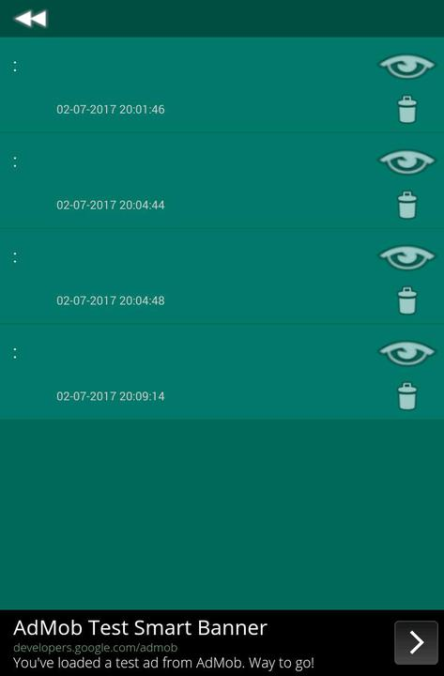
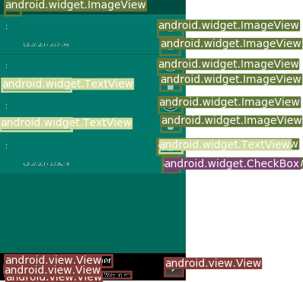
Testing result

Slide 14
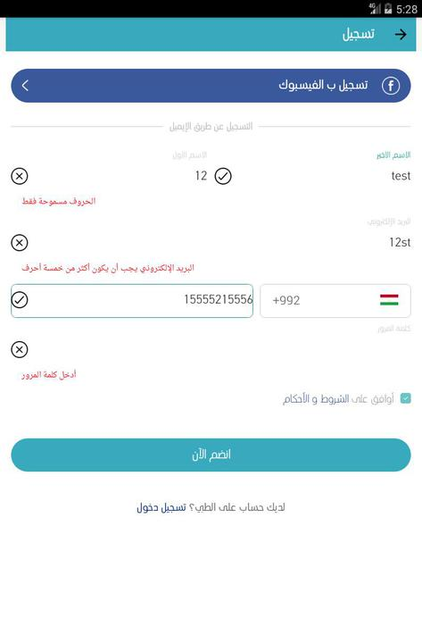
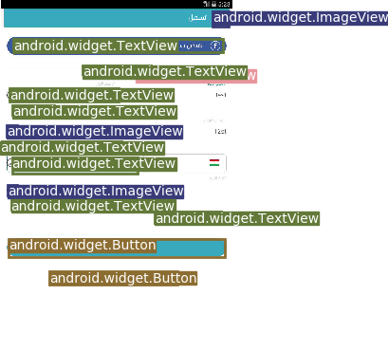
Testing result

Slide 15
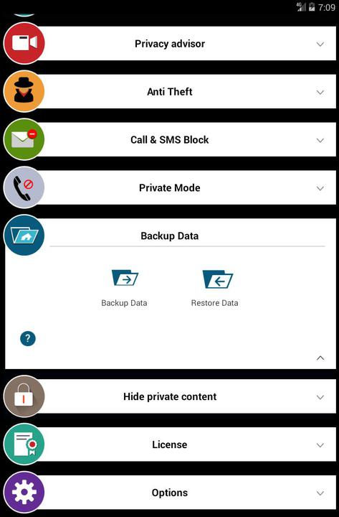
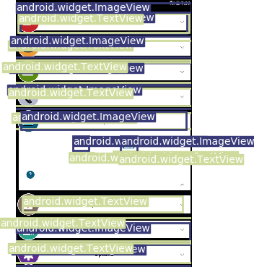
Testing result

Slide 16
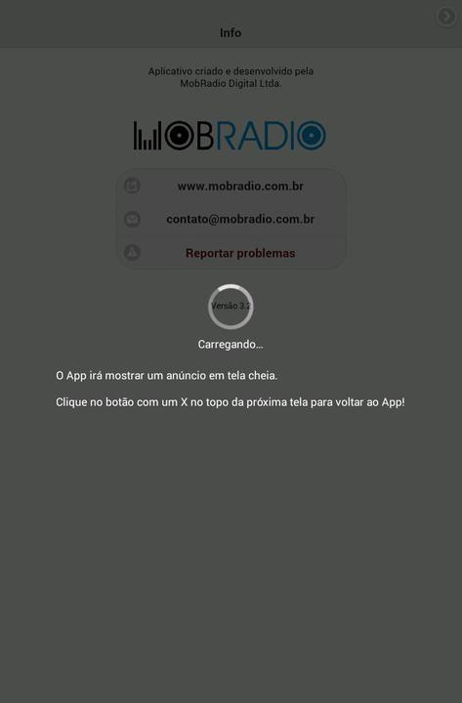
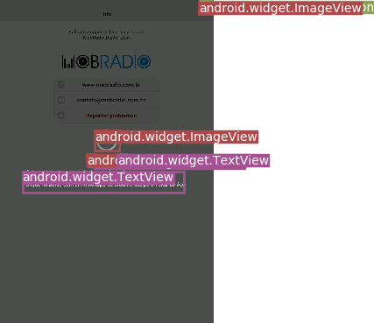
Testing result

