Slide 1
Android UI design
Jilin University

Slide 2
Main work
1、Data pre-processing
2、Data Reading
3、Construction of model
4、Model training and testing
5、Reporting and issues
6、UI design—sketch
7、UI design—paper

Slide 3
data pre-processing
Work progress last week ：
（1） Image classification
（2）Picture tagging
Encounter a problem：
（1）Picture standards

Slide 4
Data Reading
Work progress last week ：
（1）The reading of training data
get the file path and label、 gets the file path and label load data path and writes the label value 、 reading data disarranges the order、 Generate batches of the same size，test whether the data read successfully

Slide 5
Construction of model
Work progress this week：
（1）Construct the CNN
（2）Two convolution layers (one pooling layer after each convolution layer)
（3）Two fully connected layers
（4）softmaxOutput classification results

Slide 6
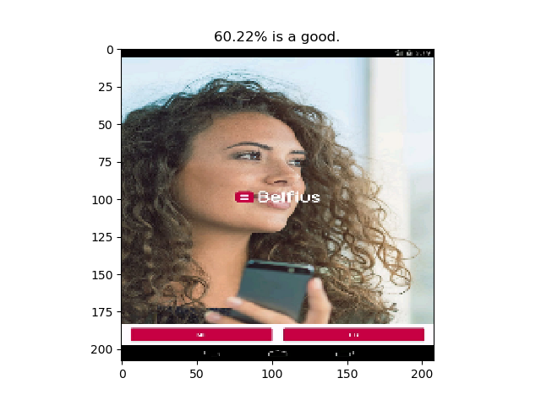
Model training and testing
Work progress last week ：
（1）Output result

Slide 7
Reporting and issues
1.Reporting
1.1 Understanding XML documents
1.2 Learn two clustering algorithms，Hierarchical clustering algorithm and K-means clustering algorithm
1.3 A program was run which Two-dimensional data point clustering
1.4 The image data is labeled as good, ugly, general
2.Issues
2.1The feature vector of image clustering can not be determined

Slide 8
UI design--sketch
The machine room has too little time available
The memory stick computer can't take it
Installed on the server, remote file transfer wasted time, always go unrealistic
To sum up, in order to facilitate future use, I bought the macbook pro to arrive on October 3。

Slide 9
UI design--paper
1、code
（1）First, according to readme learn about the environment, template library , function library, etc.
（2）Be familiar with the code on github.
2、paper
（1）Main technologies in this paper
（2） A brief understanding of the time analysis, error analysis
3、Find the REMAUI model for testing

