Slide 1
工作汇报
吴 迪
2019.8.5

Slide 2
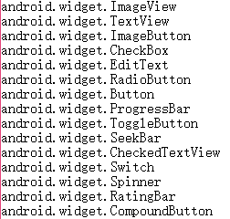
YOLOv3
input_image (608, 608)
anchors = [202,27, 93,14, 49,32,
509,14, 152,106, 76,42,
33,17, 16,12, 576,36]
categories:

Slide 3
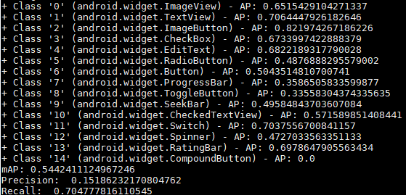
YOLOv3 testing result
iou = 0.5 epoch-49

Slide 4
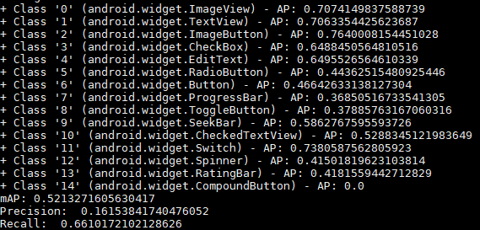
YOLOv3 testing result
iou = 0.5 epoch-47

Slide 5
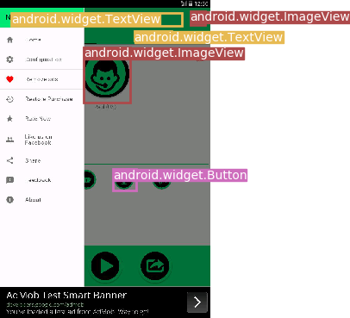
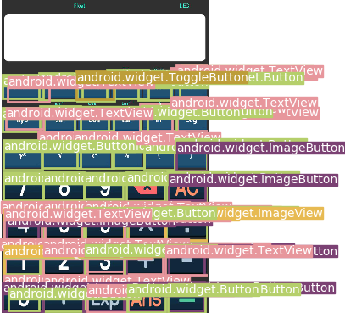
YOLOv3 testing result

Slide 6
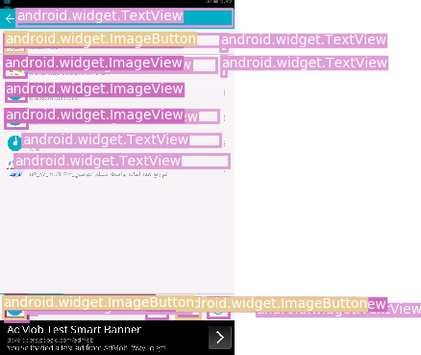
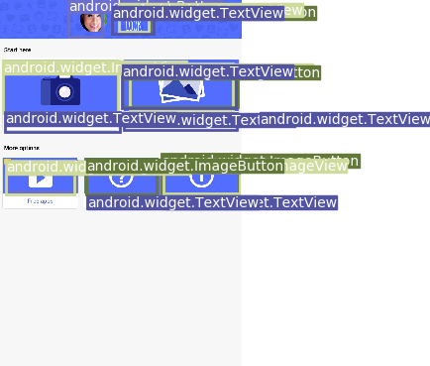
YOLOv3 testing result

Slide 7
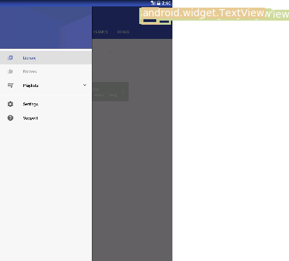
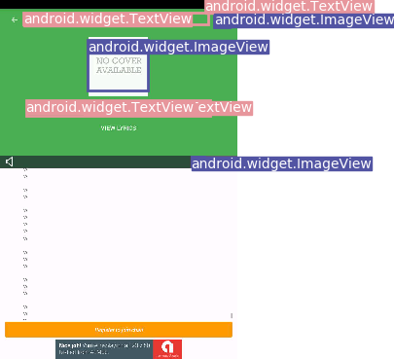
YOLOv3 testing result

Slide 8
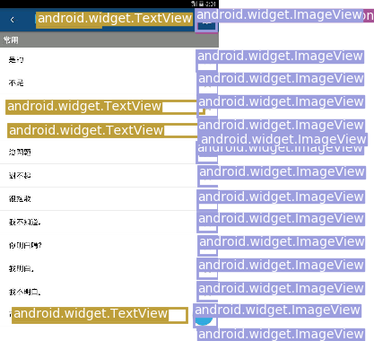
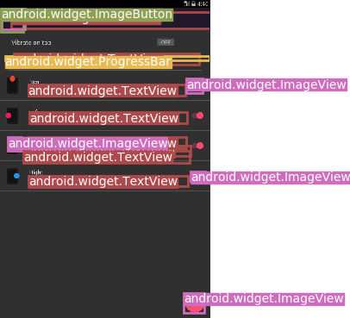
YOLOv3 testing result

Slide 9
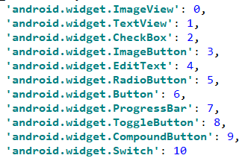
Retinanet
backbone: resnet50
categories:

Slide 10
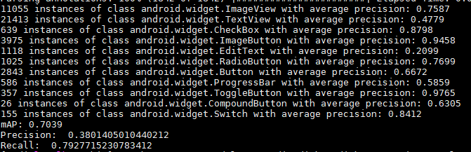
Retinanet testing result
iou = 0.5 epoch-36

Slide 11
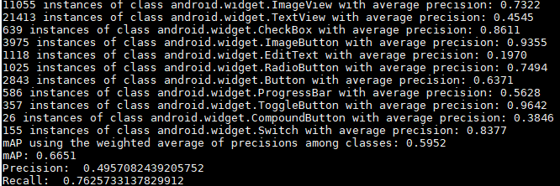
Retinanet testing result
iou = 0.5 epoch-27

Slide 12
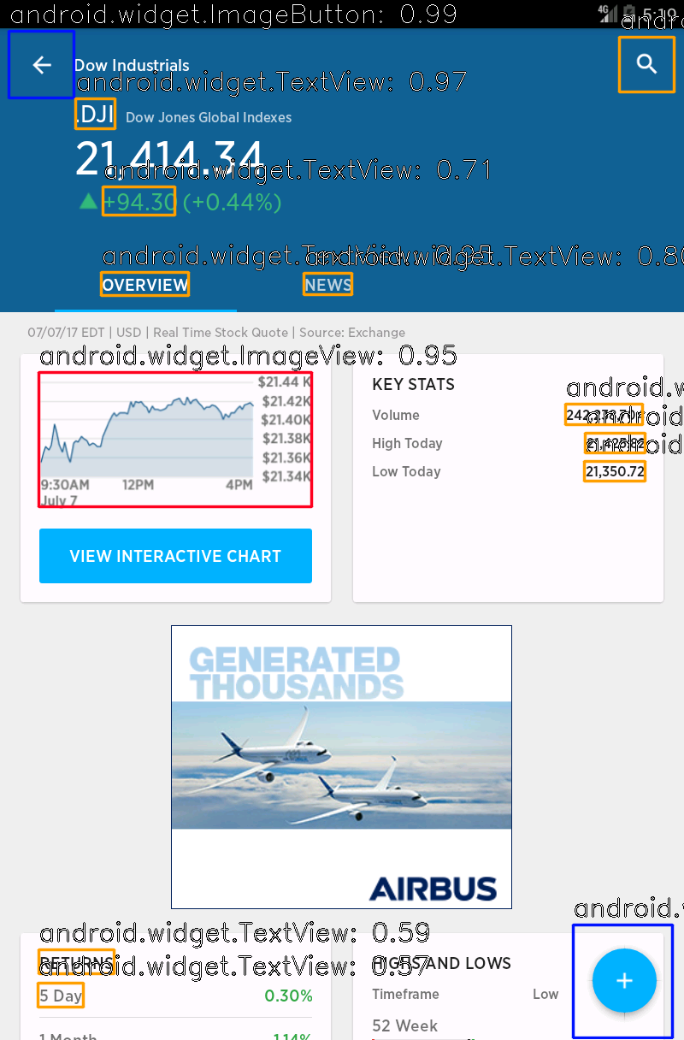
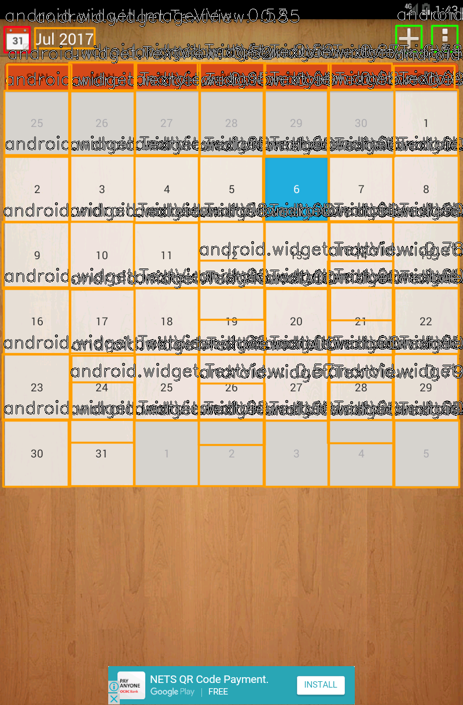
Retinanet testing result

Slide 13
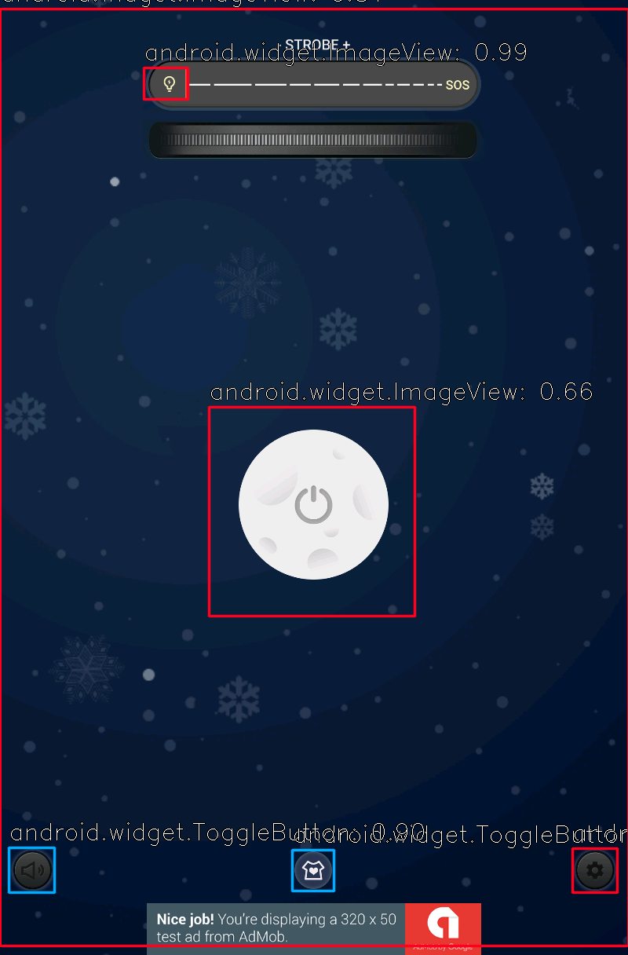
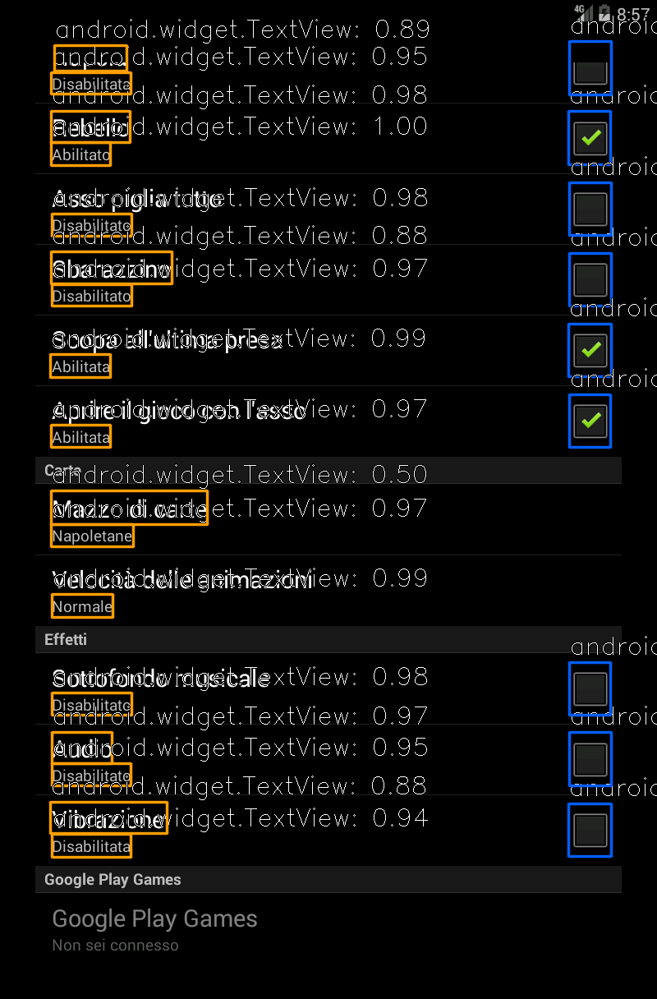
Retinanet testing result

Slide 14
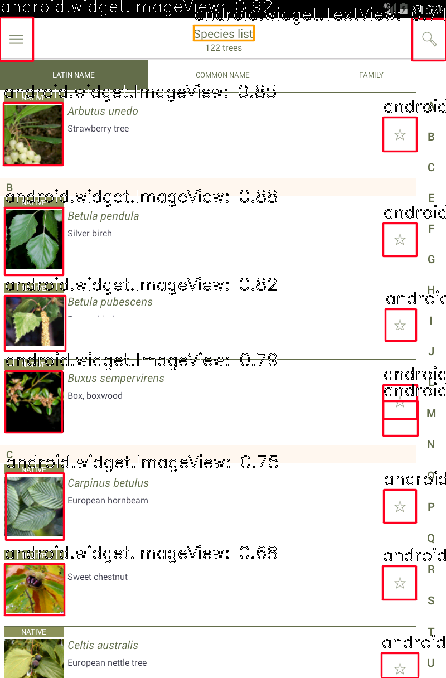
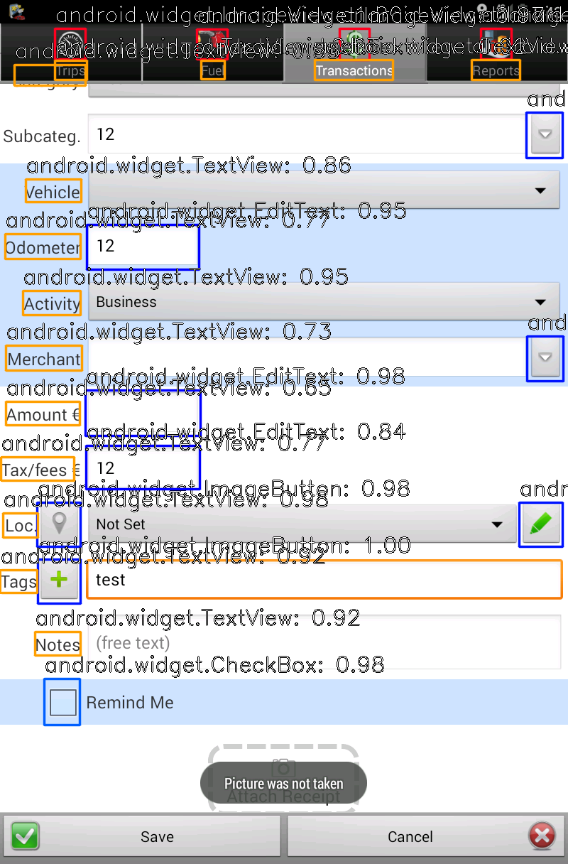
Retinanet testing result

