Slide 1
工作汇报
吴 迪
2019.4.15

Slide 2
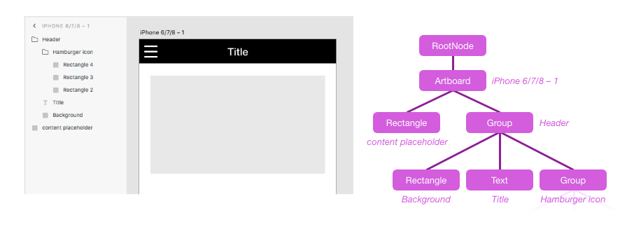
Plugin
The structure of the XD document is a node tree, which is similar to an XML file. Image from official website

Slide 3
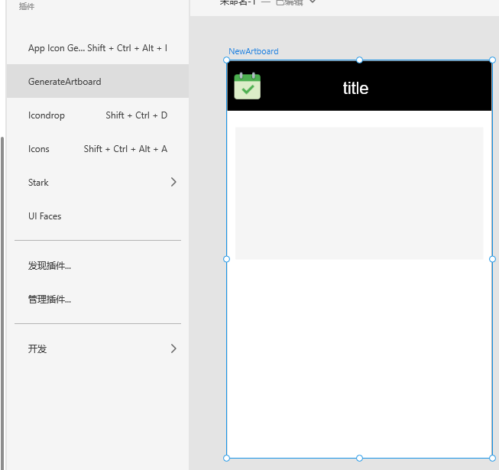
Example

Slide 4
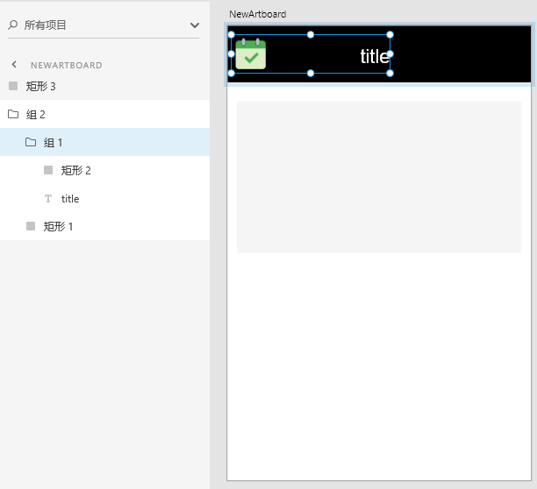

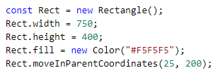
Example

Slide 5
Dataset
4496 apps
Delete UIs that do not have XML files
apps with non-english fonts
Processing completed
354 apps

Slide 6
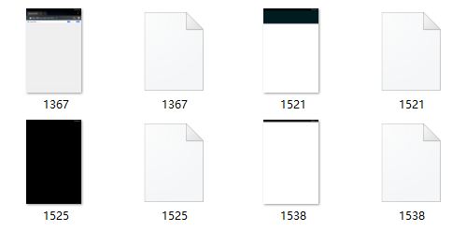
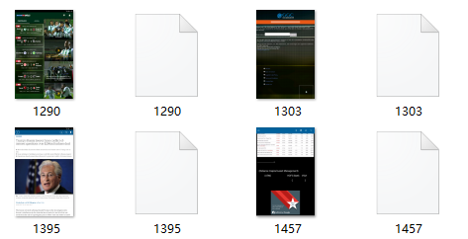
Unavailable data
1.The UI have white or black background
2.The UI have unrecognized English fonts

Slide 7
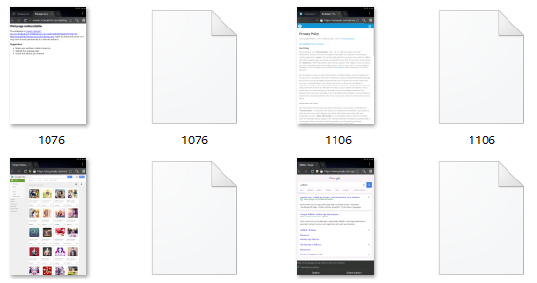
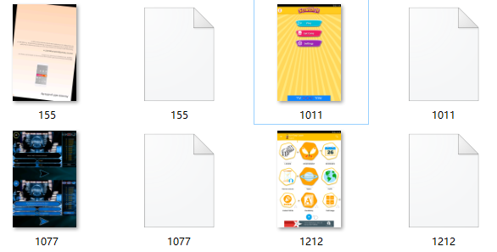
Unavailable data
3.Website
4.Others

Slide 8
Result
ramdom_data 534 UIs

Slide 9
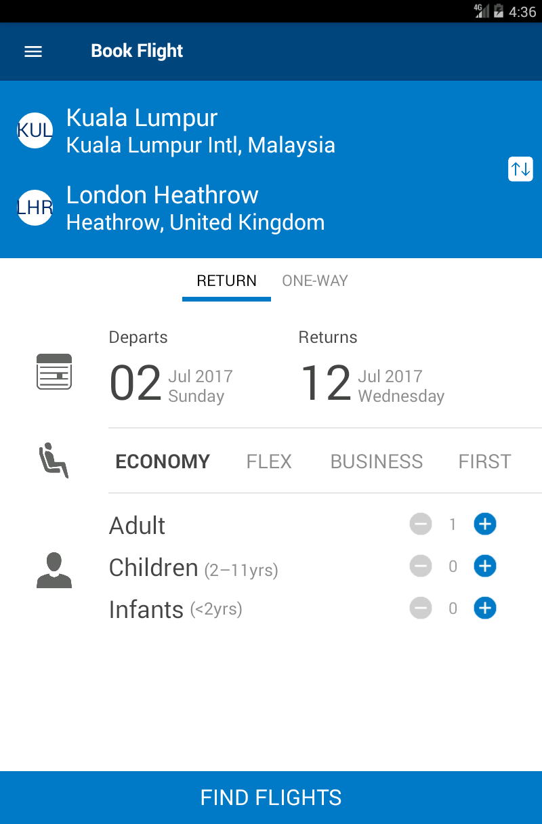
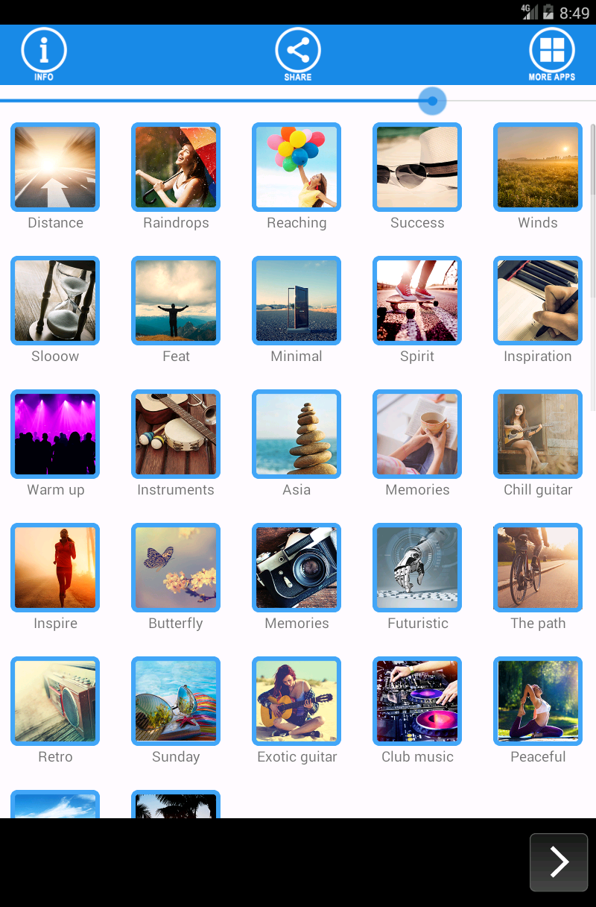


1. 2.

Slide 10
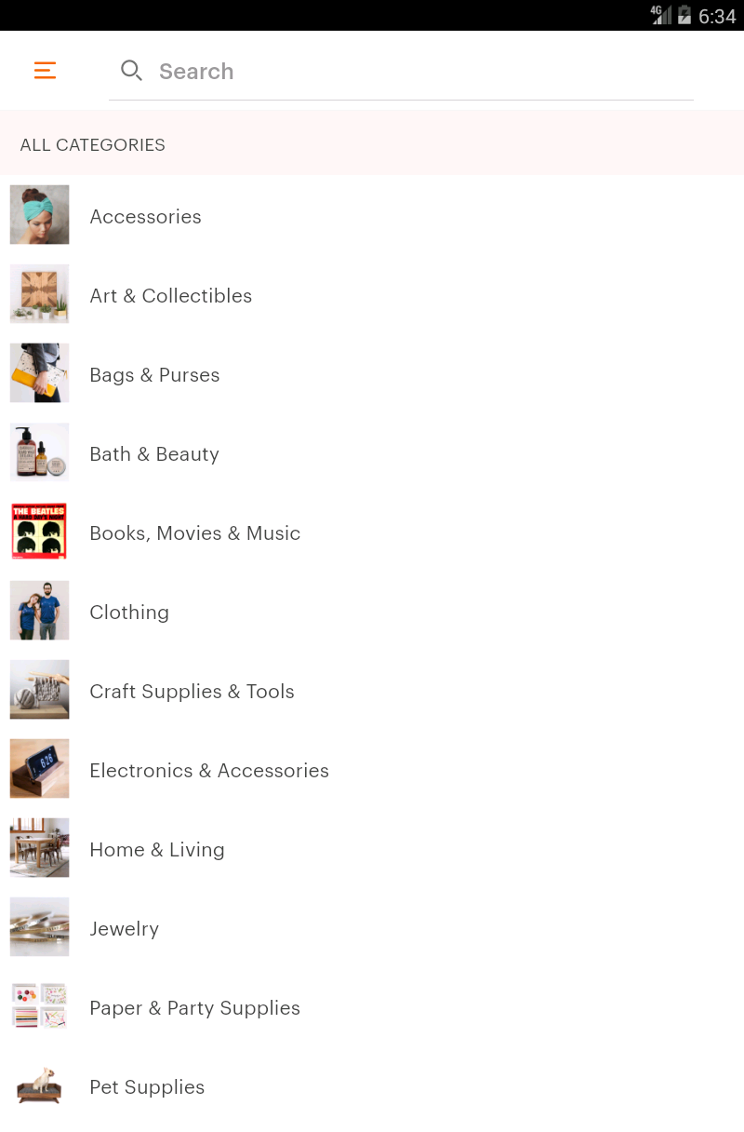
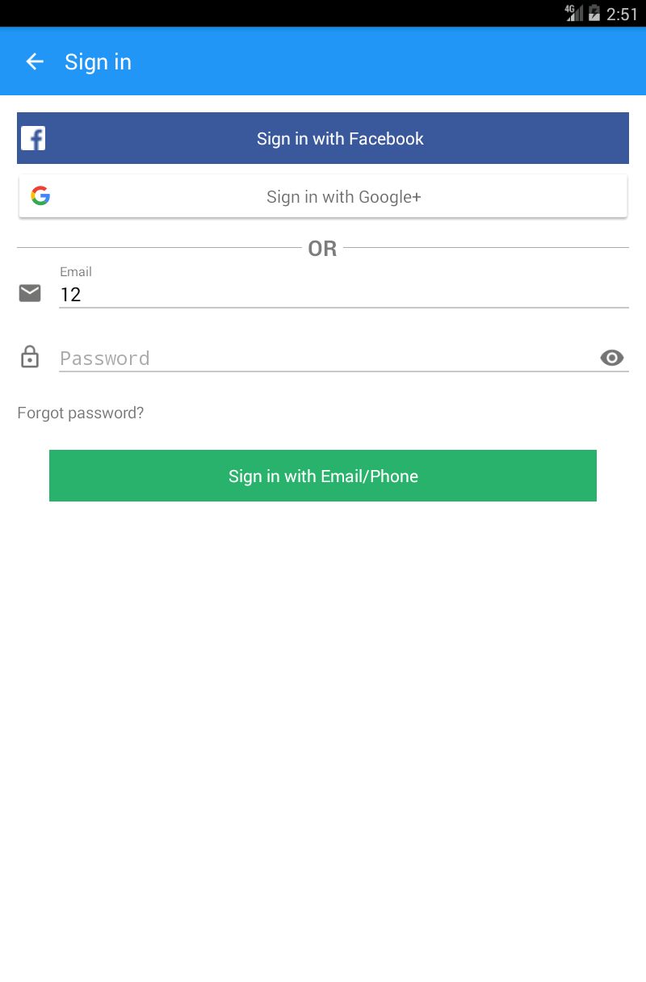


3. 4.

Slide 11
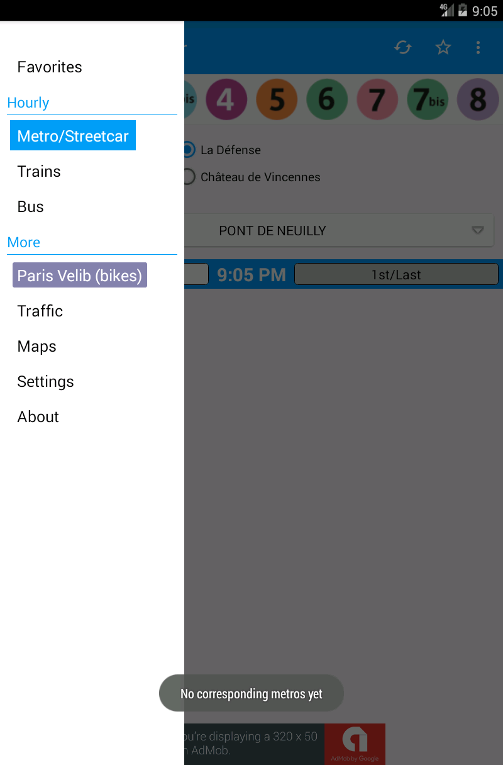



5. 6.

