Slide 1
工作汇报
吴 迪
2019.1.24

Slide 2
Code
Draw a comparison diagram based on the XML file and the code text detection results

Slide 3
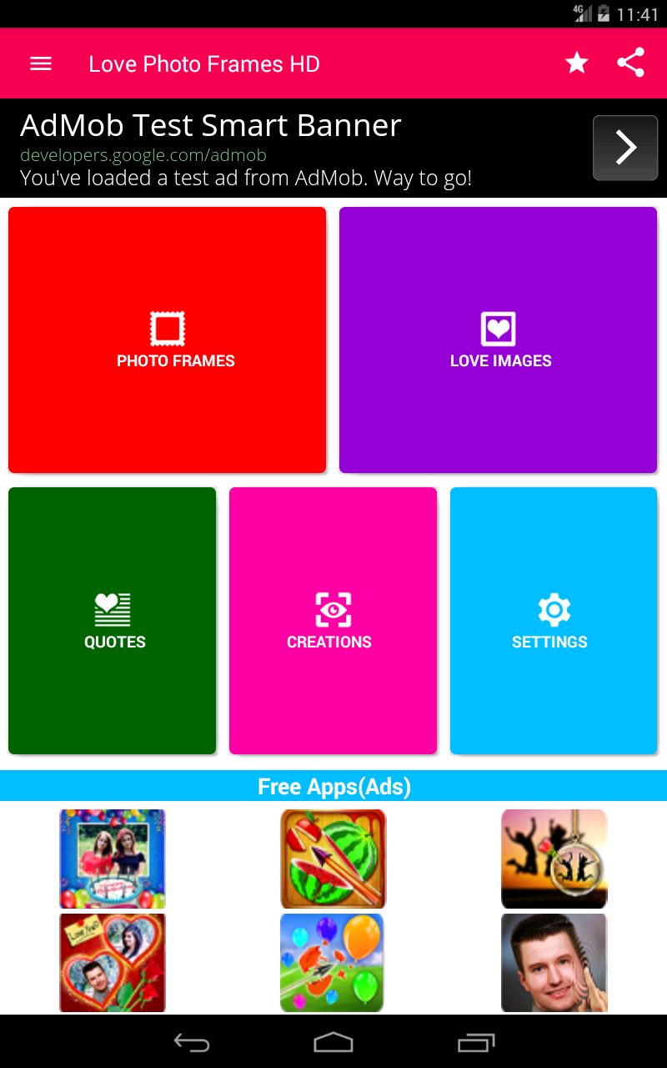
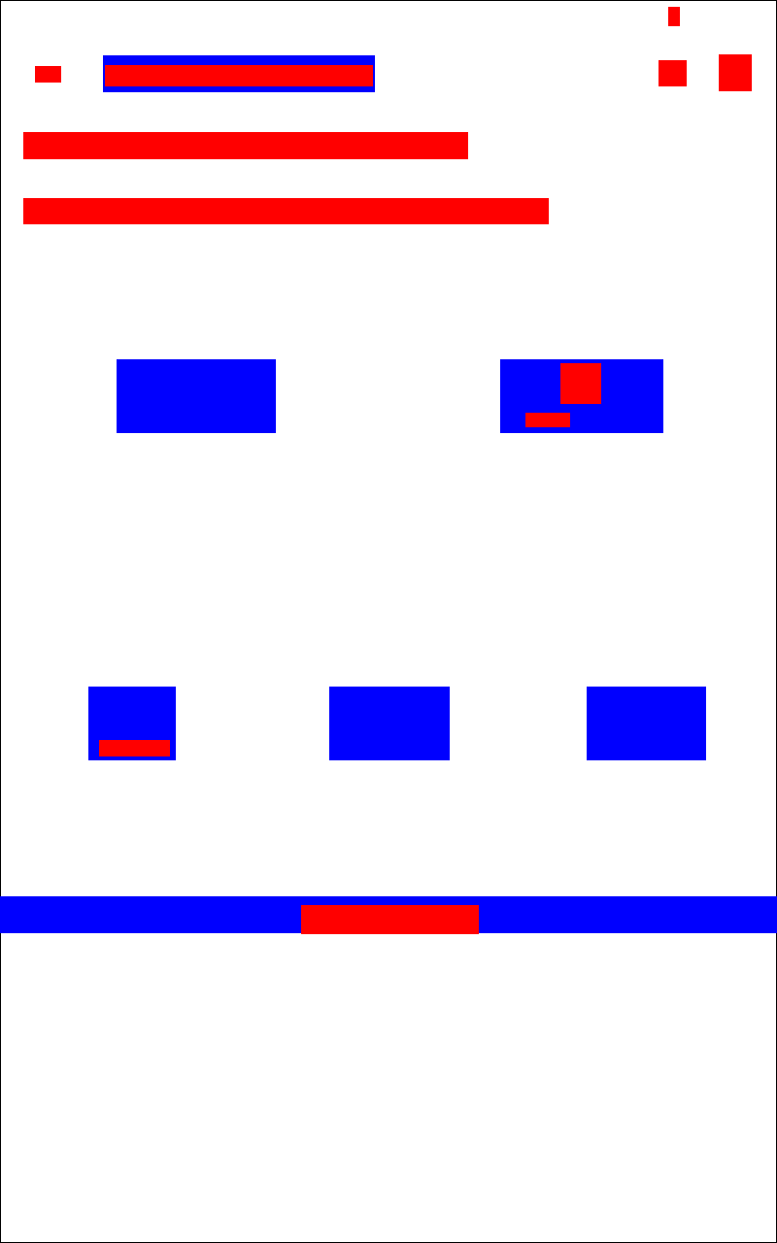
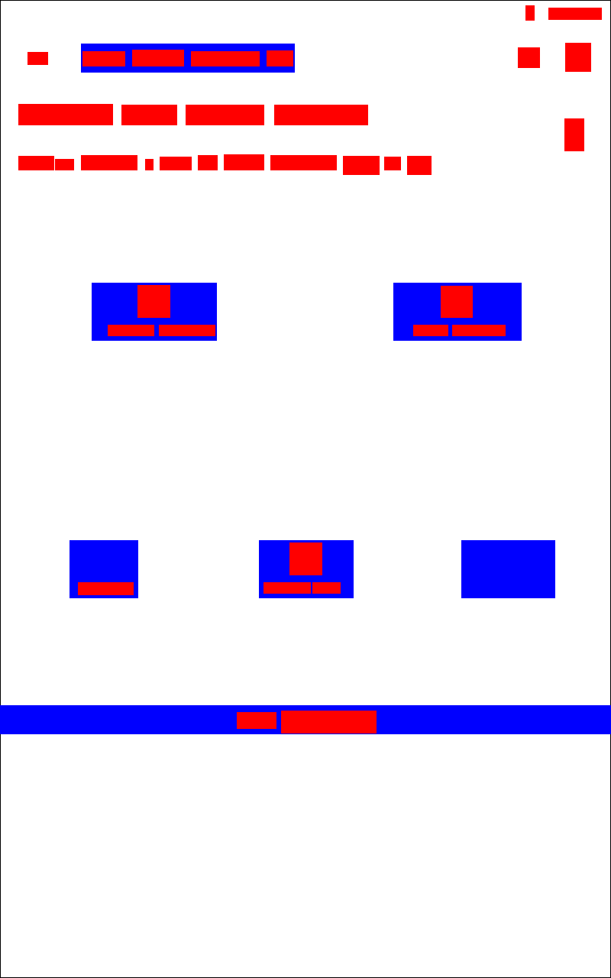
1

Slide 4
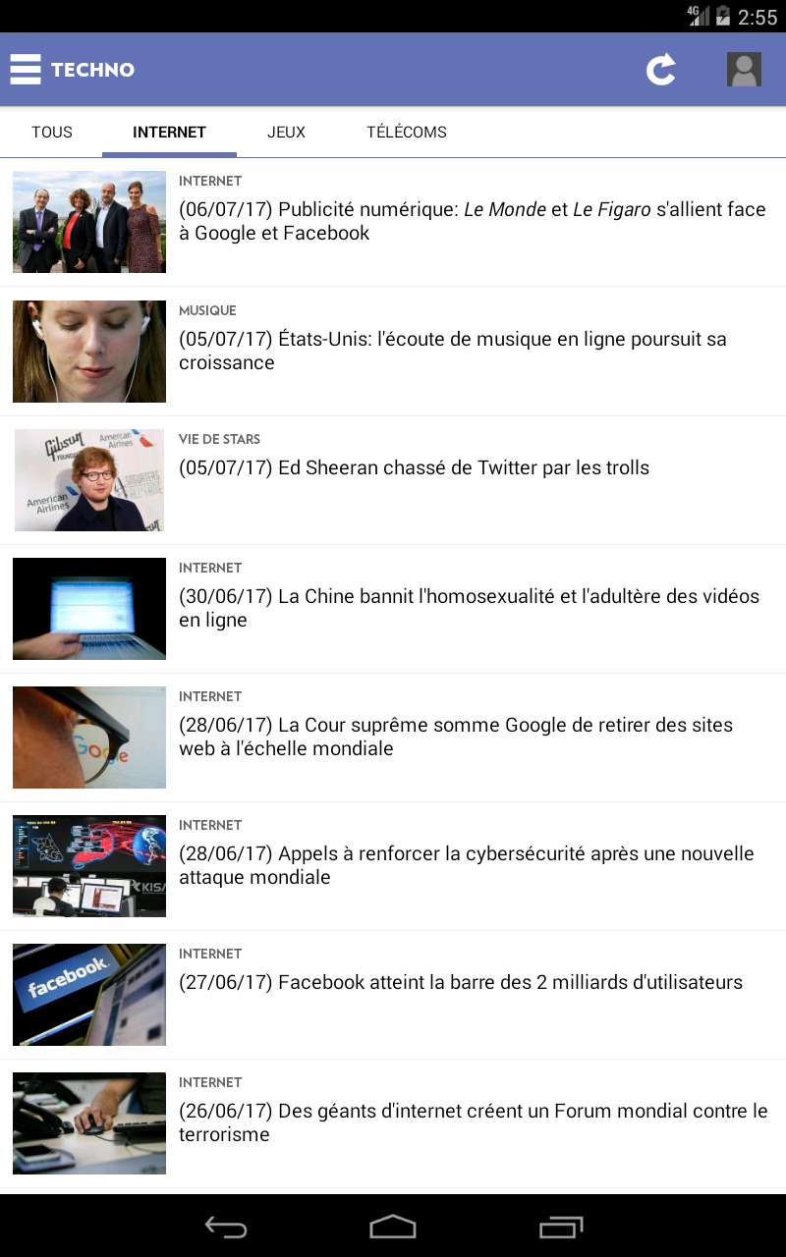
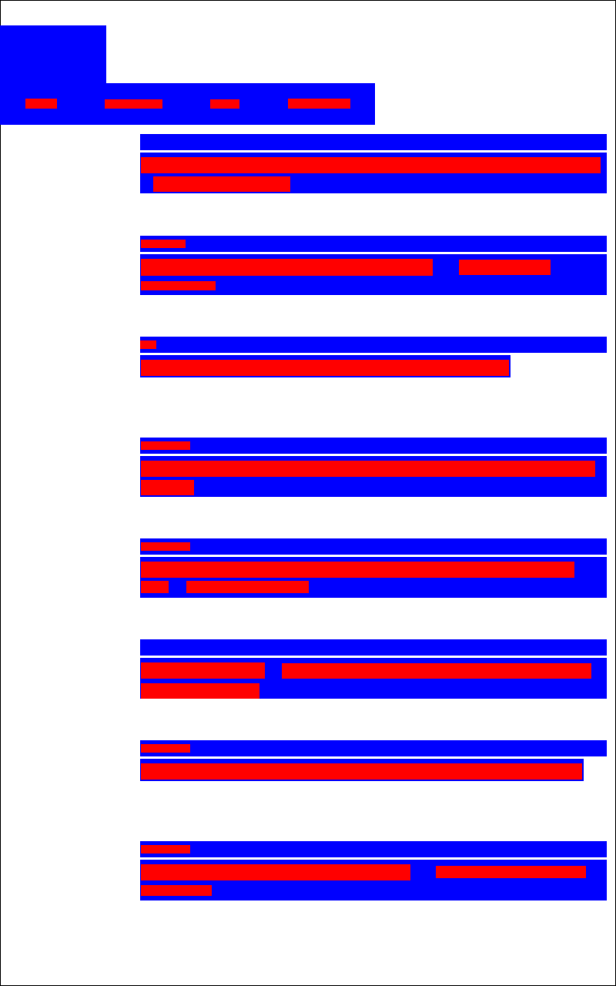
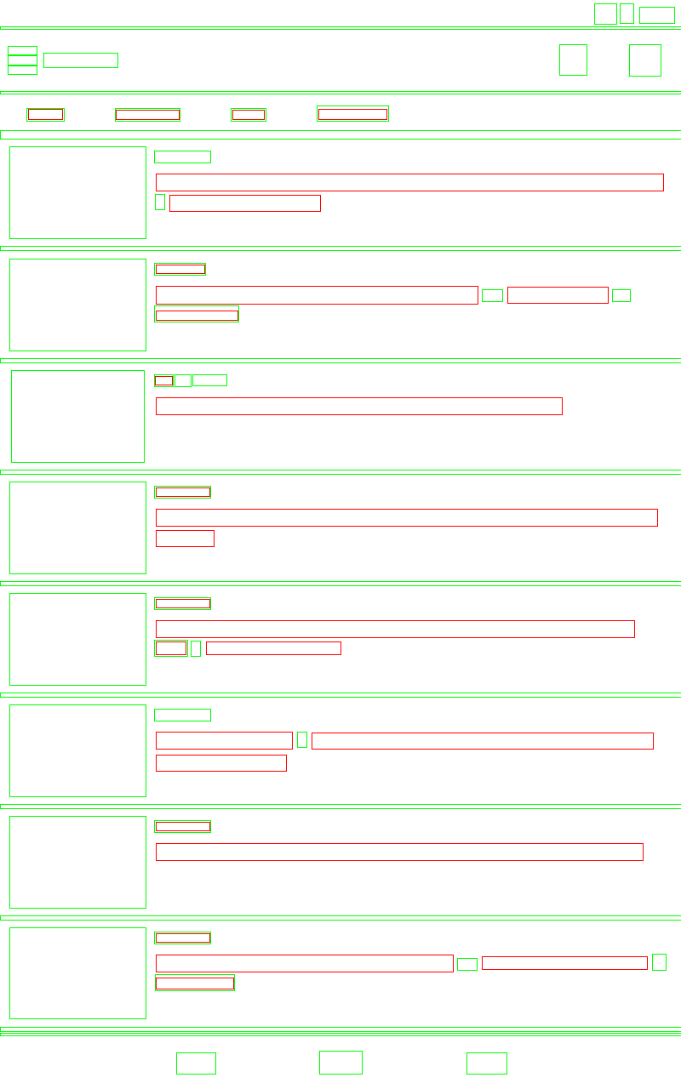
2

Slide 5
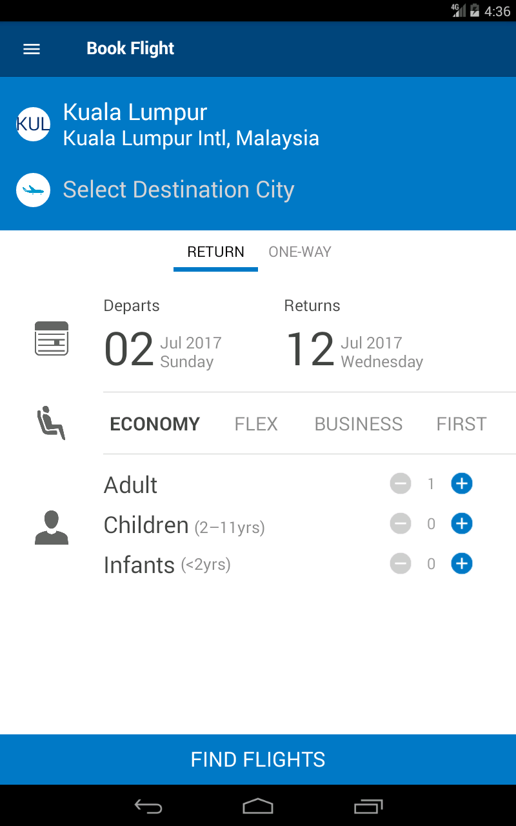
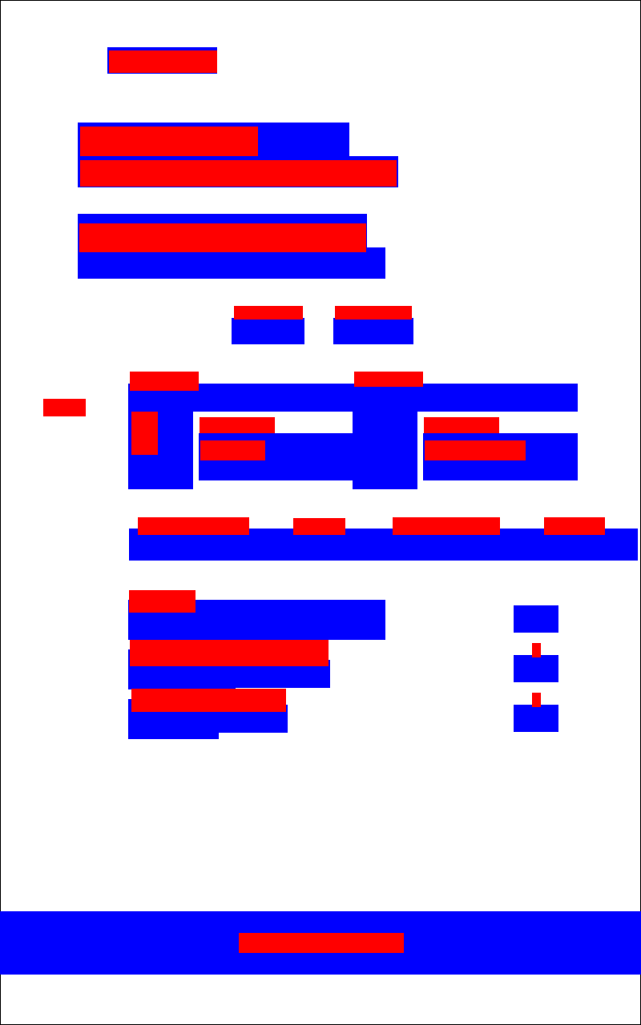
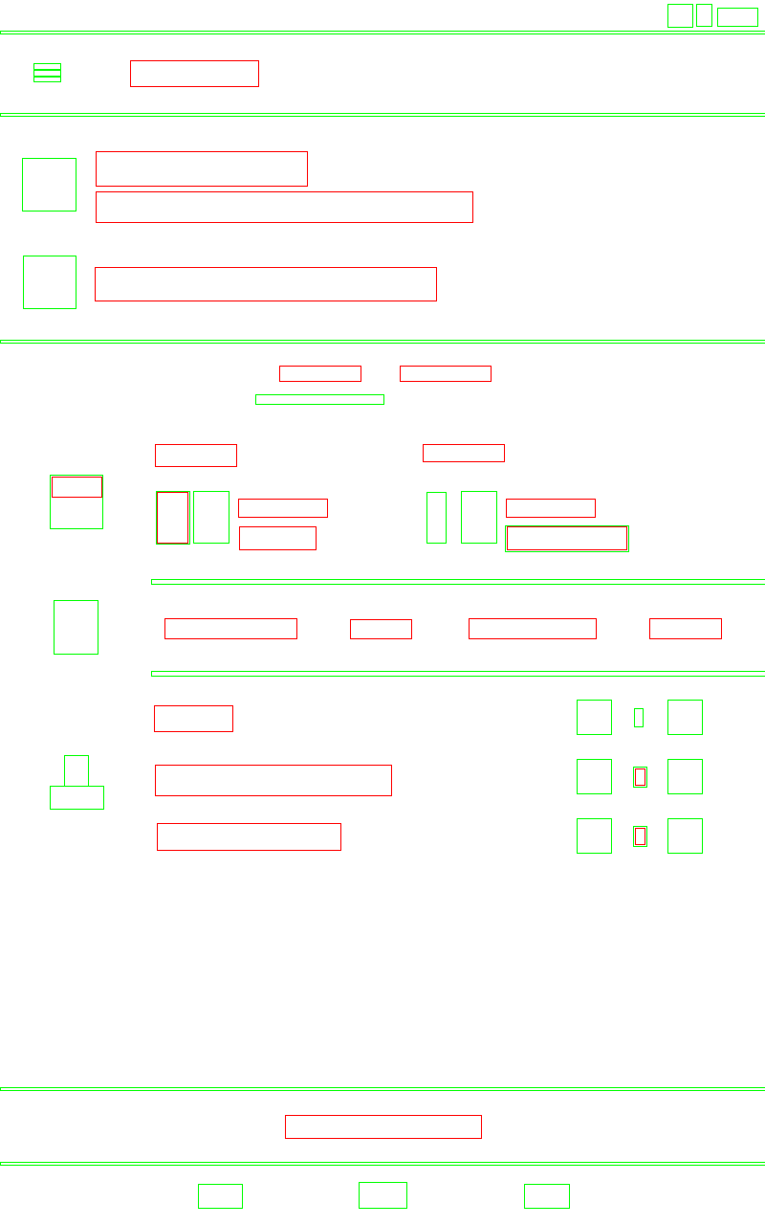
3

Slide 6

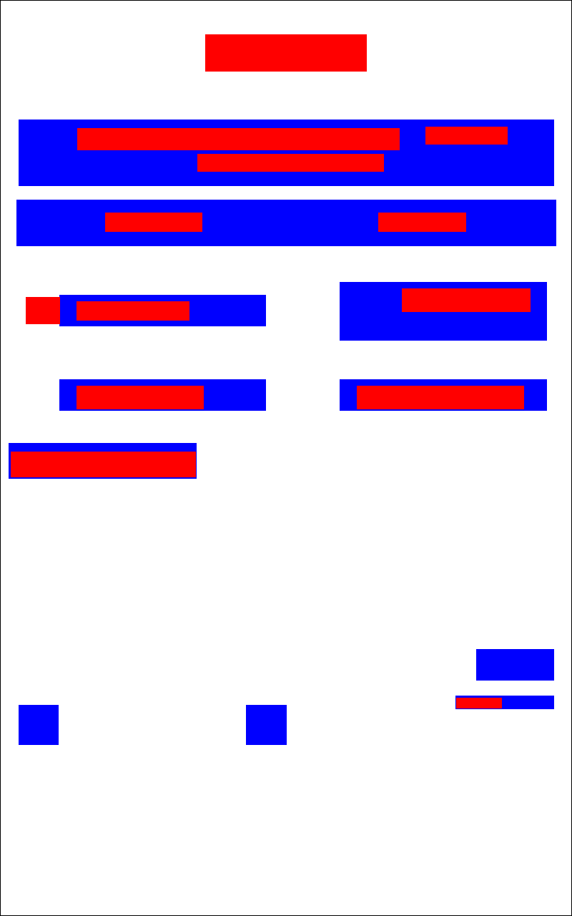
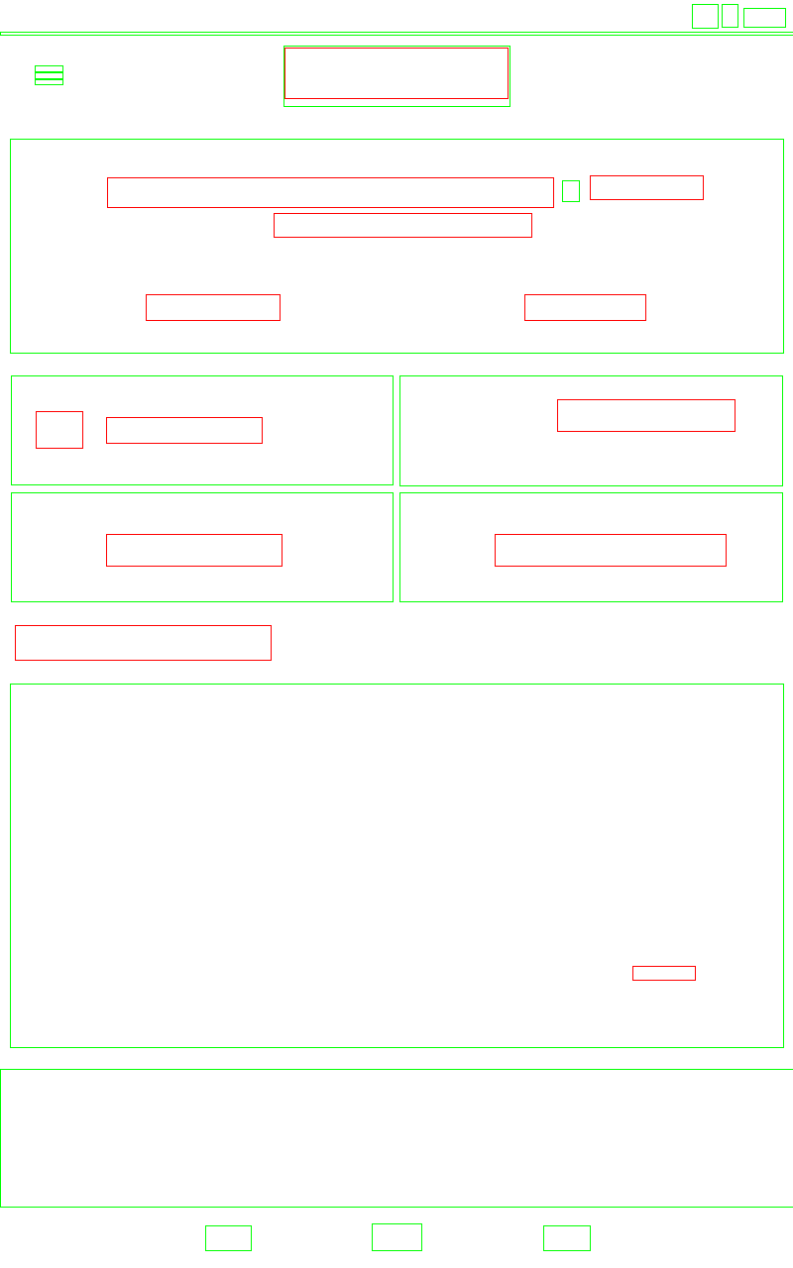
4

Slide 7
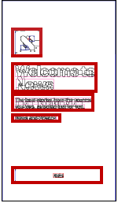
Rewire: Interface Design Assistance from Examples
OCR Tesseract
“Text Location in Complex Images” ,an algorithm for detecting text positions in complex images are used to distinguish between text and non-text regions
Merge the detected text fragments,merge non-text fragments

Slide 8
Plugin
Learned the basics of objective-c,Image scaling, image cutting in objective-c
Do some OC and JS interactions and add these functions to the plugin

