Slide 1
WeeklyWork
shencz

Slide 2
Related work
Propose a framework that learns the style of a codebase, and suggests revisions to improve stylistic consistency
Name embedding -- a neural probabilistic language model for source code that is specifically designed for the method naming problem
Change extreme summarization of source code snippets into short, descriptive function name-like summaries.
Mining Idioms from Source Code
predicting names for program entities
Code Completion， code summarization
translation between source code snippets and natural language descriptions.

Slide 3
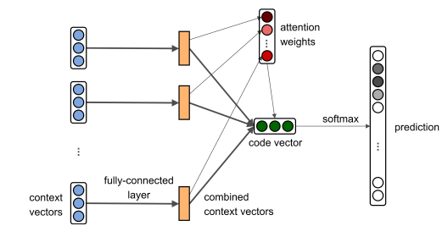
code2vec
Underlying hypothesis: the distribution of labels can be inferred from syntactic paths
Get the AST path ans path context
Transforms a code snippet into a mathematical object with AST path that can be used in a learning model
Concern code snippet as bag of path context and get weight with attention. Figure out the code vector. Feed into the model to predict labels.

