Slide 1
工作汇报
吴 迪
2019.3.25

Slide 2
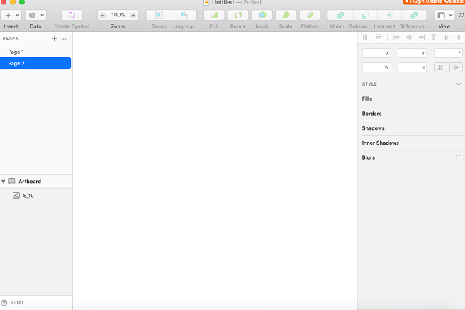
Problems
sketch官网最高版本：sketch53.2 （2019.2）
VMWare15
macOS10.14
sketch53.1
（sketch52.5）

Slide 3
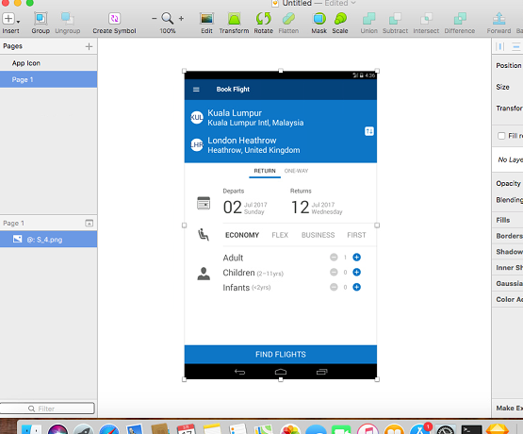
Sketch
macOS10.13
sketch51.3

Slide 4
Sketch in the vmware
Unable to display artboards, guides, etc.
Some of the sketch's own functions are not available.
Some plug-ins are not available,sunch as craft.

