Slide 1
工作汇报
吴 迪
2019.2.25

Slide 2
Code
Some changes have been made to the method for handling invalid text.The XML file structure is compared with the code run results.Here are some examples.

Slide 3



1
(a).screenshots (b).The result from the code (c).The result in the XML file

Slide 4
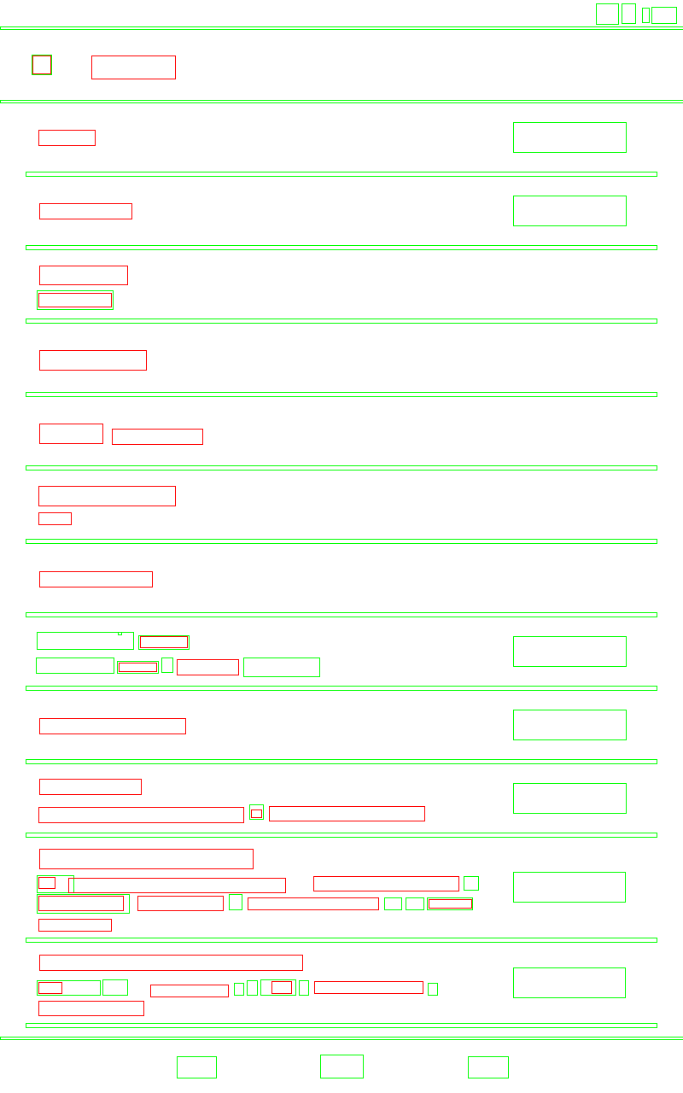
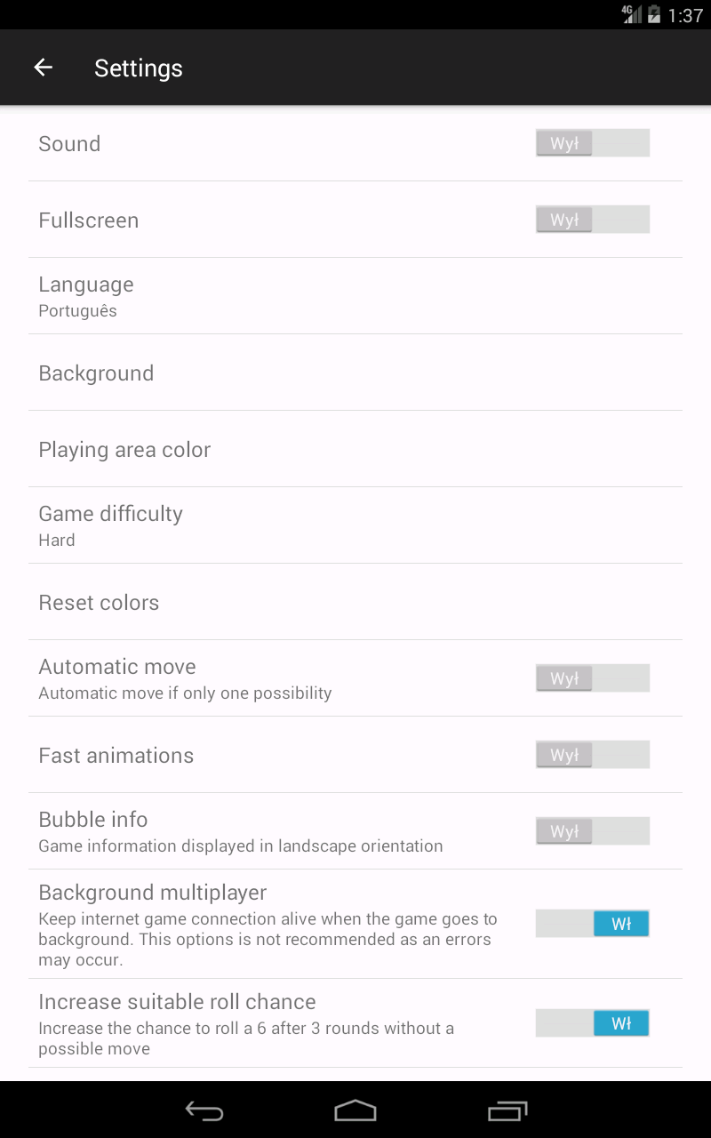
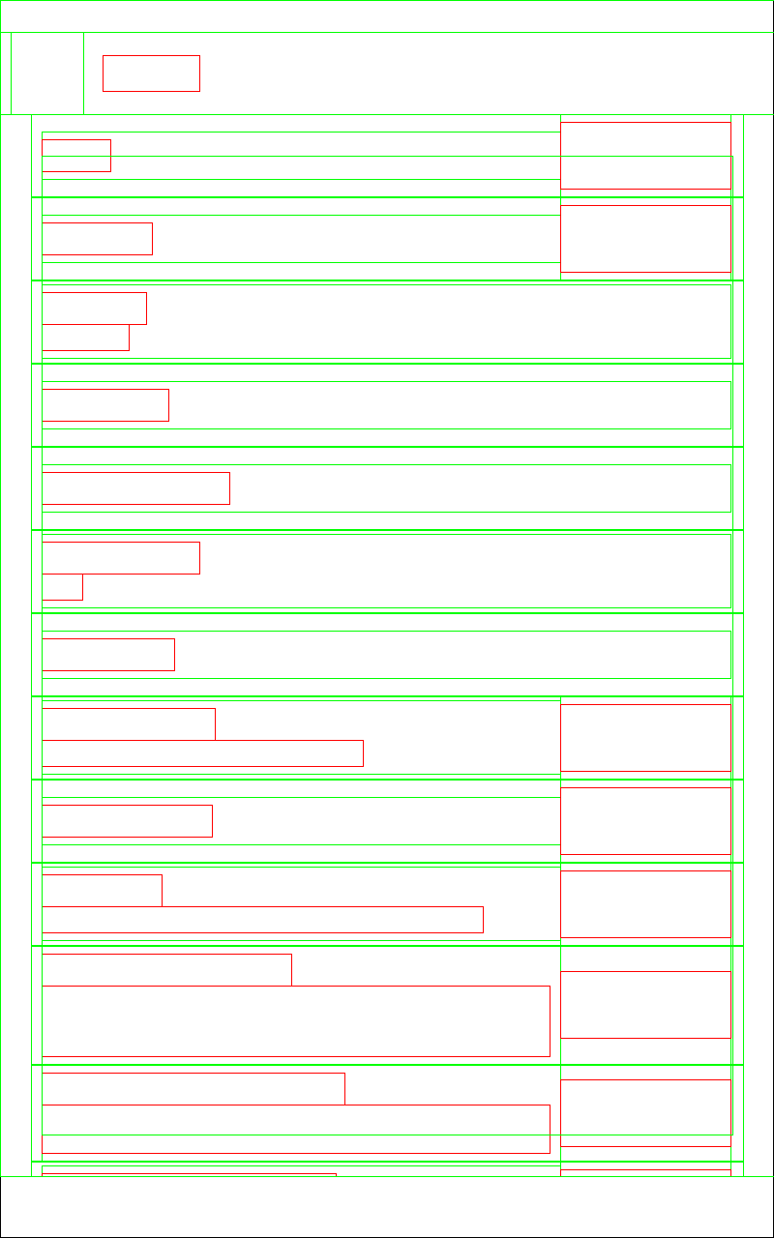
2
(a).screenshots (b).The result from the code (c).The result in the XML file

Slide 5
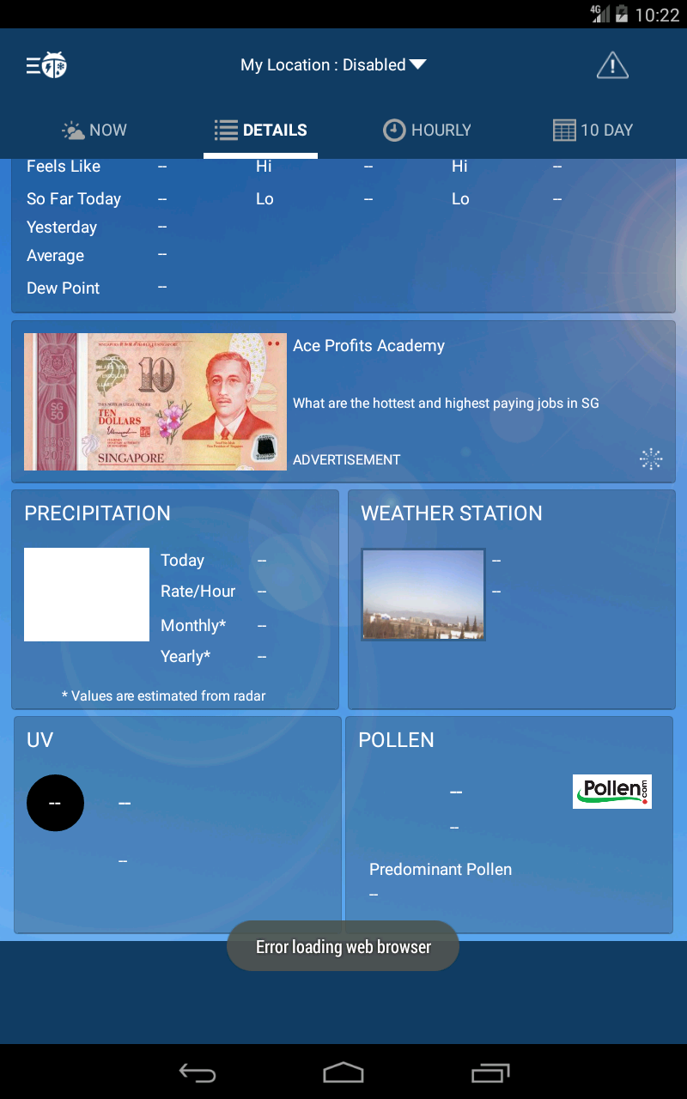
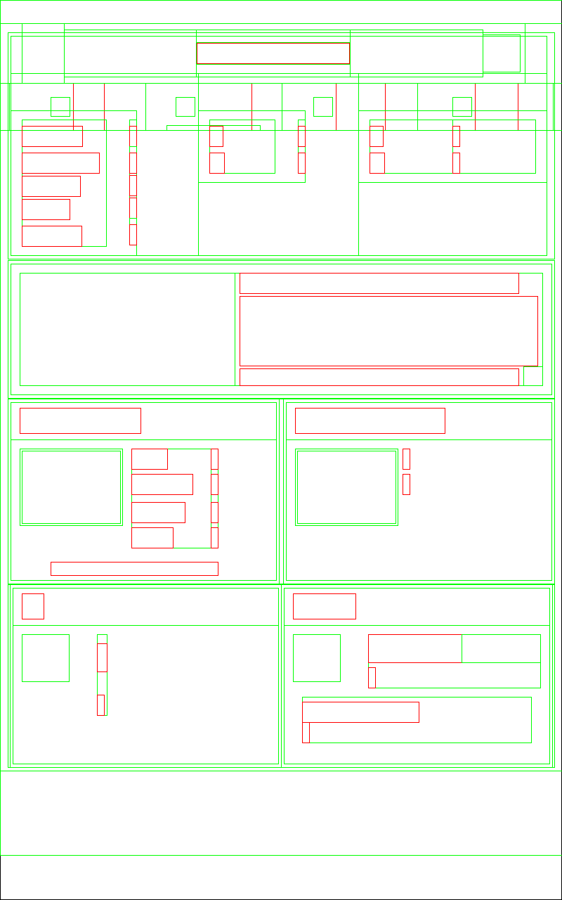

3
(a).screenshots (b).The result from the code (c).The result in the XML file

Slide 6
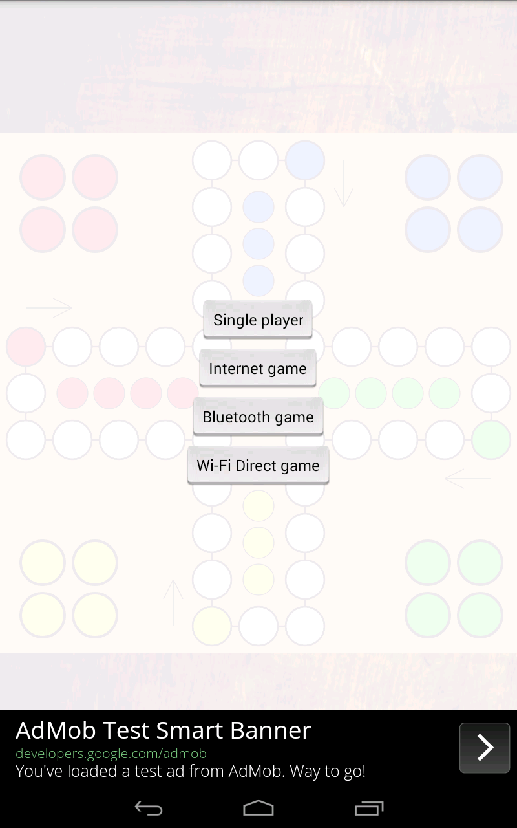


4
(a).screenshots (b).The result from the code (c).The result in the XML file

Slide 7

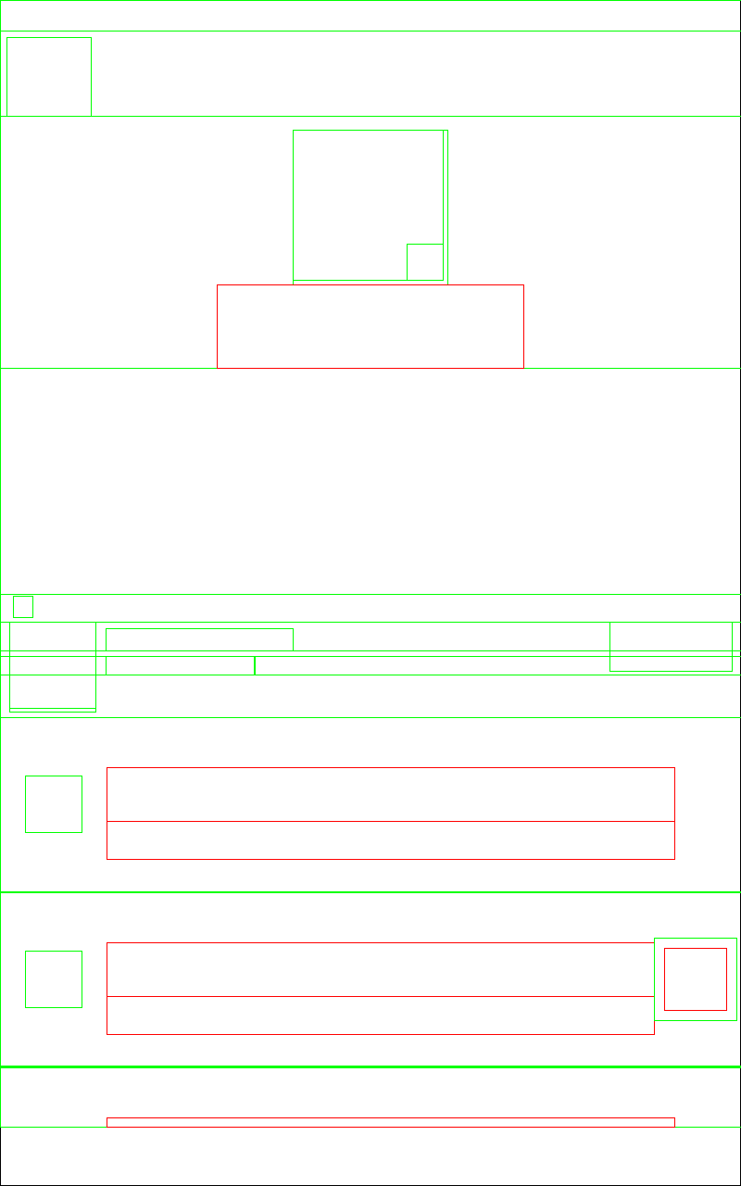

5
(a).screenshots (b).The result from the code (c).The result in the XML file

Slide 8

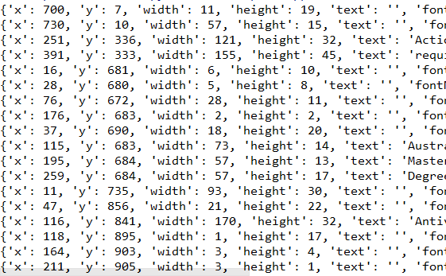
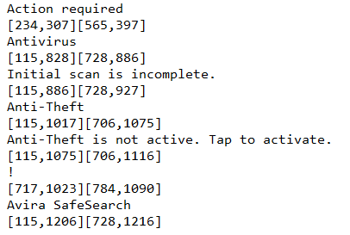
Question
(a).screenshots (b).The result from the code (c).The result in the XML file

Slide 9
Question
The current OCR is not suitable for its own font library, resulting in some fonts can not be recognized.
My idea is to train OCR, which is applicable to my own font library.

