Slide 1
工作汇报
2018年10月31日

Slide 2
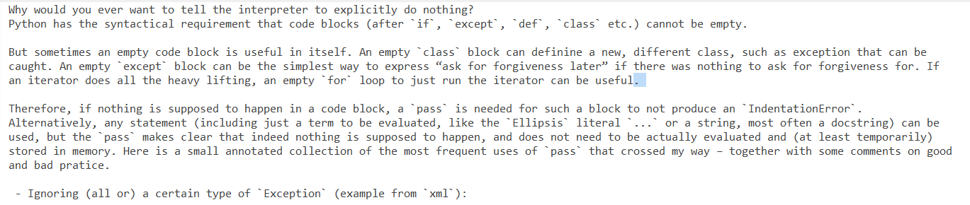
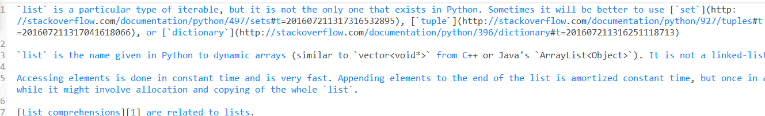
if an iterator does all the heavy lifting an empty for loop to just run the iterator can be useful. (topic：The pass statement)
2.sometimes it will be better to use set tuple or dictionary list is the name given in python to dynamic arrays similar to from c++ or java.

Slide 3
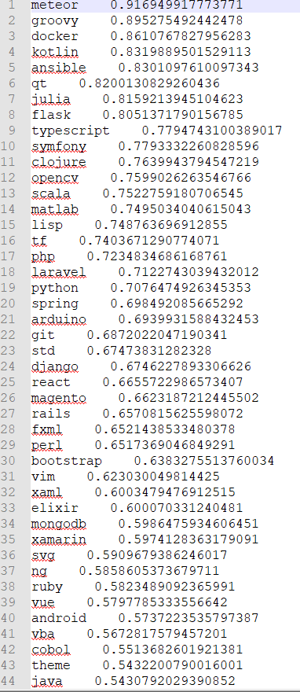
It-idf提取关键字：

Slide 4
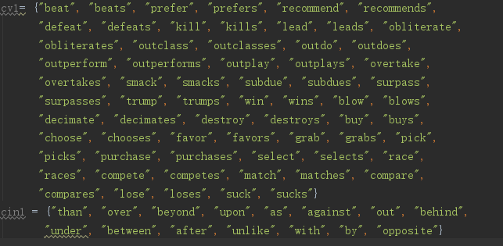
2 .比较：
Comparative sentences: 986

Slide 5
4.否定意义：
1.the github code has newer features than the official release but may be unstable.7
（tag： stanford-nlp topic Getting started with stanford-nlp example：Basic Setup from GitHub）
2.the map function is the simplest one among python built-ins used for functional programming. 6
（tag： python topic topic Getting started with example： Basic use of map, itertools.imap and future_builtins.map ）
3. linked list representation is more efficient in terms of memory managerment.10
（tag:pygame topic topic: Drawing on the screen example : Linked List representation of Queue）
4. xampp is the most popular php development environment.9
（tag： php topic topic: Installing a PHP environment on Windows example :Download and Install XAMPP）
5. gradle is more flexible easier to extend and more hype.10
（tag： spring-boot topic topic: Fully-Responsive Spring Boot Web Application with JHipster example : Create Spring Boot App using jHipster on Mac OS）
excel has far more rows than it has columns

Slide 6
Q&A

