Slide 1
工作汇报
吴 迪
2019.8.26

Slide 2
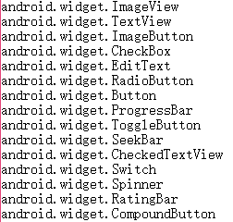
YOLOv3
input_image (608, 608)
anchors = [202,27, 93,14, 49,32,
509,14, 152,106, 76,42,
33,17, 16,12, 576,36]
categories:

Slide 3
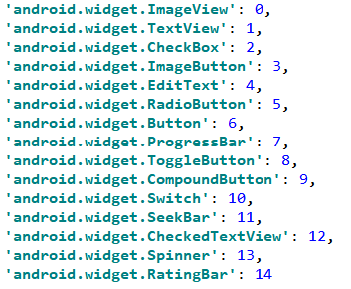
Retinanet
backbone: resnet50
categories:

Slide 4

YOLOv3: DarkNet+FPN
RetinaNet: resnet-50+FPN+FCN
CornerNet-Lite: HourglassNet+CornerNet

Slide 5
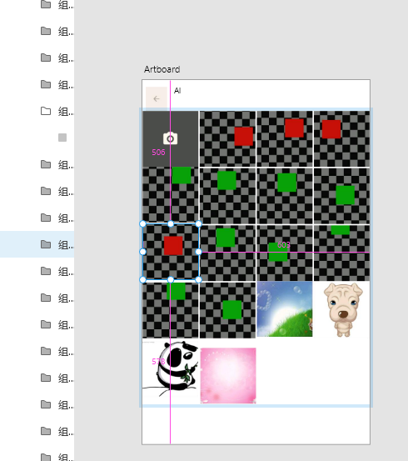
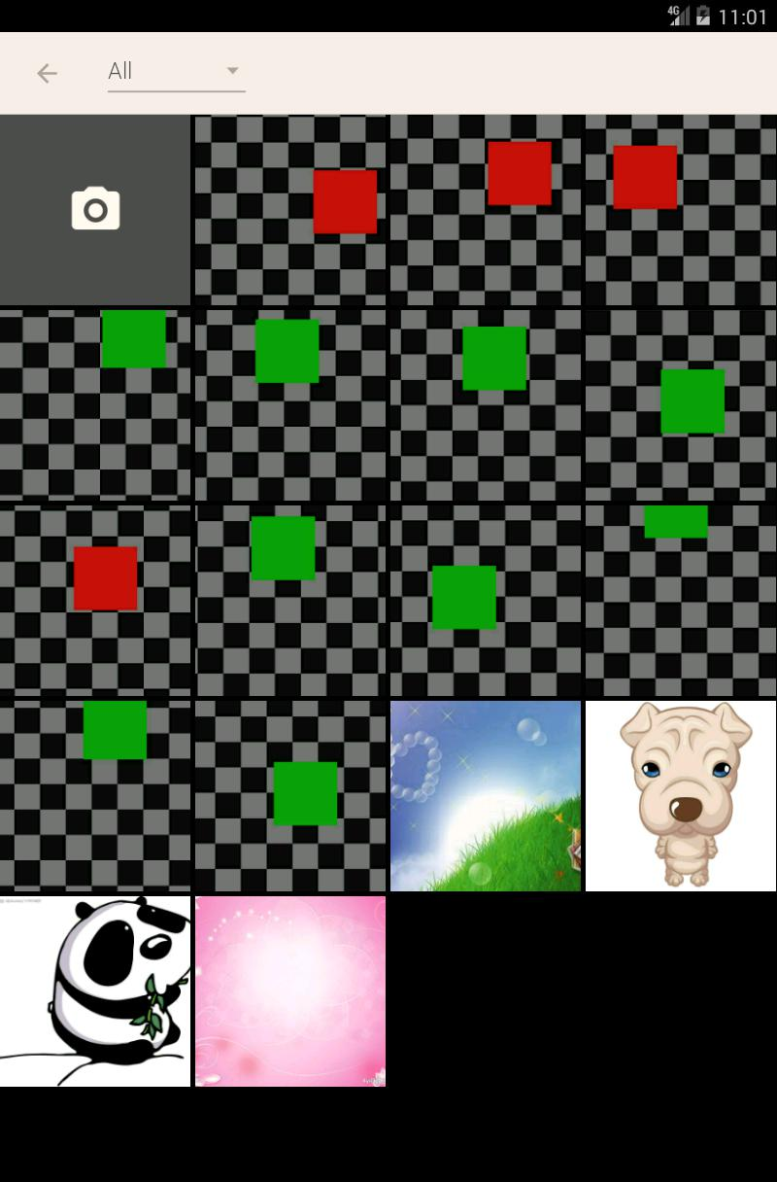
XD Plugin
Generate vector diagrams from XML files

Slide 6
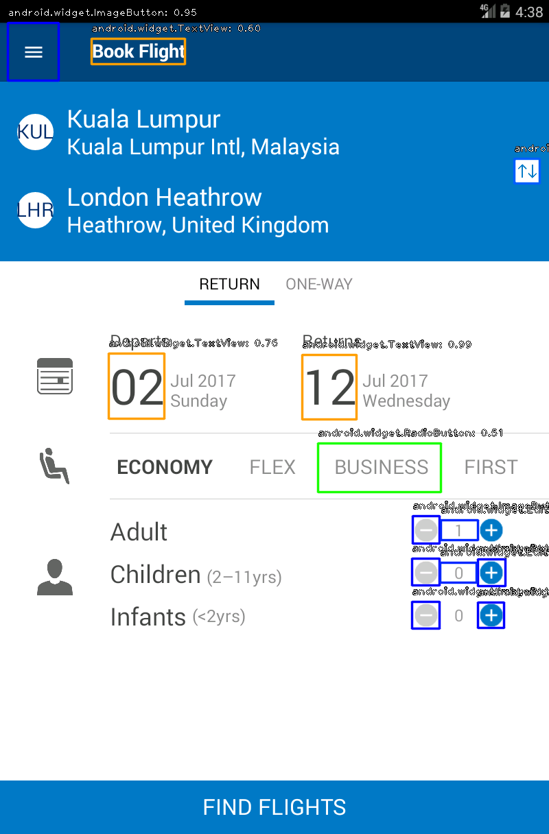
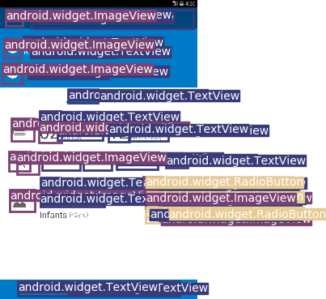
RetinaNet YOLOv3

Slide 7
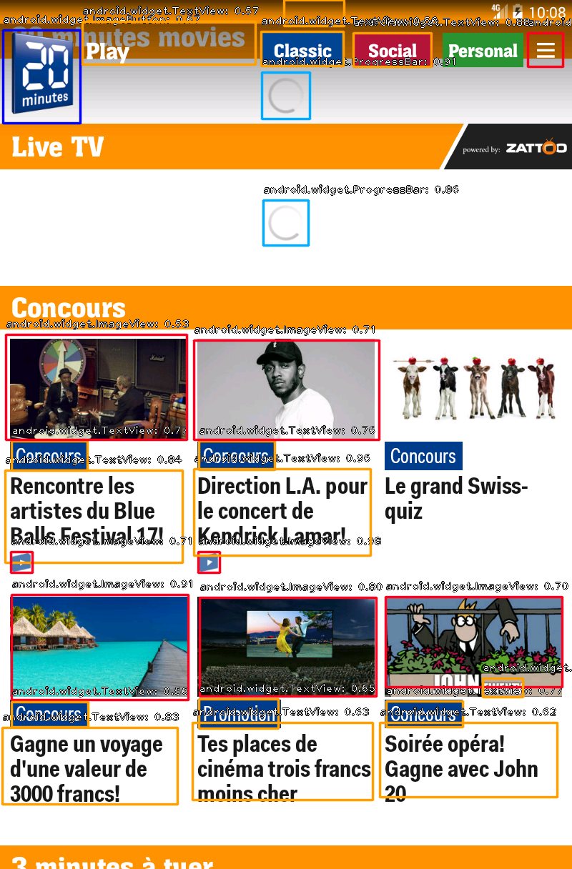
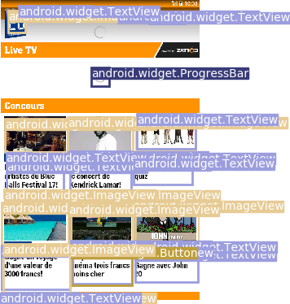
RetinaNet YOLOv3

Slide 8
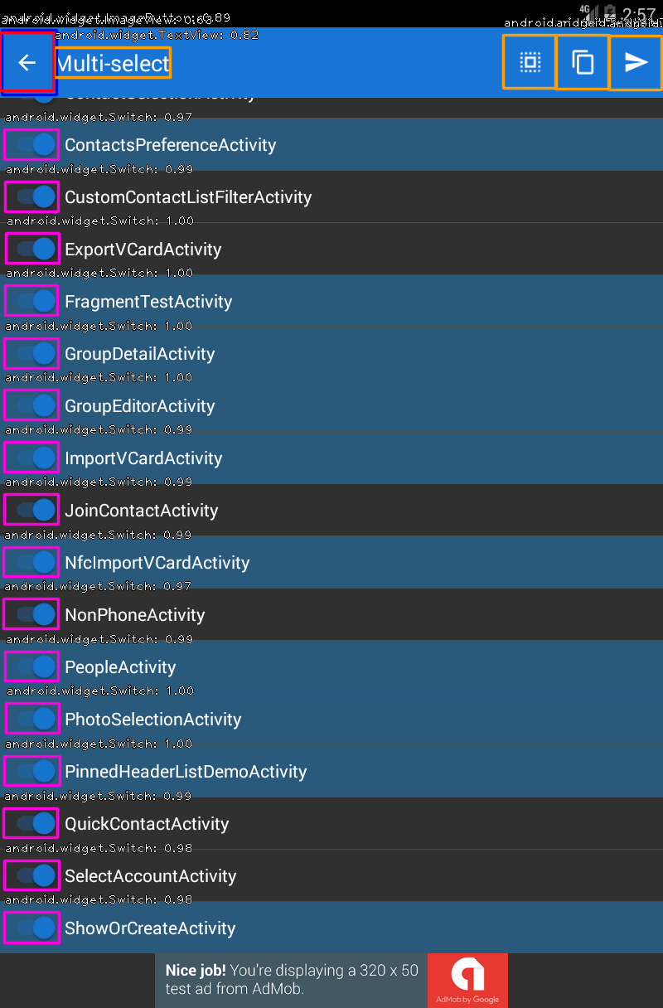
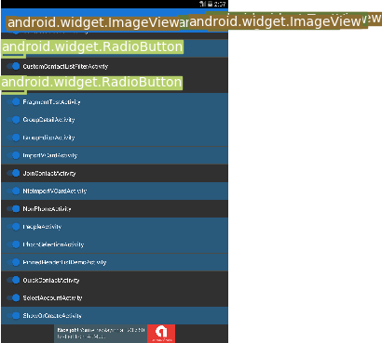
RetinaNet YOLOv3

Slide 9
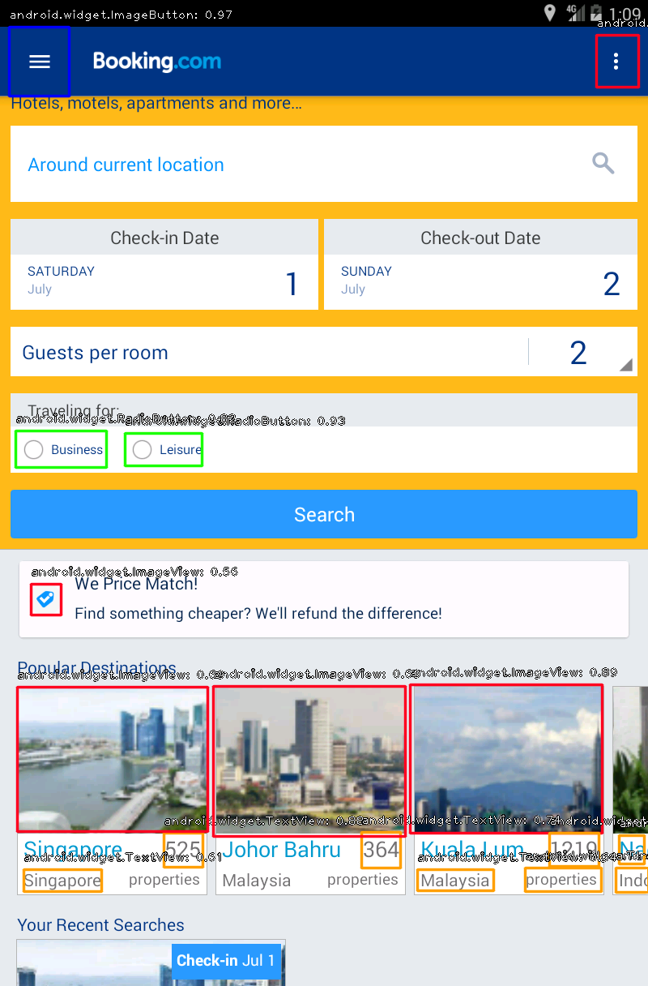
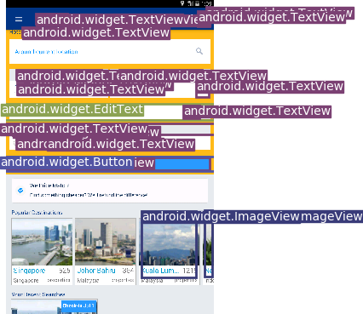
RetinaNet YOLOv3

Slide 10
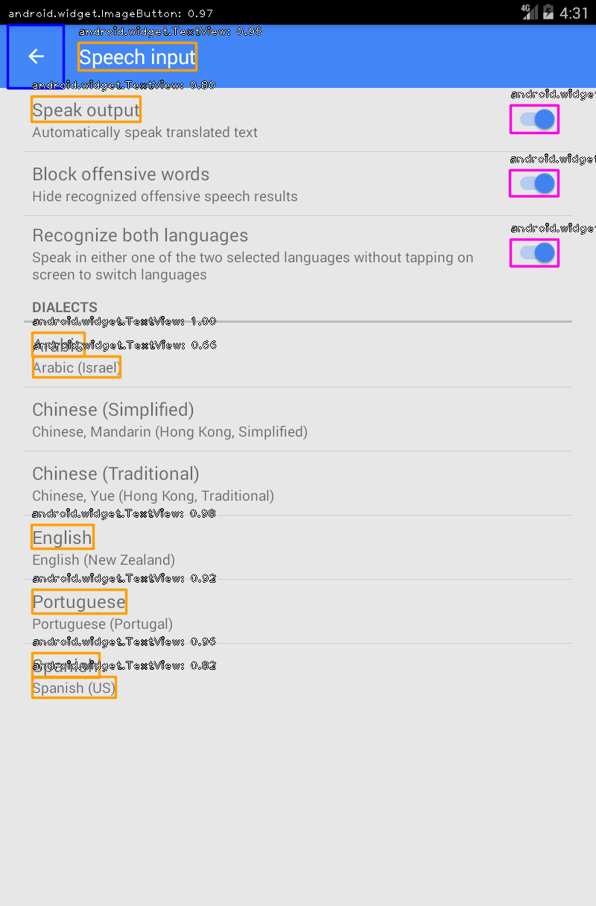
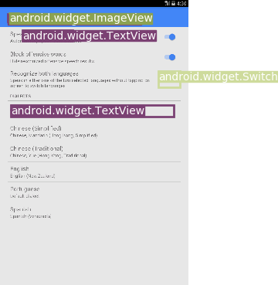
RetinaNet YOLOv3

Slide 11
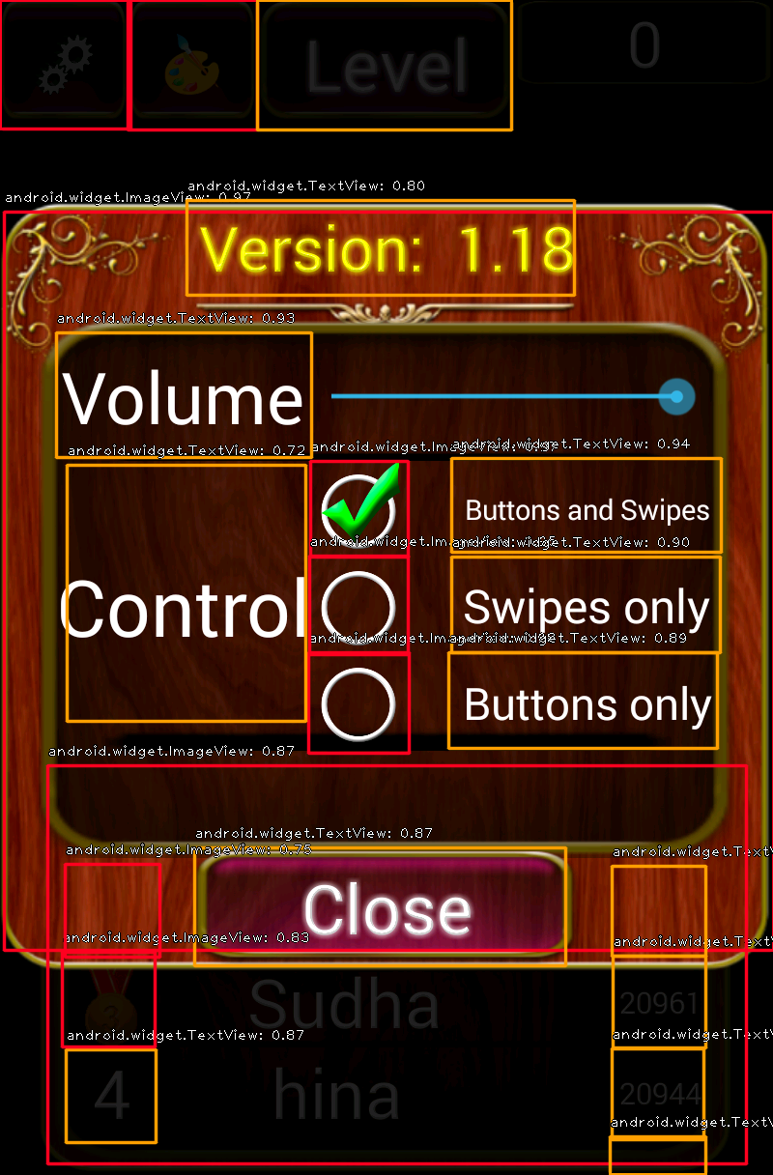
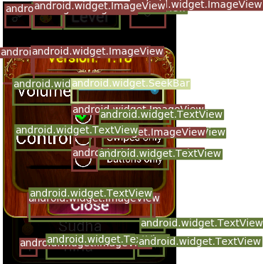
RetinaNet YOLOv3

