Slide 1
Android UI design
Jilin University

Slide 2
Main work--Sunhaotai
1、data collection
2、data processing
3、Model training and testing

Slide 3
data collection
Work progress last week ：
（1）collection UI
Clean vs complicated
Beautiful vs ugly
Fashion vs old
Layout
Usability

Slide 4
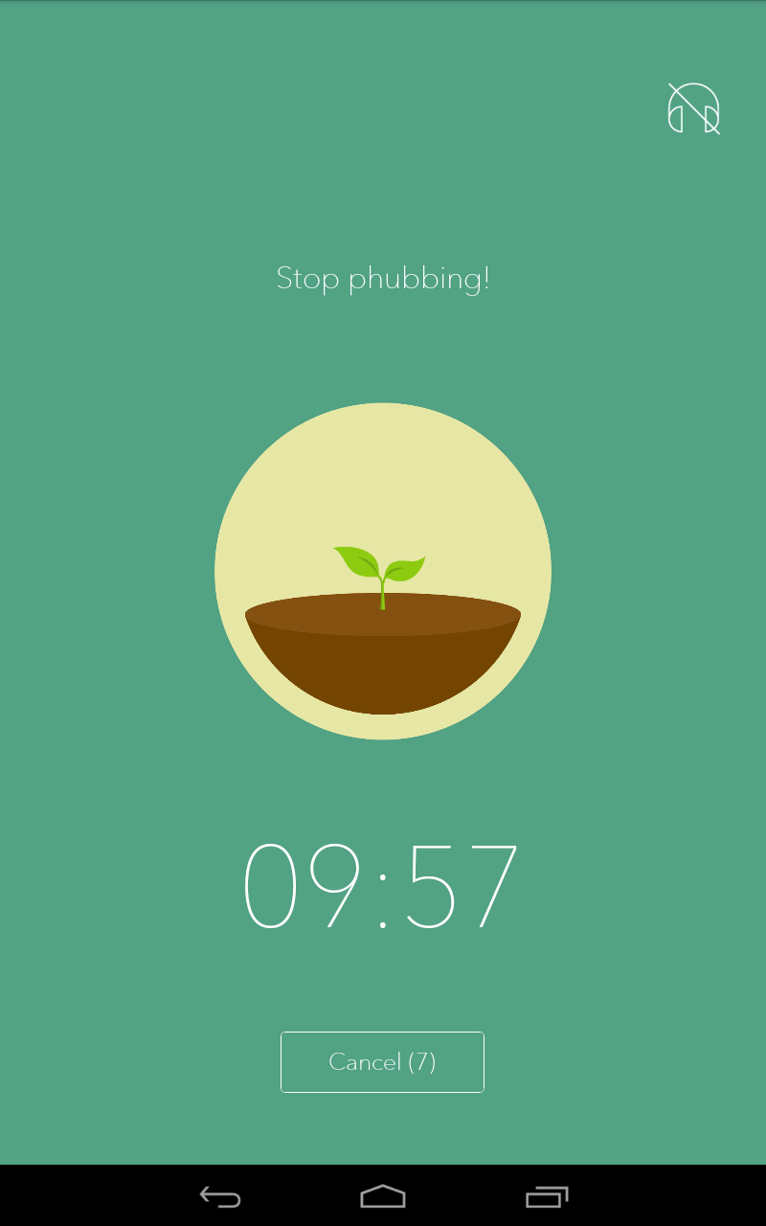
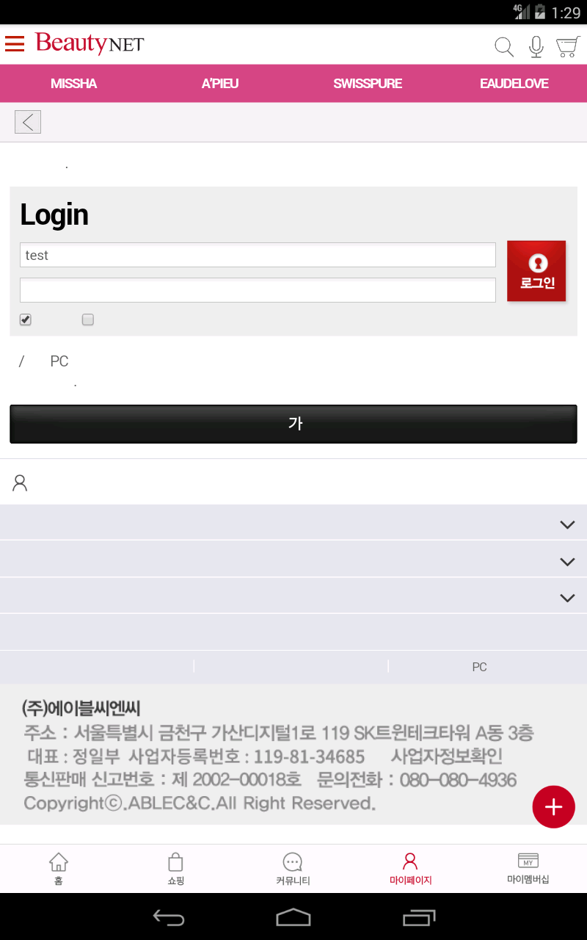
data collection
  Clean vs complicated

Slide 5
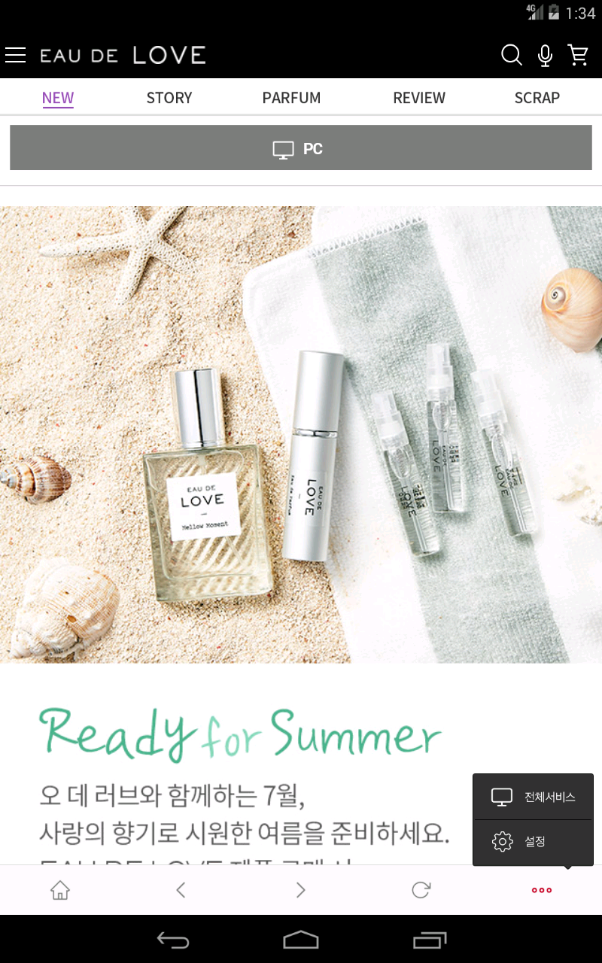
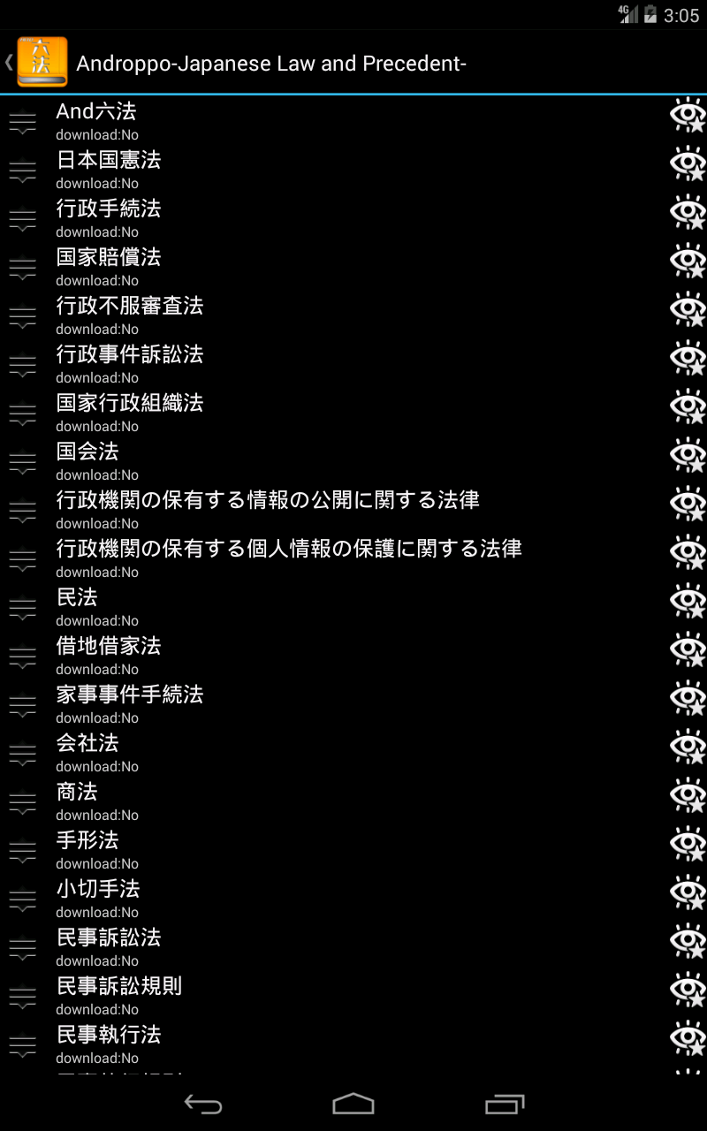
data collection
  Beautiful vs ugly

Slide 6
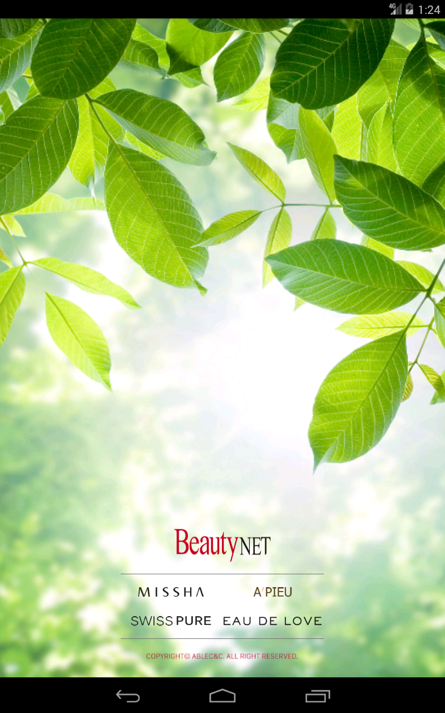
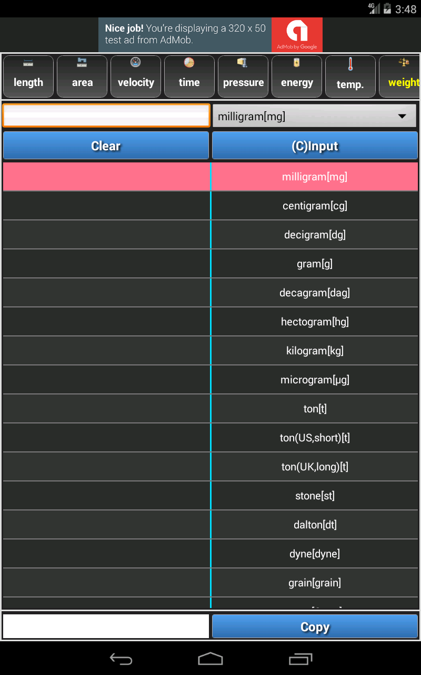
data collection
  Fashion vs old

Slide 7
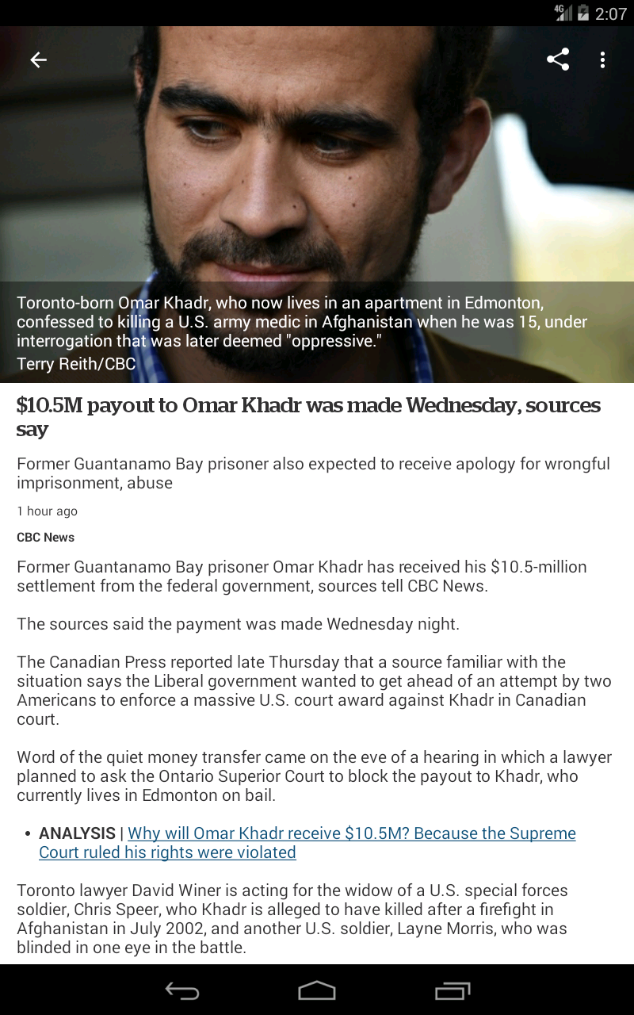
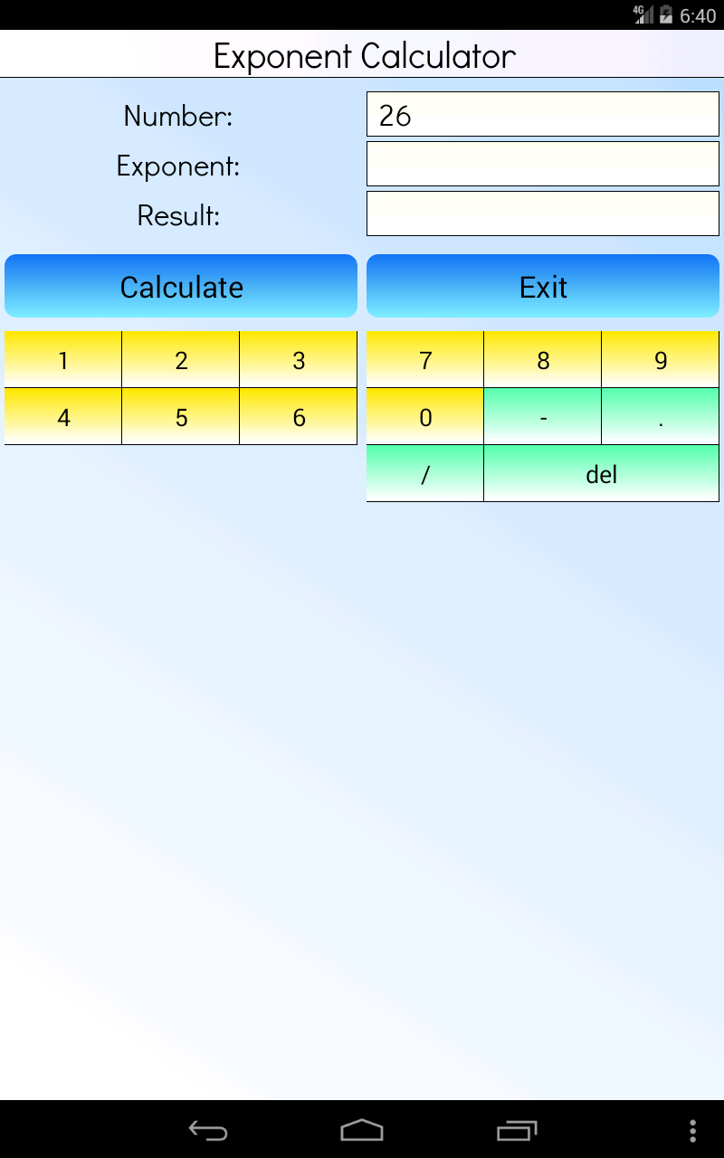
data collection
  Layout

Slide 8
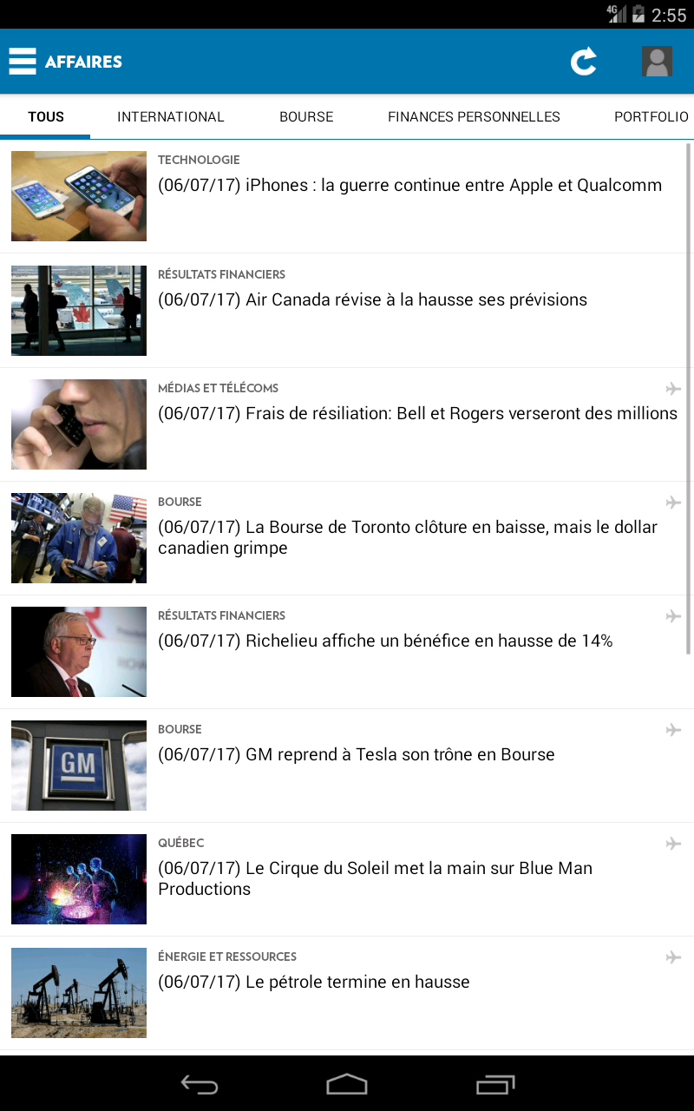
data collection
  Usability

Slide 9
data processing
Work progress last week ：
（1）Use python scripts for image tailoring

Slide 10
Model training and testing
Work progress last week ：
（1） Increase the number of picture training
Problem: according to the previous classification, the specific problems of UI design are pointed out through the training model

Slide 11
Reporting on work--Jiangxue
1. Learn the clustering code carefully and cluster our data sets through the hierarchical clustering method.
2. We discussed the classification criteria of UI pictures and classified them.

Slide 12
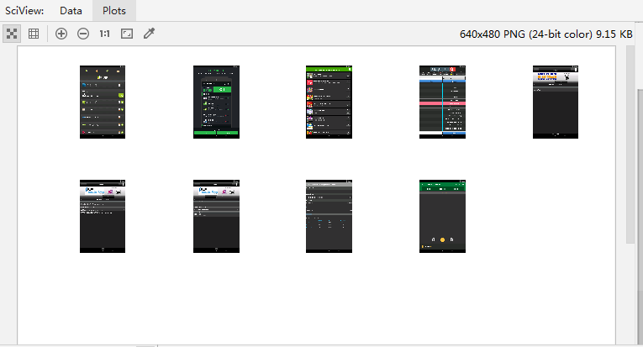

Slide 13
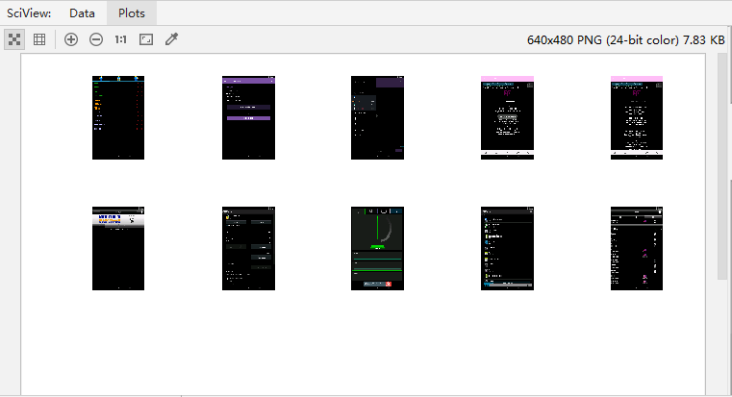

Slide 14
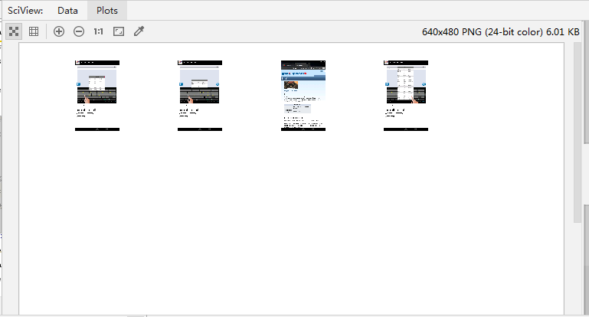

Slide 15
