Slide 1
工作汇报
吴 迪
2019.3.18

Slide 2

Problem solved
1.The new API is not available in the old version sketch.
Sketch 51.3
2.The NodeJS core module is not available.

Slide 3
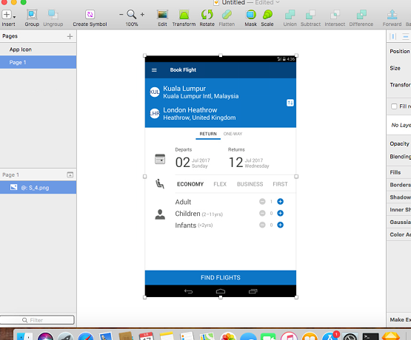
Sketch Plugin
Reading the image from the path

Slide 4
Problems
1.Use 'gm' module to segment images
2.Show each segment in the layer

