Slide 1
Work summary report
Learning content summary and questions
shencz

Slide 2
TASK：
Try using python to connect and manipulate the Mysql database
reading papers ‘diffSimilarTech’ and ‘analogical_libraries’

Slide 3
1.Connect to Mysql database with python
There are three commonly used ways for python to connect to Mysql databases, namely pyMysql, Mysqldb, and mymysql. Connector, in which Mysqldb has ceased maintenance
Taking pyMysql as an example, we tried to connect and manipulate mysql databases using python.
Technical essential:
The main steps to connect to a database using pyMysql are as follows:
1、Instantiate the connection object
2、Gets the database operation cursor of the connection object, which provides the methods needed to manipulate the database.
3、open the connection
4、Operation cursor execution method
5、submit
6、close the connection
Tips：We can use the method cursor.fetchall() to accept all returned value if we need, and it will be saved as a list
Operation is performed by passing parameters, the format character is %s

Slide 4
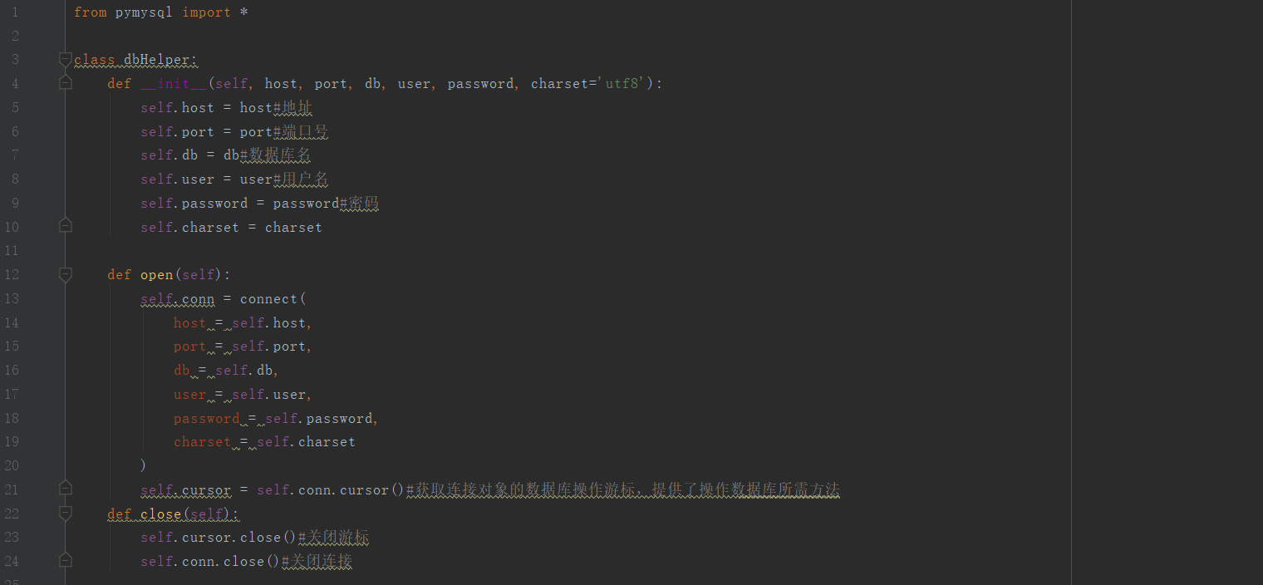
Implementation
code

Slide 5
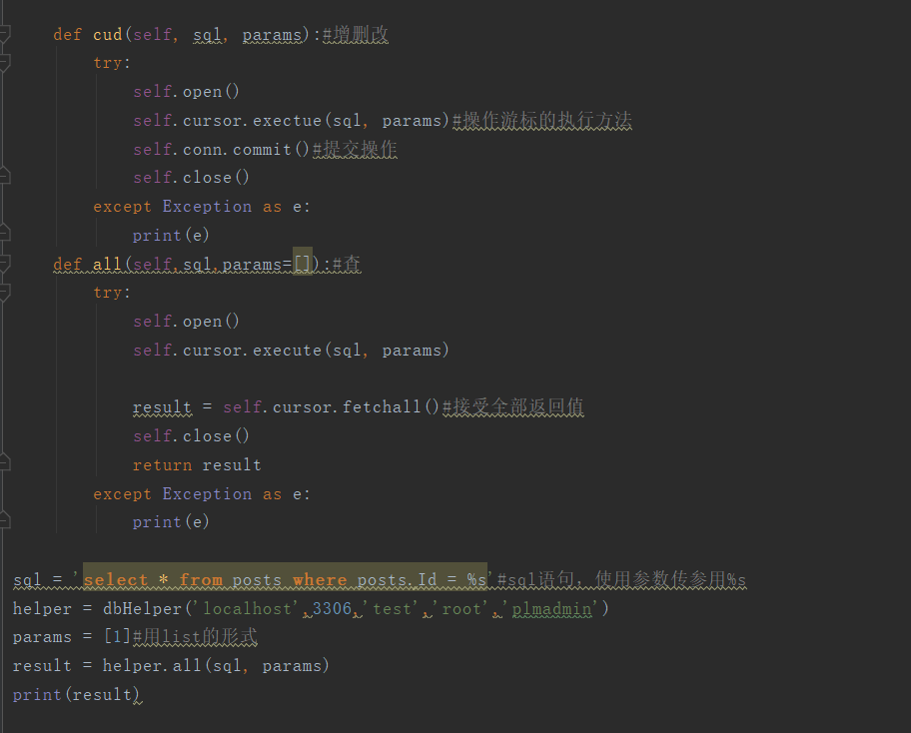
Implementation
code

Slide 6
2.Reading papers
This week I read the paper:Tell Them Apart: Distilling Technology Differences from
Crowd-Scale Comparison Discussions
This paper shows that, they built the diffTech system to exploits the crowd-sourced discussions from Stack Overflow, and assists technology comparison with an informative summary of different comparison Aspects.
Innovation point in this paper:
1.This is the first work to systematically identify comparable software-engineering technologies and distill crowd-scale comparative sentences for these technologies.
2. This method automatically distills and aggregates crowd opinions into different comparison aspects so that developers can understand technology comparison more easily
3. Our experiments demonstrate the effectiveness of our method by checking the accuracy and usefulness of each step of our approach.
4. We implement our results into a practical tool and make it public to the community. Developers can benefit from the technology comparison knowledge in our website

Slide 7
2.Reading papers
Method:
First: Mining similar technology by word embedding techniques and determine the corresponding technology`s category with natural language methods. And building a knowledge base of comparable technologies.
Second: For each pair of comparable technologies in the knowledge base, analyzing the Q&A discussions in Stack Overflow to extract plausible comparative sentences by which Stack Overflow users express their opinions on the comparable technologies.
Measure the similarity among the comparative sentences, and then cluster them into several groups, each of which may identify a prominent aspect of technology comparison that users are concerned with.

Slide 8
3.Question
1.There are a lot of terms and techniques that I don't understand, I try to search them.
2. I need to keep reading that book
3.I am not sure what does TagWiki mean？

Slide 9
thanks
shencz
20180911

