Slide 1
Weekly work
shencz

Slide 2
SELECT a.Id, a.ParentId, a.CreationDate, a.Score, a.Body, a.LastEditDate, a.LastActivityDate, b.Text FROM Posts AS a inner join Comments AS b on a.Id = b.PostId
and (b.Text LIKE '%out-of-date%' OR b.Text LIKE '%obsolete%' OR b.Text LIKE '%outdated%' OR b.Text LIKE '%antiquated%' OR b.Text LIKE '%antique%' OR b.Text LIKE '%demoded%')
and a.PostTypeId = '2' and b.Score >= '1' ORDER BY rand() LIMIT 100
77 useful
6298 in total

Slide 3
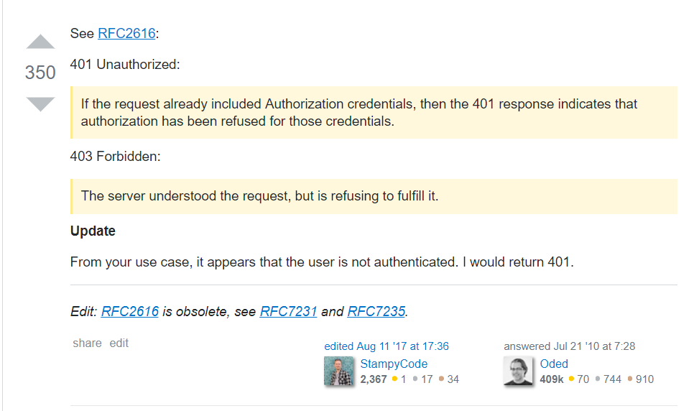
Oracle samples

Slide 4
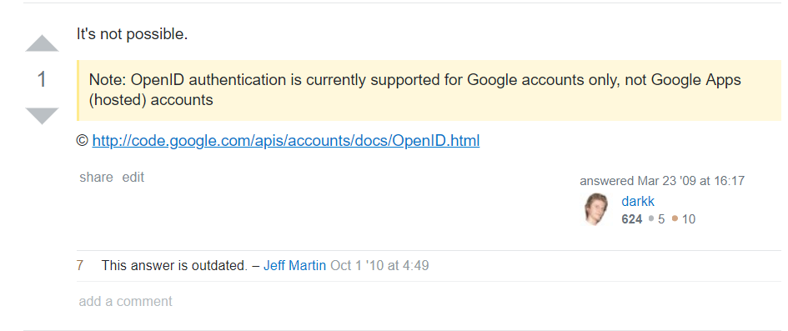
Oracle samples

Slide 5
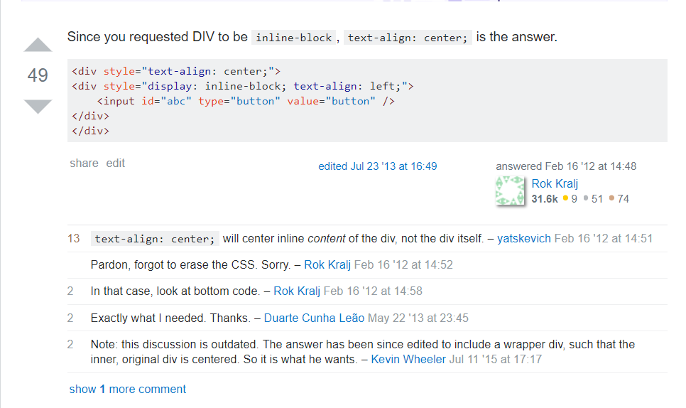

Slide 6
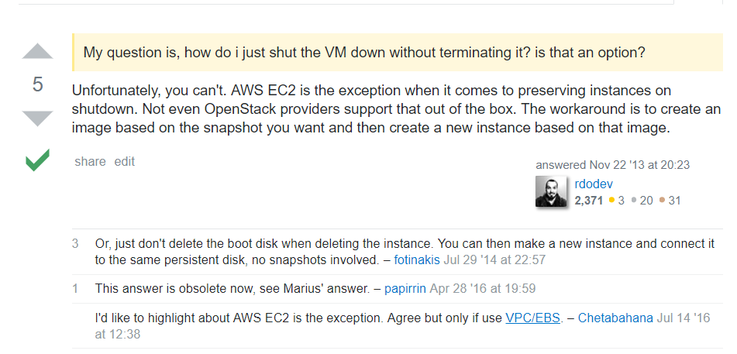

Slide 7
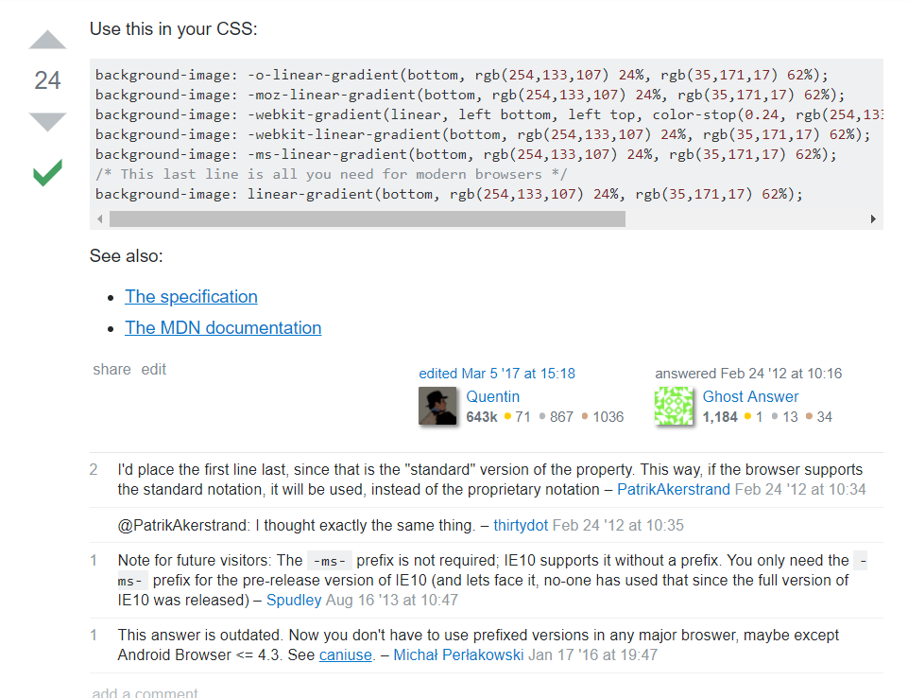

Slide 8
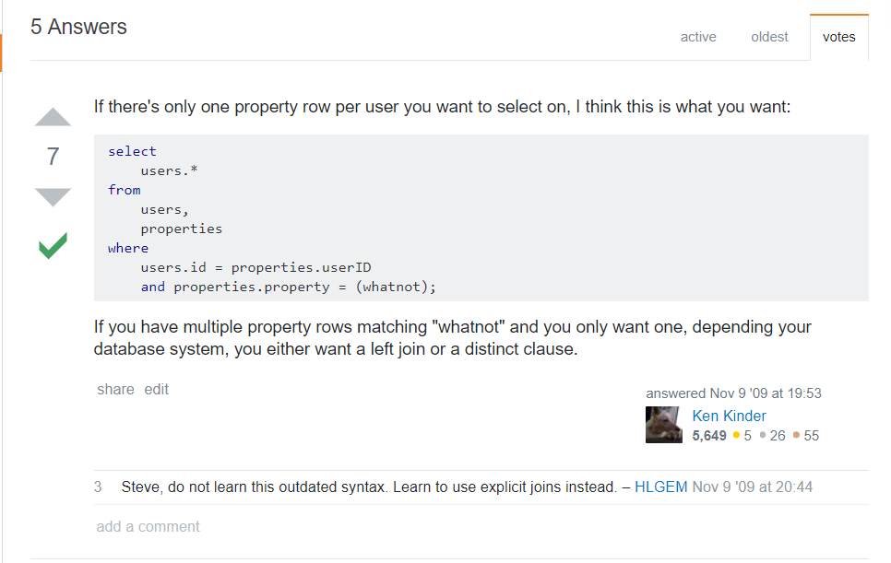

Slide 9
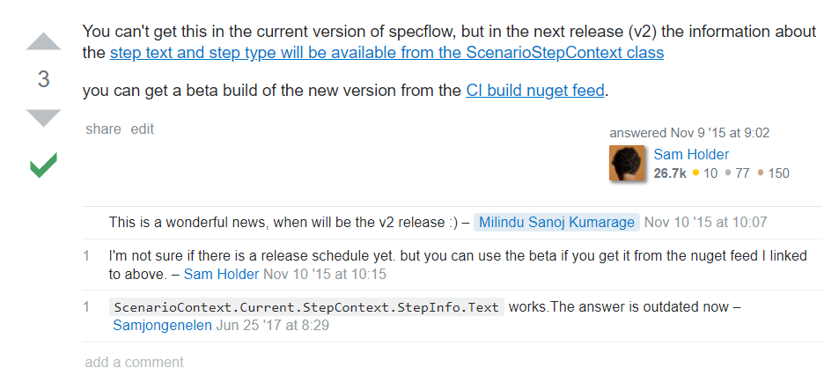

Slide 10
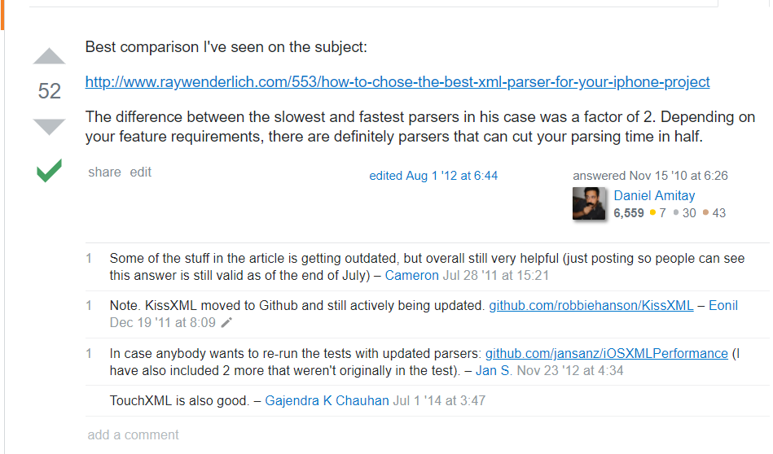

Slide 14
CreationDate | LastEditDate | LastActivityDate
2008 | 2011 | 2011
2011 | 2016 | 2016
2014 | 2017 | 2014
2012 | 2014 | 2014
2012 | 2013 | 2013
2009 | 2013 | 2013
2010 | 2012 | 2012
2009 | 2014 | 2014
2011 | 2014 | 2014
2013 | 2018 | 2018
2012 | 2014 | 2014
2012 | 2014 | 2014
2012 | 2017 | 2012
2014 | 2018 | 2018
2016 | 2017 | 2017
2013 | 2017 | 2016
2015 | 2016 | 2016
2010 | 2017 | 2017
2010 | 2017 | 2017
2011 | 2014 | 2014
2012 | 2018 | 2018
2016 | 2017 | 2017

Slide 15
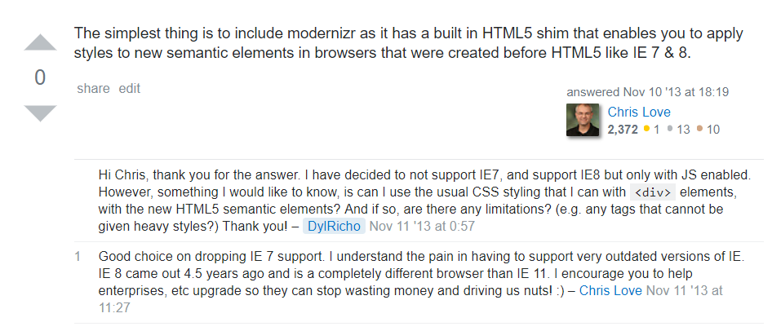
Some posts is discussing outdated technology, they are not obsolete in themselves, but be queried.

Slide 16
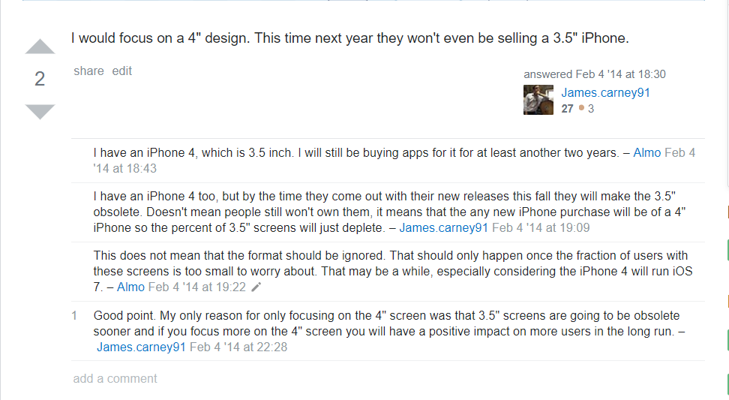

Slide 17
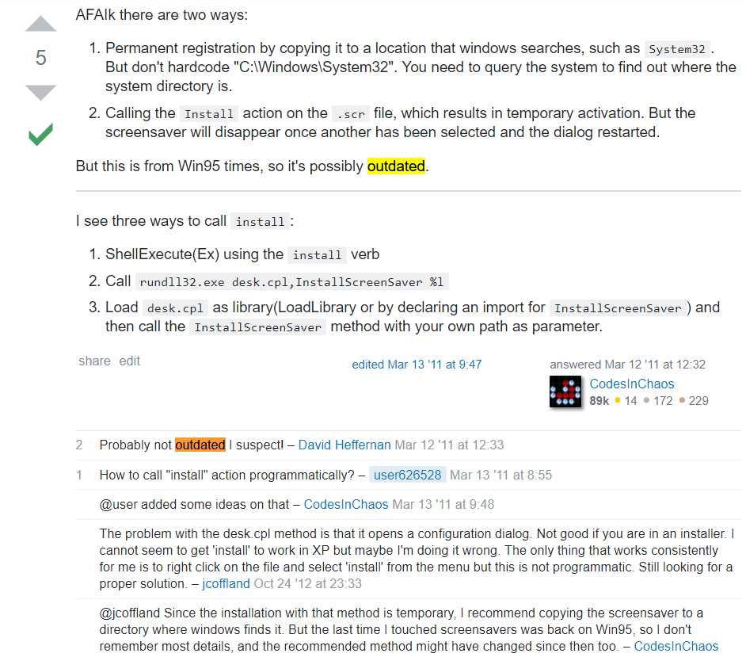

Slide 18
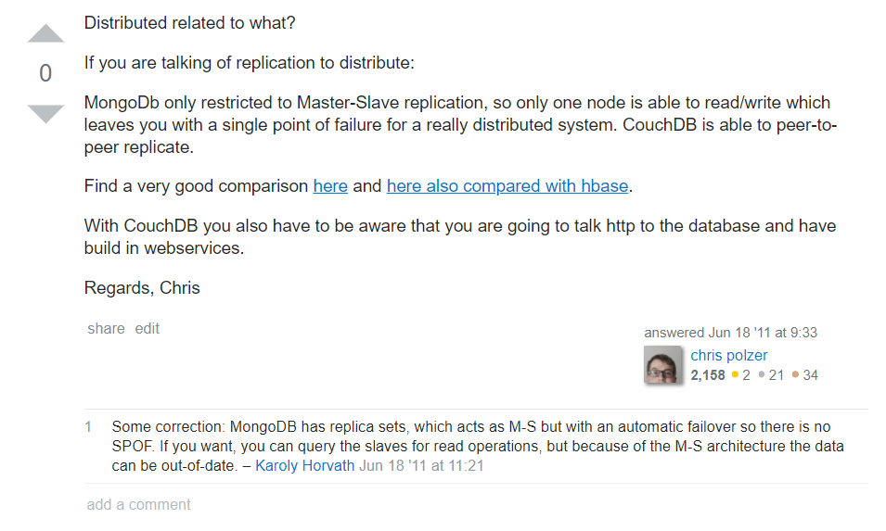

Slide 19
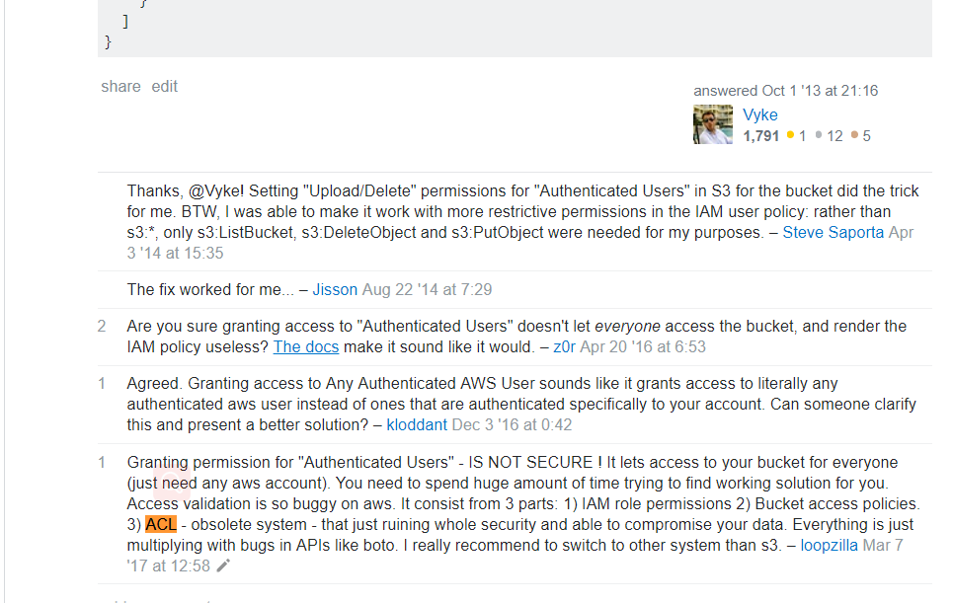

Slide 20
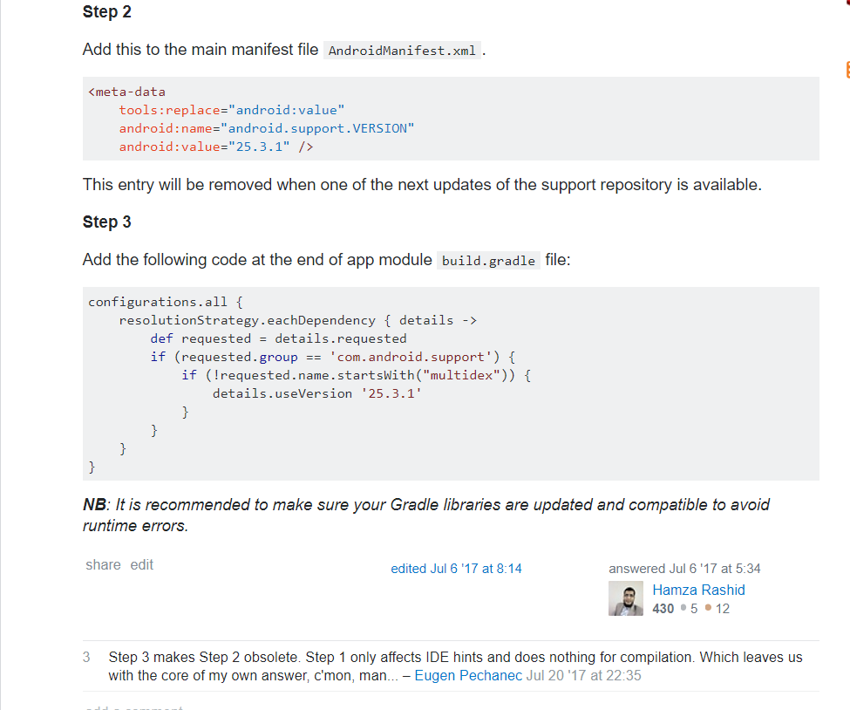

Slide 21
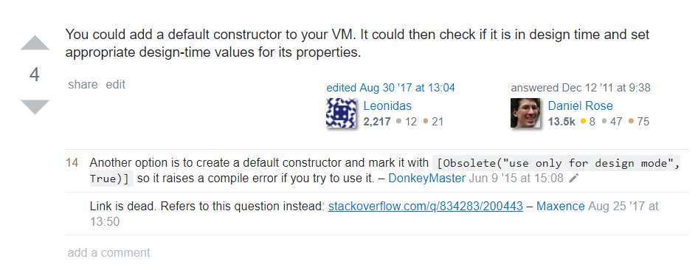
Tips named Obsolete

Slide 22
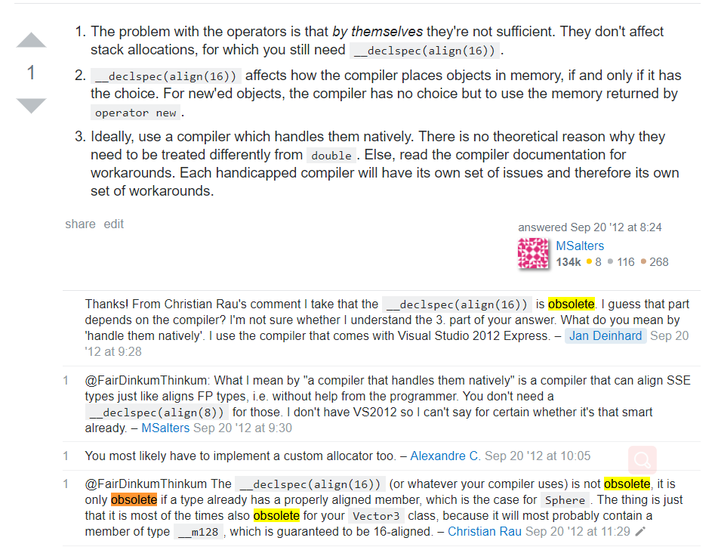
The comment is wrong

Slide 23
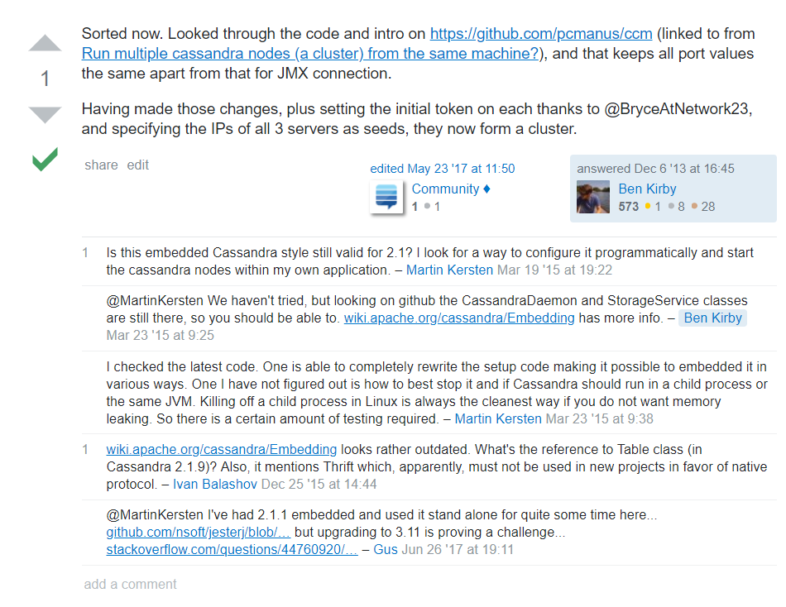

Slide 24
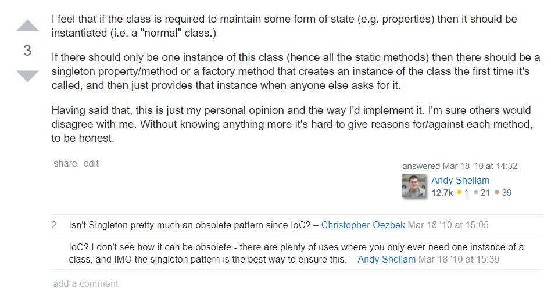

Slide 25
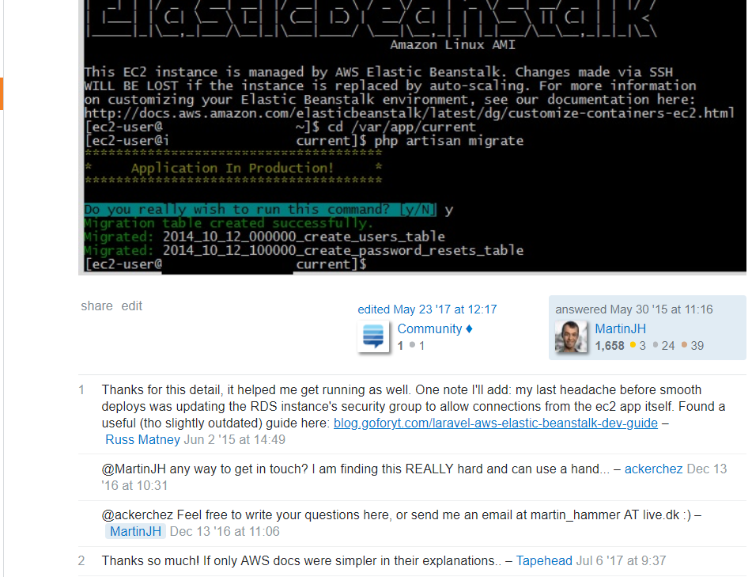
There is outdated content in the comments

Slide 26
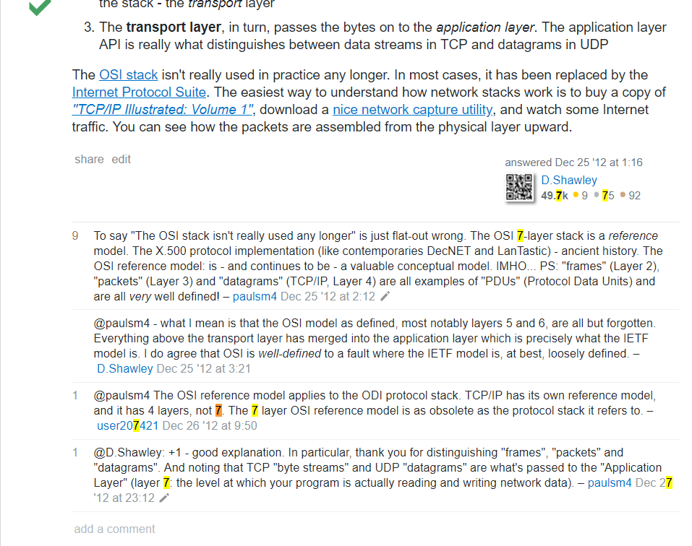

Slide 27
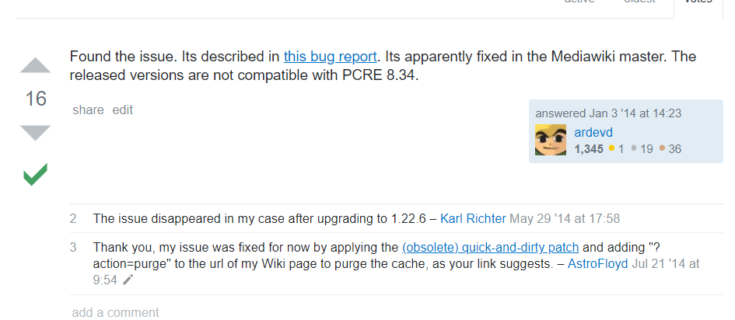

Slide 28
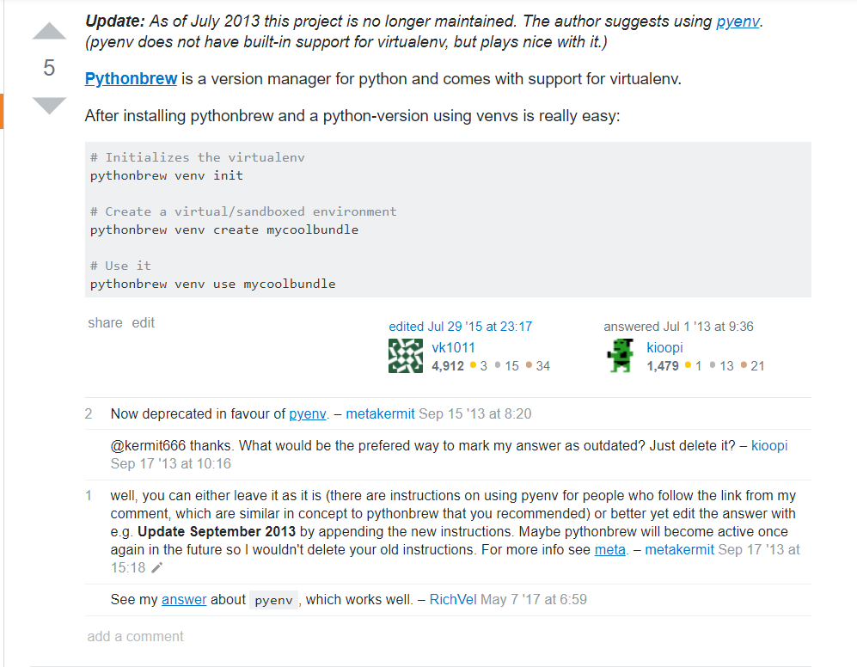
Own version maintenance

Slide 29
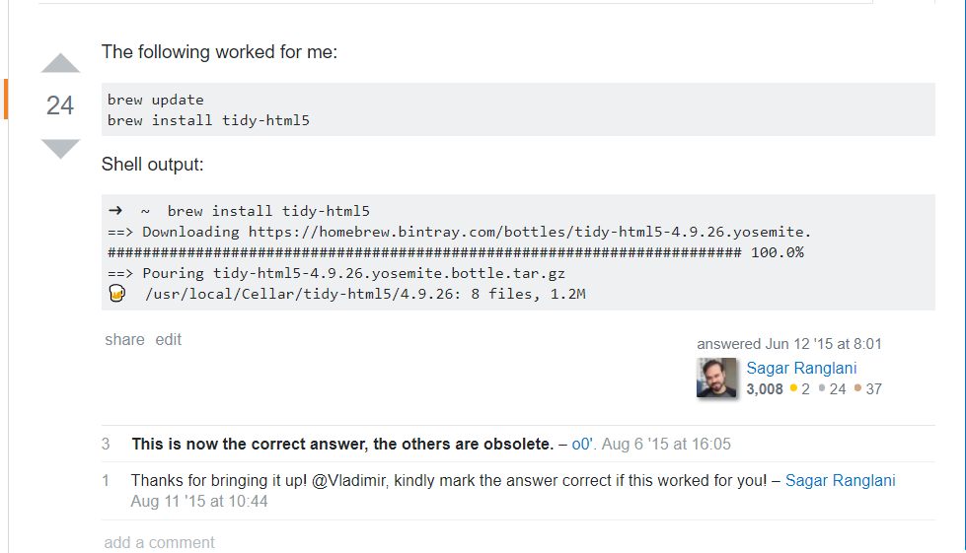

Slide 30
SELECT a.Id, a.ParentId, a.CreationDate, a.Score, a.Body, a.LastEditDate, a.LastActivityDate, b.Text FROM Posts AS a inner join Comments AS b on a.Id = b.PostId
where (b.Text LIKE ‘%This answer is out-of-date%' OR b.Text LIKE '%This answer is obsolete%' OR b.Text LIKE '%This answer is outdated%' OR b.Text LIKE '%This answer is antiquated%' OR b.Text LIKE '%antique%' OR b.Text LIKE '%demoded%')
and a.PostTypeId = '2' and b.Score >= '1' ORDER BY a.Id;
272 in total

Slide 31
select Body from Posts where (Tags = 'python' or Tags like '%python-3%') and (Body like '%print %' or Body like '%exec %' or Body like '%execfile%' or Body like '%<>%' or Body like '%xrange(%' or Body like '%.next(%' or Body like '%raw_input%' or Body like '%has_key%' or Body like '%file(%'or Body like '%apply(%' or Body like '%StandardError%');
18797条

