Slide 1
Weekly work
shencz

Slide 2
Hand picking
‘% obsolesc%' ‘% out-of-style%' '% out of style%' ‘% out of fashion%’
‘% out-of-fashion%' ‘% out date%'
‘% dismoded%' ‘% antique%' ‘% demoded%’

Slide 3
'% out-of-date%’ ‘% out of date%’
‘% outdate%’
‘% old-fashion%’ ‘% old fashion%’
‘%obsolet%’
Take out ‘%@%’ ‘%+1 %’ ‘%+1,%’
6061

Slide 4
23971 in total
'%been abandoned%’
'%deprecated%’
'%no longer maintain%' '%no longer available%' '%no longer valid%' '%no longer exist%’ '%no longer work%' '%no longer true%' '%no longer support%' '%no longer use%' '%no longer corrent%' '%no longer allow%' '%no longer compatible%' '%no longer accurate%’
'%but nowadays%' '%Nowadays%’
'%no more maintain%' '%no more available%' '%no more valid%' '%no more exist%'
'%no more working%' '%no more true%' '%no more support%' '%no more useful%' '%no more allow%' '%no more accurate%'

Slide 5
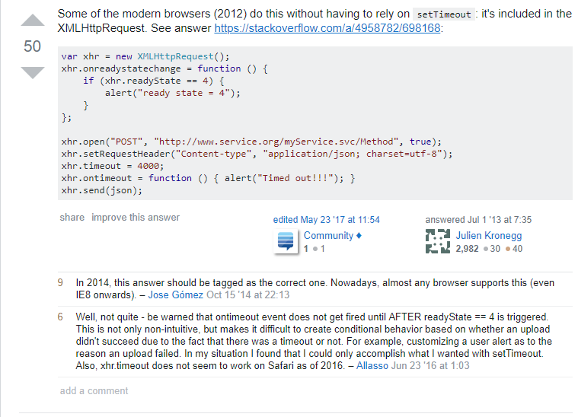

Slide 6
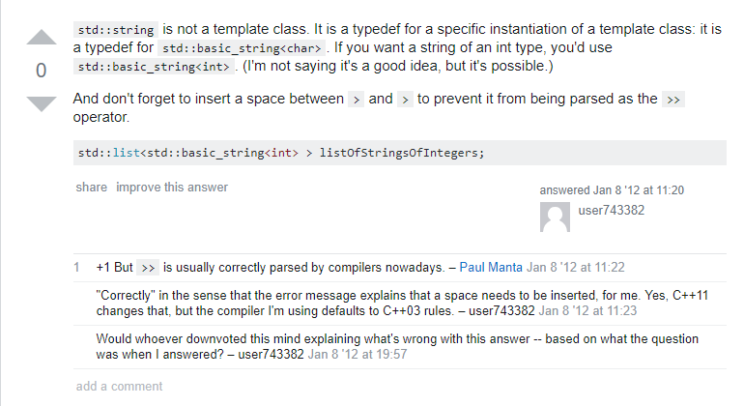

Slide 7
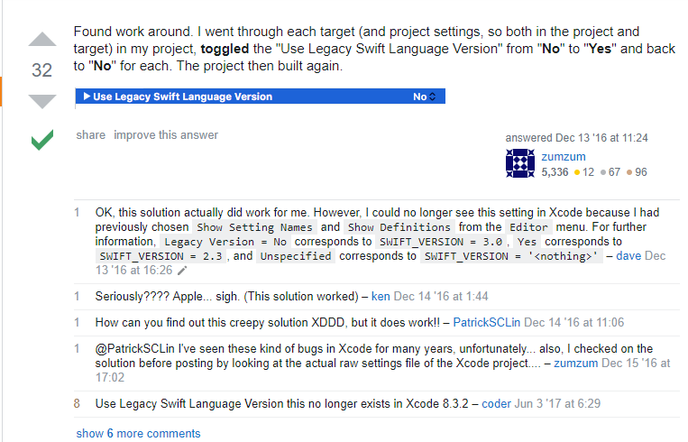

Slide 8
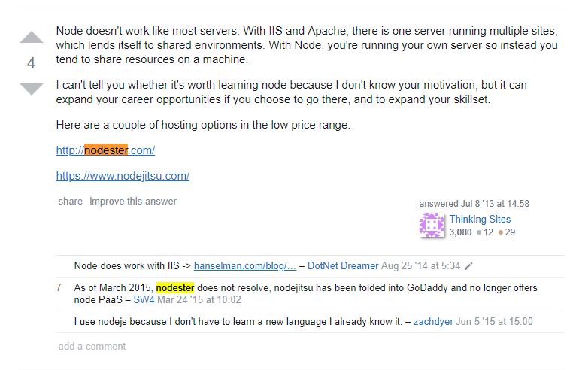

Slide 9
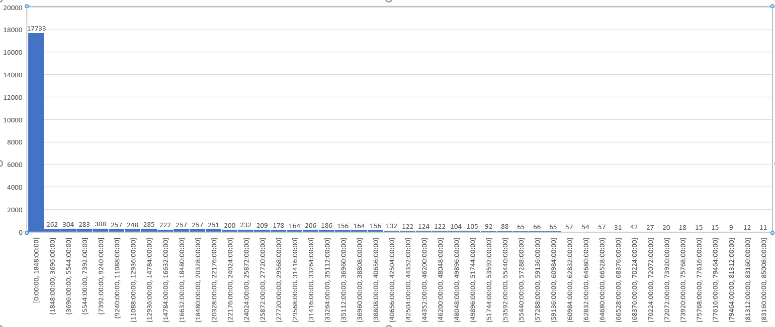

Slide 10
Problems : the out of date posts has been edited
Next step:
Score >= 100
Lastactivitydate – CreationDate belong to 0-1848days
Too long comments
There are no keywords in posts but in comments
In recent years, Low score
Words means accept and right

Slide 11
Positive simples
Problem’s CreationDate >= "2013-01-01"
Problem’s ViewCount > 50000
Answer’s Score >= 20
Exclude keywords
Limit 20000

Slide 12
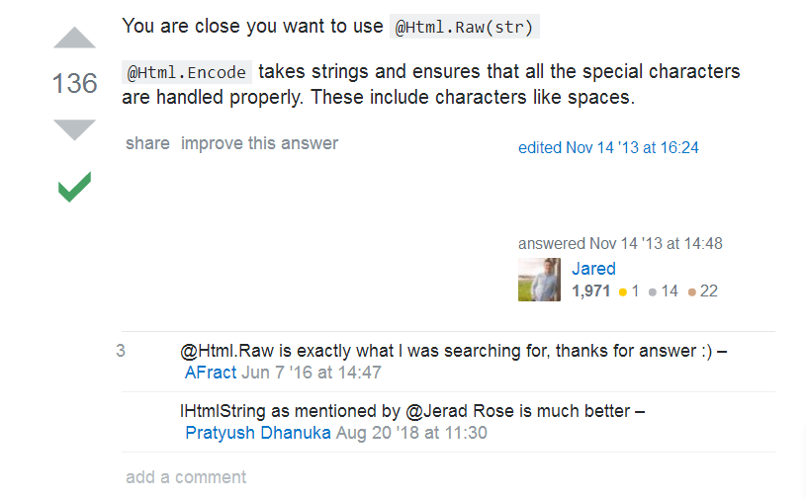
Positive simples

Slide 13
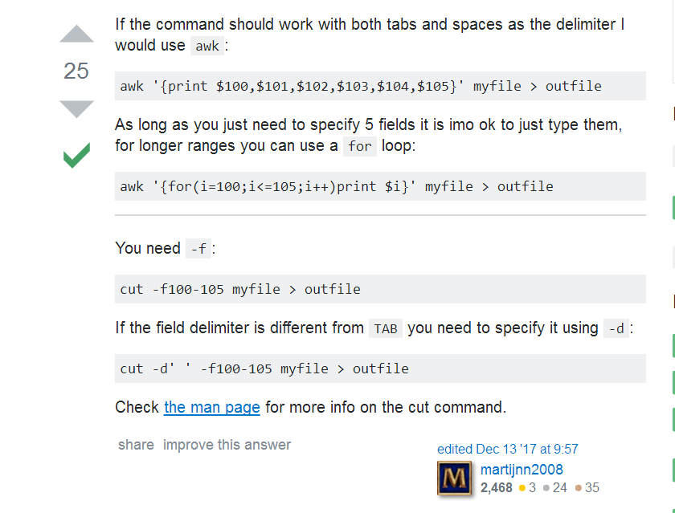
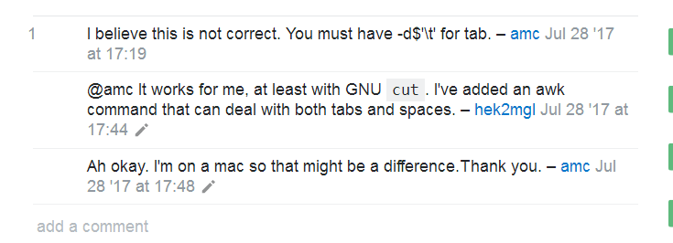
Positive simples

Slide 14
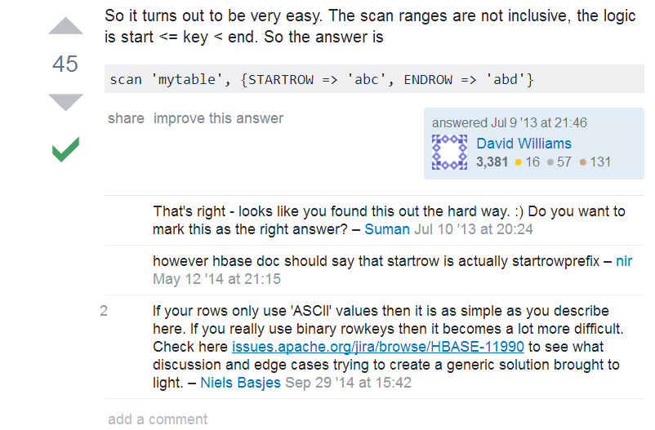
Positive simples

Slide 15
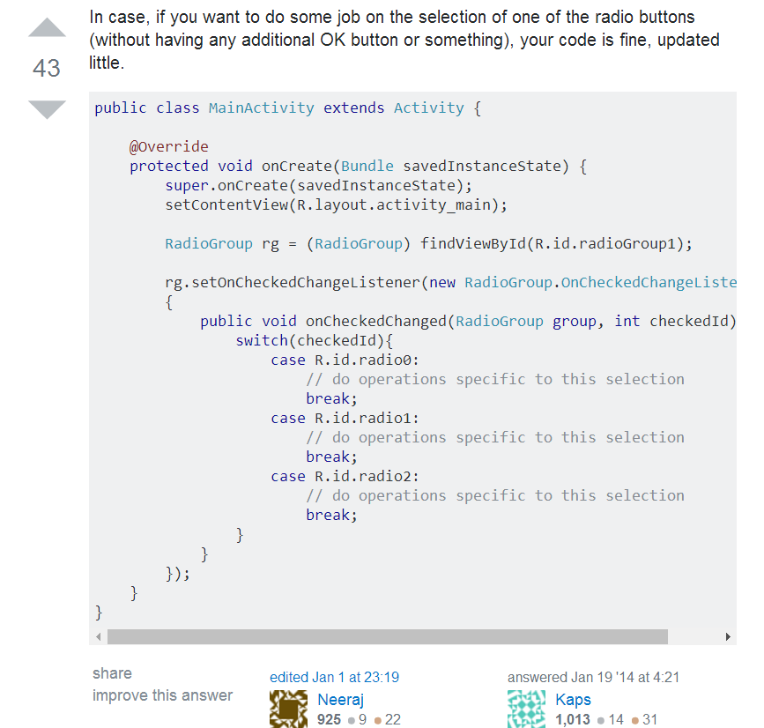
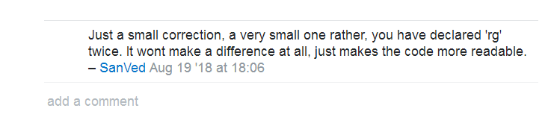
Positive simples

Slide 16
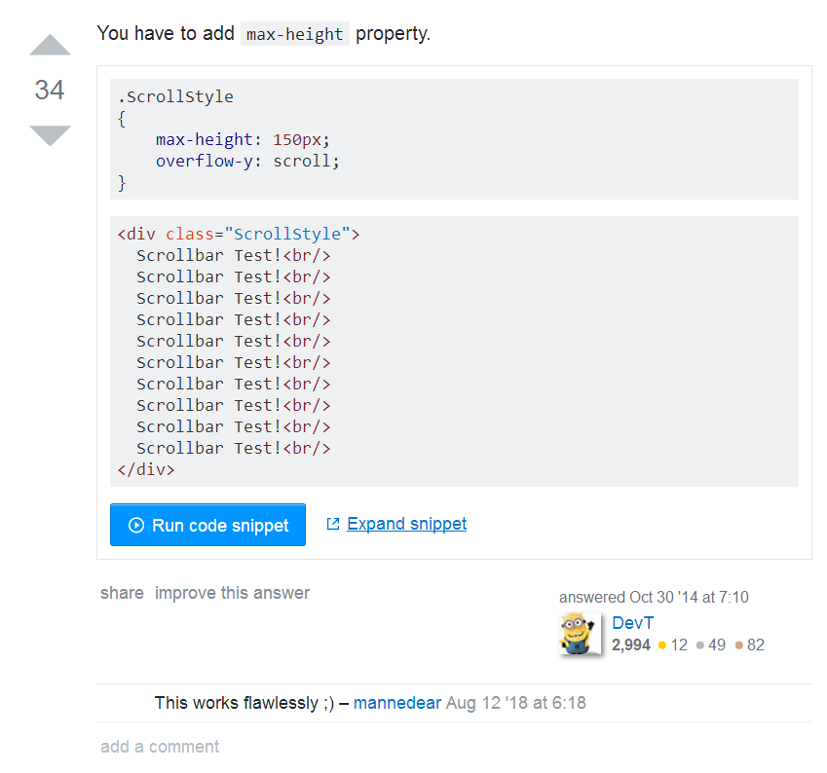
Positive simples

Slide 17
Model choice
FastText
Fast learning speed
FastText is suitable for cases where the classification categories are very large and the data sets are large enough. It is easy to overfit when the classification categories are small or the data sets are small.
Text-CNN
The learning speed is faster than RNN
Language continuity is ignored
Text-RNN
Slow
The principle is easy to understand

