Slide 1
Weekly Work
Shencz Guosj-20190502

Slide 2
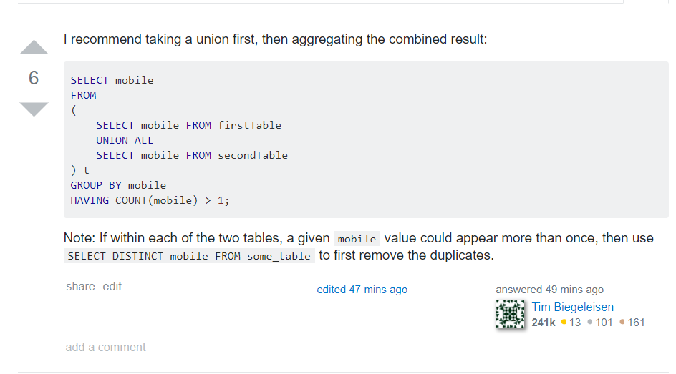

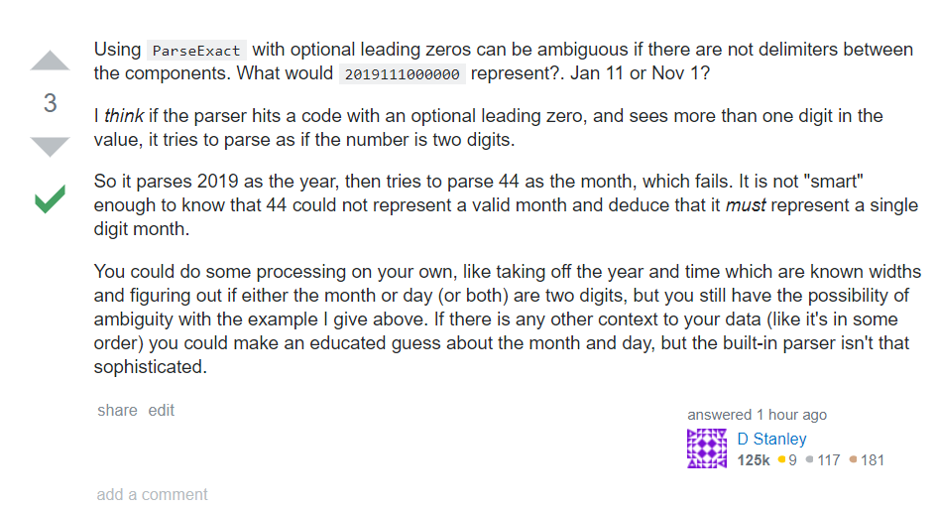
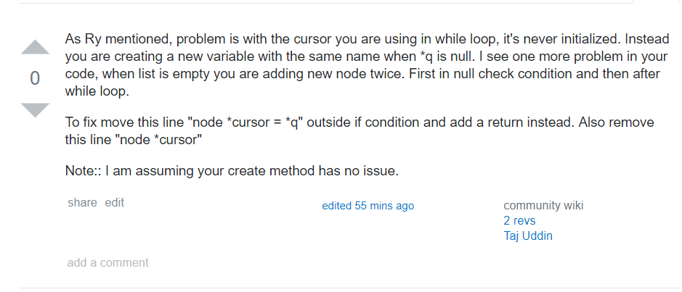



Slide 3
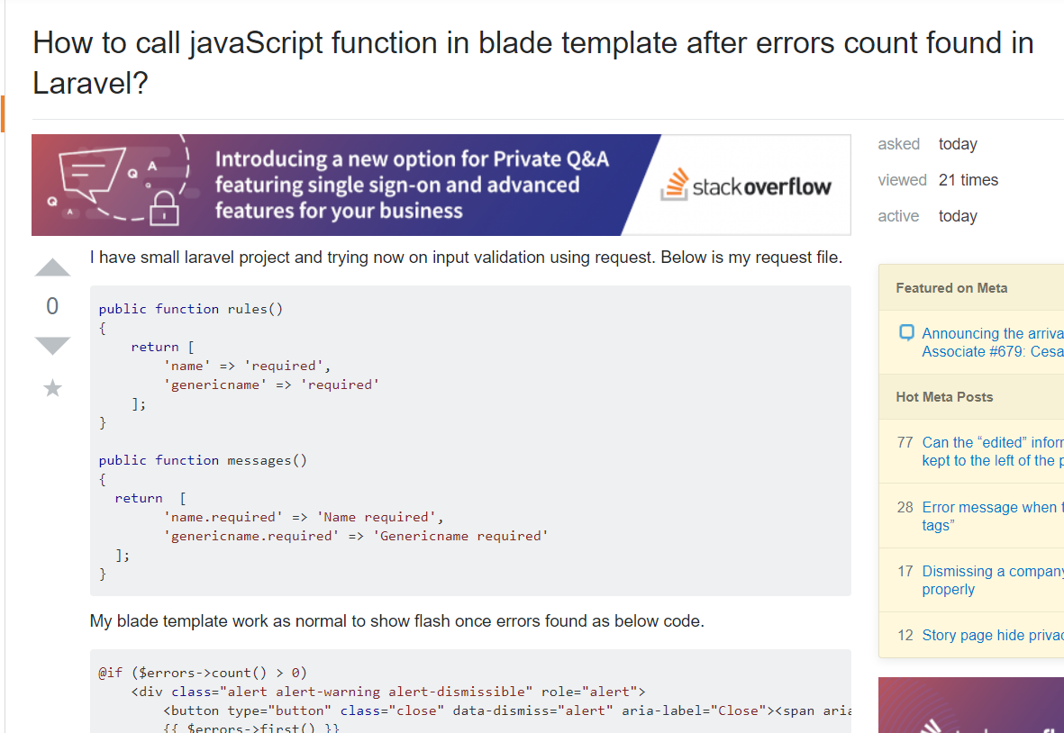
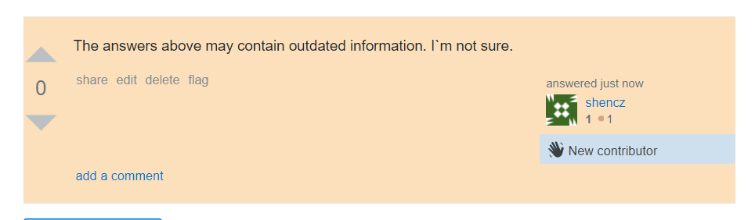
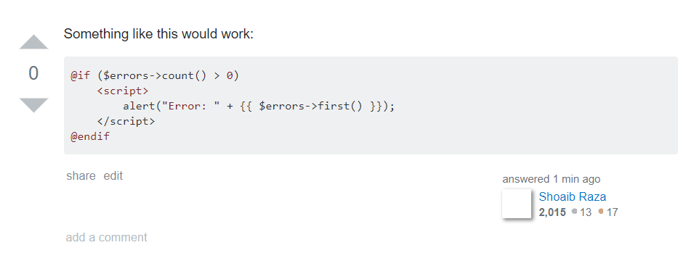
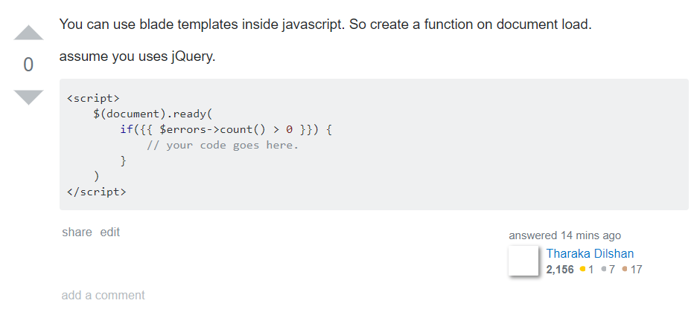



Slide 4
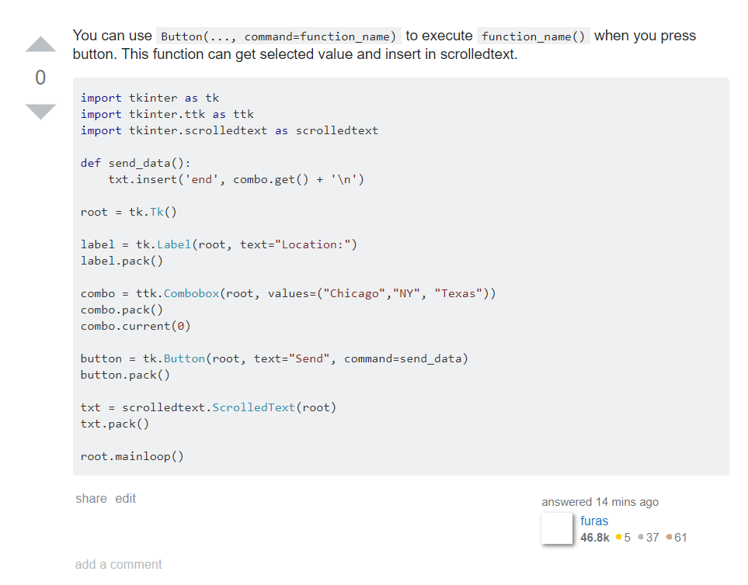

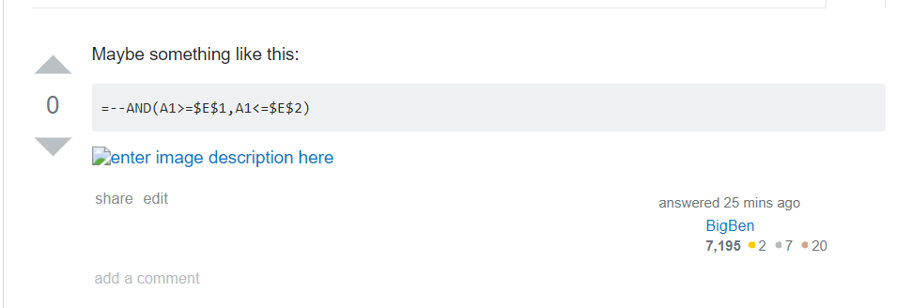


Slide 5
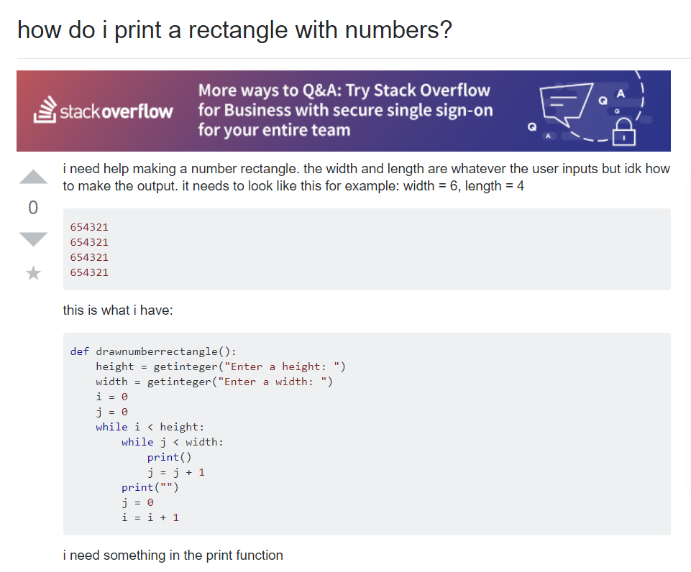
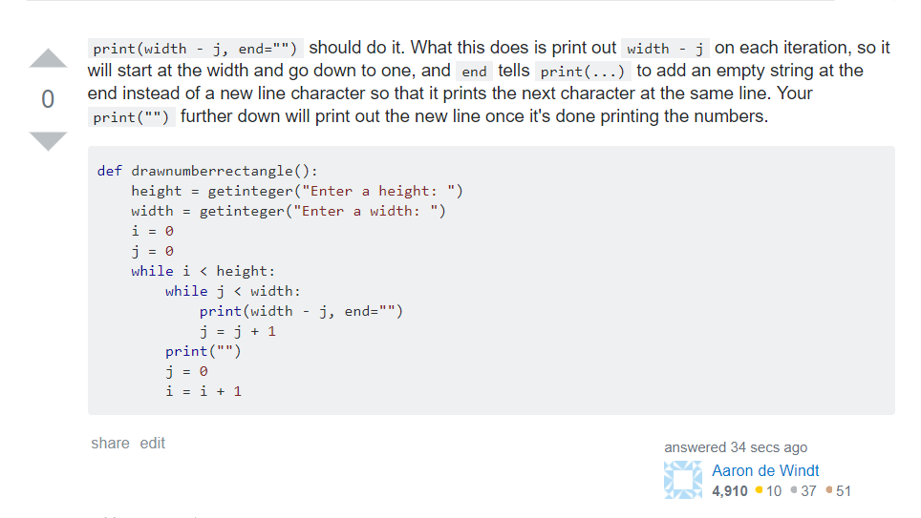

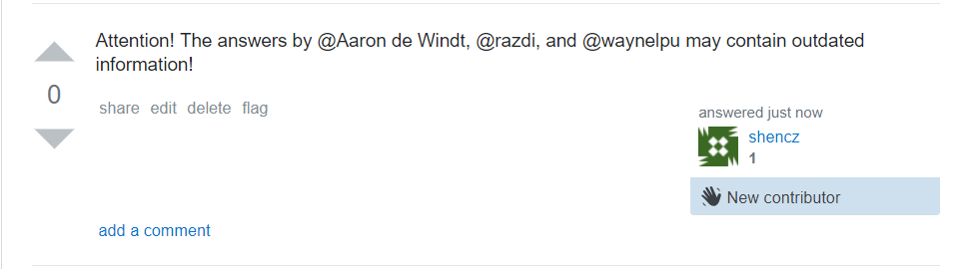
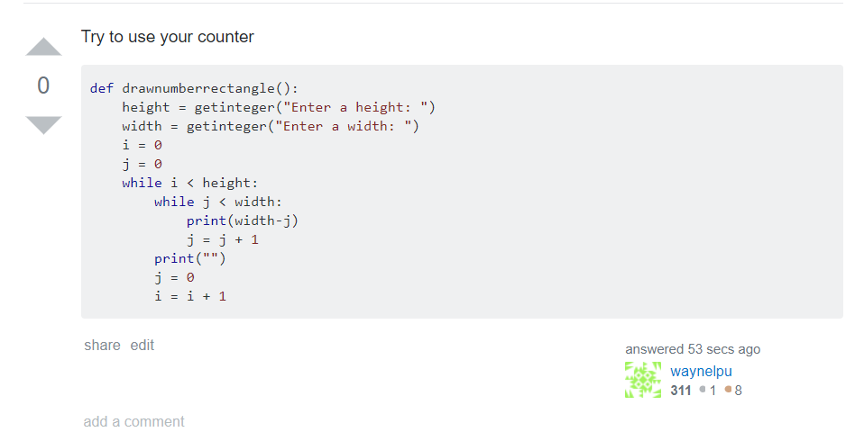

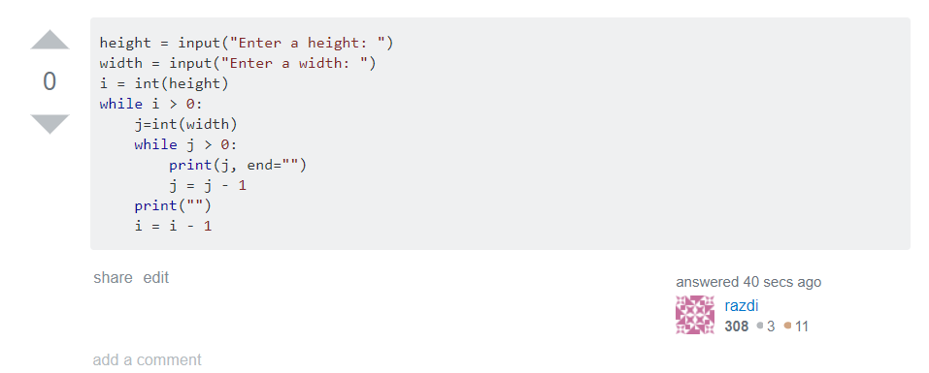


Slide 6
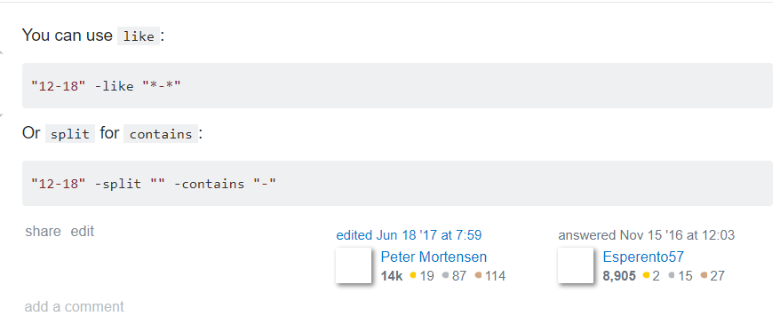

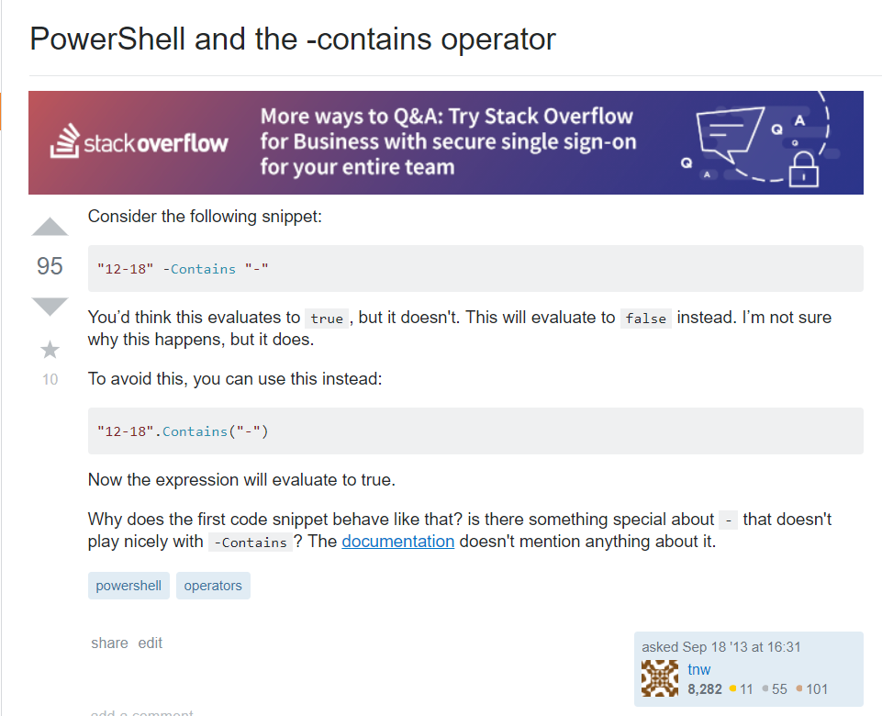
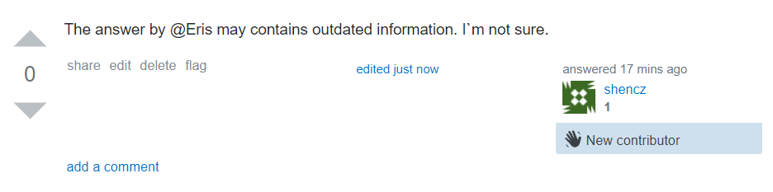
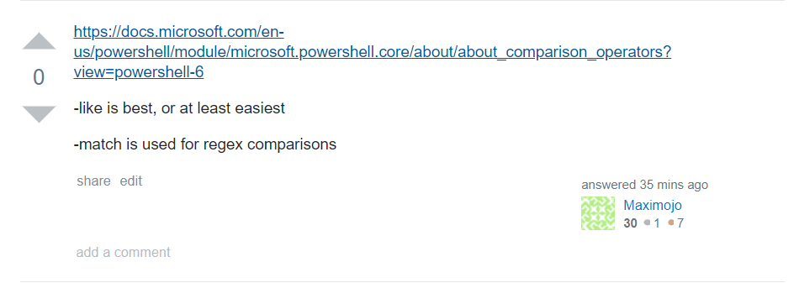

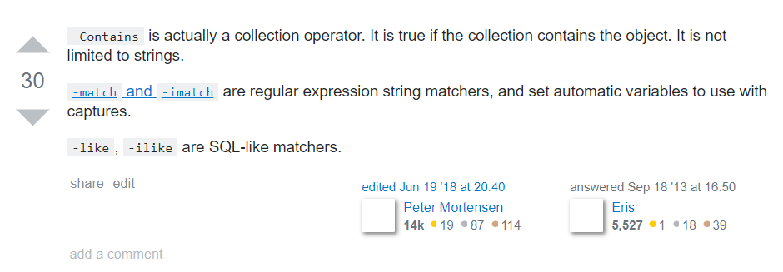

18877580

Slide 7
Thinking about bad data
1. No technology, just discuss or a wide range of describe
1 0with xcode 4.6 i was also getting this problem. i installed the command line tools which made gcc available in /usr/bin/gcc. i managed to get it to work using: rvm install 1.9.3 --with-gcc=gcc nb. i dont have homebrew installed.
1 0 i resolved this issue by run ie 11 as administrator.
1 0 try adding host param mongorestore --host=127.0.0.1 --port=27133 dump
1 0 lauch the sdk manager and download the new package android sdk build-tools which didn't get installed automaticaly when you update to adt 22
0 1 i ran into a similar problem, npm cache clean solved it.
0 1 you should let visual studio itself tell you why it needs to rebuild. **visual studio 2015** has built in support for this: - tools (menu) - options - project and solution - build and run change msbuild project build output verbosity to **detailed** or diagnostics. *to get this information in other visual studio versions, you need to use debugview and modify `devenv.exe.config` (see colin smith's answer: http://stackoverflow.com/a/21759835/1941779). note that this solution does not work for visual studio 2015.*

Slide 8
Thinking about bad data
2. Too long sentence and too long code
0 1 use `angularfire` if you want explicit sync, i.e. any changes made to your model will instantly propagate to all other clients (and vice versa). use `angularfirecollection` if you want to be in control of when any local data changes must be sent to the server. any remote changes will still automatically update your local collection. implicit sync: <!-- language-all: lang-js --> myapp.controller('myctrl', ['$scope', 'angularfire', function myctrl($scope, angularfire) { var promise = angularfire(url, $scope, 'items', []); } ]); first argument is the location of the firebase at which you want to store/retrieve data. second argument is the scope, third argument is the name of the property under $scope you want the data bound as soon as the promise is fulfilled. for example: promise.then(function() { // data available in $scope.items }); fourth argument is the type of data you want in your js object. use `[]` for arrays, `{}` for objects, `""` for strings, `1` for numbers and `true` for boolean. note that if no data is present in the provided firebase location you can also use this argument to set the default value. in implicit sync if you want to make any changes, simply modify `$scope.items` and the change will automatically synchronize with all other clients via firebase. similarly, any changes made remotely will automatically update `$scope.items`. explicit sync: myapp.controller('myctrl', ['$scope', 'angularfirecollection', function myctrl($scope, angularfirecollection) { $scope.items = angularfirecollection(url); } ]); this method only takes one argument. if you want to add or remove items, use the `add`, `remove` or `update` methods. for example: $scope.items.add({test: "object"}); since `angularfirecollection` does not require a scope, you can also use this if you want to use firebase outside of a controller (like angular directives, modules, etc.) hope this helps!

Slide 9
Thinking about bad data
3.The method itself is not targeted or too short to contain useful information
0 1 git alias pushall "git remote | xargs -l 1 git push" git pushall
0 1 add scrolling="no" attribute to the iframe.
0 1 board[3][3] = {{8, 7, 6}, {5, 4, 3}, {2, 1, 0}}; must be: int board[3][3] = {{8, 7, 6}, {5, 4, 3}, {2, 1, 0}};
0 1 change the wrap_content to fill_parent in the scrollview height attribute.
1 0 you need to initialize it first: p = pump().getpumps()
1 0 open cmd run this sqlcmd -l you will get list of sql server instance
4. hyperlink

Slide 10
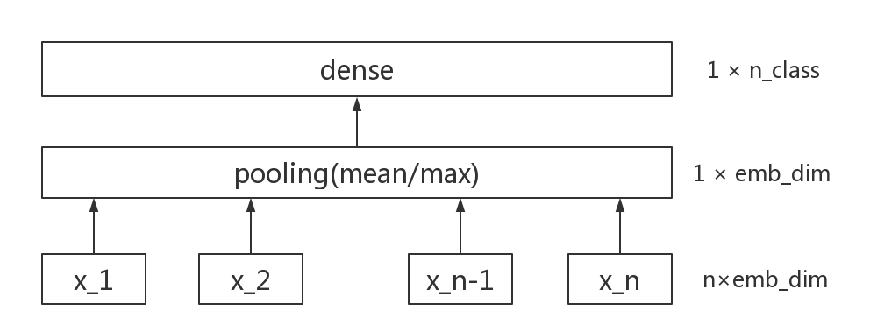

Slide 11
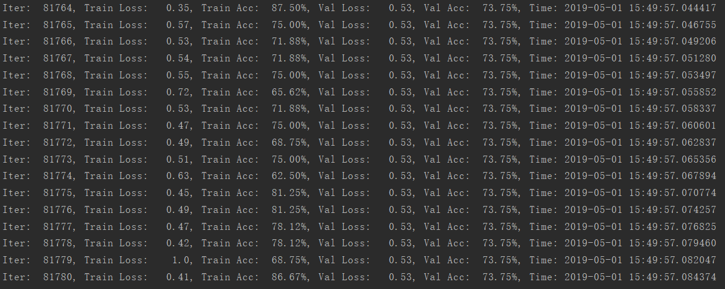

Slide 12
RNN-gru
Embedding_dim: 300
Hidden_size: 128
Dropout_keep_prob: 0.5
L2_reg_lambda: 3.0
Batch_size: 64
Num_epochs: 100
Learning_rate: 1e-3
accuracy rate: 86.2%

Slide 13
Question
Feature visualize
hyperlink

