Slide 1
Weekly word
20190516

Slide 2
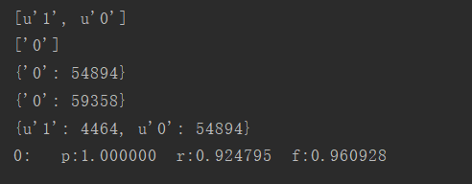

fasttext
rnn

Slide 3
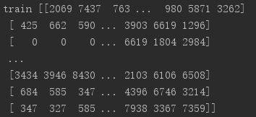
Fasttext model data process
1.Build vocabulary set
2.map every word in vocabulary to id
2.for every post, map word to id
3.create bi-gram set
4.add bi-gram to every post
5. pad sequences for 300
There are 109021 samples in total.
min length for 7 and max length for 57277
0.9 data for train and 0.1 for test

Slide 4
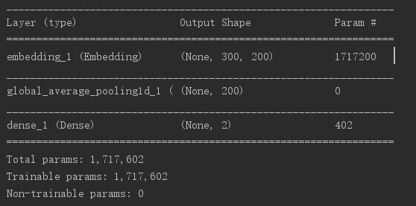
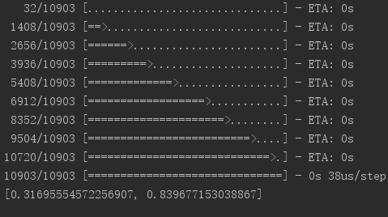
Fasttext model architecture
Input data shape: samples, 300
Embedding layer: vocab_size, 200
input : samples X 300
output: (samples X300X200)
GlobalAveragePooling1D:
Input: samples X300X200
Output: samples X 200
Dense(2, activation = ‘softmax’): 200, 2
Input: samples X 200
Output: samples X 2

Slide 5
Problem
How to pad sentences
For each post, we average the word vectors to represent a sentence. This means that the word location information is lost. Even backtracking we can't locate key phrases
Solution by myself:
Add attention mechanism

Slide 6
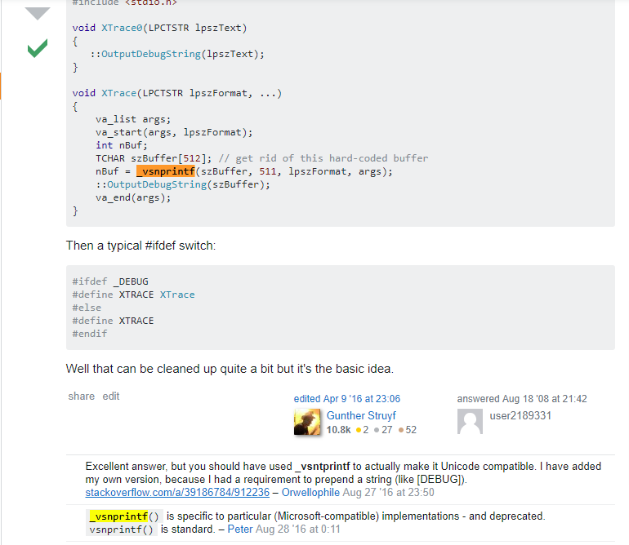
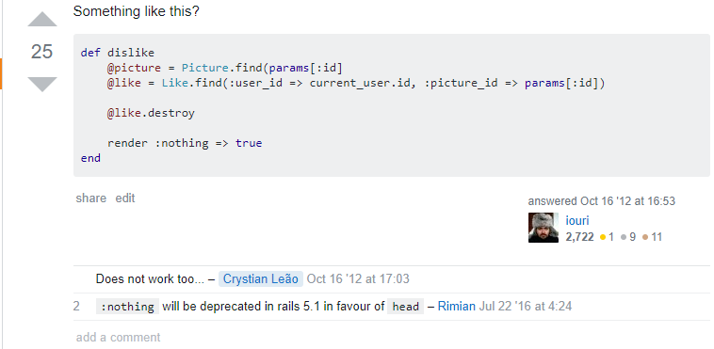
1. Some methods or functionality are out of date in code and make a statement in the comments

Slide 7
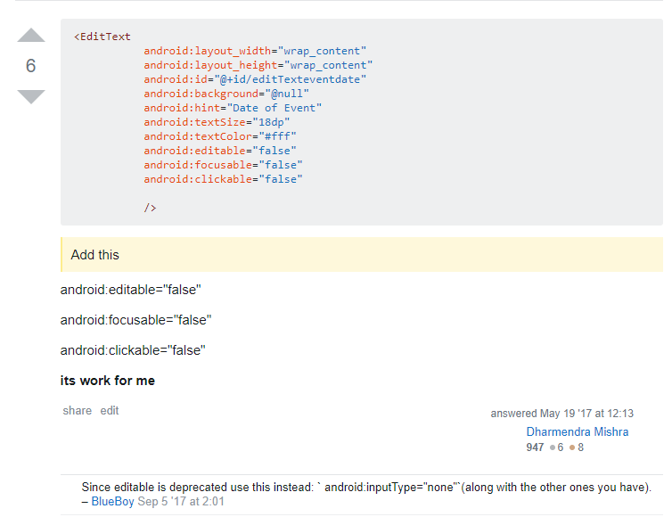
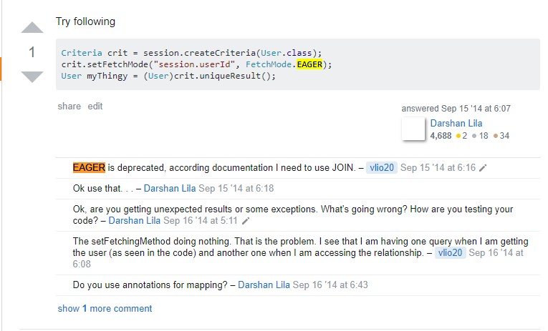
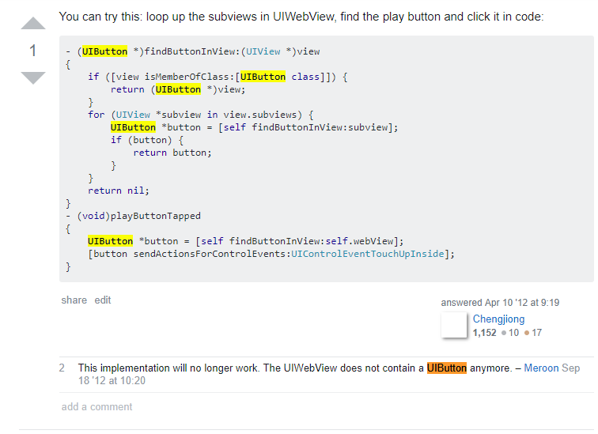
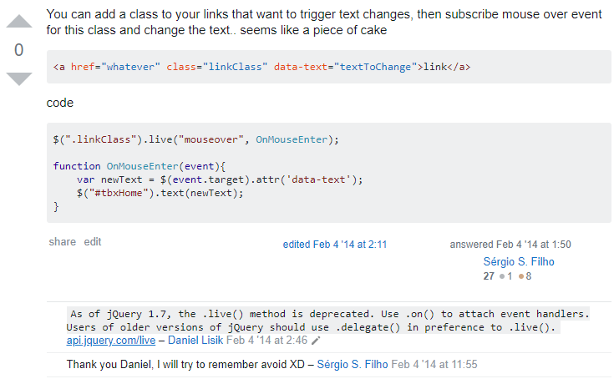

Slide 8
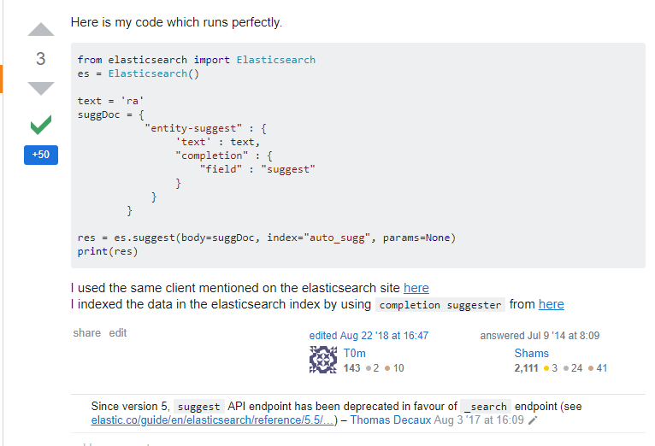
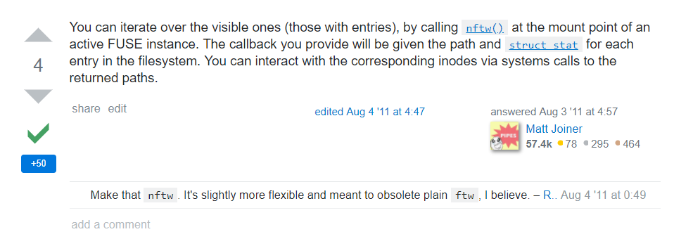
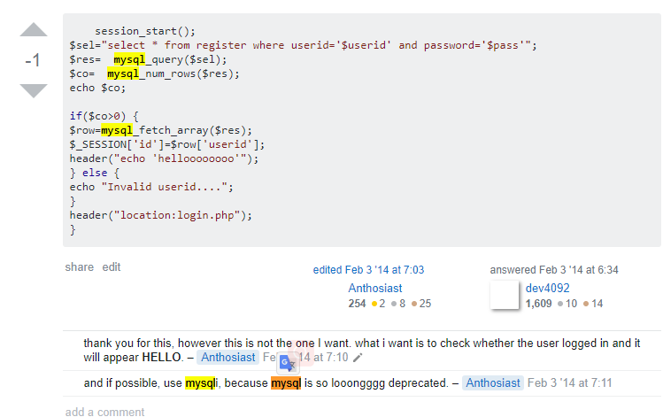
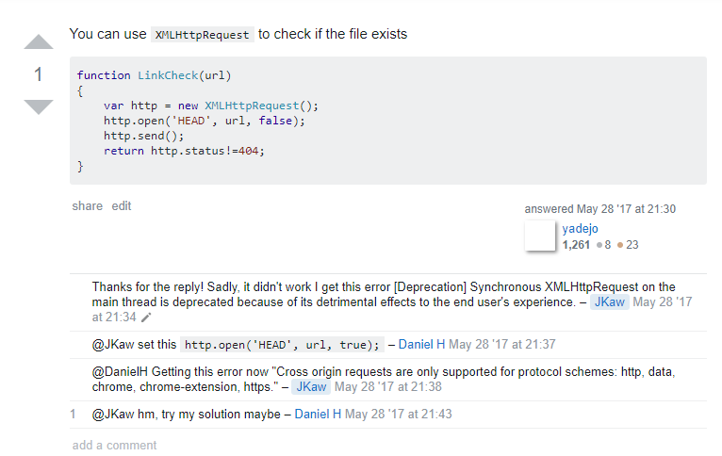

Slide 9
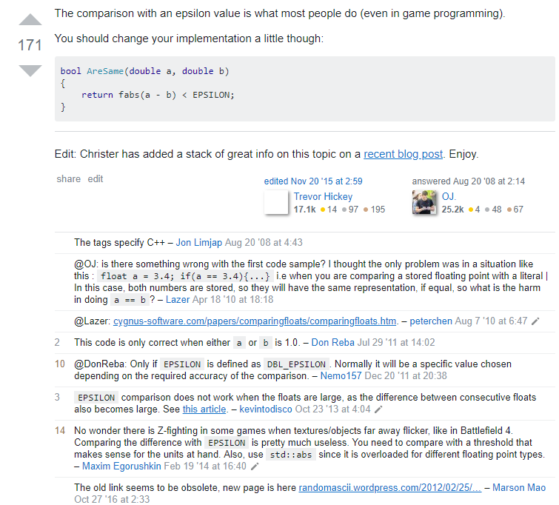
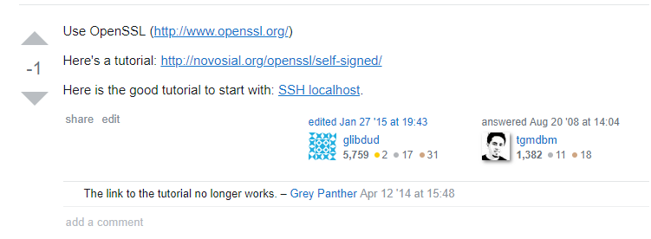
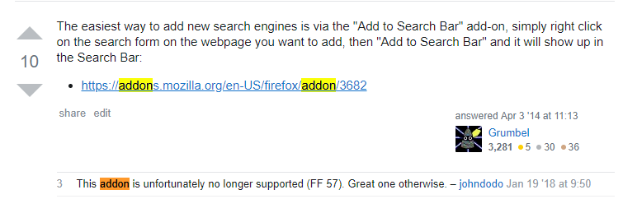
2.Some reference or Link obsolete

Slide 10
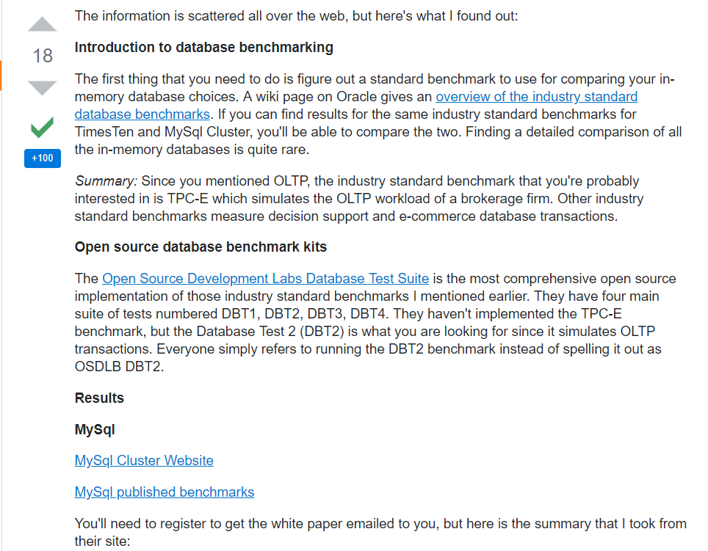
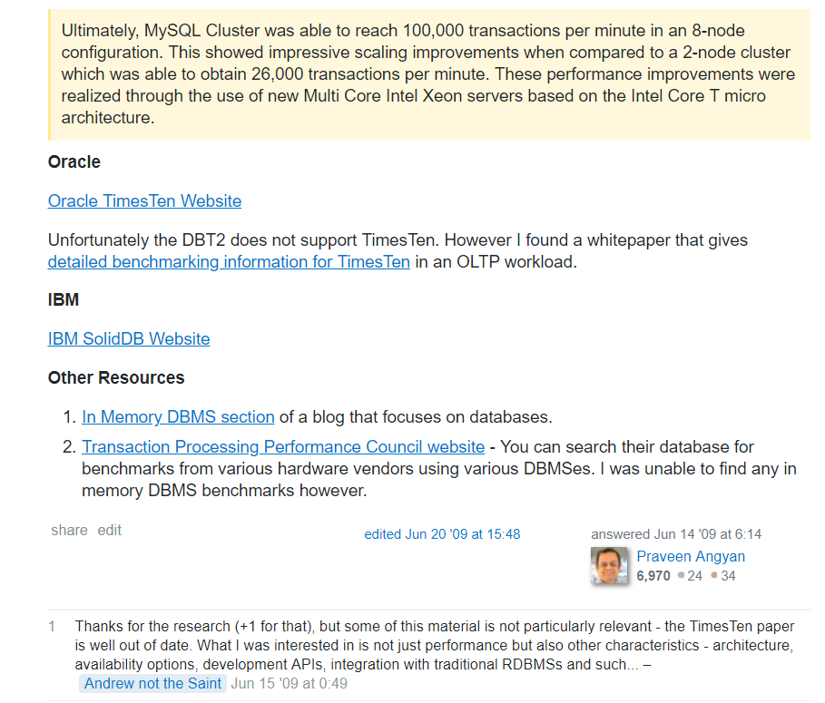

Slide 11
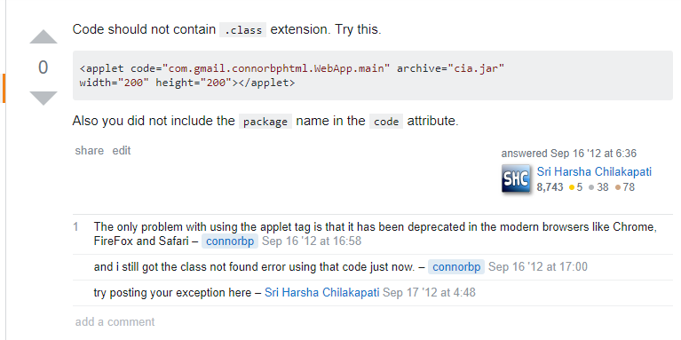
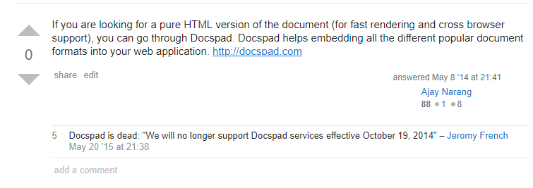
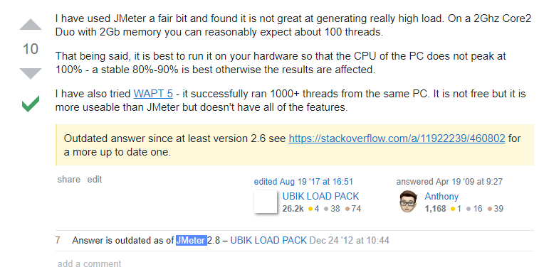
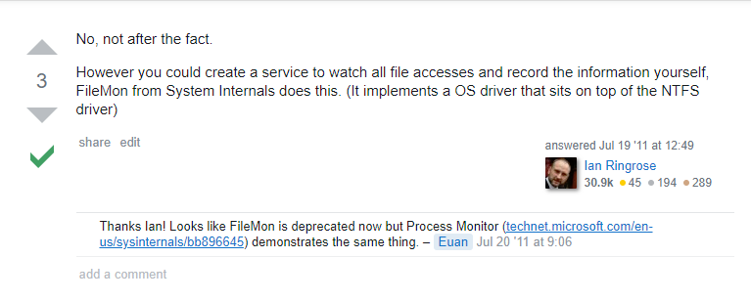
3. Some tool obsolete

Slide 12
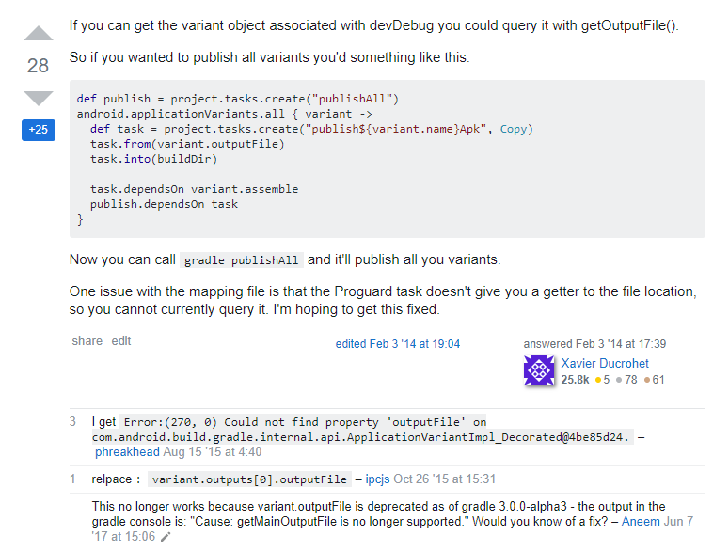
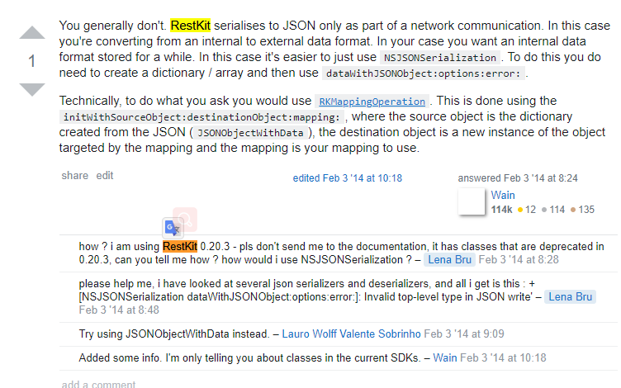

Slide 13
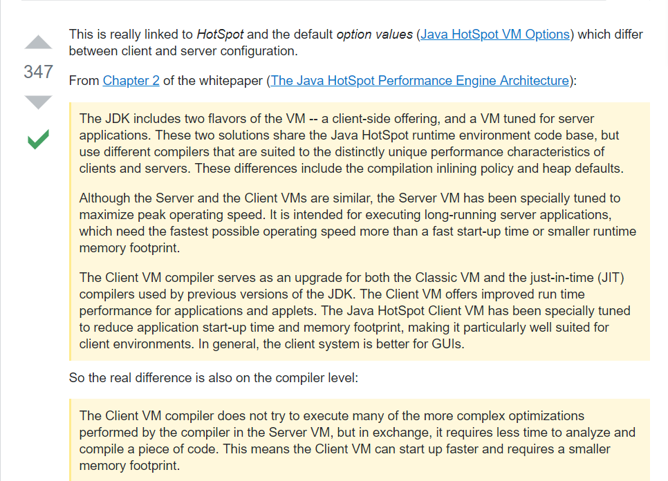
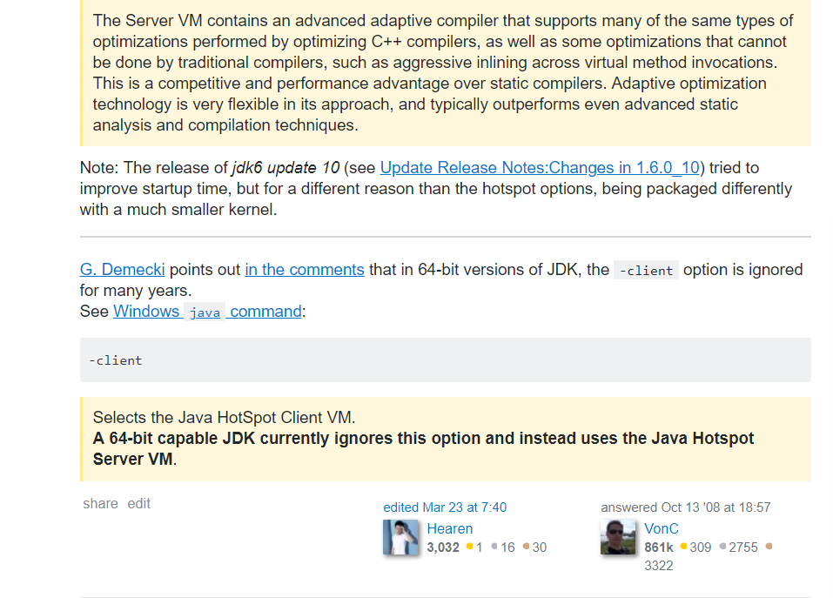
4.Programming Language features obsolete

Slide 14
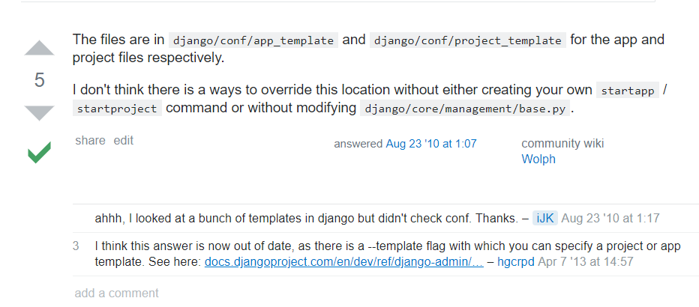
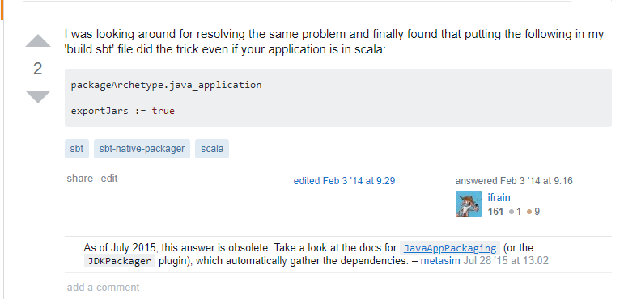
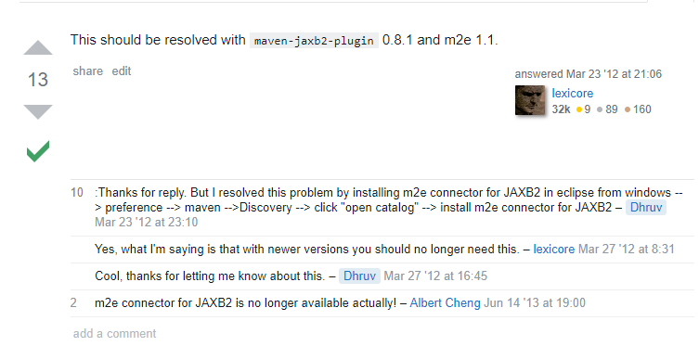
5.Framework method outdated

Slide 15
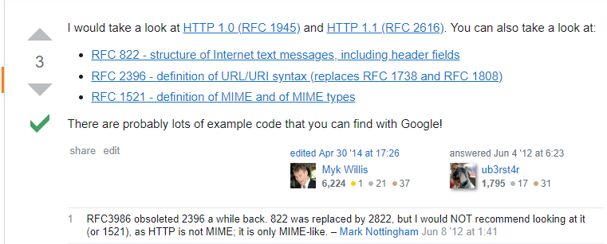
6.Protocol outdated

Slide 16
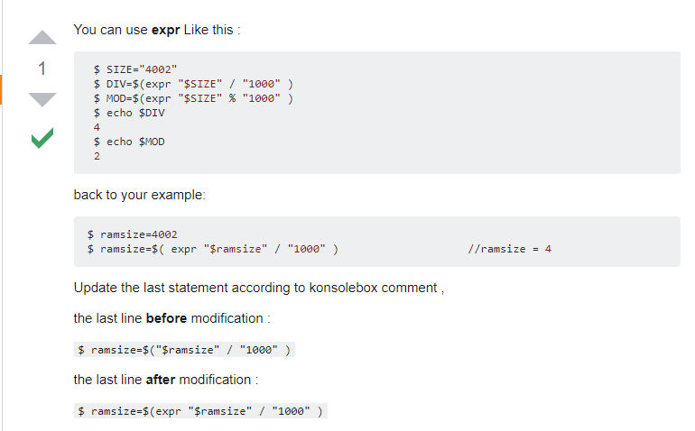
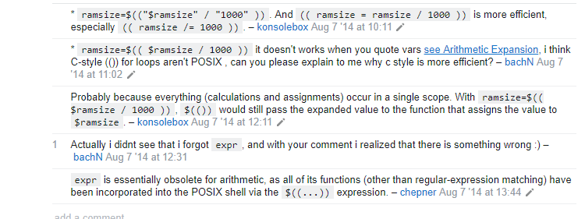
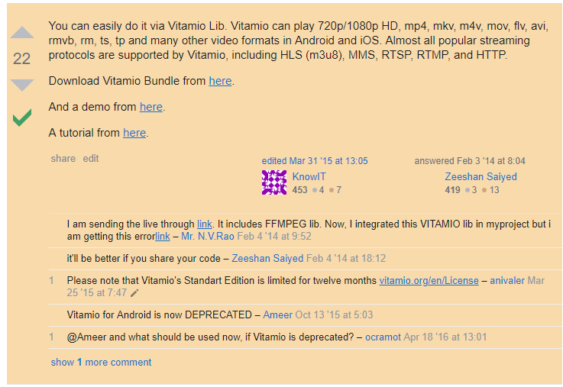
7 os platform caused obsolete

