Slide 1
Weekly work
shencz

Slide 2
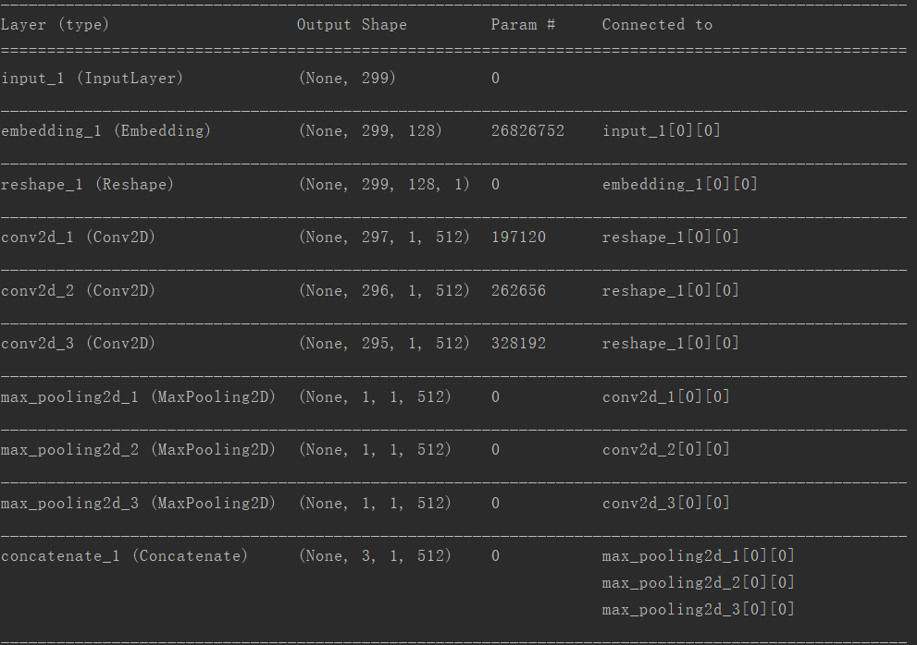
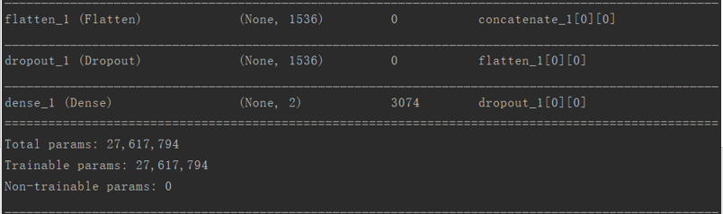
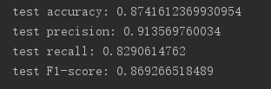

Slide 3
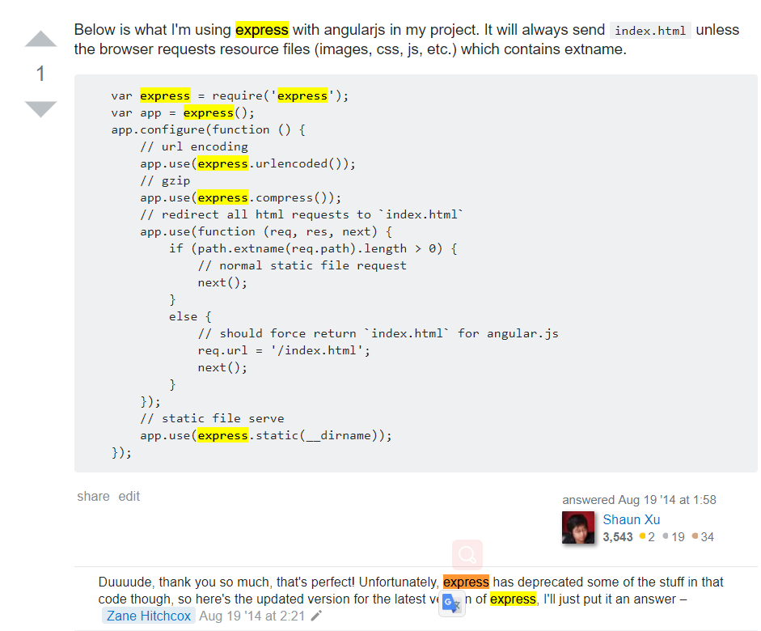
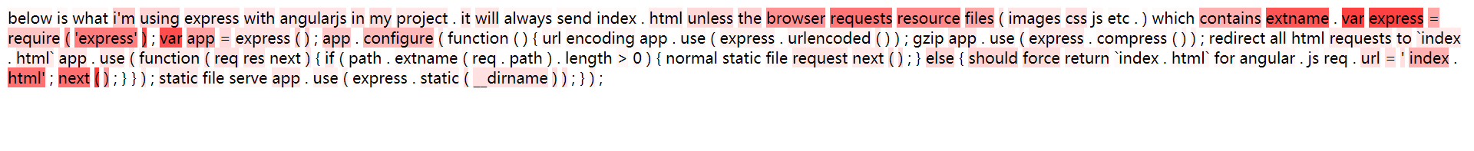

Slide 4
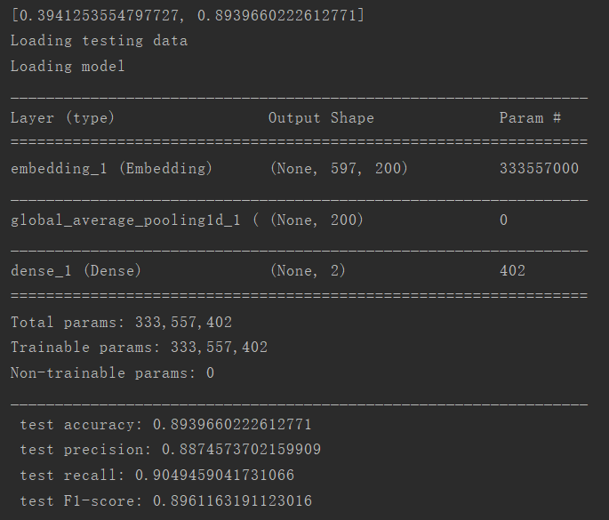

Slide 5
Assume one:
Get embedding layer output as word vector
Get Average Pooling layer output as sentence vector
For each word, get the cosine similarity to the sentence vector
Calculated by softmax function for the list of cosine similarity
Normalize to get the weight for each word

Slide 6
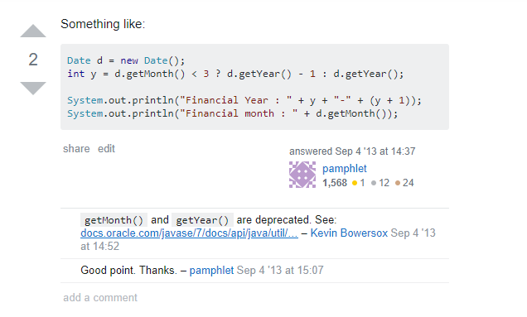

Slide 7
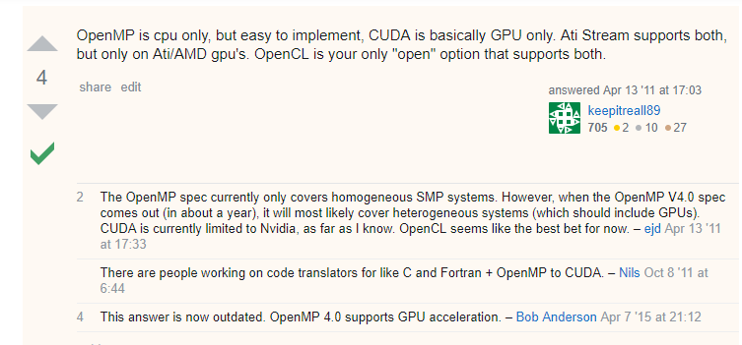

Slide 8
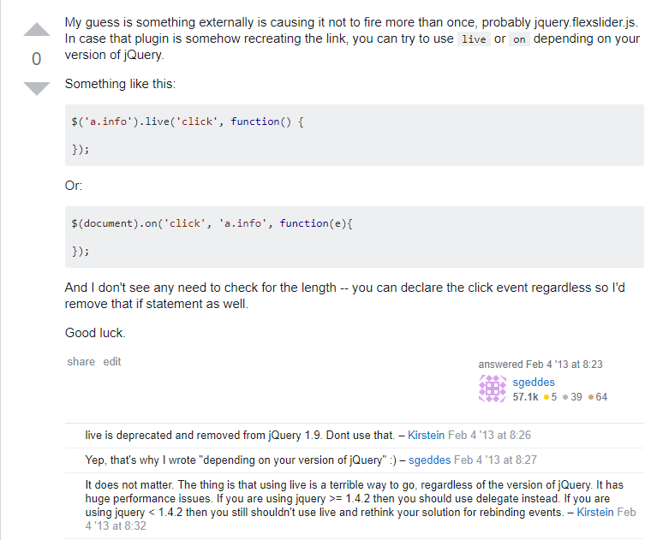

Slide 9
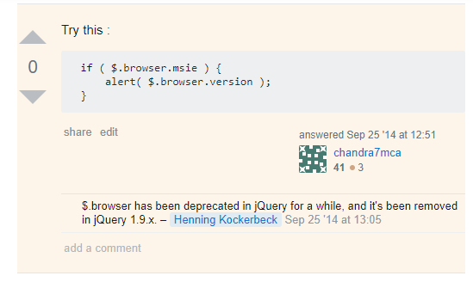


Slide 10
Assume two:
Get the weight for each nerve of the dense layer(200, 1)
For each dimension of a word, calculate the dimension value multiplied by the weight, and then calculate the sum as the weight of the word
Normalize to get the weight for each word

Slide 11
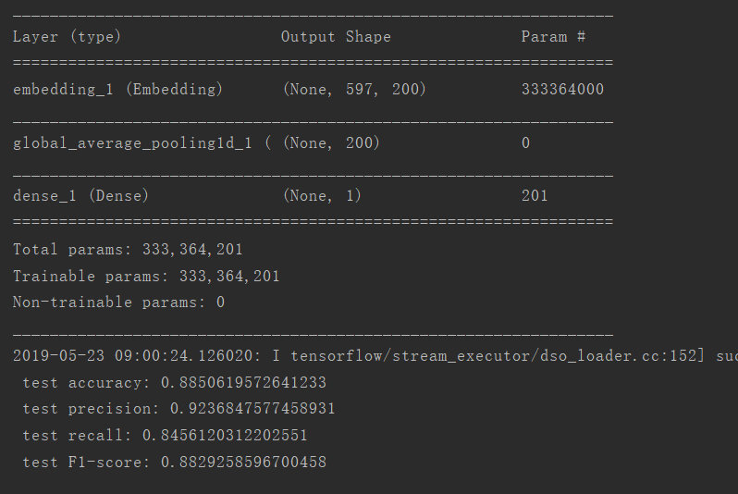

Slide 14
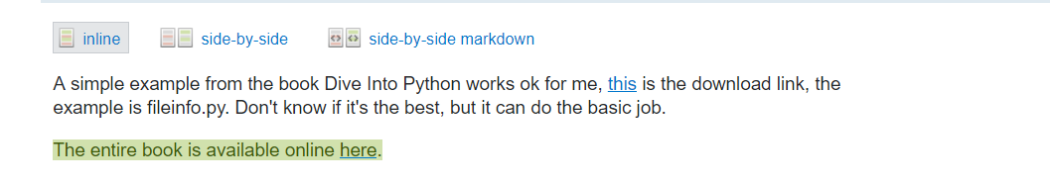
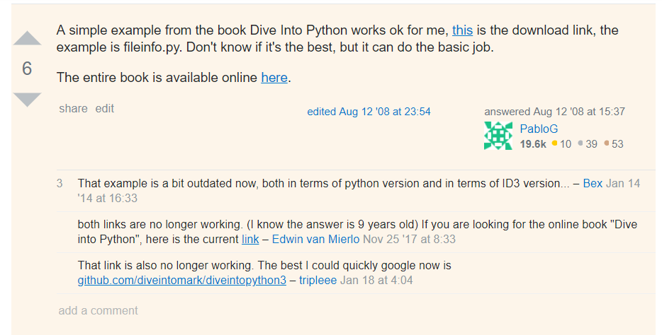

Slide 15
