Slide 1

Weekly Work
shencz
20190606

Slide 2
Visualization test
Part 1

Slide 3
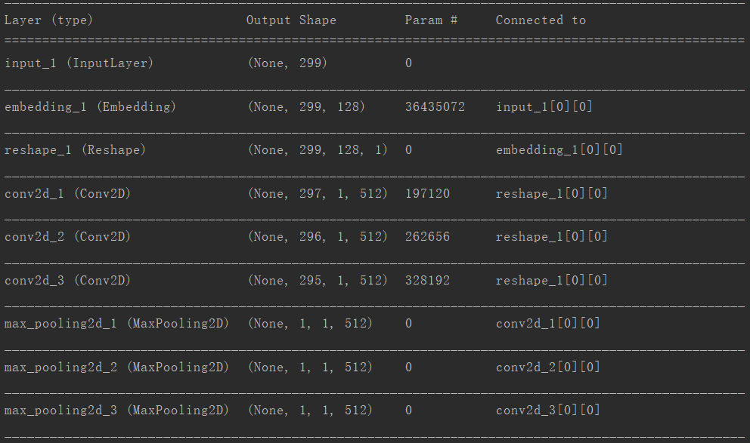
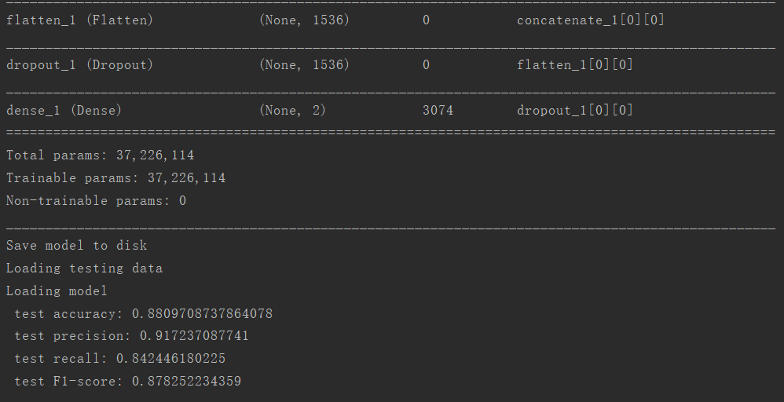
CNN

Slide 4
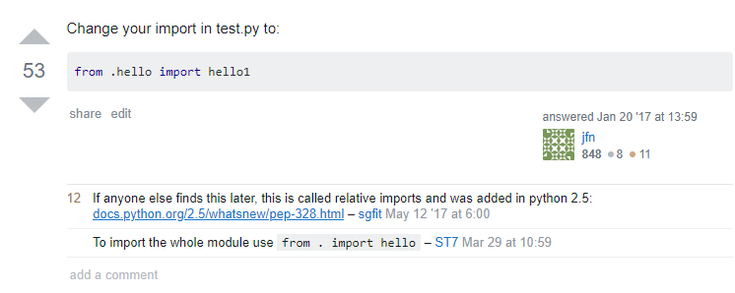
y=0 y_pred=1

Slide 5
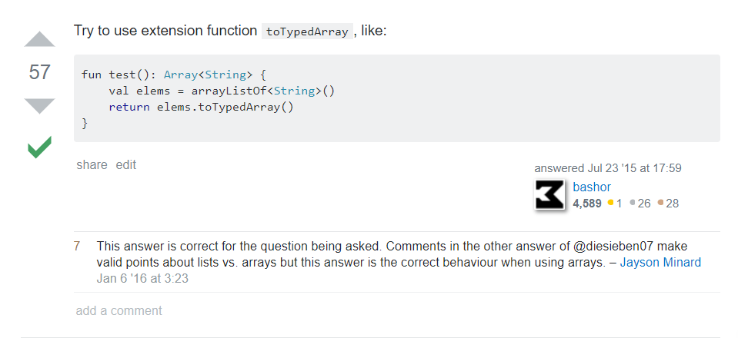
y=0 y_pred=1

Slide 6
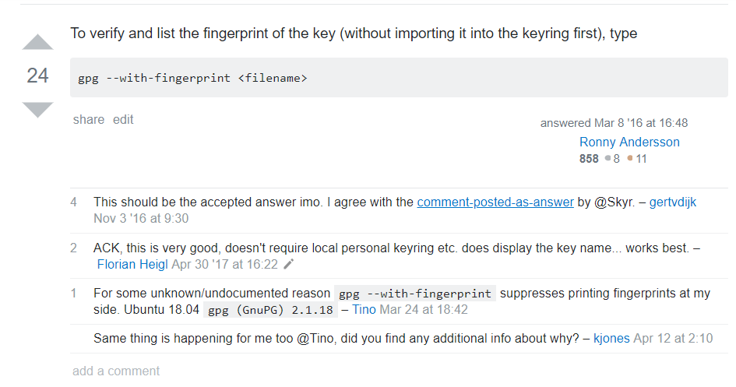
y=0 y_pred=1

Slide 7
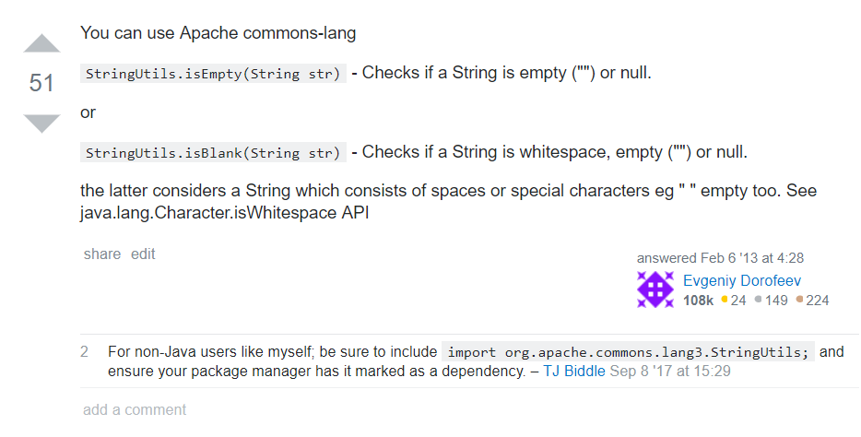
y=0 y_pred=1

Slide 8
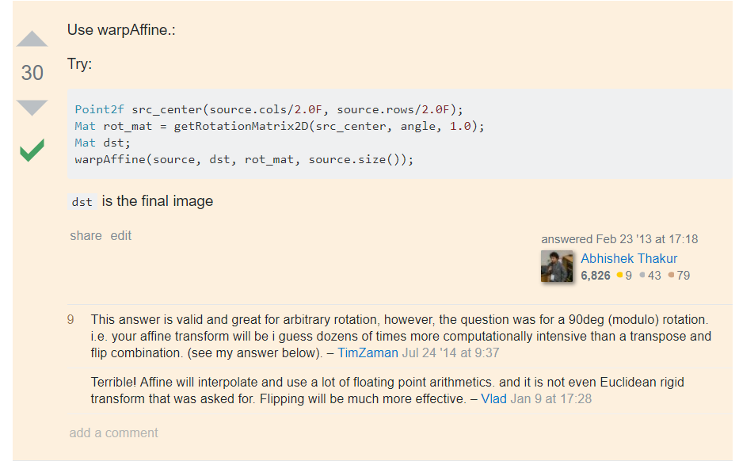
y=0 y_pred=1

Slide 9
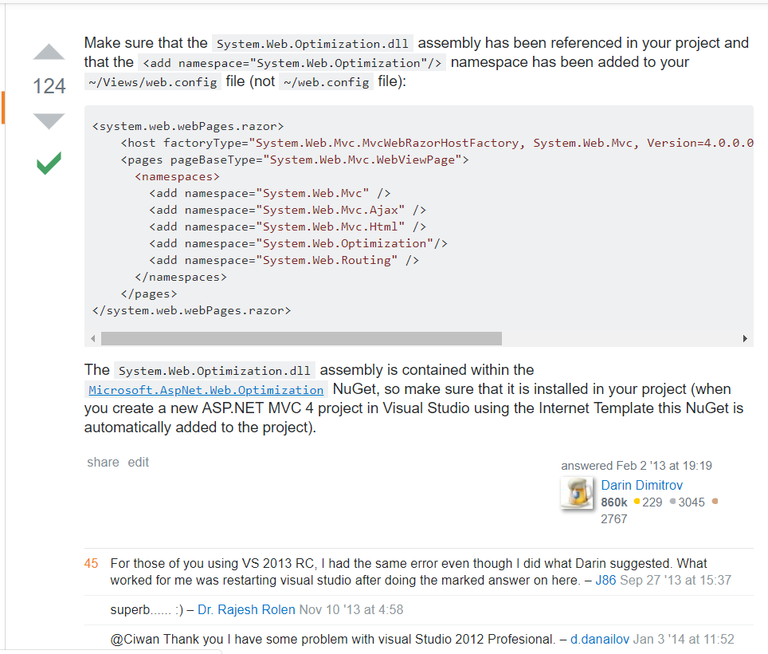
y=0 y_pred=1

Slide 10
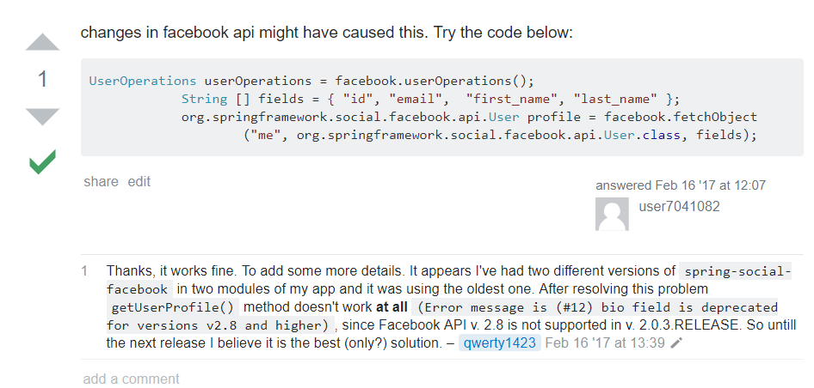
y=1 y_pred=0

Slide 11
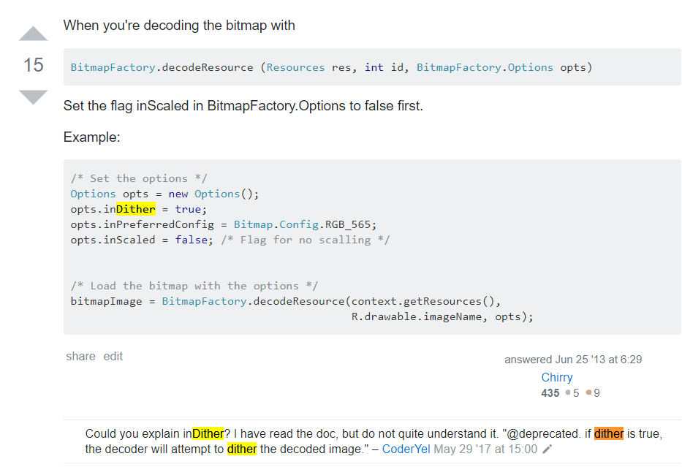
y=1 y_pred=0

Slide 12
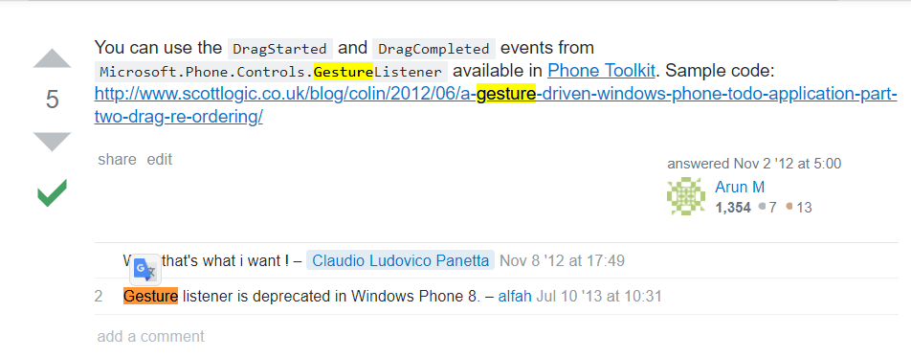
y=1 y_pred=0

Slide 13
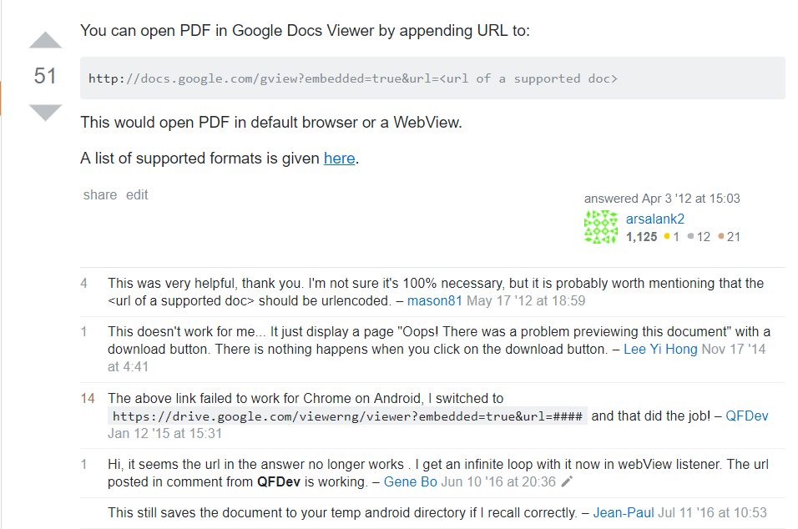
y=1 y_pred=0

Slide 14
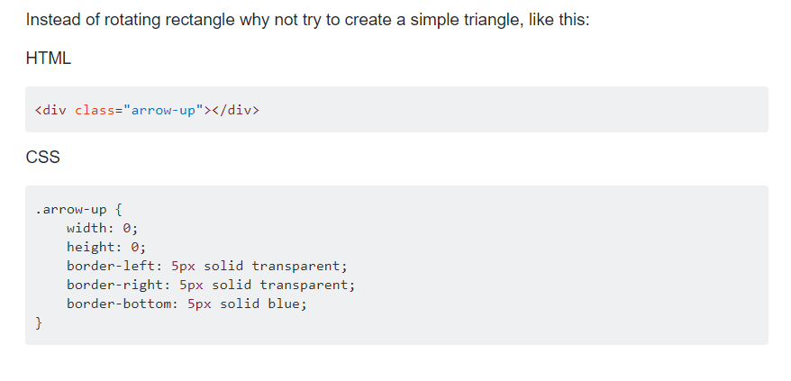
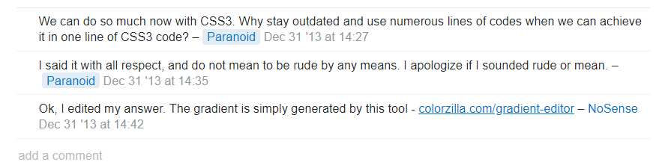
y=1 y_pred=0

Slide 15
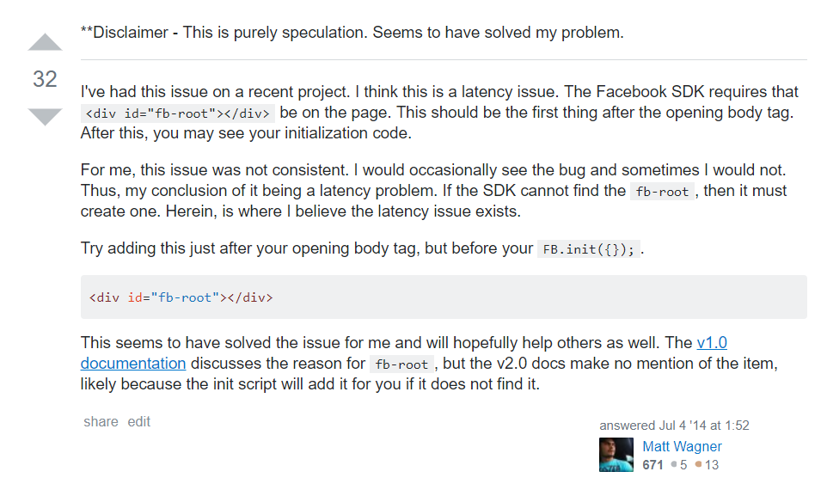
y=0 y_pred=0

Slide 16
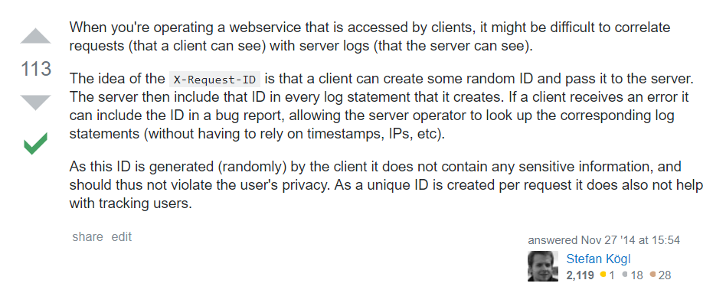
y=0 y_pred=0

Slide 17
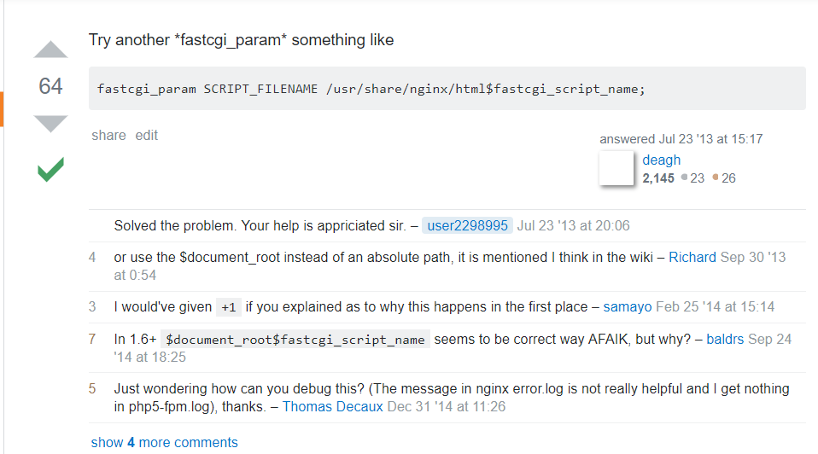
y=0 y_pred=0

Slide 18
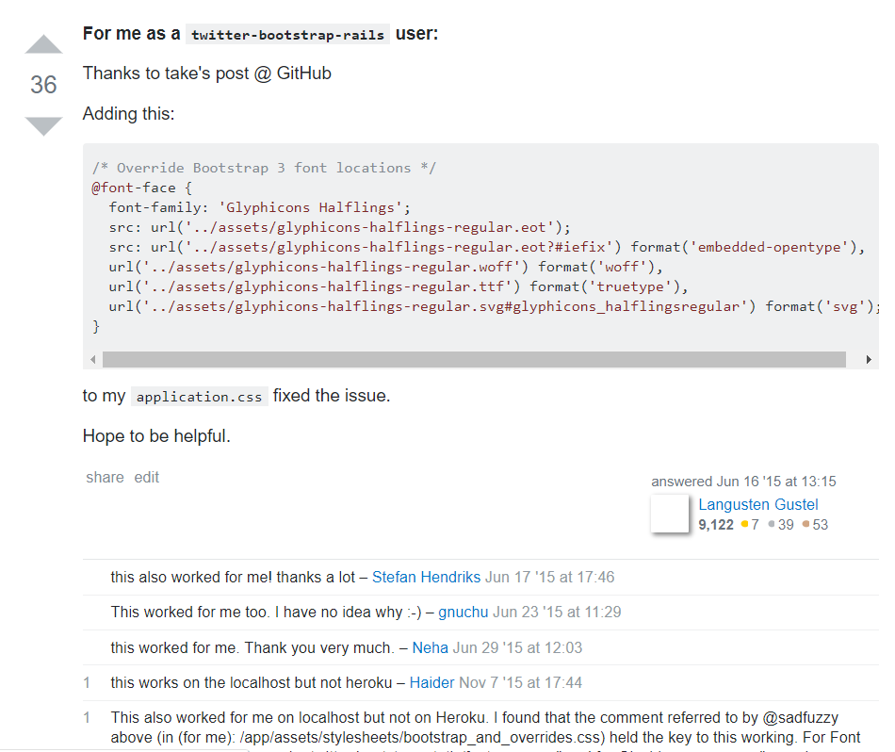
y=0 y_pred=0

Slide 19
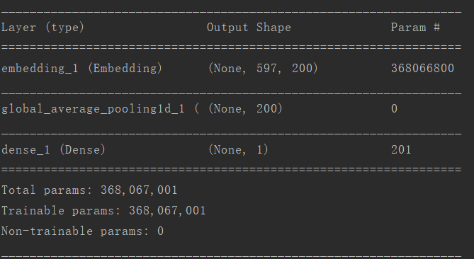
fasttext

Slide 20
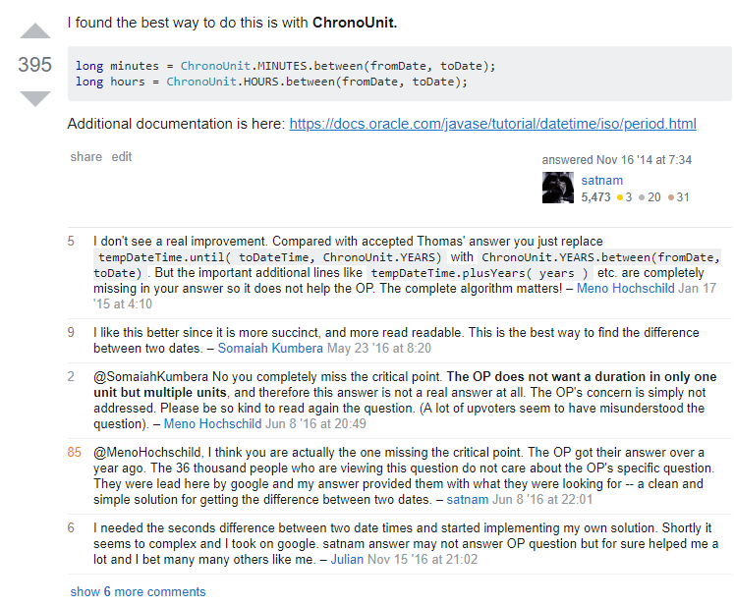
y=0 y_pred=1

Slide 21
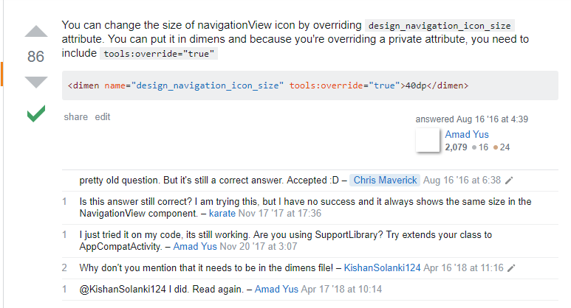
y=0 y_pred=1

Slide 22

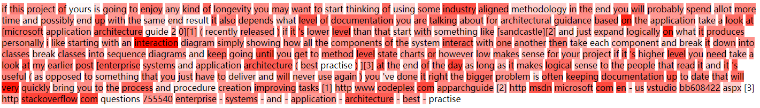
y=1 y_pred=0

Slide 23
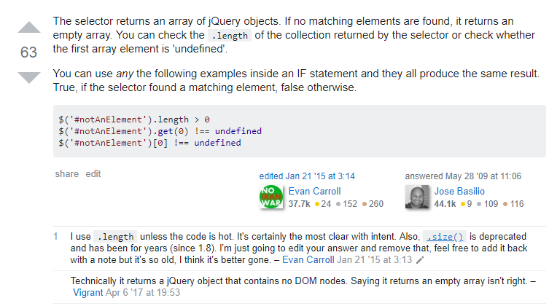
y=1 y_pred=0

Slide 24
Paper reading
Part 2

Slide 25
Paper
contributions
1.We introduce the PIP loss, a novel metric on the dissimilarity between word embeddings;
2. We develop a mathematical framework that reveals a fundamental bias-variance trade-off in dimensionality selection. We explain the existence of an optimal dimensionality, a phenomenon
commonly observed but lacked explanations;
3. We quantify the robustness of embedding algorithms using the exponent parameter , and
establish that many widely used embedding algorithms, including skip-gram and GloVe,
are robust to over-fitting;
4. We propose a mathematically rigorous answer to the open problem of dimensionality selection
by minimizing the PIP loss. We perform this procedure and cross-validate the results
with grid search for LSA, skip-gram Word2Vec and GloVe on an English corpus.

Slide 26

PIP loss
PIP matrix:
PIP loss:
The i-th row of the PIP matrix, can be viewed as the relative position of vi anchored all other vector.

Slide 27
Dimensionality affect
The PIP loss is affected by k, the dimensionality we select for the trained embedding
When dimensionality is too large, too much noise is included, causing the second and third terms to be too large(high variance).

Slide 28
Dimensionality Selection
Simulate the clean signal matrix M = UDV and the noisy signal matrix M = m + Z
Factorizing M and m we can simulate the oracle embedding E = UD` and trained embedding E, in which case the PIP loss between them can be firectly calculated.
For skip-gram, we use the PMI matrix as its signal matrix

Slide 29
Saliency map
Part 3

Slide 30
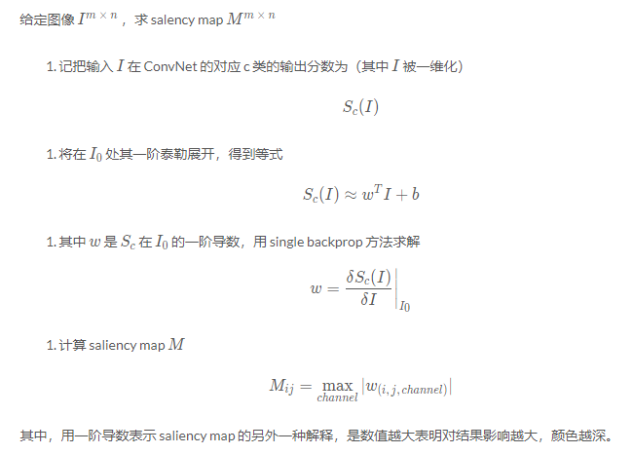
Saliency map
Paper reading :Deep Inside Convolutional Networks: Visualising Image Classification Models and Saliency Maps
The idea is pretty simple. We compute the gradient of output category with respect to input image. This should tell us how output category value changes with respect to a small change in input image pixels. All the positive values in the gradients tell us that a small change to that pixel will increase the output value. Hence, visualizing these gradients, which are the same shape as the image should provide some intuition of attention.

Slide 31
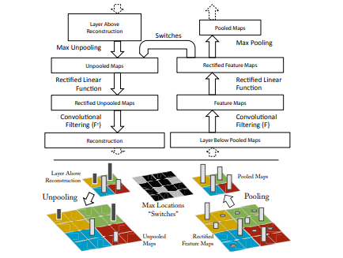
Saliency map
Paper reading :Visualizing and Understanding Convolutional Networks

Slide 32
question
Part 3

Slide 33
question
How to get a quantitative indicator for the approach and it`s accuracy?

Slide 34
谢谢！
汇 报 人：沈椿壮

