Slide 1

Weekly Work
shencz
20190620

Slide 2
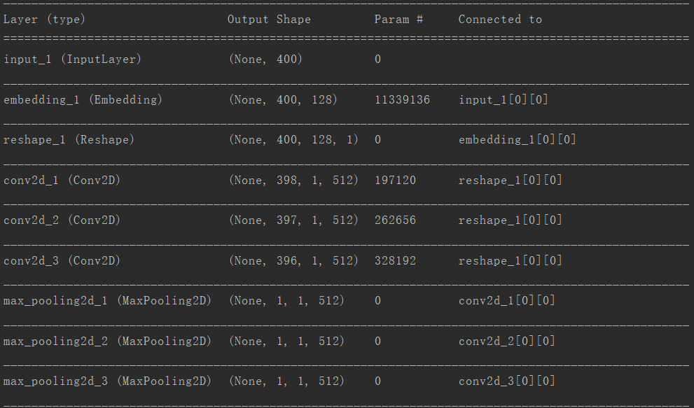
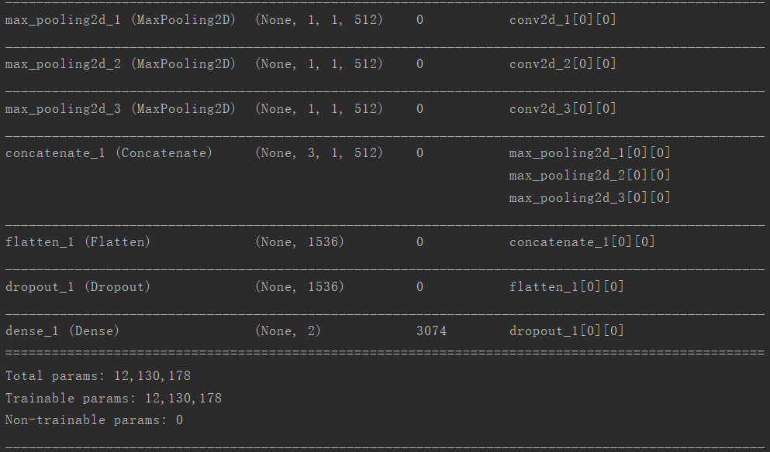
CNN

Slide 3
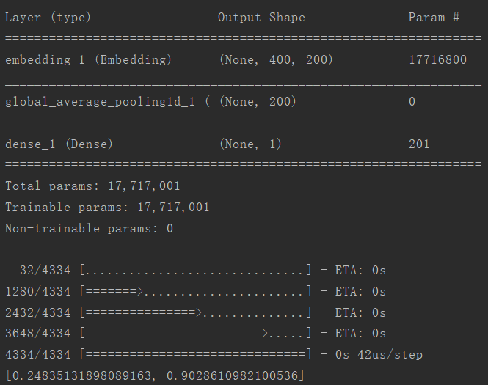
fasttext

Slide 4
postitve
Predict positive

Slide 5
positive
Predict positive

Slide 6
positive
Predict positive

Slide 7
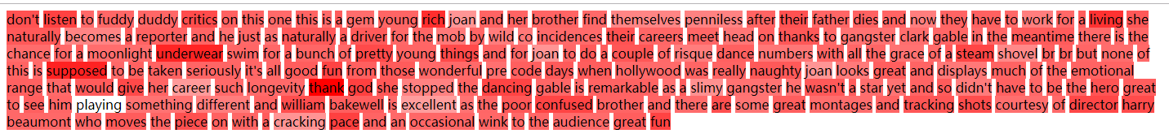
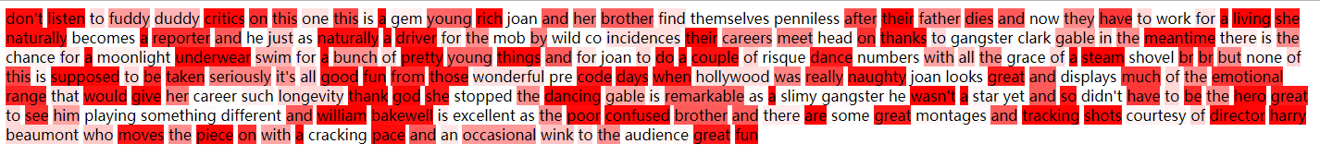
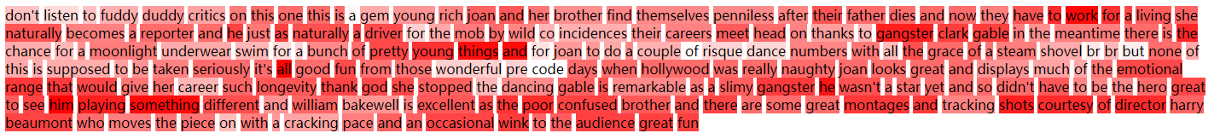
positive
Predict positive

Slide 8
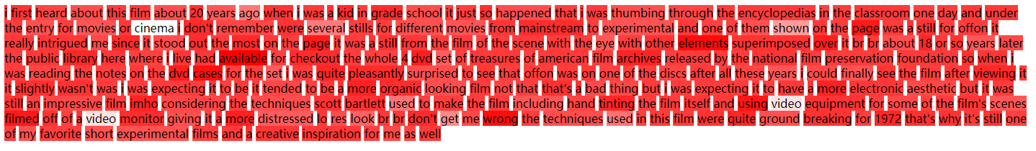
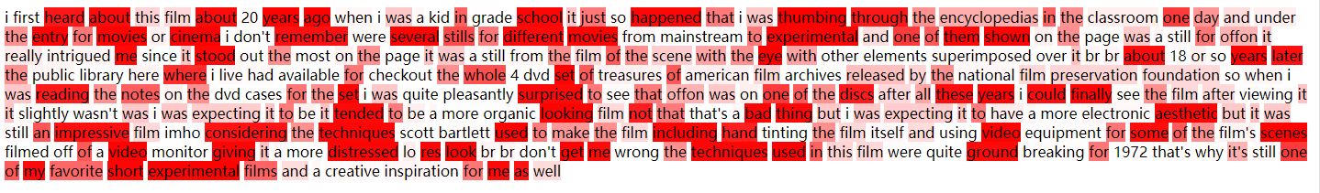
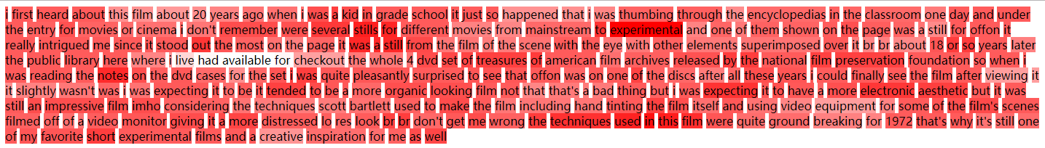
positive
Predict negative

Slide 9
positive
Predict negative

Slide 10
positive
Predict negative

Slide 11
negative
Predict negative

Slide 12
negative
Predict negative

Slide 13
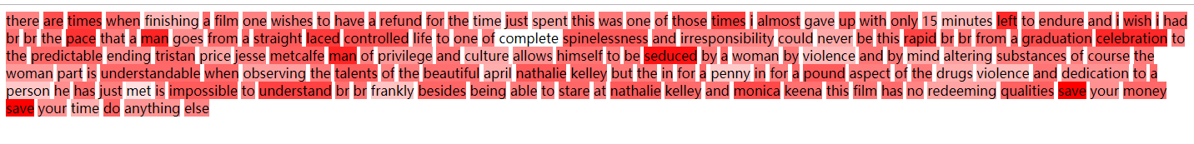
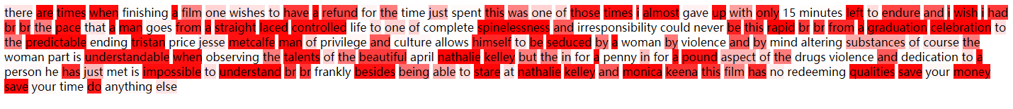
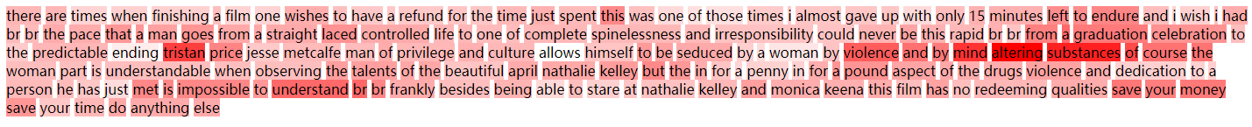
negative
Predict positive

Slide 14
谢谢！
汇 报 人：沈椿壮

