Slide 1
Weekly work
Shencz guosj

Slide 2
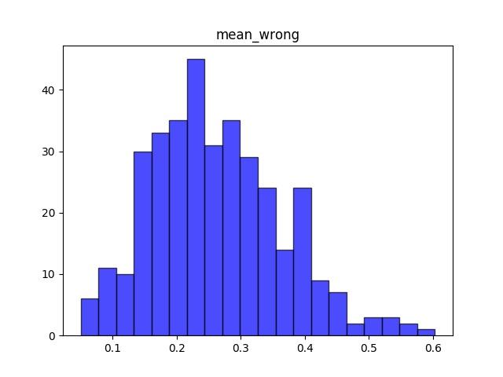
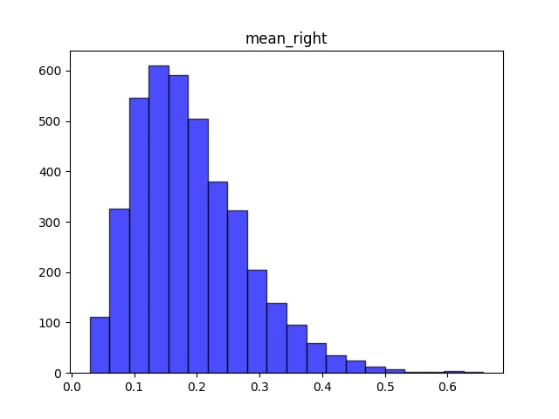

Slide 3
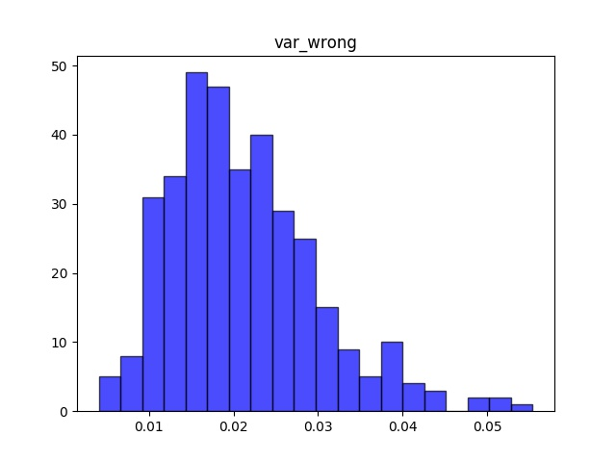
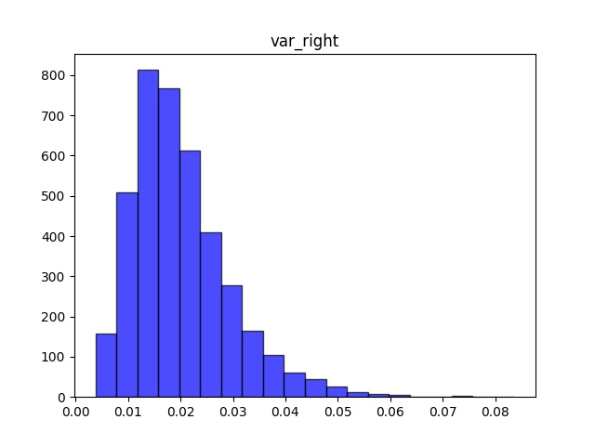

Slide 4
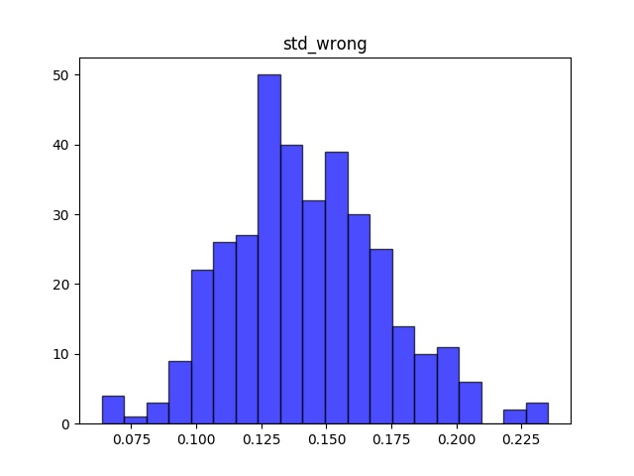
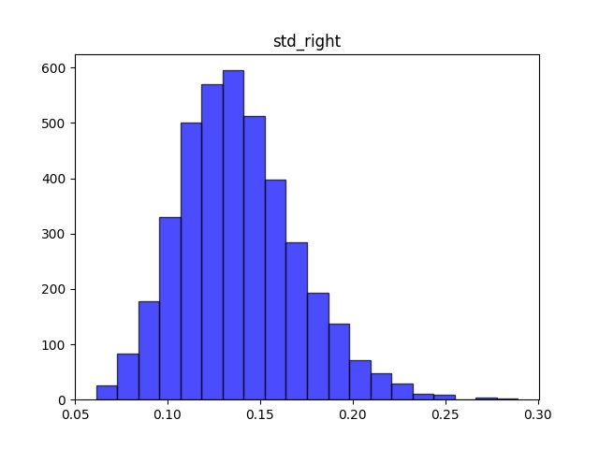

Slide 5
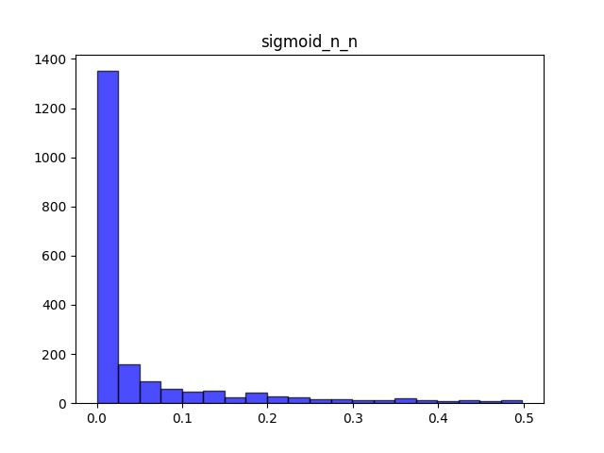
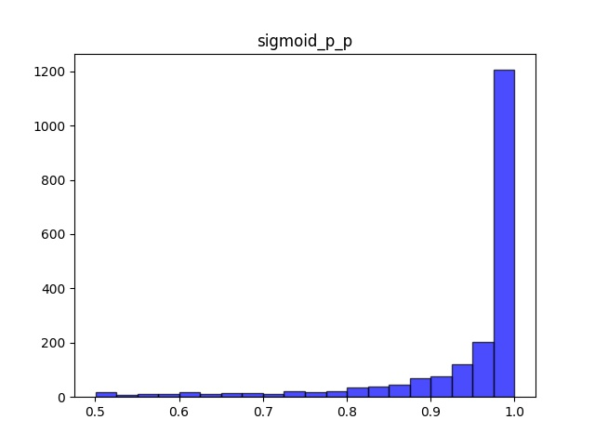

Slide 6
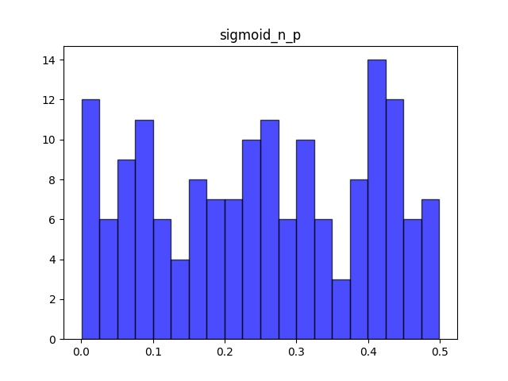
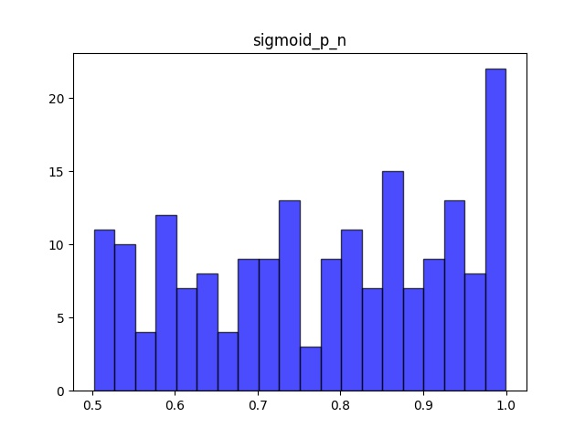

Slide 7
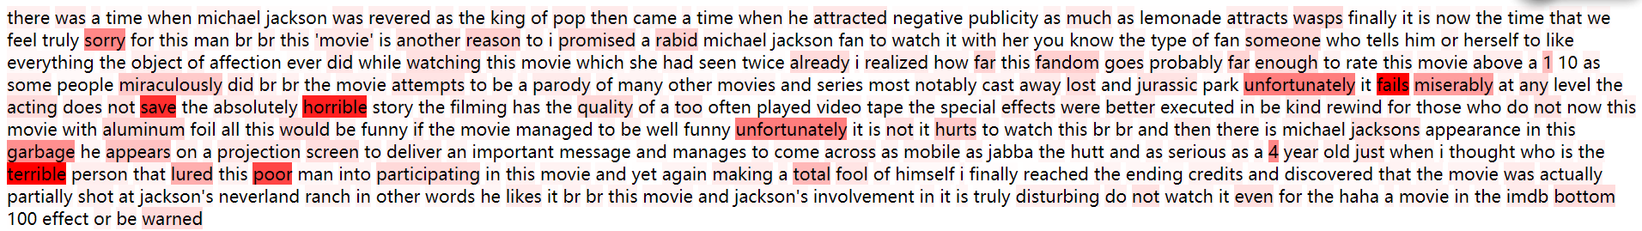
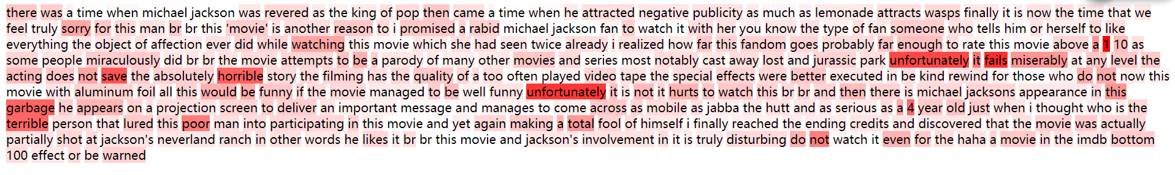
Fasttext: label 0, predict 0
Fasttext-bigram: label 0, predict 0

Slide 8
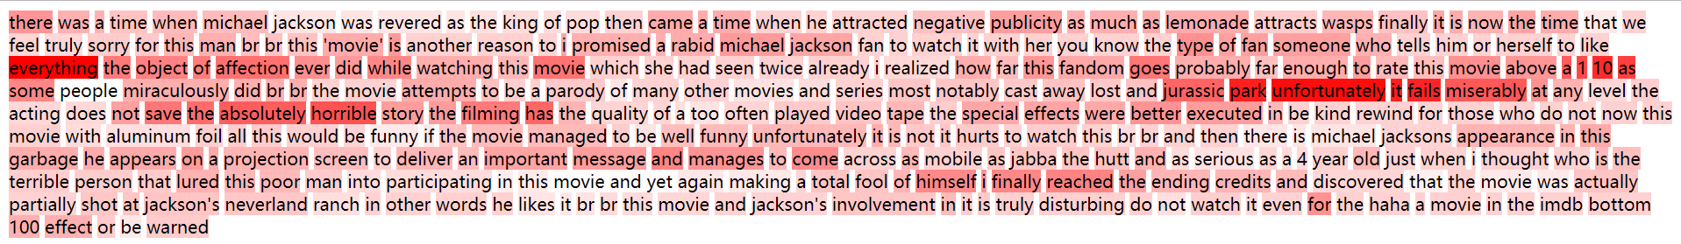
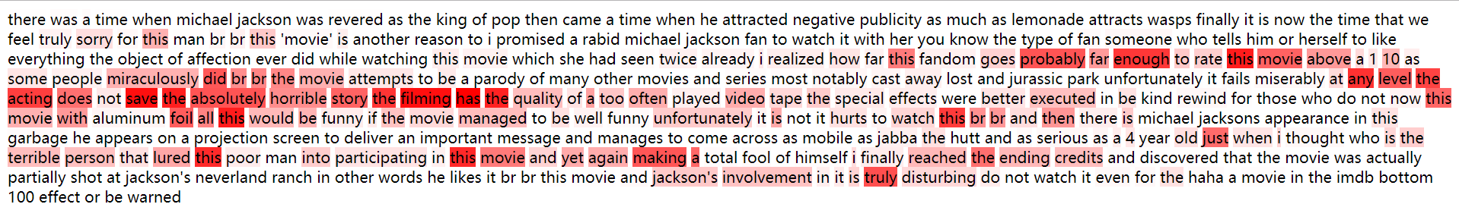
CNN: label 0, predict 0
Attention based gru: label 0, predict 0

Slide 9
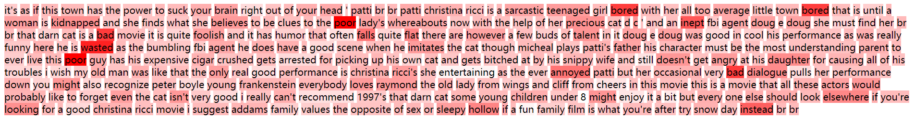
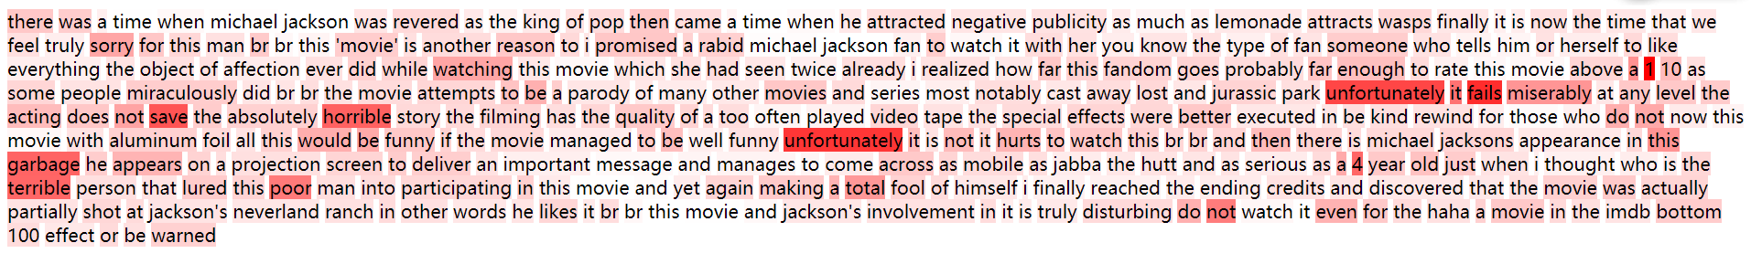
Fasttext: label 0, predict 0
Fasttext-bigram: label 0, predict 0

Slide 10
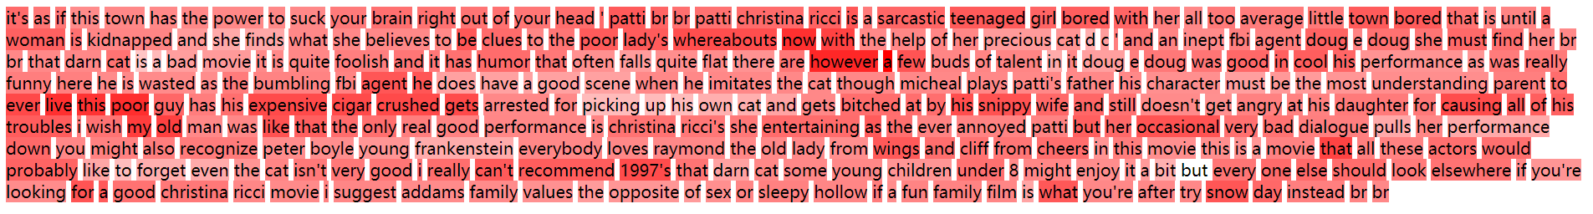
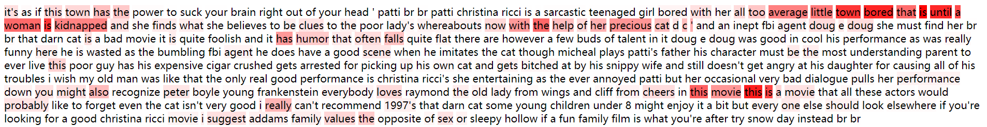
CNN: label 0, predict 0
Attention based gru: label 0, predict 0

Slide 11
Fasttext: label 0, predict 0
Fasttext-bigram: label 0, predict 0
CNN: label 0, predict 0
Attention based gru: label 0, predict 0

Slide 12
Fasttext: label 0, predict 0
Fasttext-bigram: label 0, predict 0
CNN: label 0, predict 0
Attention based gru: label 0, predict 0

Slide 13
Fasttext: label 0, predict 1
Fasttext-bigram: label 0, predict 0
CNN: label 0, predict 1
Attention based gru: label 0, predict 1

Slide 14
Fasttext: label 0, predict 1
Fasttext-bigram: label 0, predict 0
CNN: label 0, predict 0
Attention based gru: label 0, predict 0

Slide 15
Fasttext: label 0, predict 1
Fasttext-bigram: label 0, predict 0
CNN: label 0, predict 1
Attention based gru: label 0, predict 0

Slide 16
