Slide 1
WORK one：
I learn more about word2vec theory. Especially the input and output data type.
Try again to process the data Tags by split:
I train a word2vec mode by tags and then save it.
Test the model

Slide 2
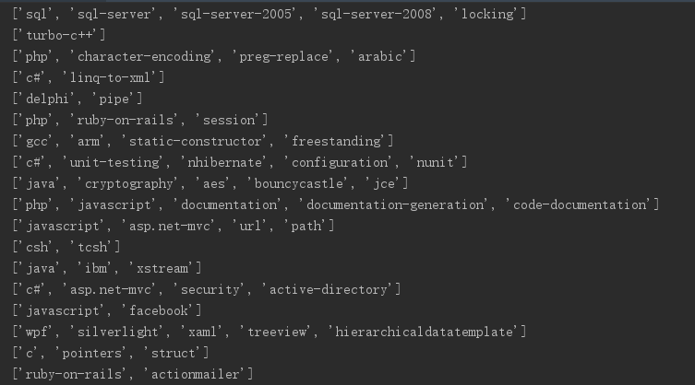
result：
Tags I processed

Slide 3
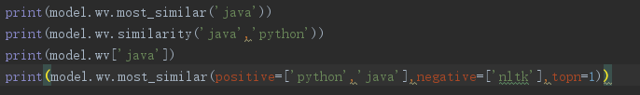
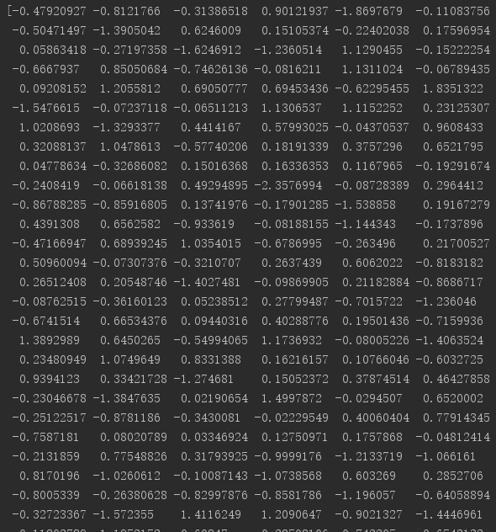
result：
Use model

Slide 4
WORK TWO：
I learned the code and try to get the body.
I processed the body and train a word2vec model
I used the model

Slide 5
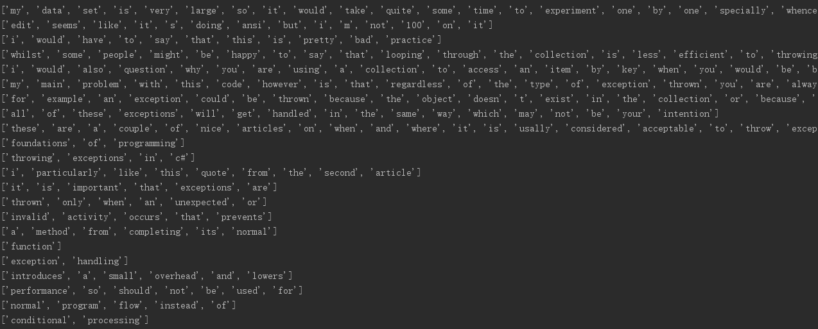
result：
Body I processed

Slide 6
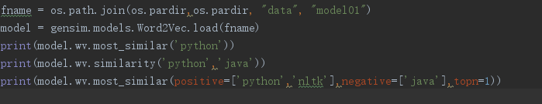
result：
Use model

Slide 7
WORK Three：
I learned the sentence2vec theory, include skip thoughts and quick thoughts
I am learning the code in github
I am trying to understanding the code and encode my own model

Slide 8
Question：
We didn`t understand the data set very well
We don`t understand parameter in word2vec, we the need to learn more theory.

