Slide 1
WORK one：
We read the data, and summarize the noise as many as we can.
We try to process the sentence by the code.
Here are the problems need to be dealt with:
Character entities eg:&#xD
HTML tag
soft hyphen &shy

Slide 2
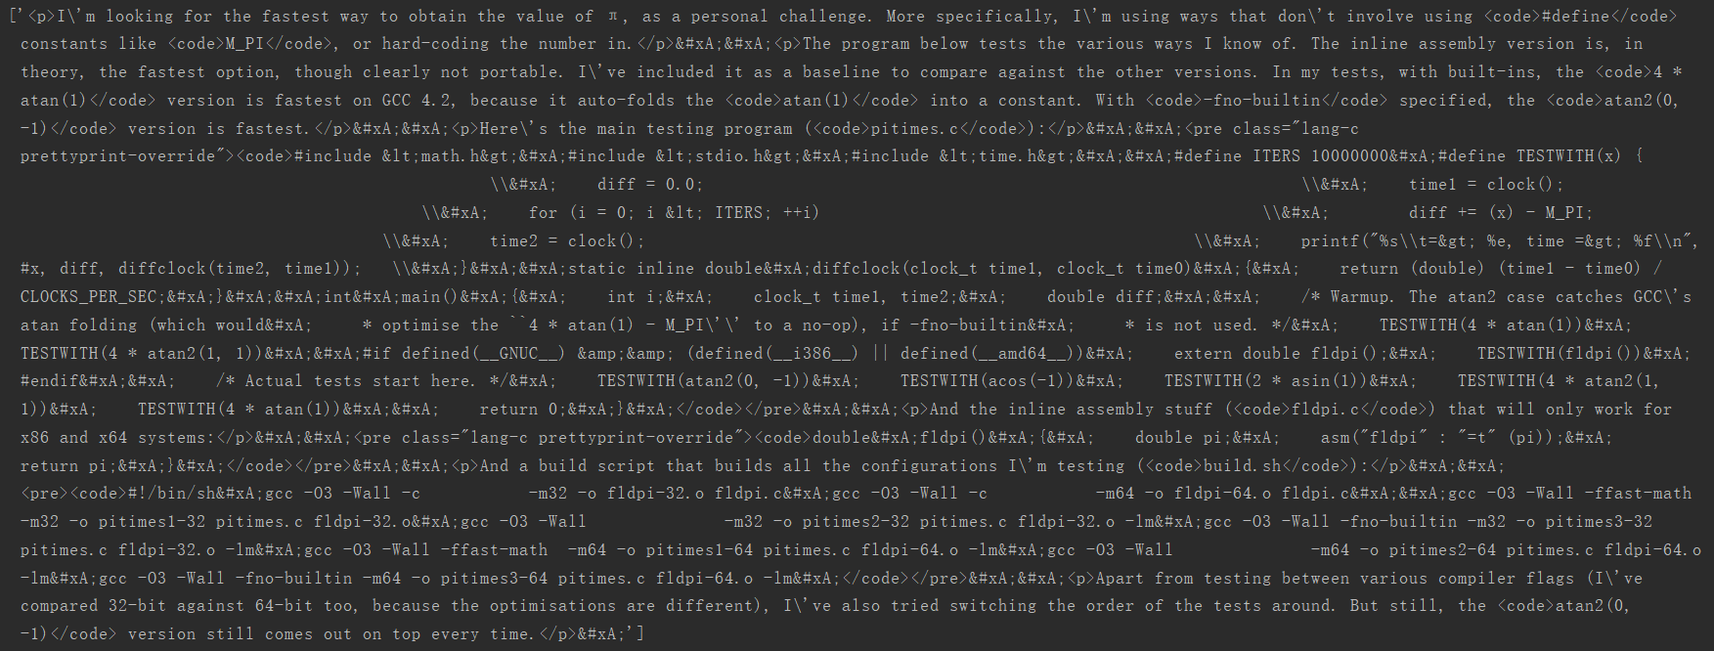
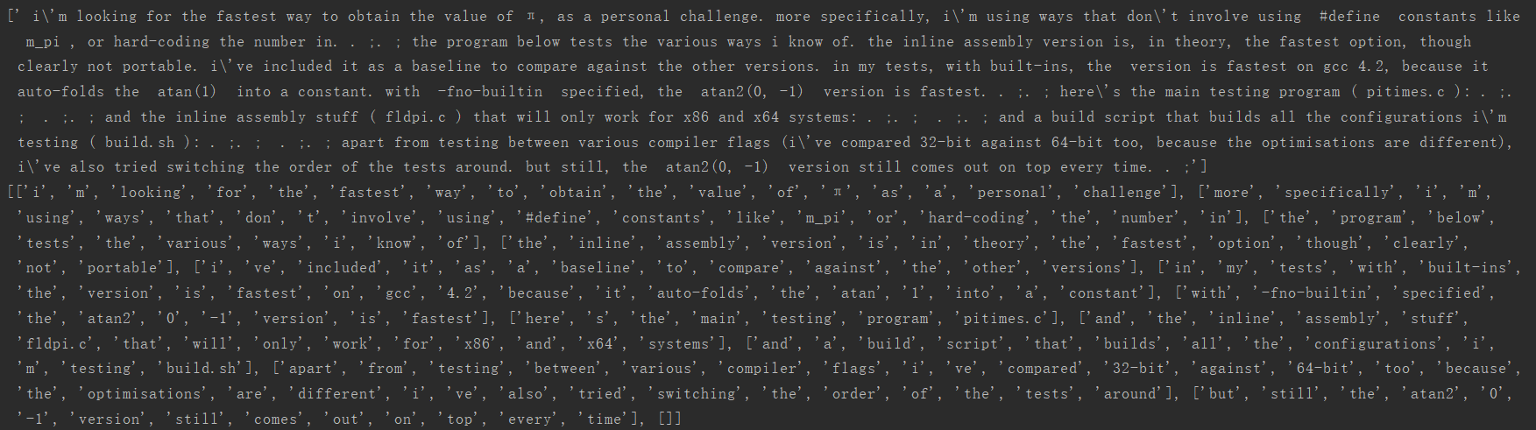
result：

Slide 3
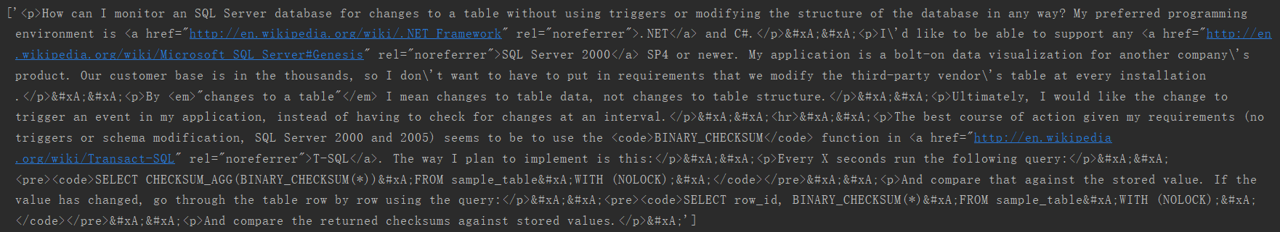
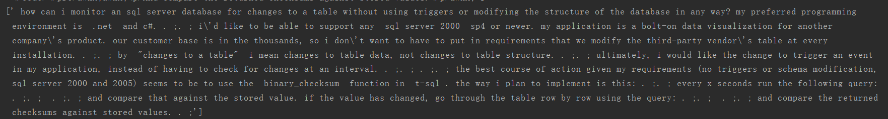
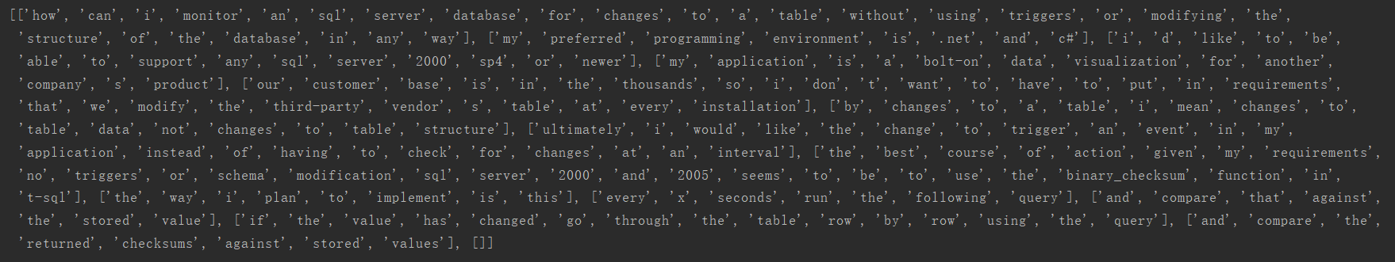
result：

Slide 4
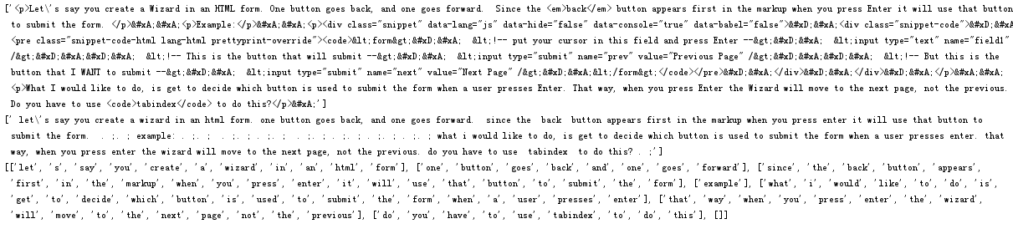
result：

Slide 5
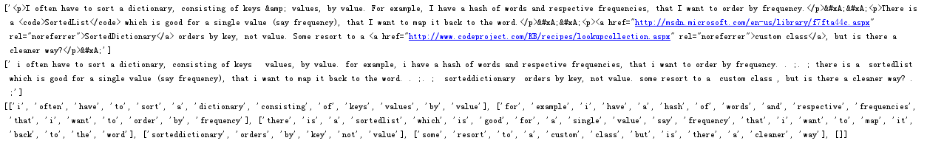
result：

Slide 6
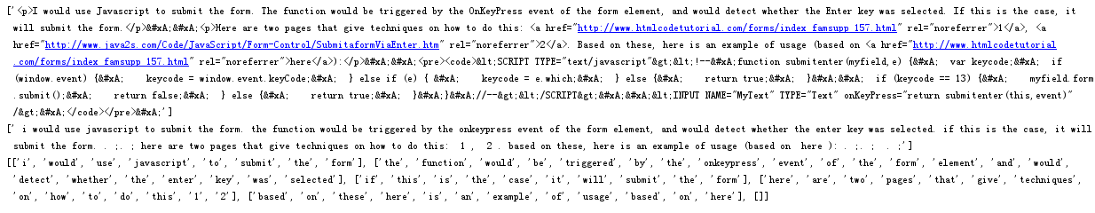
result：

Slide 7
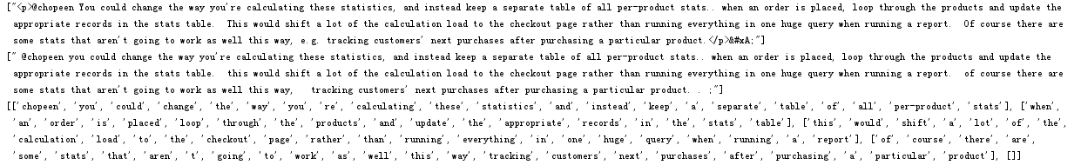
result：

Slide 8
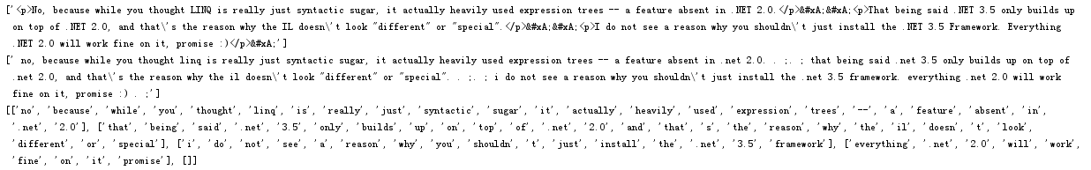
result：

Slide 9
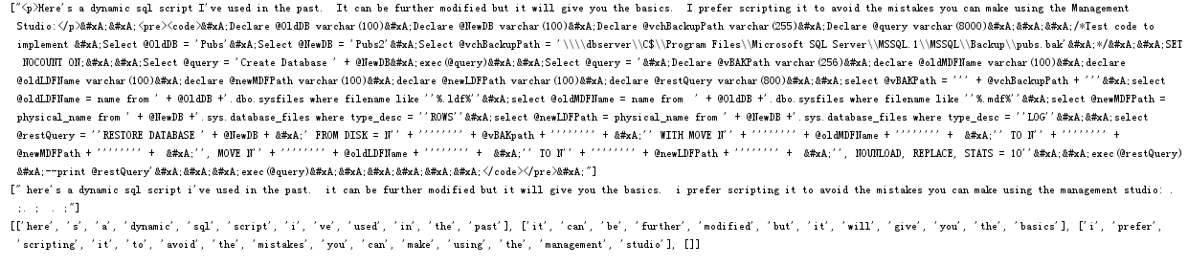
result：

Slide 10
WORK TWO：
We select data by stream processor
We use the SSCursor to select data.
We think Limit offset can be used, too.
We selected the data

Slide 11
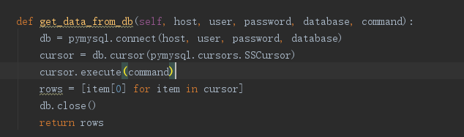
result：

Slide 12
SELECT COUNT(*) FROM Posts：查询到的数据：40700647条数
SELECT * from Posts where id = (SELECT max(id) FROM Posts);
id最大的时间：2018-06-03 05:18:45
SELECT * from Posts where id = (SELECT MIN(id) FROM Posts);
id最小的时间：2008-07-31 21:42:53
查询表中question SELECT Count(*) from Posts where PostTypeId=1; 15930617
answer数目:24676333
SELECT Count(*) from Posts where PostTypeId=3 or PostTypeId=4 or PostTypeId=5 or PostTypeId=6 OR PostTypeId=7 or PostTypeId=8; others 93697

Slide 13
WORK Three：
We try to use the sentence2vec model, quick-thought model.
We read the information and try to used the model.
We debug the code. And train a model by 100000 body`s data.
It is training

Slide 14
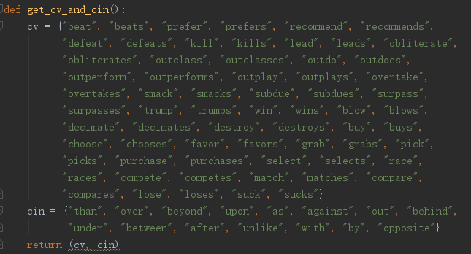
Question：

Slide 15
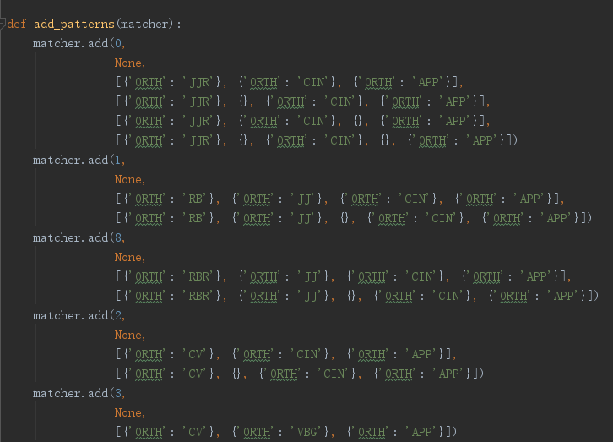
Question：

Slide 16
Question：
Processing of hyperlinks
<a href="http://msdn.microsoft.com/en-us/library/system.math.truncate.aspx" rel="noreferrer">
<p>How do I store binary data in <a href="http://en.wikipedia.org/wiki/MySQL" rel="noreferrer">MySQL</a>?</p>
"https://stackoverflow.com/questions/14/whats-the-difference-between-math-floor-and-math-truncate-in-c/580252#580252"
The information from <code>tag

Slide 17
Question：
More symbol represents line breaks

