Slide 1
工作汇报
2018年10月17日

Slide 2
1.Json files are treated as dictionary data structures.
eg：{'Id': 88305, 'DocTopicId': 953, 'UserId': 4333838, 'DocContributorTypeId': 1, 'CreationDate': '/Date(1490309827447-0400)/'},
2.Conversion of timestamps: /Date(1490309827447-0400)/
2017-03-24 06:57:07
3.Currently, we have screened 260 meaningful sentences
four types;
Notes:
采用不同的特征表达形式可以构造出不同的滤波组

Slide 3
Introduce table Contributortypes.json
doucumention role : Minor,Major
total number：2
introduce：Two types of contributors to the document
Contributordeletionreasons.json
introduce：The reason the contributor was removed or changed
total number：4
Four types:Upgrade,Rollback.ExampleMoved ,ExampleDeleted
Doctagversions .json
introduce：Version types of each tag in the document
total number：5956
Four types:Upgrade,Rollback,ExampleMoved ,ExampleDeleted
eg：The version of python：2.0 2.1 2.2 2.3 2.4 2.5 2.6 2.7 3.0 3.6 3.7
version：[3.7] CreationDate：2016-03-24 07:53:18
ReleaseDate：2017-05-08 12:00:00
Notes:
采用不同的特征表达形式可以构造出不同的滤波组

Slide 4
contributors.json
introduce：Contributor information on topic
total number:79447
creationDate；first:2015-11-05 12:19:02
last: 2016-07-24 09:17:44
topichistorytypes.json
introduce：All the state phases of a topic
total number:29
29types
topichistories.json
introduce：Each topic status history
total number:161639
topics.json
introduce：Each topic status history
total number:8038
python number:202
Remarkhtml field is used for sentence analysis
examples.json
introduce：The specific information of the title contained in each topics
total number:23916
bodyhtml field is used for sentence analysis
first: 2015-11-05 12:19:02
last: 2016-07-24 09:17:44

Slide 5
定义类：
1.python is a widely used programming language.
2.python is a high-level dynamic interpreted programming language.
3.python 2.x is the legacy version though it still sees widespread use.
4.list is a particular type of iterable but it is not the only one that exists in python.
5.a tuple is a sequence of values.
6.list comprehensions were outlined in pep 202 and introduced in python 2.0.
7.mapping is any dictionary-like object with keys that match with the template placeholders.

Slide 6
2比较：
1.a comprehension or generator expression is more readable more powerful and more efficient than filter or ifilter.
2.this module will answer question such as is it faster to do a list comprehension or use the built-in list when transforming a set into a list.
3.python 2.7 is backwards-compatible with most earlier versions of python and can run python code from most 1.x and 2.x versions of python unchanged.
4.the capitalization of the tkinter module is different between python 2 and 3.

Slide 7
关系解释类：
1.in python 2 print is a statement print hello world whilst in python 3 it is a function print hello world note for backwards compatibility print as a function is also available in python 2.7 onwards.
2.currently there are two major release branches of python which have some significant differences.
3.the choice of which database package will be used such as dbm.ndbm or dbm.gnu depends on which interface is availables.
4.avoiding the cross-platform encoding hell when using python s built-in open it is best-practice to always pass the encoding argument if you intend your code to be run cross-platform.

Slide 8
问句：
1.why would you ever want to tell the interpreter to explicitly do nothing.
2.so the generational garbage collection speeds things up tremdously by not requiring that we scan over objects that aren t likely to need gc all the time but how does it help us break cyclic references.

Slide 9
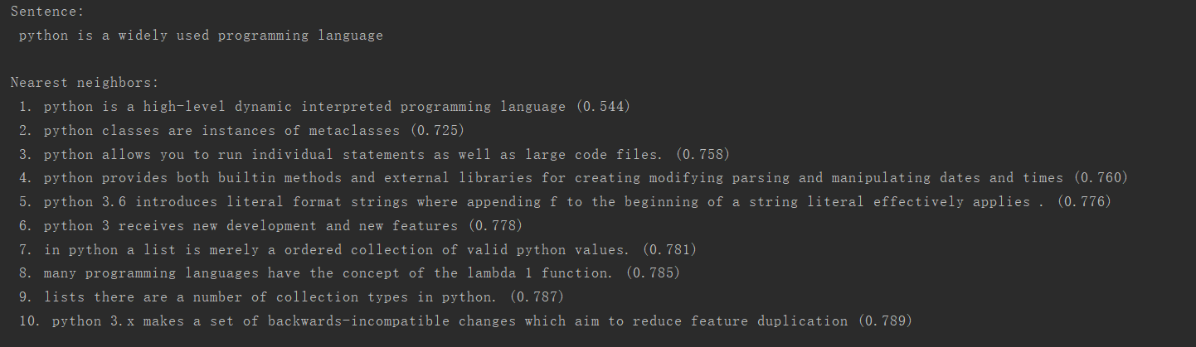
evaluation result：

Slide 10
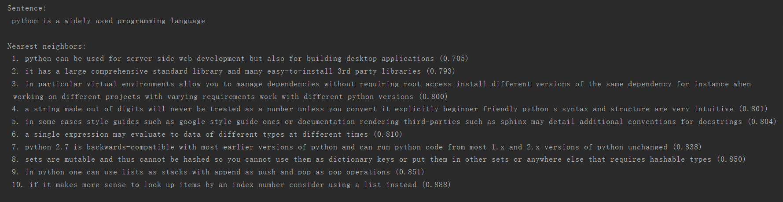
From each class

Slide 11
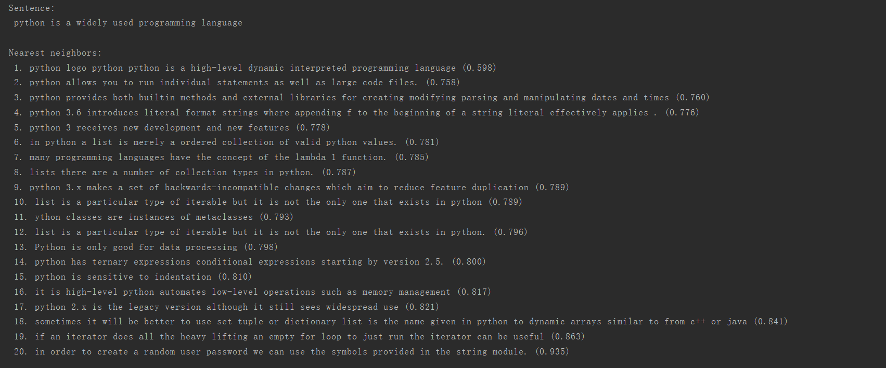
Twenty sentences and add a sentence with a opposite meaning

Slide 12
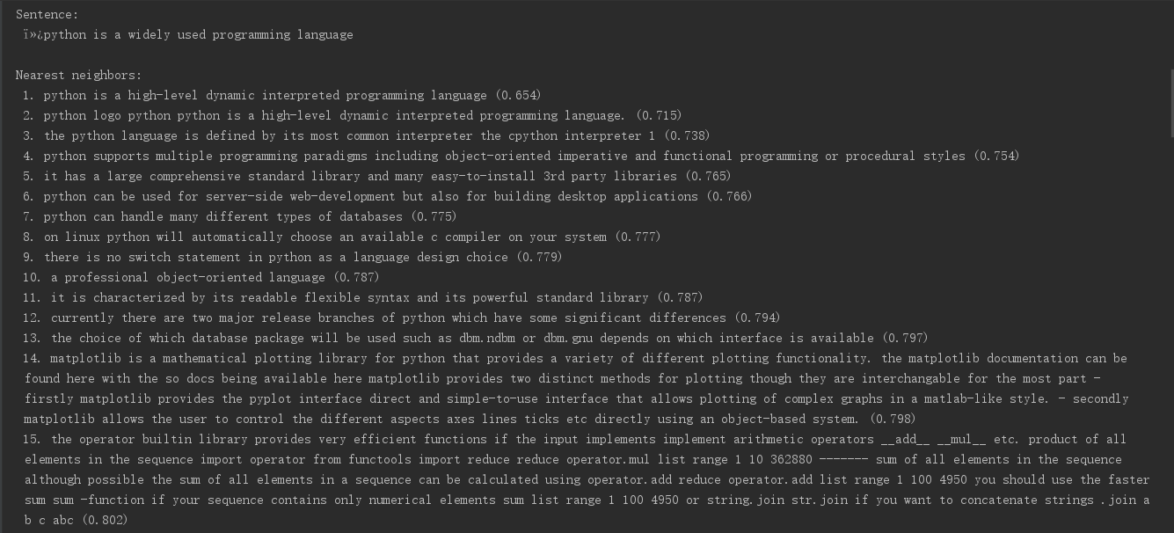
More sentences and add some noises

Slide 13
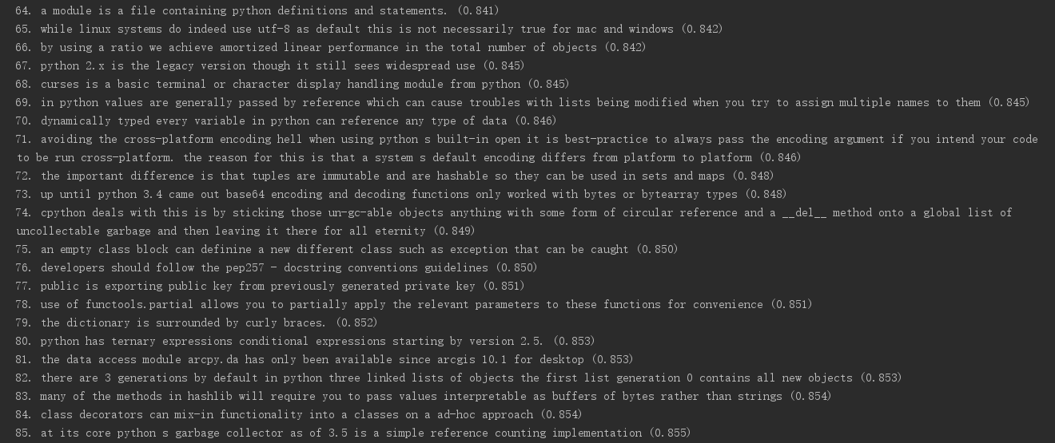
More sentences and add some noises

Slide 14
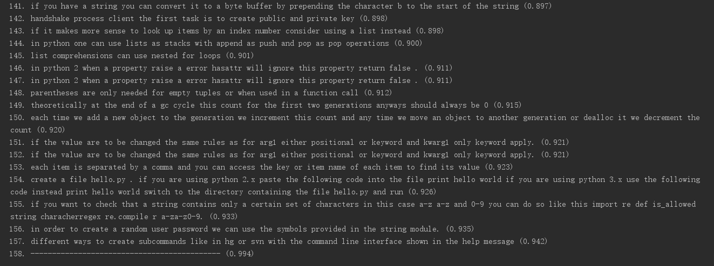
More sentences and add some noises

Slide 15
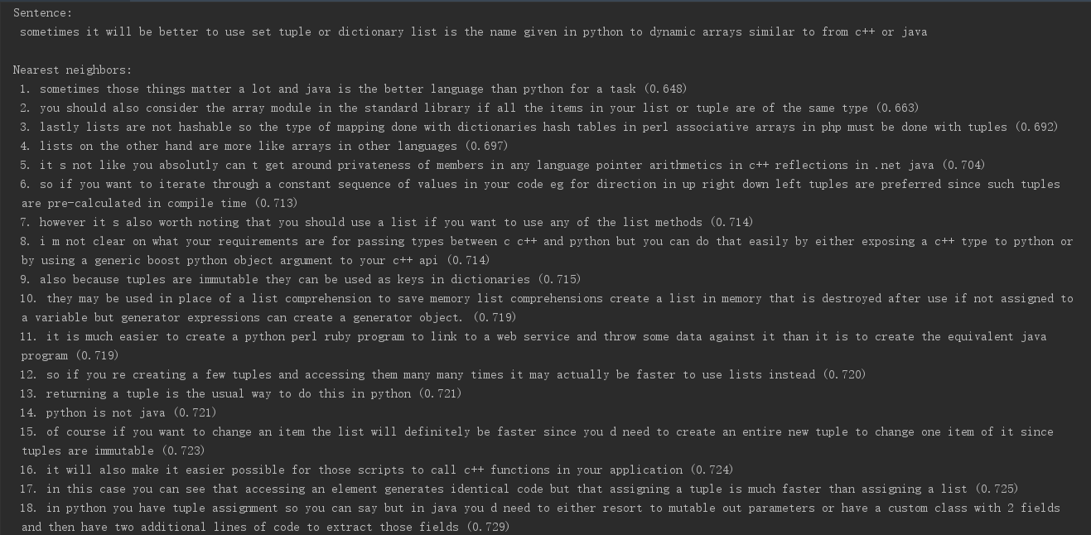
Select 1000 sentences from Stackoverflow

Slide 16
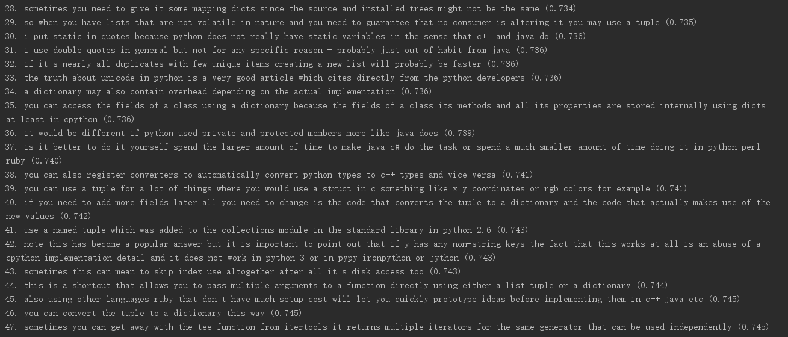
Select 1000 sentences from Stackoverflow

Slide 17
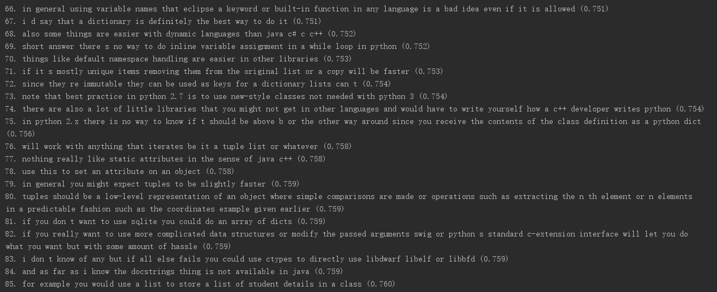
Select 1000 sentences from Stackoverflow

Slide 18
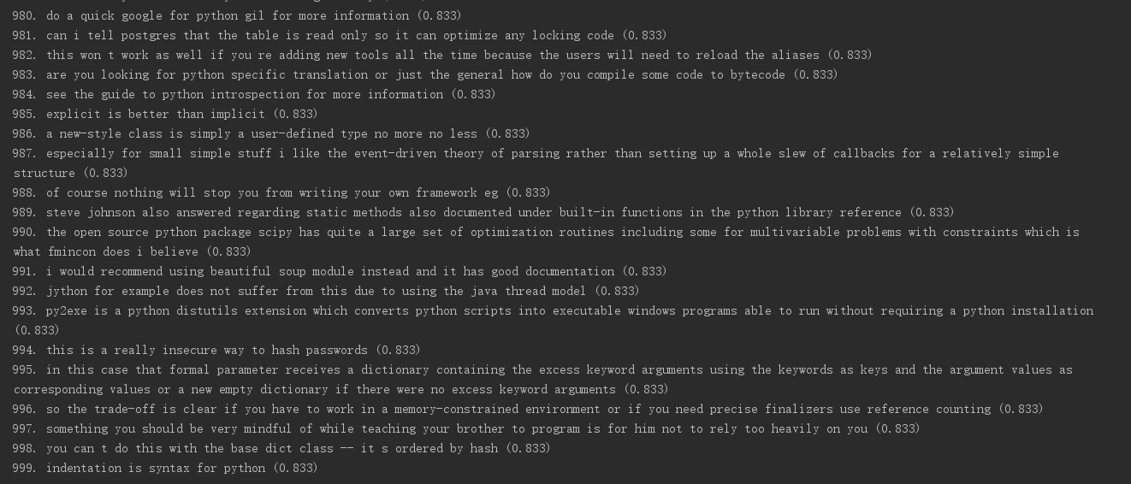
Select 1000 sentences from Stackoverflow

Slide 19
Q&A

Slide 20
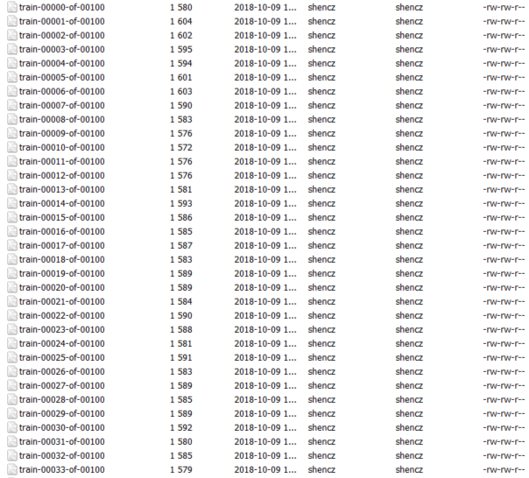
Divide data into 100 times
Vocabulary expansion?

