Slide 1
Weekly work
shencz

Slide 2
Background
With the development of technology, some once great answer becoming out-of-data, obsolete, or somewhat problematic.
Due to legacy applications that still need the code and some people still use this technology, we can not simply delete these answer.
Some useful answers are at the bottom of the list.

Slide 3
survey
Where are the code snippets in Stack Overflow answers from?
Are Stack Overflow answerers aware of outdated code in their answers?
Are Stack Overflow answerers aware of software licensing violations caused by code snippets in their answers?
What are the problems Stack Overflow visitors experiencing from reusing code snippets on Stack Overflow?
Are Stack Overflow visitors aware of code licensing on Stack Overflow?

Slide 4
Conclusions of survey
Code in Stack Overflow answers is usually written from scratch to answer a question. Nonetheless, there are some code snippets that are copied from the answerer’s personal or company projects, or from open source software.
Outdated code on Stack Overflow occurs when a code snippet is copied from another location and is no longer up-to-date. The results show that although the answerers are aware of outdated code in their answers, 19% of them rarely or never fix the code.
More than half of them (64%) reuse code from Stack Overflow at least once a week. Sixty-seven percent of the visitors find a problem from reusing Stack Overflow snippets ranging from a mismatched solution, outdated solution, incorrect solution, and buggy code. However, 56% of the participants never report the problems back to Stack Overflow.

Slide 5
Existing solutions
Comment to the OP suggesting that their answer is out-of date and needs to be updated
Post a new answer with the updated information
Edit or suggest an edit (if you don’t have privileges) to correct the answer
Add a types of notices named obsolete
Add a new flag
Add a dedicated section for "Alternate Versions of this Question“
Change the sort algorithm

Slide 6
Work we can do
Find different answers to different versions of the same question by NLP, Mark its version information.

Slide 7
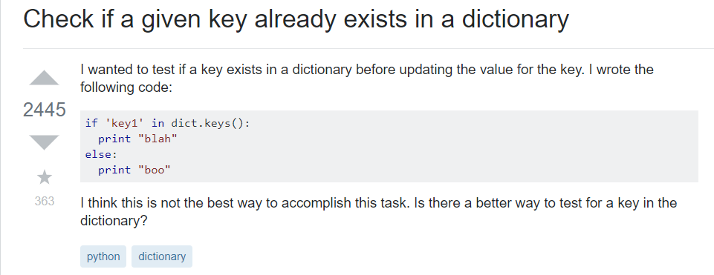
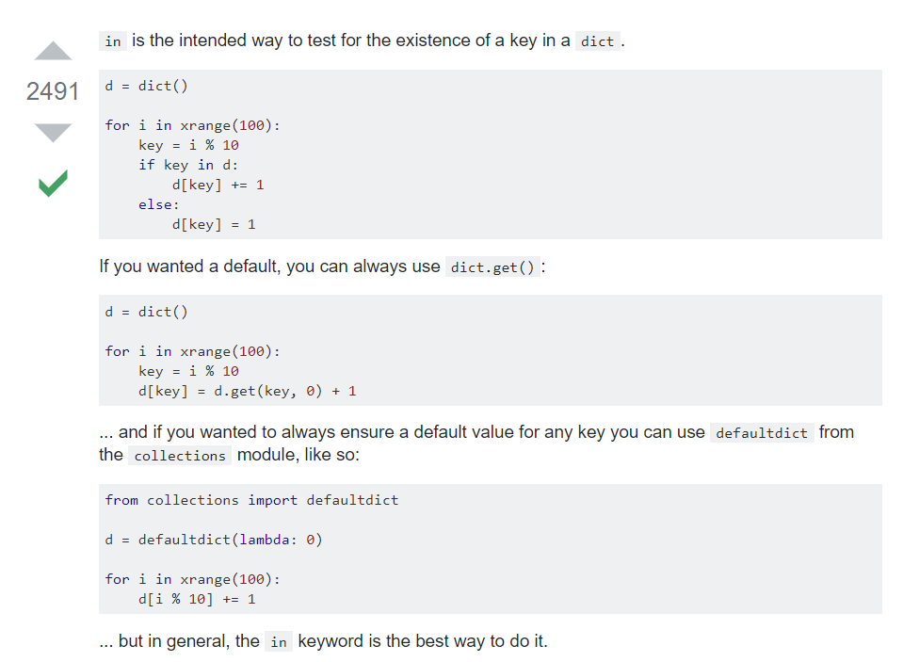

Slide 8
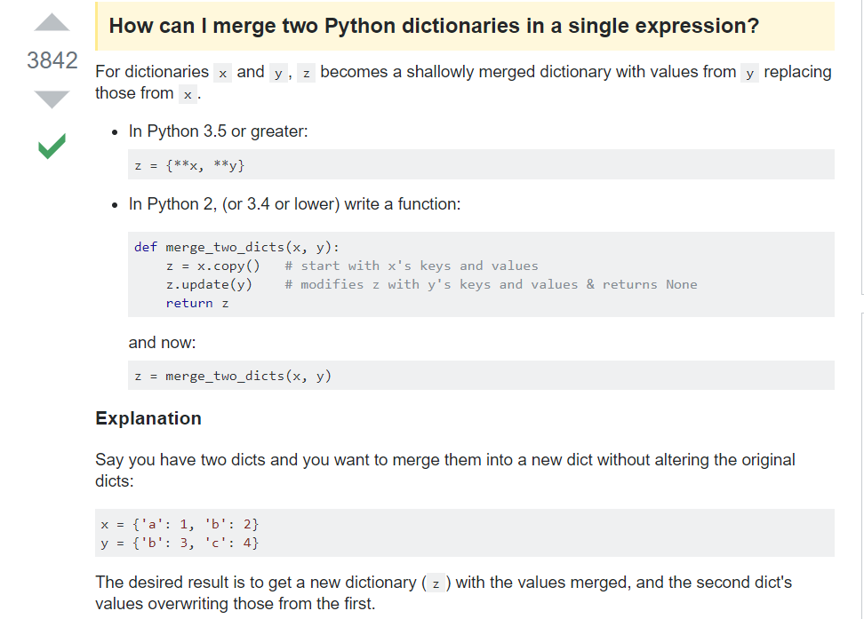
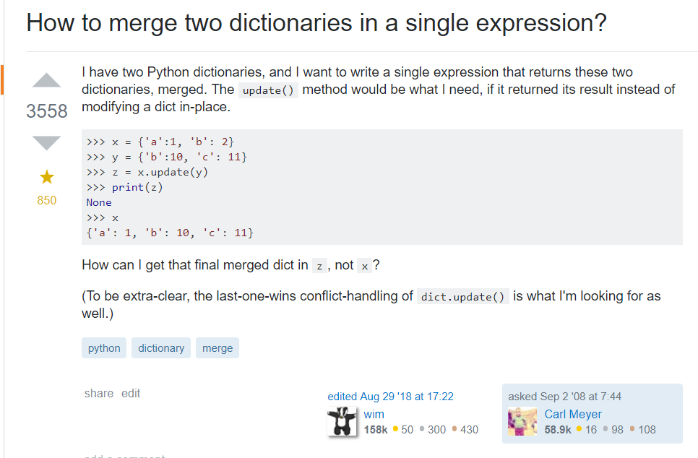
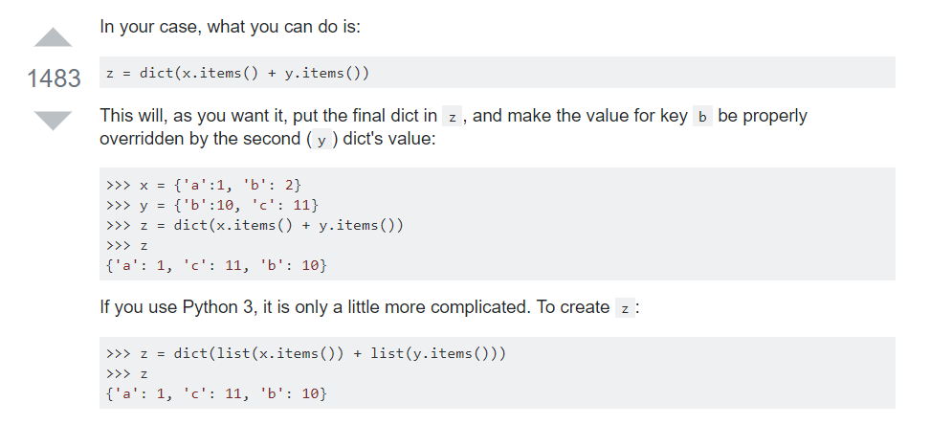
https://stackoverflow.com/questions/38987/how-to-merge-two-dictionaries-in-a-single-expression

Slide 9
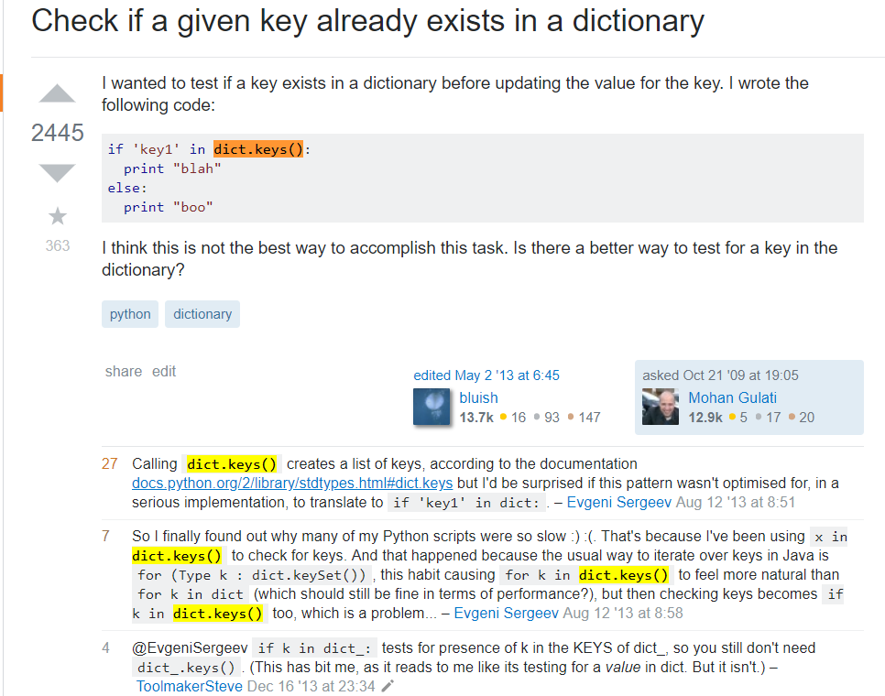
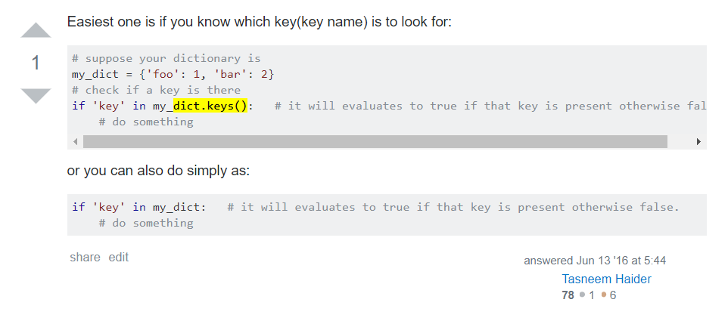

Slide 10
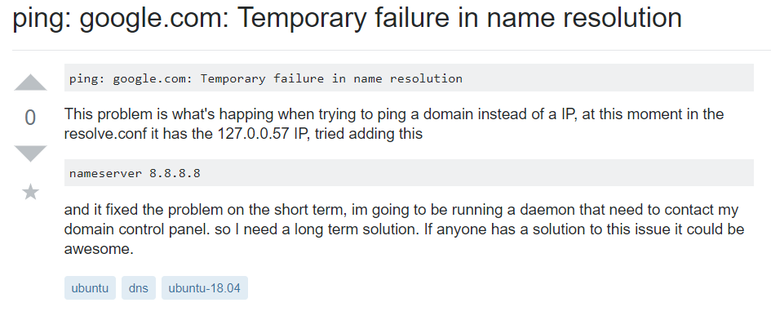
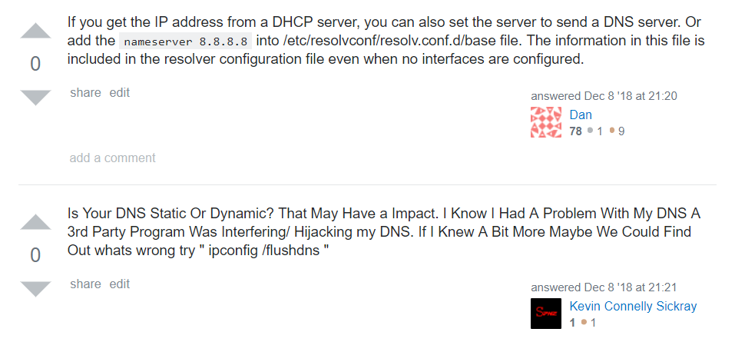

Slide 11
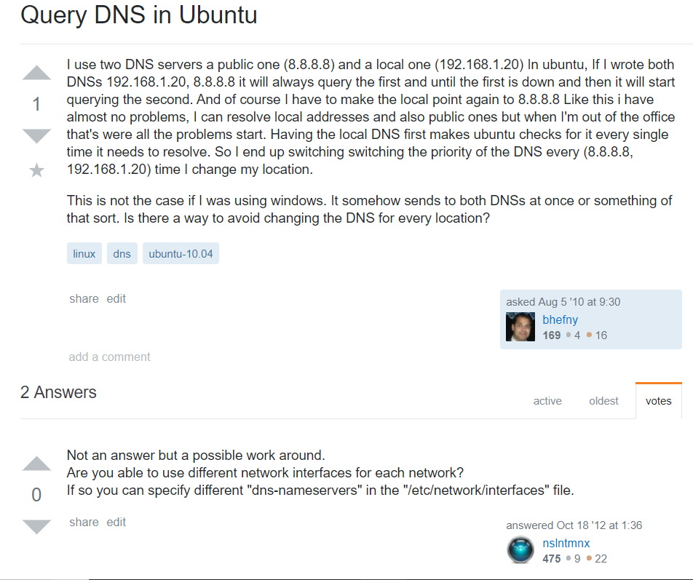
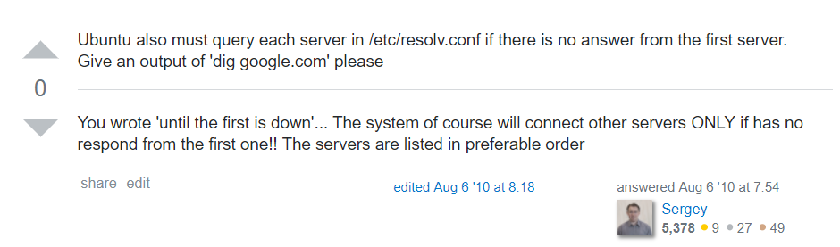

Slide 12
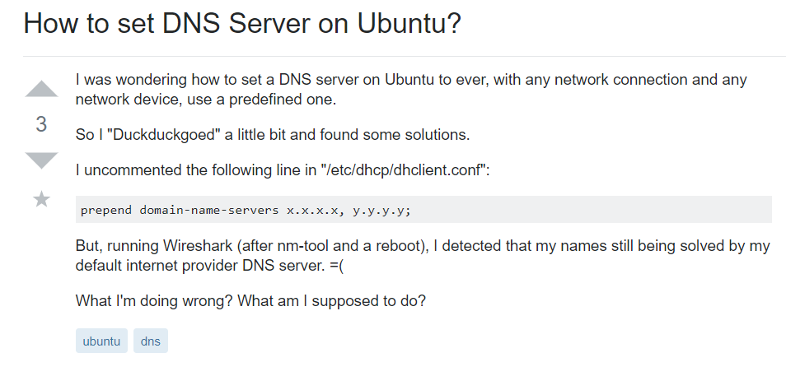
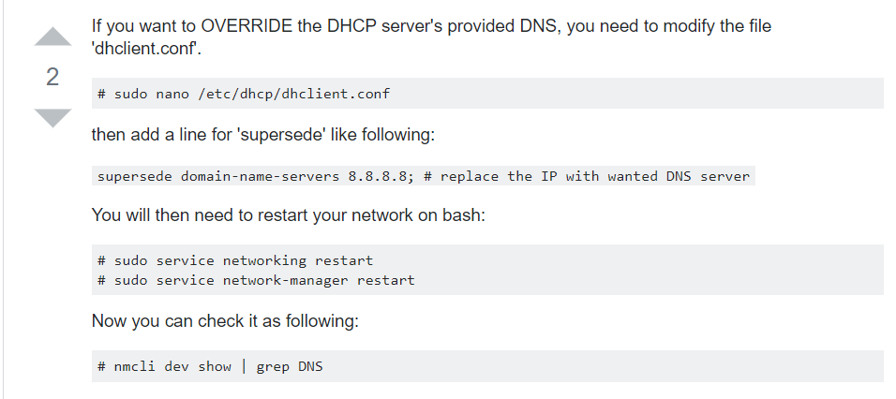

Slide 13
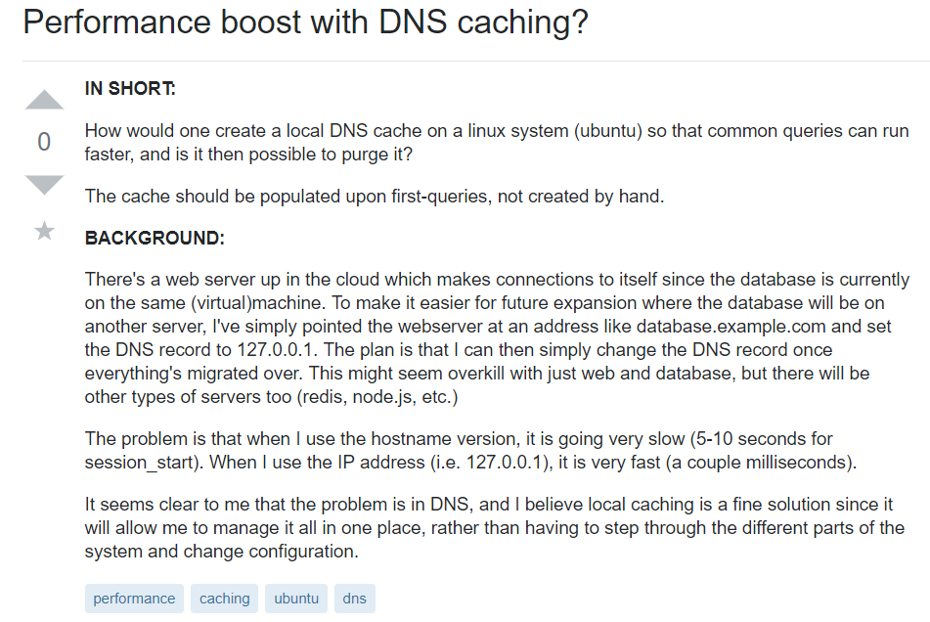
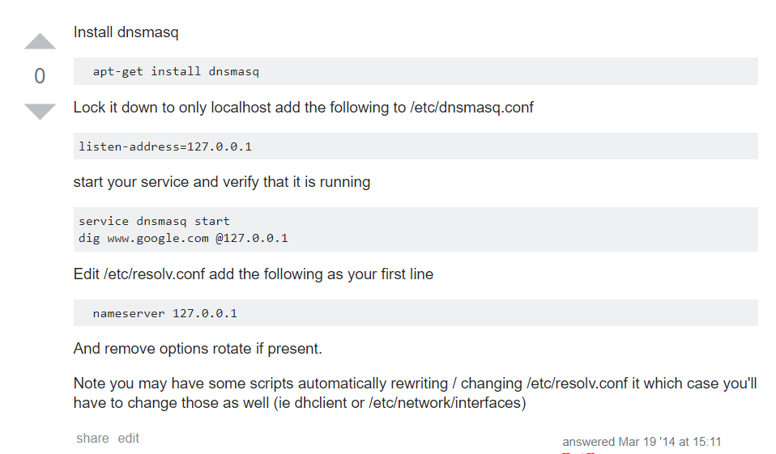
Notes:
Python 版本之间区别，总结一下区别，写一个脚本，看看能找到多少
搜集正反样本，在评论commone里找一下是否有人说该帖子过时。

