Slide 1
Weekly work
20190312-shencz

Slide 2
Add Keywords
Screening Keywords
Delete if Keywords in Answer Posts
If Last Edit Date is NULL
yes
no
Add Negative rules
Select Post History versions

Slide 3
1.Add Keywords
no longer maintain(240) no longer available(515) no longer valid(438) no longer exist(583)
no longer work(1847) no longer true(355) no longer support(526)
no longer use(336) no longer current(154) no longer allow(81) no longer compatible(11)
no longer accurate (61)no longer update(14)
no longer relevant(135)
out-of-date out of date outdate obsolete deprecated
no more maintain no more available no more valid no more exist
no more working no more true no more support no more useful
no more allow no more accurate (115)

Slide 4
2.Delete the posts which have the keywords in body (23576)
3. Divided into two parts according to whether LastEditDate is null
(11398 null and 12178 not null)

Slide 5
3.1.for the “null” part ,find negative rules
Delete “not deprecated” 85%

Slide 6
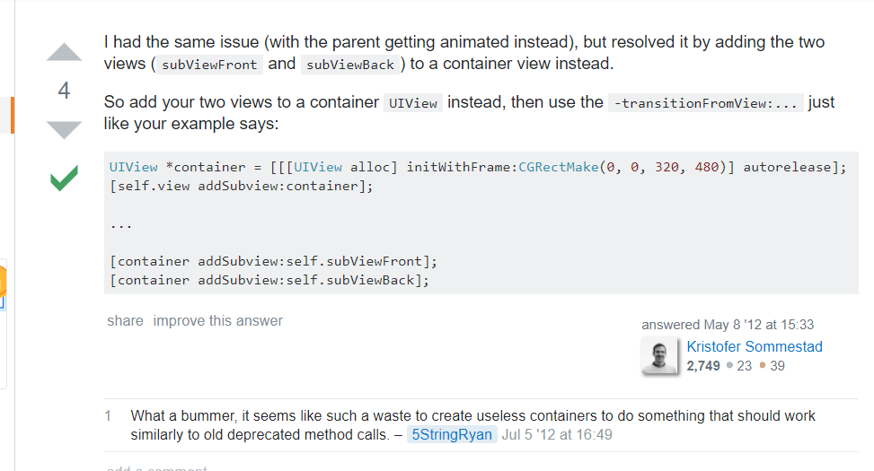

Slide 7
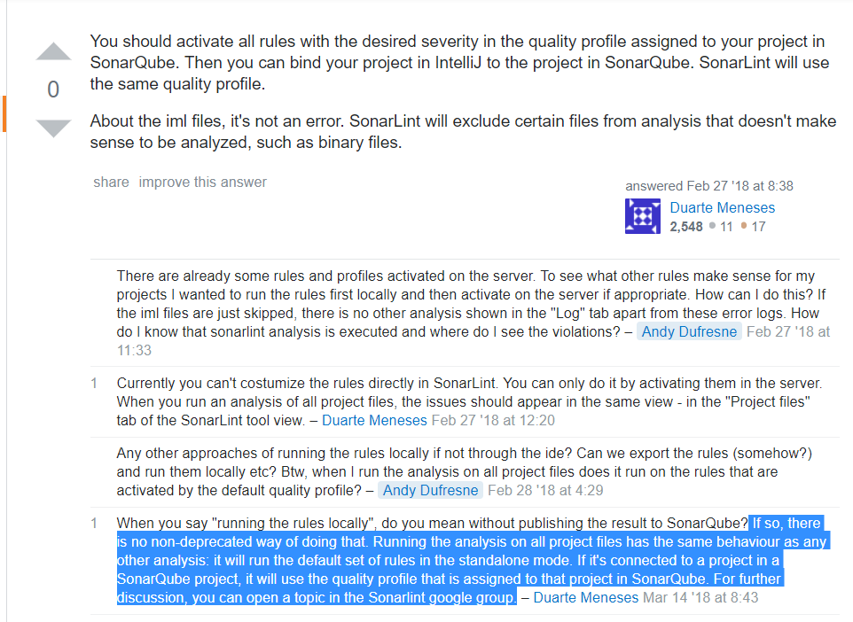

Slide 8
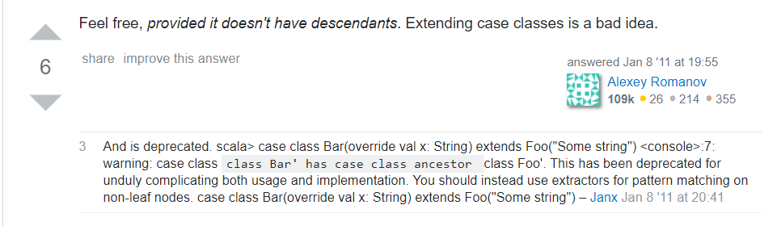

Slide 9
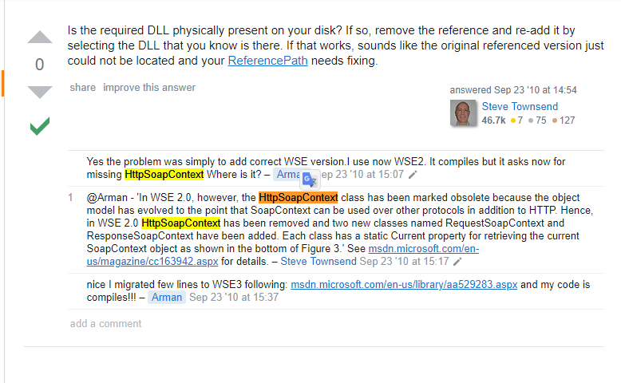

Slide 10
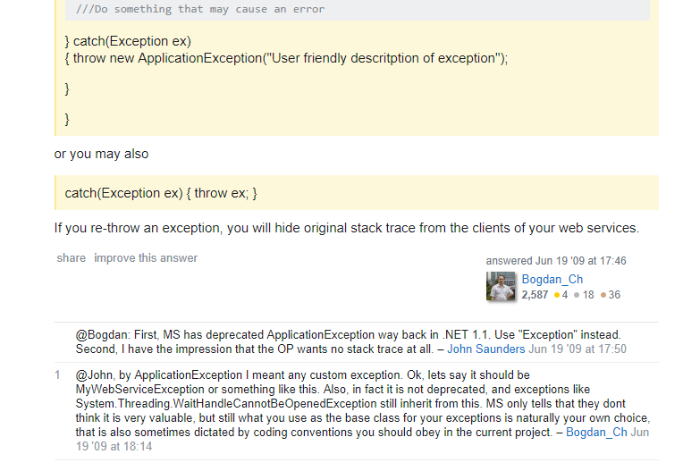

Slide 11
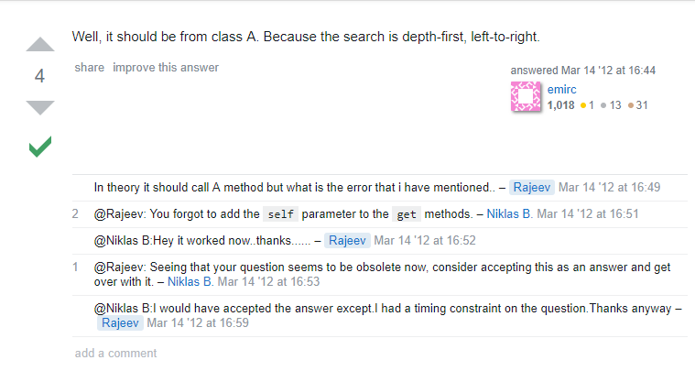

Slide 12
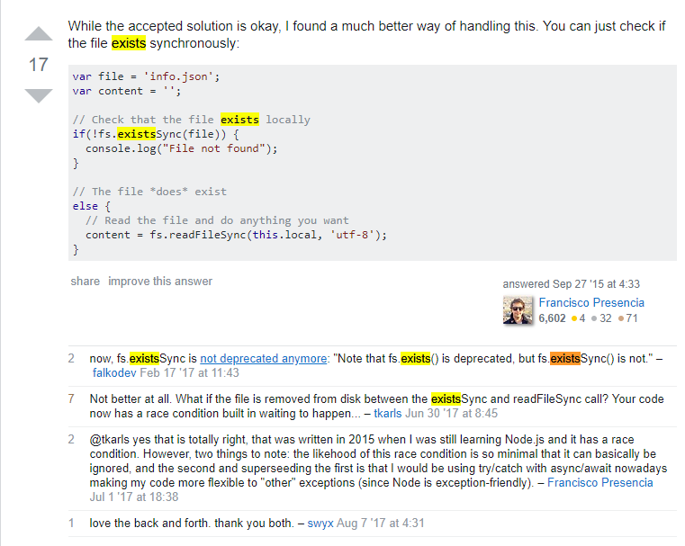

Slide 13
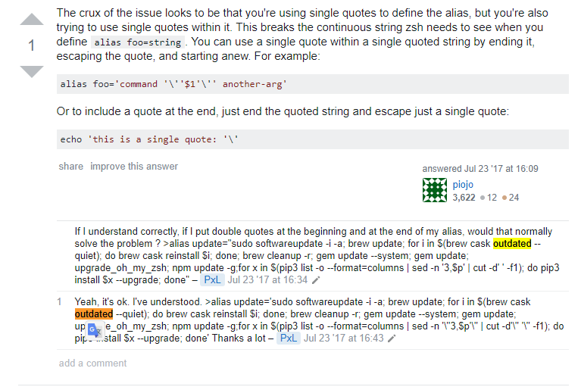

Slide 14
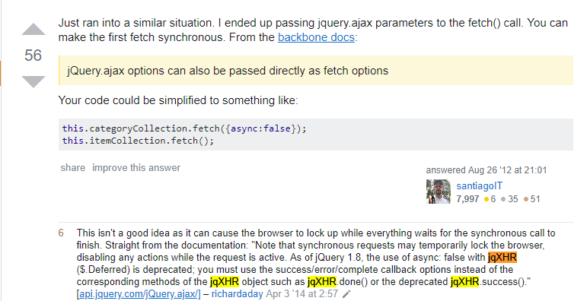

Slide 15
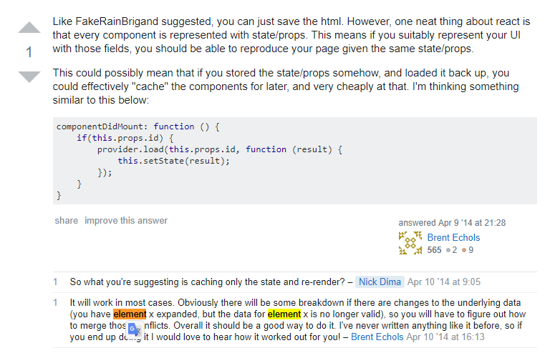

Slide 16
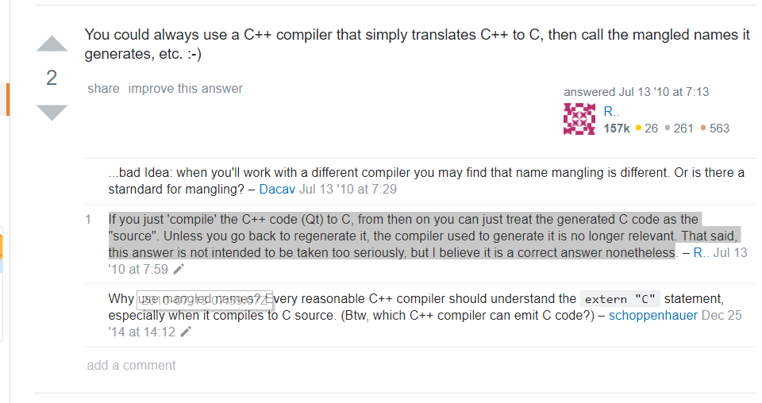

Slide 17
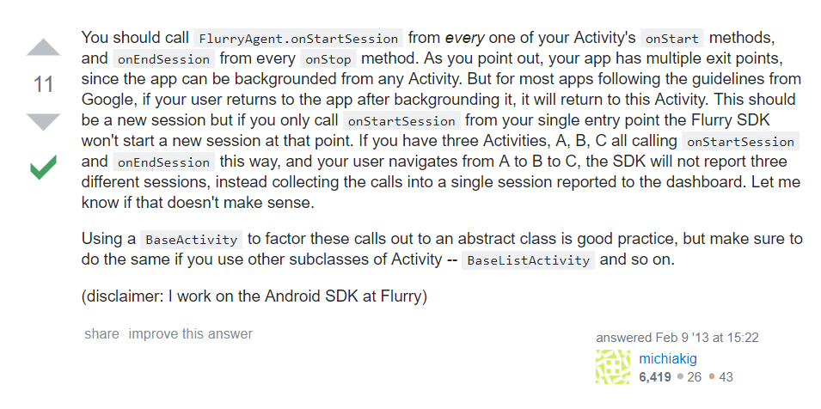
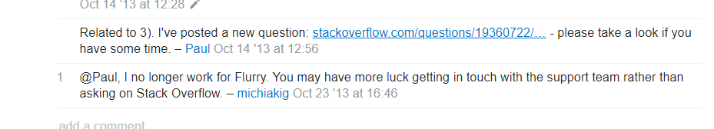

Slide 18
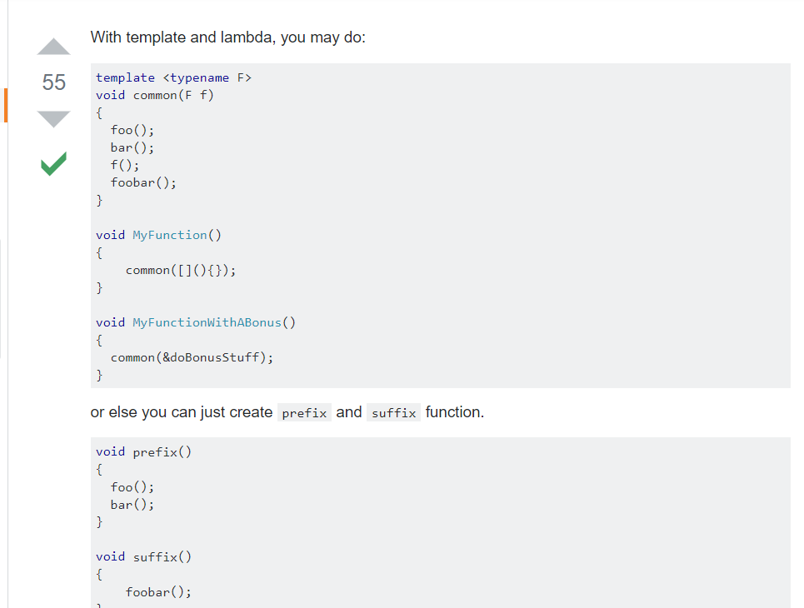
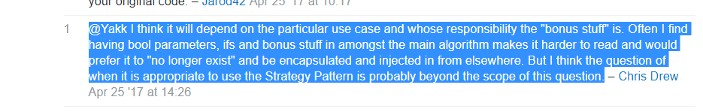

Slide 19
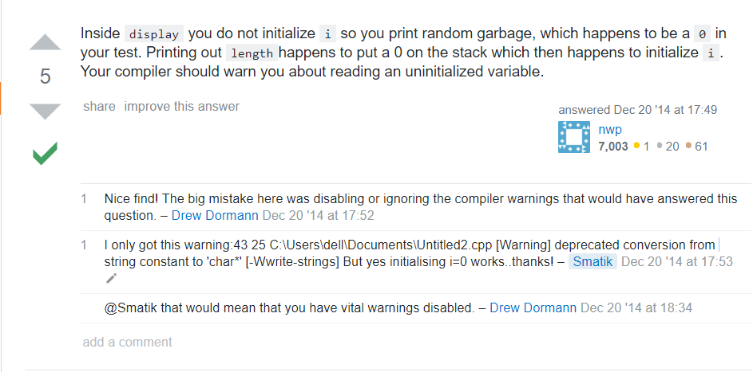

Slide 20
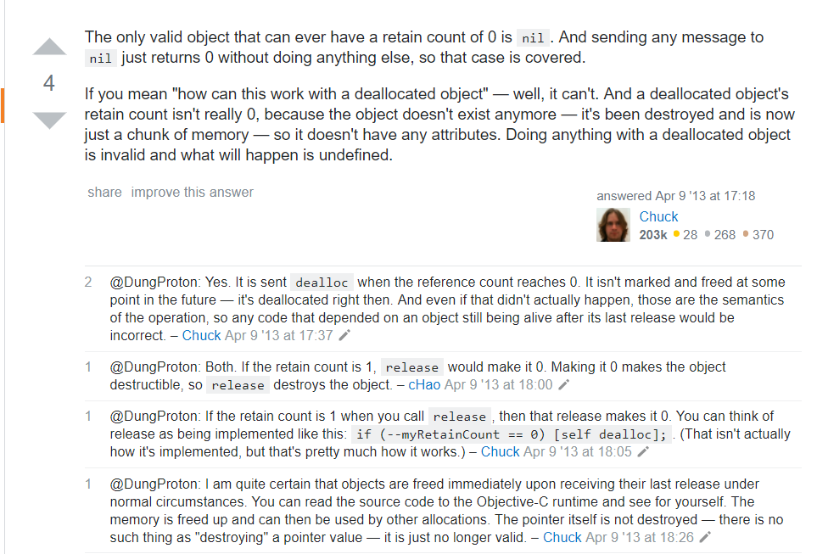

Slide 21
3.2 for the “not null” part ,find previous version(12178)

Slide 22
For the paper: 87842

