Slide 1
Weekly work

Slide 2
FastText
Observing data that are classified incorrectly
The feature is not obvious after data processing

Slide 3
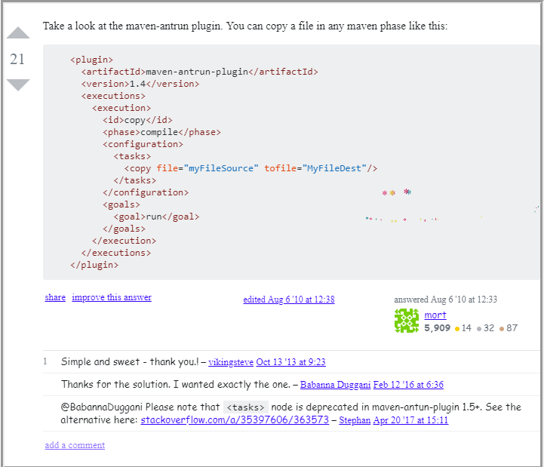

Slide 4
simple way to start, try jquery 1 $ #links .load /main_page #jq-p-getting-started li more at jquery docs 2 if you want to use iframes then start with wikipedia on iframes 3 doctype html public -//w3c//dtd html 4.01 transitional//en http://www.w3.org/tr/html4/loose.dtd > example the material below comes from the website http://example.com/ alternative text for browsers that do not understand iframes. 1 : http://jquery.com/ 2 : http://docs.jquery.com/ajax/load 3 : http://en.wikipedia.org/wiki/iframes

Slide 5
$cookie masi gmail.com,777 $cookie_tripped split , , $cookie echo cookie: . $cookie_tripped 0
customizing the layout can indeed be accomplished with resharper. go to: resharper->options->languages->c#->formatting style->type members layout and uncheck the use default patterns option.
//when select should be disabled: $ '#my_select' .attr 'disabled', 'disabled' //when select should not be disabled $ '#my_select' .removeattr 'disabled'

Slide 6
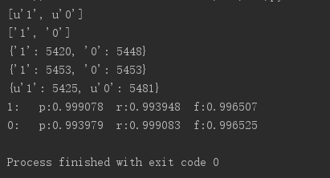
FastText model
Epoch = 25
Dim/hidden layer node = 200
Lr = 0.1
Window size 6
Word_ngrams = 2
90% for train (49059) and 10% for test
Try to change the dataset (0.991938)

Slide 7
TextCNN question
There is a big difference in the length of data in data sets.
The longest sentence has 3000 words
How to define the N in the input N*K of CNN, that is, how to define the length of the sequence of the input sentences, because for different sentences, the number of words contained is not the same.The input of CNN requires a fixed matrix N*K.
Filter size
How the net extract features
Sentence 2 Vec?

