Slide 1
Weekly work
20190411

Slide 2
Change Negative simple
Change the rules: view count > 10000
Html tag (html answers?)
<kbd></kbd> <a></a><em></em> <strong></strong> <pre></pre> <b></b><h1></h1><h2></h2> <li></li><i><li><ol></ol> <strong></strong> <p></p> <br></br> <dl></dl><ul></ul> <dt> </dt> <a href="URL"></a>

Slide 3
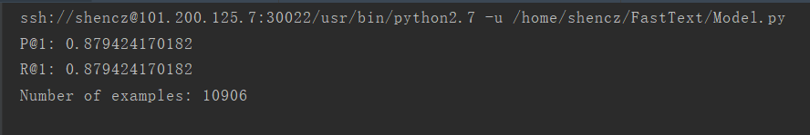
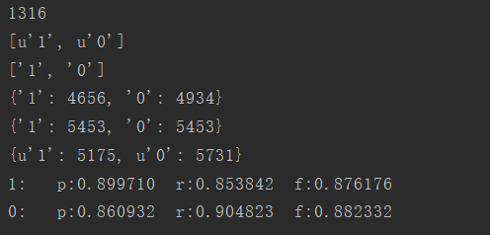
FastText

Slide 4
0 1 thanks guys for the record, this is line 176 in c: xampp apache conf httpd.conf note that you also have to edit line 203. also note that you have to use forward slashes / instead of back slashes and restart your server.
0 1 i haven't tried the sofware verify tools, but mozilla has tools that track overall memory consumed by firefox for the purpose of stemming leaks: http://www.mozilla.org/performance/tools.html https://wiki.mozilla.org/performance:leak_tools there's also this guy saying to avoid large arrays in the context of closures, towards article bottom http://ajax.sys-con.com/node/352585
0 1 quick expectedexception shortcut just a quick shortcut to add to my unit test attributes. shortcut : ee available in : available in: c# 2.0+ files where type member declaration is allowed expectedexception typeof $type$
0 1 this is a classic application for a queue data structure. a stack of size 10 would keep track of the first 10 elements you added to it, whereas a queue of size 10 would keep track of the 10 most recent elements. if you are looking for a recent items list, as suggested by the title of your question, then a queue is the way to go.
0 1 optionparser.parse_args returns an object with the option variable names as attributes, rather than as dictionary keys. the error you're getting means that options does not support subscripting, which it would normally do by implementing __getitem__ . so, in other words, your options are at: options.optiona options.optionb rather than: options 'optiona' options 'optionb' template variable substitution expects a dict -like interface, so it's trying to find optiona and optionb using the latter approach. use vars as roadierich suggests in his answer to make the template substitution approach work. alternatively, unless you really need a template object, i'd recommend using a simple print : print 'option a is s and option b is s' options.optiona, options.optionb
0 1 fading in or out can be achieved by changing the opacity of an element over time, a very simple example: var iframe document.getelementbyid 'iframe' fadeout iframe, 1000 function fadeout el, duration / param el - the element to be faded out. param duration - animation duration in milliseconds. / var step 1 / duration 10, opacity 1 function if opacity 0 return el.style.opacity opacity - step settimeout arguments.callee, 10
0 1 in the first class, sayhi is actually an instance method which you are calling as a static method and you get away with it because sayhi never refers to $this. static functions are associated with the class, not an instance of the class. as such, $this is not available from a static context $this isn't pointing to any object

Slide 5
0 1 this question is kind of old, but i just ran across this problem myself. this is my solution: jslider slider new jslider / your options here if desired / mouselistener listeners getmouselisteners for mouselistener l : listeners removemouselistener l // remove ui-installed tracklistener final basicsliderui ui basicsliderui getui basicsliderui.tracklistener tl ui.new tracklistener // this is where we jump to absolute value of click override public void mouseclicked mouseevent e point p e.getpoint int value ui.valueforxposition p.x setvalue value // disable check that will invoke scrollduetoclickintrack override public boolean shouldscroll int dir return false addmouselistener tl
0 1 well, you can call ssh from python... import subprocess ret subprocess.call ssh user host program # or, with stderr: prog subprocess.popen ssh user host program errdata prog.communicate 1
0 1 i blogged about simple asp.net module. you can check it here http://www.ilkeraksu.com/post/2009/07/14/very-very-simple-but-very-very-efficient-aspnet-tracking-module.aspx http://www.ilkeraksu.com/post/2009/07/14/very-very-simple-but-very-very-efficient-aspnet-tracking-module.aspx
0 1 something like this error handling omitted : file file fopen filename , a fseek file, -10, seek_end ftruncate fileno file , ftell file
0 1 this url has the comparisons of the different approaches along with some benchmarking: http://skymind.com/ ocrow/python_string/
0 1 you can do the following: var result from x in appentities where x.id 32 select x var sql system.data.objects.objectquery result .totracestring that will give you the sql that was generated.
0 1 click me to open in a new tab/window its the setting in a browser that determines whether to open the page in a new tab or in a new window.
0 1 here's why isinstance is better than type : class vehicle: pass class truck vehicle : pass in this case, a truck object is a vehicle, but you'll get this: isinstance vehicle , vehicle # returns true type vehicle vehicle # returns true isinstance truck , vehicle # returns true type truck vehicle # returns false, and this probably won't be what you want. in other words, isinstance is true for subclasses, too. also see: http://stackoverflow.com/questions/707674/how-to-compare-type-of-an-object-in-python
0 1 try this: grant all privileges on dbtest. to 'user' 'hostname' identified by 'password' with grant option
0 1 http://www.appelsiini.net/projects/lazyload demo: http://www.appelsiini.net/projects/lazyload/enabled.html
0 1 char name is sufficient. when you assign dolphin to name, the value of the pointer changes. finally, the delete name is wrong. it tries to delete the constant char dolphin which is not allocated on the heap. so, the entire code could read int main char name name dolphin cout your name is : name endl the compiler doesn't complain since your code didn't violate c++'s grammar

Slide 6
TextCNN
Embedding_dim:128
Filter_size:3,4,5
Num_filter:128
Dropout_keep_prob 0.5
L2 reg_lambda 1
Batch_size 64
Num_epochs 50
Max_random_length 80
0.9 for train and 0.1 for test
Evaluate on all training data Accuracy：0.980023

Slide 7
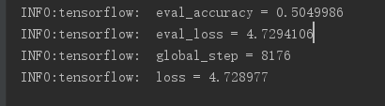
bert
Embedding_dim:768
Attention head: 12
Layer : 12
Batch_size 32
Hidden/Attention_dropout_prob 0.1
Position_embedding 512
Learning rate 5e-5
Max_random_length 128
0.8 for train and 0.1 for test and 0.1 for validate
Evaluate on all training data Accuracy：0.5049986

Slide 8
RNN
LSTM
Bidirectional Gru
Embedding_dim:10
Batch_size:128
Seq_max_len:60
Layer : 64
Learning rate: 0.015
0.9 for train and 0.1 for test
Evaluate on all training data Accuracy 0.510779113924
Embedding_dim:10
Batch_size:128
Seq_max_len:55
Layer : 64
Learning rate: 0.01
Fully connected layer:2
0.9 for train and 0.1 for test
Evaluate on all training data Accuracy： 0.508010126582

