Slide 1
Weekly work
20190411

Slide 2
Change Negative simple
Change the rules: view count > 10000
Html tag (html answers?)
<code>|</code>|<p>|</p>|<pre>|</pre>|<em>|</em>|<a>|</a>|<strong>|</strong>|<blockquote>|</blockquote>|<br>|</br>|<br/>
<ol>|</ol>|<li>|</li>|<ul>|</ul>|<h1>|</h1>|<h2>|</h2>|<h3>|</h3>|<kbd>|</kbd>|<i>|</i>|<hr>|</hr>|<sup>|</sup>|<s>|</s> <a href="URL">

Slide 3
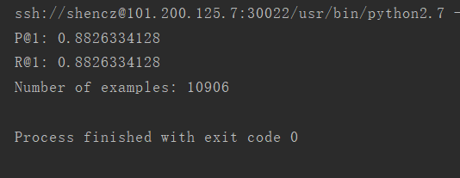
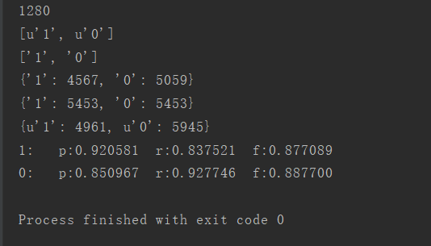
FastText

Slide 4
0 1 a simple example from the book dive into python works ok for me, [this](www.diveintopython.org/download/diveintopython-examples-5.4.zip) is the download link, the example is fileinfo.py. don't know if it's the best, but it can do the basic job.
0 1 i think what you're asking is you want a code-behind file for a resourcedictionary. you can totally do this! in fact, you do it the same way as for a window: say you have a resourcedictionary called myresourcedictionary. in your myresourcedictionary.xaml file, put the x:class attribute in the root element, like so: <resourcedictionary xmlns="http://schemas.microsoft.com/winfx/2006/xaml/presentation" xmlns:x="http://schemas.microsoft.com/winfx/2006/xaml" x:class="myresourcedictionary" x:classmodifier="public"> then, create a code behind file called myresourcedictionary.xaml.cs with the following declaration: partial class myresourcedictionary { ... } and you're done. you can put whatever you wish in the code behind: methods, properties and event handlers.
0 1 it's pretty simple. at the command line, navigate to your eclipse installation. for example: `cd /applications/eclipse/` one there, launch eclipse as follows: `./eclipse &` this will launch eclipse and immediately background the process. rinse and repeat to open as many unique instances of eclipse as you want. i'm not sure if there is a way to do this from the gui, but i'm comfortable at the command line so it's a no-brainer for me. hope that helps!
0 1 i think that the first case is more efficient because in the myclass[] arr = mylist.toarray(new myclass[0]); the runtime actually creates an empty array (with zero size) and then in the toarray method creates another array to fit the actual data.
0 1 in their homepage, at the [tour][1] you can see a partial list of office, tools and games that already run ok (or more or less) at reactos. if you subscribe to the newsletter, you'll receive info about much more - for instance, i was quite surprised when i read most sql server 2000 tools actually work on reactos!! query analyzer, osql and books online work fine, enterprise manager and profiler are buggy and the dbms won't work at all. at a former workplace (an all ms shop) we investigated seriously into it as a way to reduce our expenditure in licenses whilst keeping our in-house developed apps. since it couldn't run msde fine, we had to abandon the project - hope in the future this will be solved and my ex-coworkers can push it again. these announcements might as well be also on their homepage - i couldn't find them after 5 mins. of searching, though. probably the easiest way to know all these compatibility issues is to join the newsletter, or look for its archives. i have been tracking this os' progress for quite some time. i believe it has all the potential to really bring an oss operating system to the masses for it breaks the "chicken and egg" problem: it has applications and drivers from the very beginning (since it aims to have full abi compatibility with ms windows). just wait for their first beta, i won't be surprised if they surpass linux in popularity really soon after that... [1]:http://www.reactos.org/en/tour.html
0 1 seems like they explain it here: <http://www.easymodrewrite.com/notes-last> under "example 1
0 1 see the following article: <http://forums.wincustomize.com/3258>

Slide 5
0 1 sudo killall -9 firefox should work
0 1 `<form><input type="hidden" name="selval"><select onchange="this.form.selval.value=this.selectedindex"><option>val1</option><option>val2</option></select></form>` pure javascript from within a form
0 1 textarea, input{ outline:none;} although, it's been argued that keeping the glow/outline is actually beneficial for accessibility as it can help users see which element is currently focused.
0 1 your code also chops of zeros in numbers like "1000". a better variant would be to only chop of zeros that are after a decimal point. the basic replacement with regular expressions would look like this: str.replace(/(\.[1-9]*)0*$/$1/);
0 1 run this select case transaction_isolation_level when 0 then 'unspecified' when 1 then 'readuncomitted' when 2 then 'readcomitted' when 3 then 'repeatable' when 4 then 'serializable' when 5 then 'snapshot' end as transaction_isolation_level from sys.dm_exec_sessions where session_id = @@spid
0 1 seems to be all 64-bit processors has sse2. since compiler option always switched on by default no need to switch it on manually.
0 1 a logical expression which evaluates to true or false, normally to direct the execution path in code.
0 1 sometimes the object test bench is a bit clumsy; you can also use the much simpler immediate window: debug -> windows -> immediate. then you can type: mynamespace.myclass.mystaticmethod() [enter] if there's a breakpoint in the method, the debugger will start and break at that position. if you need to call an instance method: new mynamespace.myclass().instancemethod() [enter] you can also create variables and assign them return values--then call methods on those variables.
0 1 see the plugin: http://plugins.jquery.com/project/cookie you can then do: $.cookie("test", 1);
0 1 this may or may not be possible, depending on your windows installation. see the "implicitly setting the currentuiculture property" section at http://msdn.microsoft.com/en-us/library/441487wx.aspx for details. for additional information concerning the behaviour on various windows versions, see http://msdn.microsoft.com/en-us/library/dd374098(vs.85).aspx.

Slide 6
1 0 you have wrong where clause you need to compare user_id from your table ,you are comparing the id of email to the provided $user_id $ci- db- select('email'); $ci- db- from('emails'); $ci- db- where('user_id', $userid); $ci- db- join('user_email', 'user_email.user_id = emails.id', 'left'); $query = $ci- db- get(); a more useful way is to give aliases to your tables so the tables with same columns will not have any confusion $ci- db- select('e.email'); $ci- db- from('emails e'); $ci- db- join('user_email ue', 'ue.user_id = e.id', 'left'); $ci- db- where('ue.user_id', $userid); $query = $ci- db- get();
1 0 a table in lua is a set of key-value mappings with unique keys. the pairs are stored in arbitrary order and therefore the table is not sorted in any way. what you can do is iterate over the table in some order. the basic pairs gives you no guarantee of the order in which the keys are visited. here is a customized version of pairs, which i called spairs because it iterates over the table in a sorted order: function spairs(t, order) -- collect the keys local keys = {} for k in pairs(t) do keys[#keys+1] = k end -- if order function given, sort by it by passing the table and keys a, b, -- otherwise just sort the keys if order then table.sort(keys, function(a,b) return order(t, a, b) end) else table.sort(keys) end -- return the iterator function local i = 0 return function() i = i + 1 if keys[i] then return keys[i], t[keys[i]] end end end here is an example of use of such function: highscore = { robin = 8, jon = 10, max = 11 } -- basic usage, just sort by the keys for k,v in spairs(highscore) do print(k,v) end -- jon 10 -- max 11 -- robin 8 -- this uses an custom sorting function ordering by score descending for k,v in spairs(highscore, function(t,a,b) return t[b] t[a] end) do print(k,v) end -- max 11 -- jon 10 -- robin 8
1 0 //- just indent the comment like normal elements just indent your comment like you do other elements. just be careful that you have your indention correct or you may comment out more than you intended.
1 0 why do you install php over the package manager and apc over pecl? apt-get install php-apc is much easier and you get the correct package for apc.
1 0 no. jquery 1.9+ and 2.0+ are the same for newer browsers. the difference between 1.9x and up (including 1.10) and 2.0 and up is the 2.0+ branch gets rid of the extra code that provides support for legacy browsers. for newer browsers, you shouldn't see any difference (except possibly a faster jquery because of its smaller size.)
1 0 first drag a tabbarcontroller from object library you see that only two tabs with thier vc there. to add more tab item in tabbarvc drag vc from object library then control drag from tabbarvc to newly vc then segue relation pop ups select last one relationship segue -> view controllers
1 0 an alternative to overcome this is running the change detector manually. you first inject the changedetectorref: constructor(private changedetector : changedetectorref) {} then you call it after updating the variable that controls the *ngif show() { this.display = true; this.changedetector.detectchanges(); }
1 0 [chr(i) for i in range(ord('a'),ord('z')+1)]

Slide 7
1 0 what you are looking for is the youtube api's https://developers.google.com/youtube/android/player/reference/com/google/android/youtube/player/youtubeplayer#loadvideo%28java.lang.string%29loadvideo method. from the https://developers.google.com/youtube/android/player/reference/com/google/android/youtube/player/youtubeplayer#loadvideo%28java.lang.string%29docs: public abstract void loadvideo (string videoid) loads and plays the specified video. you can use it like this: @override public void oninitializationsuccess(youtubeplayer.provider provider, youtubeplayer player, boolean wasrestored) { this.player = player; player.loadvideo(video.id); // where video.id is a string of a youtube video id } in a similar vein, there is also the cuevideo method, which adds the video to the playlist, but does not automatically start playing the video.
1 0 you can use @testpropertysource to override values in application.properties. from its javadoc: test property sources can be used to selectively override properties defined in system and application property sources for example: <pre class=""lang-java prettyprint-override@runwith(springjunit4classrunner.class) @springapplicationconfiguration(classes = exampleapplication.class) @testpropertysource(locations=""classpath:test.properties"") public class exampleapplicationtests { }
1 0 note that math.hypot is part of the es2015 standard. there's also a good polyfill on the https://developer.mozilla.org/en-us/docs/web/javascript/reference/global_objects/math/hypotmdn doc for this feature. so getting the distance becomes as easy as math.hypot(x2-x1, y2-y1).
1 0 add this code after pdfreader definition pdfreader.unethicalreading = true;
1 0 if you are including the image as a resource, it is easiest to just edit the image yourself in a program like http://www.gimp.org/gimp. you can add your background there, and be sure of what it is going to look like and don't have use to processing power modifying the image each time it is loaded. if you do not have control over the image yourself, you can modify it by doing something like, assuming your bitmap is called image. bitmap imagewithbg = bitmap.createbitmap(image.getwidth(), image.getheight(),image.getconfig()); // create another image the same size imagewithbg.erasecolor(color.white); // set its background to white, or whatever color you want canvas canvas = new canvas(imagewithbg); // create a canvas to draw on the new image canvas.drawbitmap(image, 0f, 0f, null); // draw old image on the background image.recycle(); // clear out old image
1 0 for security reasons, your local drive is declared to be ""other-domain"" and will taint the canvas. (that's because your most sensitive info is likely on your local drive!). while testing try these workarounds: put all page related files (.html, .jpg, .js, .css, etc) on your desktop (not in sub-folders). post your images to a site that supports cross-domain sharing (like dropbox.com). be sure you put your images in dropbox's public folder and also set the cross origin flag when downloading the image (var img=new image(); img.crossorigin=""anonymous"" ...) install a webserver on your development computer (iis and php web servers both have free editions that work nicely on a local computer).

Slide 8
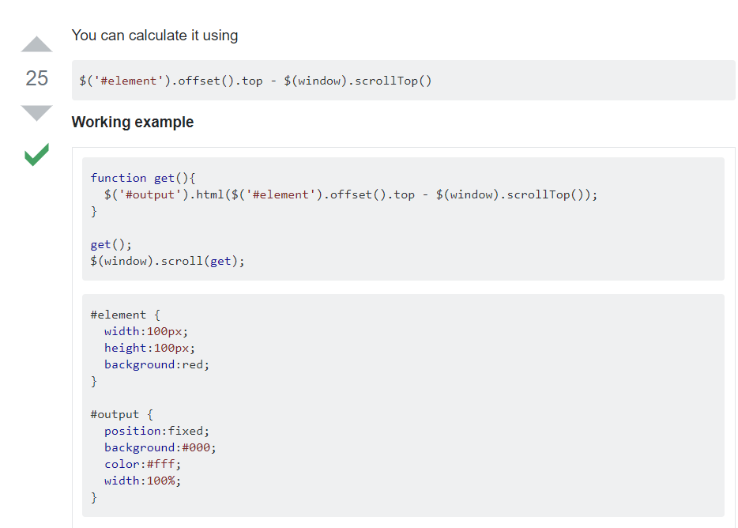
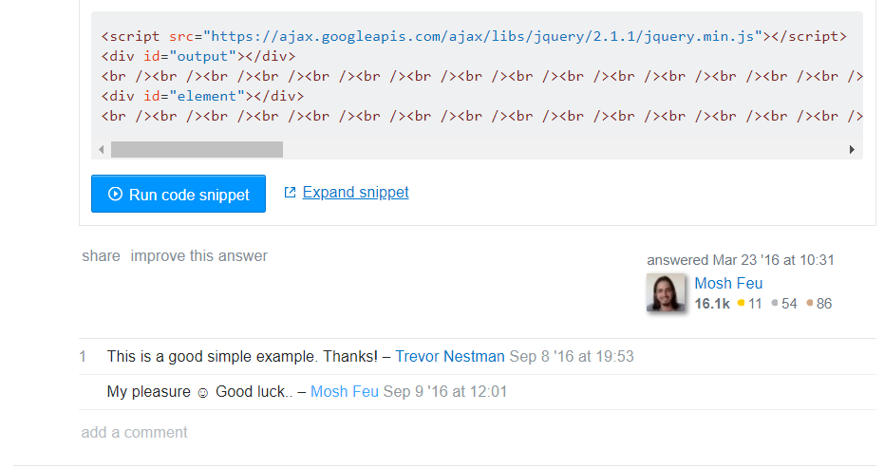

Slide 9
TextCNN
Embedding_dim:128
Filter_size:3,4,5
Num_filter:128
Dropout_keep_prob 0.5
L2 reg_lambda 1
Batch_size 64
Num_epochs 50
Max_random_length 80
0.9 for train and 0.1 for test
Evaluate on all training data Accuracy：0.980023

Slide 10
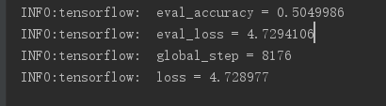
bert
Embedding_dim:768
Attention head: 12
Layer : 12
Batch_size 32
Hidden/Attention_dropout_prob 0.1
Position_embedding 512
Learning rate 5e-5
Max_random_length 128
0.8 for train and 0.1 for test and 0.1 for validate
Evaluate on all training data Accuracy：0.5049986

Slide 11
RNN
LSTM
Bidirectional Gru
Embedding_dim:10
Batch_size:128
Seq_max_len:60
Layer : 64
Learning rate: 0.015
0.9 for train and 0.1 for test
Evaluate on all training data Accuracy 0.510779113924
Embedding_dim:10
Batch_size:128
Seq_max_len:55
Layer : 64
Learning rate: 0.01
Fully connected layer:2
0.9 for train and 0.1 for test
Evaluate on all training data Accuracy： 0.508010126582

