Slide 1
工作汇报
吴 迪
2019.6.17

Slide 2
Data
23853 UIs (80%) for training
2983 UIs (10%) for testing
2981 UIs (10%) for validation
Cut images (800,1216,3)
Fixed the negative coordinates to 0

Slide 3
YOLOv3
"input_size": [416,416],
"batch_size": 8,
"decay”=0.0005,
"learning_rate":0.001,
"epoch": 50,
"categories": 75,

Slide 4

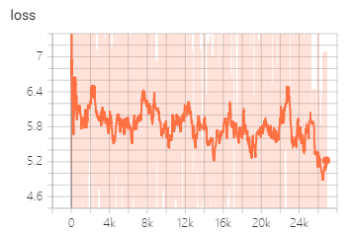
Testing result
iou = 0.5

Slide 5
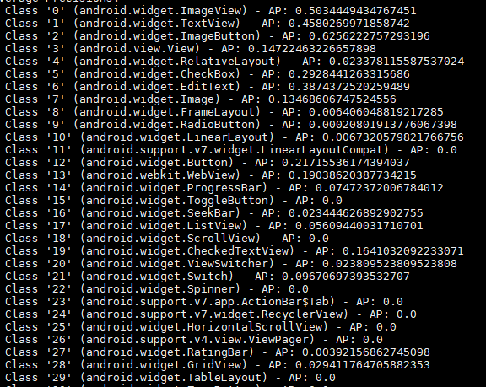
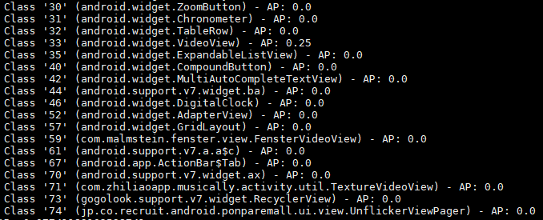
Testing result
Average precision for each category

Slide 6
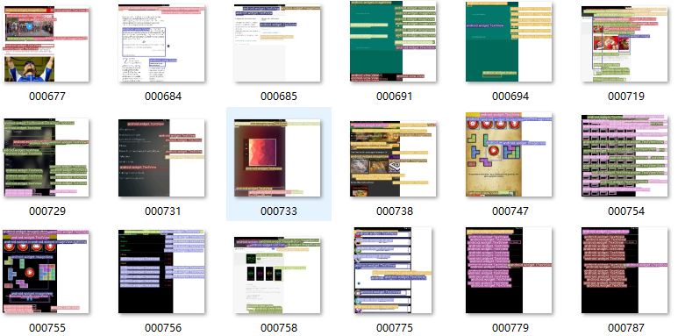
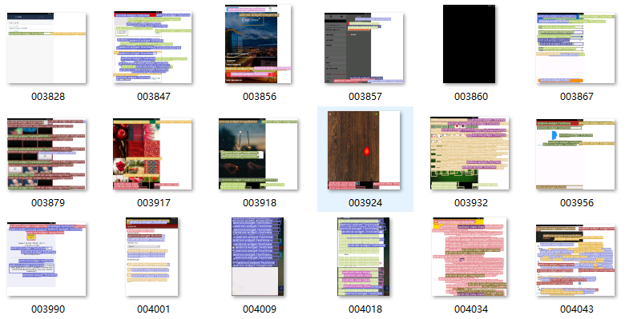
Testing result

Slide 7

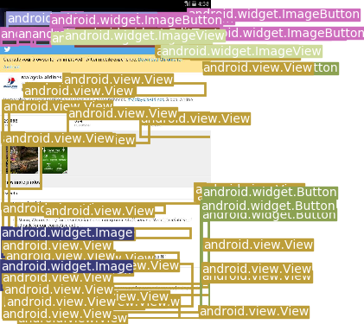
Testing Data

Slide 8
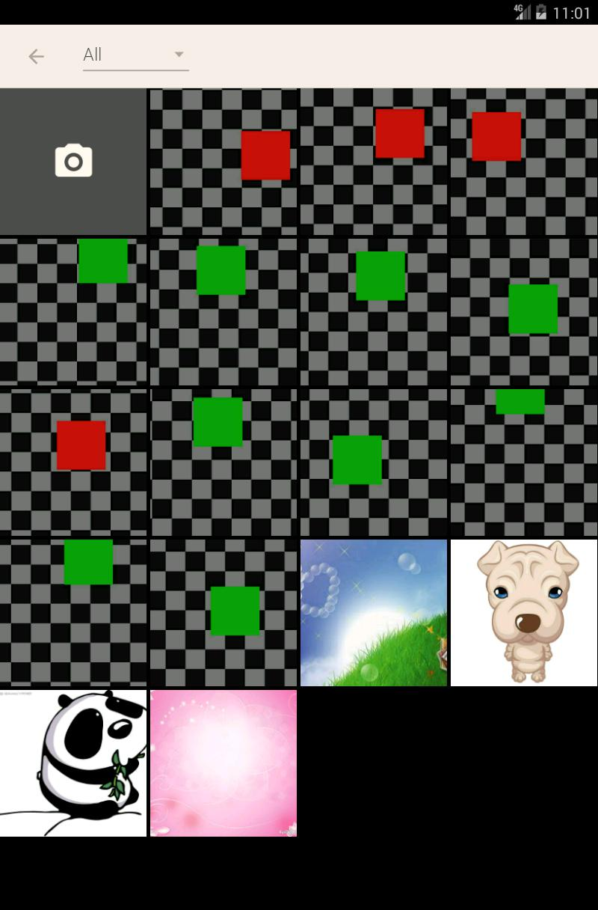
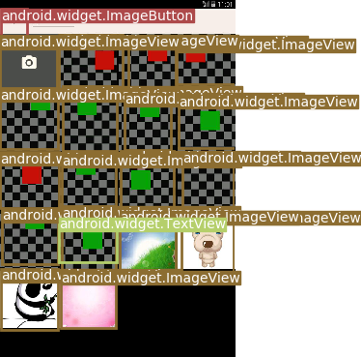
Testing Data

Slide 9
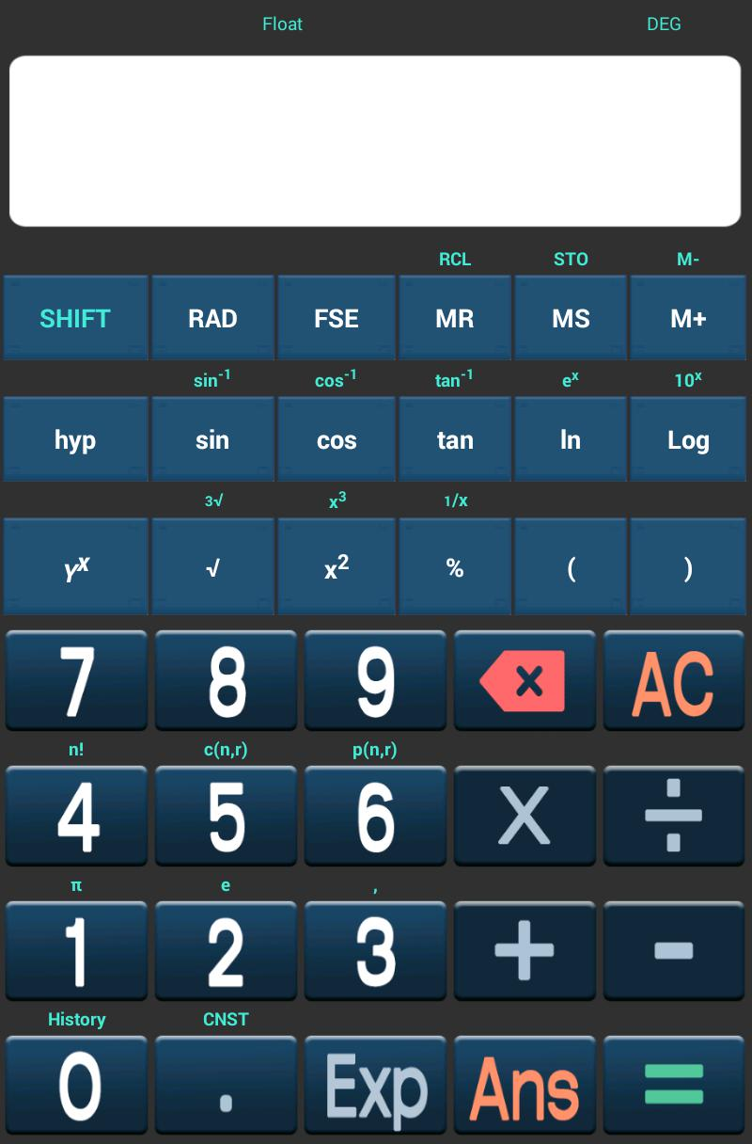
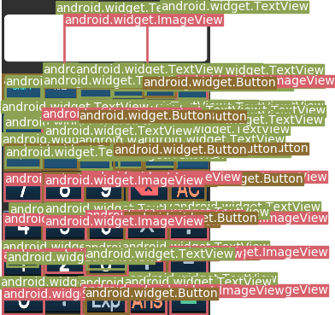
Testing Data

Slide 10
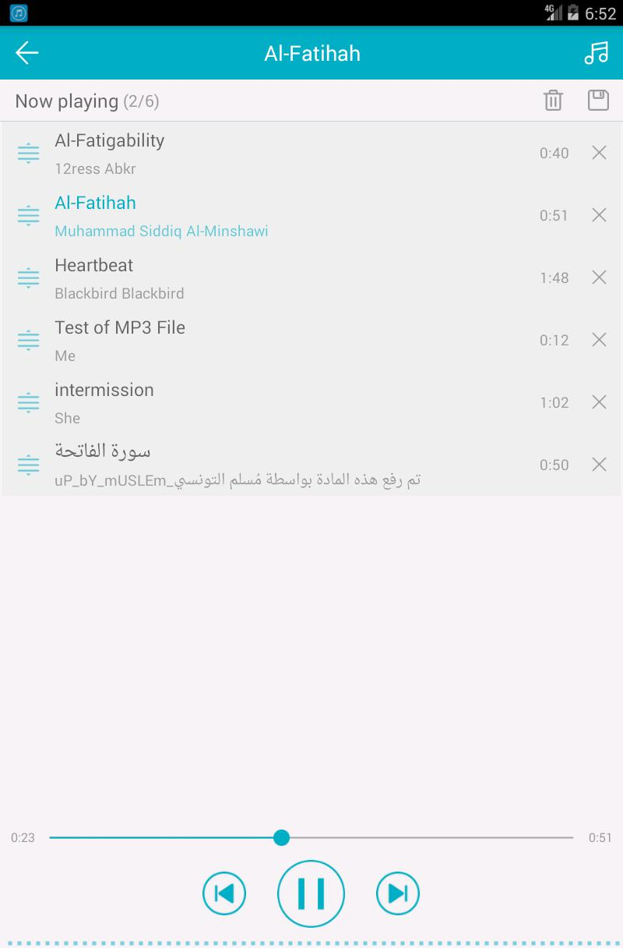
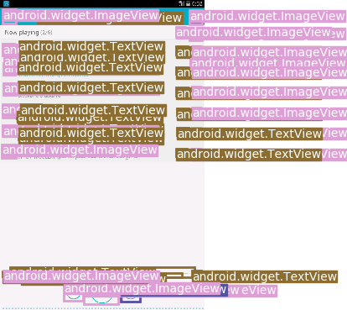
Testing Data

Slide 11
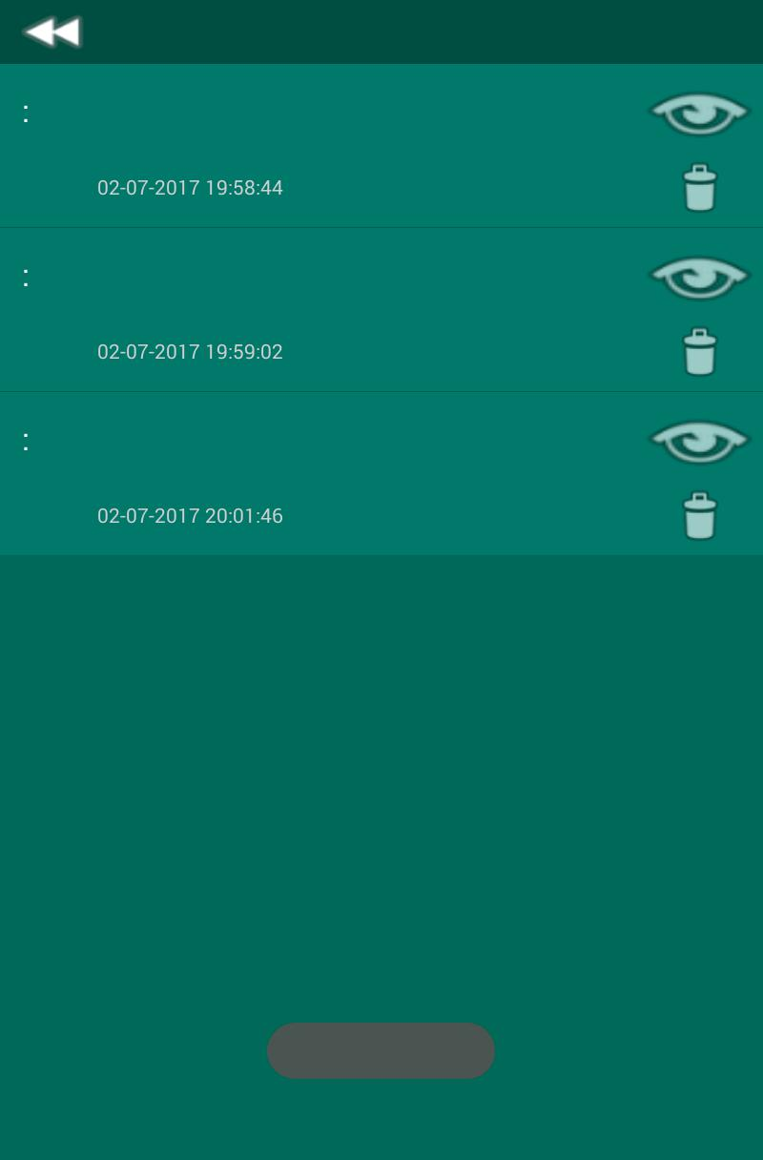
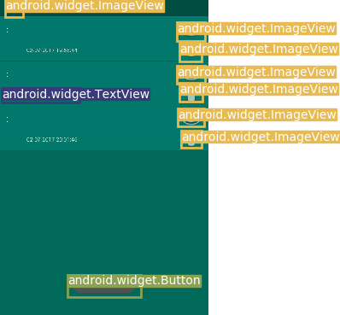
Testing Data

Slide 12

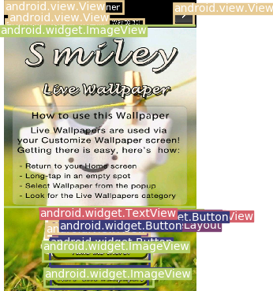
Testing Data

