Slide 1
Android UI design

Slide 2
Main work
一、 Appdivide into groups
二、 Color statistics
三、 Component statistics

Slide 3
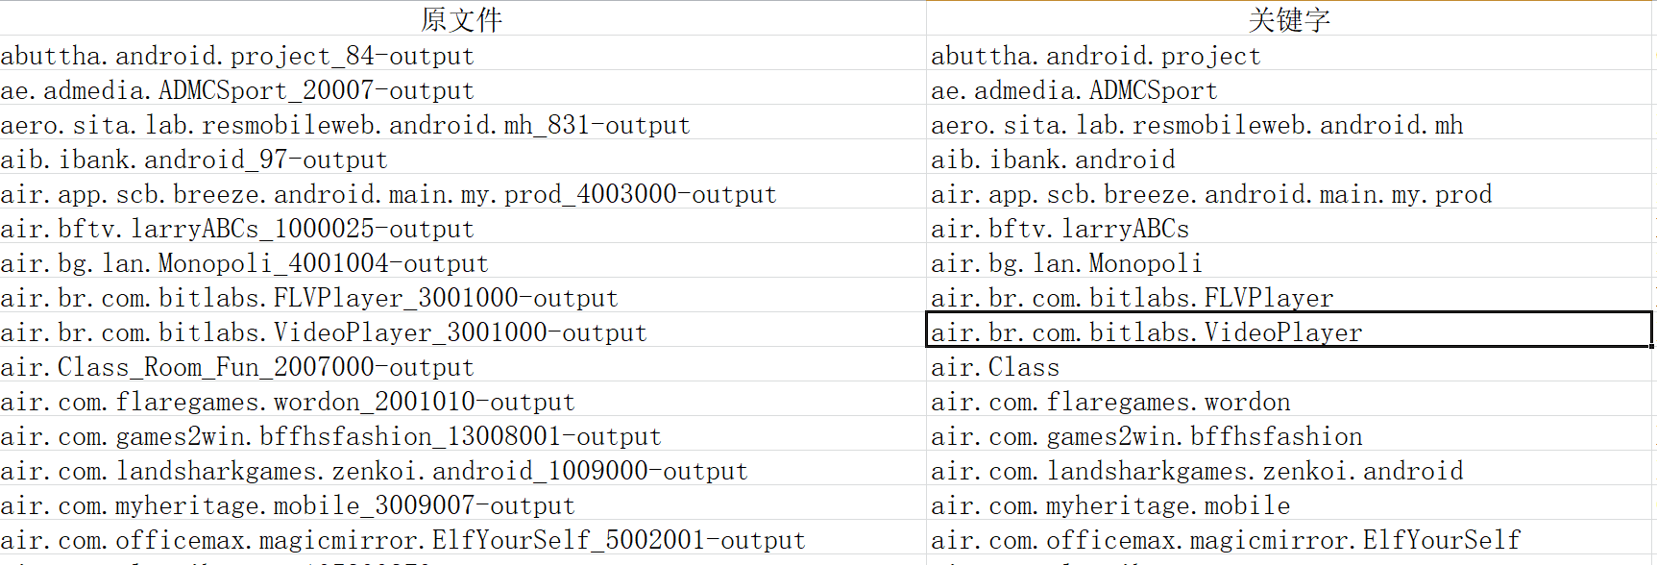
Appdivide into groups
Work progress last week ：
（1） The information of UI map library is matched with the meta.TXT text

Slide 4
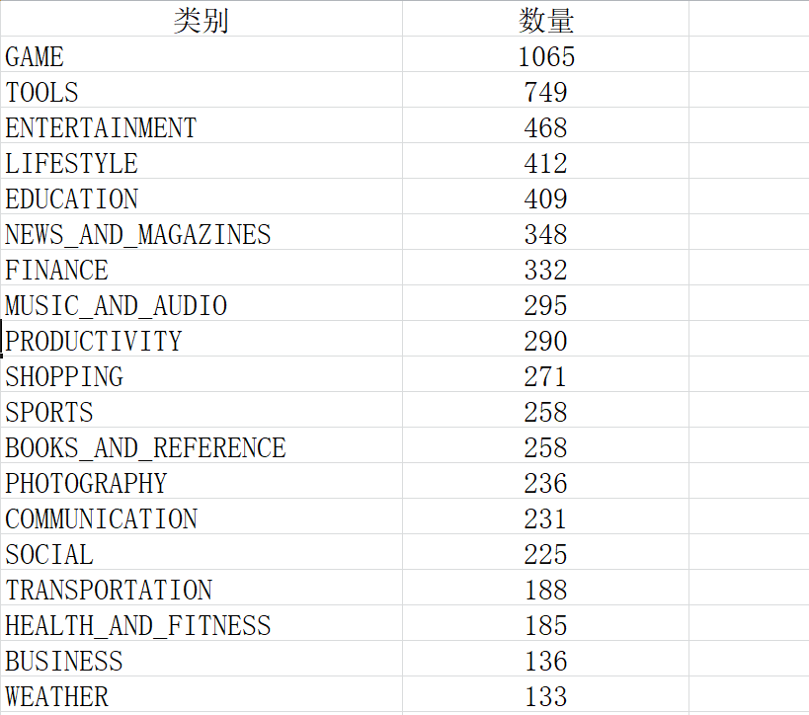
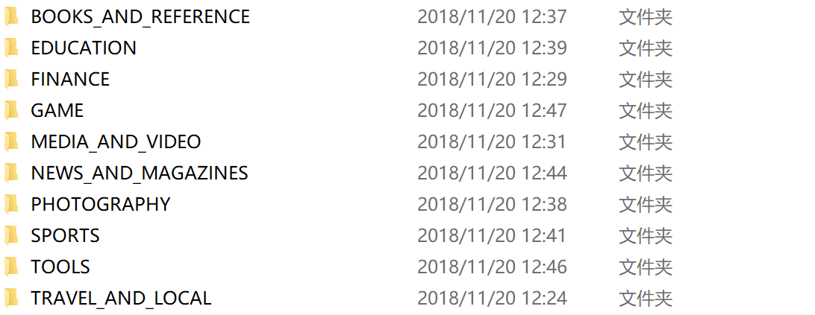
Appdivide into groups
Work progress last week ：
（2）Classification is based on the "Category" : "BUSINESS" type in the meta. TXT text

Slide 5
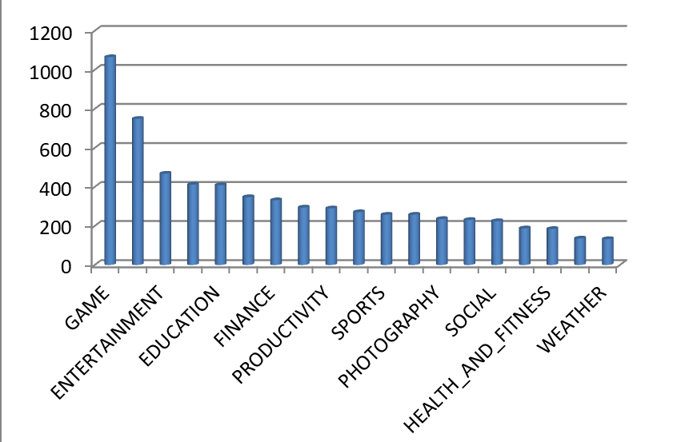
App divide into groups
Work progress last week ：
（3）divide into groups

Slide 6
Color statistics
Work progress last week ：
（1）The app screenshots in the UI gallery (to be deleted) are selected for color calculation
颜色 | 范围
黑色 | np.array([0, 0, 0]) np.array([180, 255, 46]
橙色 | np.array([11, 43, 46]) np.array([25, 255, 255]
白色 | np.array([0, 0, 221] np.array([180, 30, 255]

Slide 7
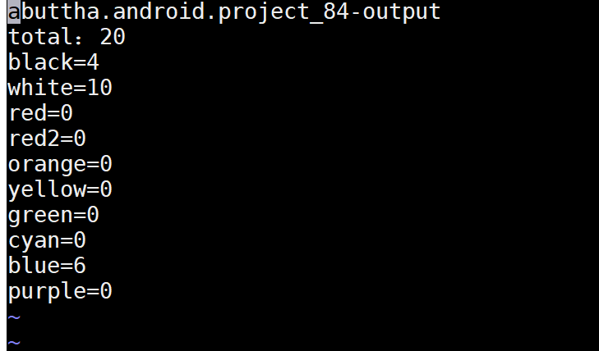
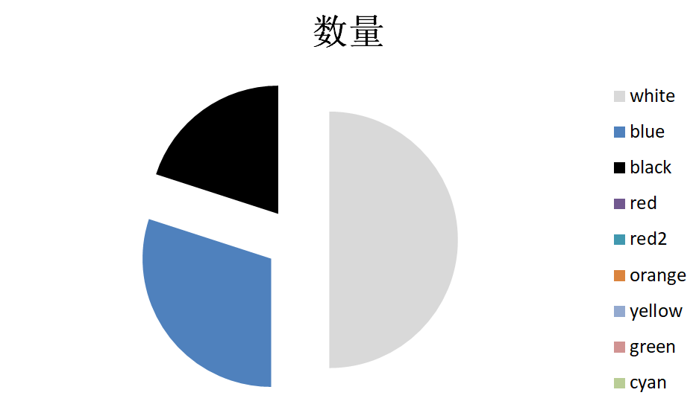
Color statistics
Work progress last week ：
（1）The app screenshots in the UI gallery (to be deleted) are selected for color calculation

Slide 8
Color statistics
Work progress last week ：
（1）The app screenshots in the UI gallery (to be deleted) are selected for color calculation
颜色 | 范围
黑色 | np.array([0, 0, 0]) np.array([180, 255, 46]
橙色 | np.array([11, 43, 46]) np.array([25, 255, 255]
白色 | np.array([0, 0, 221] np.array([180, 30, 255]

Slide 9
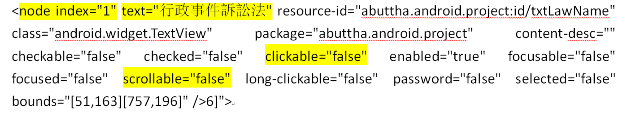
组件统计
Work progress last week ：
（1）Component information division in app-xml in UI library

Slide 10
Component statistics
Work progress last week ：
（1）Component information division in app-xml in UI library
分类 | 说明
index | ViewGroup中的序号 从0开始
text | 控件中显示的文本内容
class | 控件的类型
clickable | 是否允许click
scrollable | 是否允许滚动
password | 是否允许滚动
bounds | 控件绘制的长宽及位置 四个数据，分成两组，分别是 左上坐标和右下坐标

Slide 11
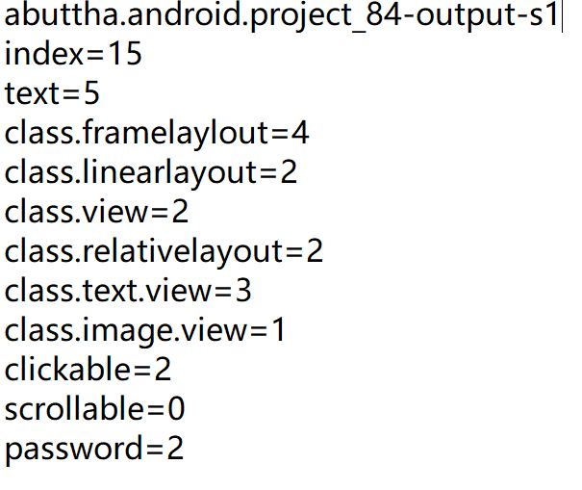
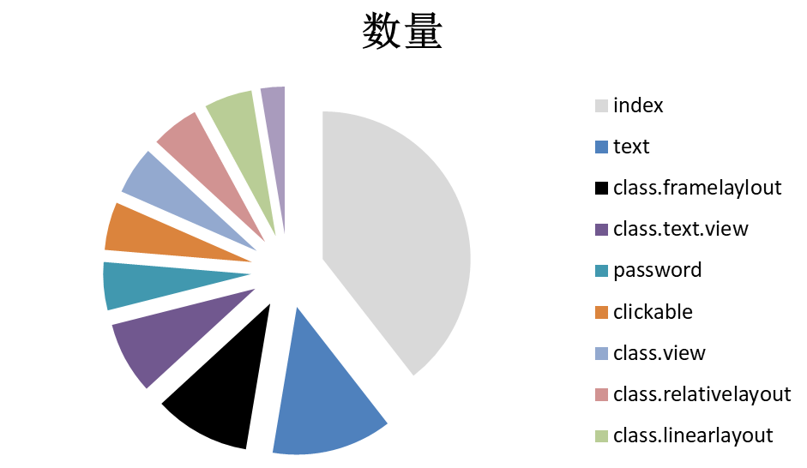
Component statistics
Work progress last week ：
（1）data statistics

