Slide 1
工作汇报
吴 迪
2019.7.29

Slide 2





Metrics
https://github.com/rafaelpadilla/Object-Detection-Metrics
Average Precision: The 11-point interpolation tries to summarize the shape of the Precision x Recall curve by averaging the precision at a set of eleven equally spaced recall levels [0, 0.1, 0.2, ... , 1]:
Notes:
recall>=r max Precision

Slide 3
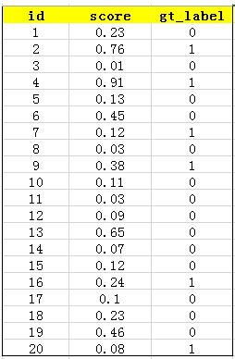
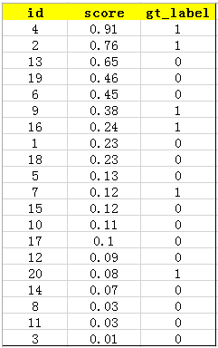
AP for each category
Test results will be recorded in the specified format for each category:
image_id confidence_score groundtruth_label
Each row can calculate its precision and recall

Slide 4
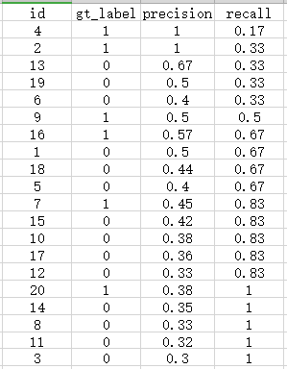
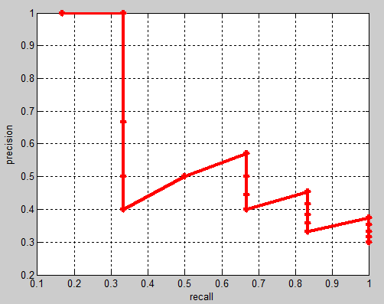
AP for each category
iou = 0.5 The first five is true positive. gt = 6
AP = (1+1+1+1+0.57+0.57+0.57+0.45+0.45+0.38+0.38)/11

Slide 5
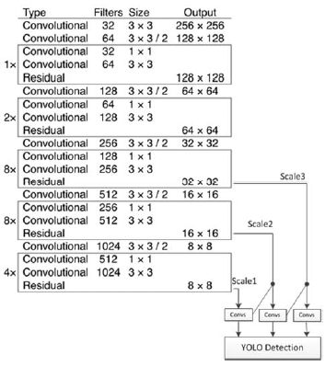
YOLOv3
input_image (608, 608)
anchors = [202,27, 93,14, 49,32,
509,14, 152,106, 76,42,
33,17, 16,12, 576,36]

Slide 6
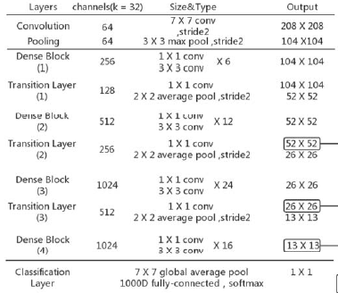
Helmet Detection Based On Improved YOLO V3 Deep Model
2019 IEEE, May 9-11,2019
YOLOv3-Densebackbone architecture,The size of the final three-scale feature map is set at 13×13, 26×26, and 52×52. The feature map of 13×13 is the output of the backbone network.The feature maps of 26×26 and 52×52 are upsampled by the previous output. The three scales respectively preserve the prediction results.They are used to predict large, medium and small objects, respectively.

Slide 7
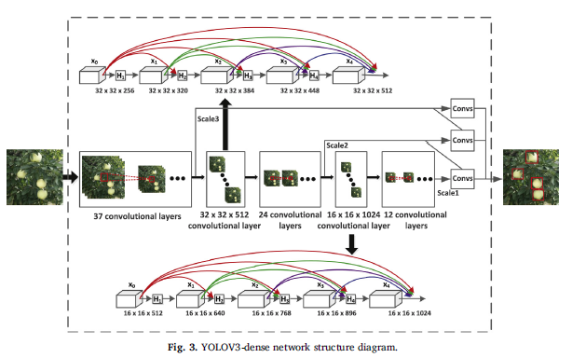
Apple detection during different growth stages in orchards using the improved YOLO-V3 model
Computers and Electronics in Agriculture 157 (2019) 417–426
The YOLOV3-dense model proposed in this paper predicts bounding boxes at three different scales: 64× 64, 32 × 32, and 16× 16.

Slide 8
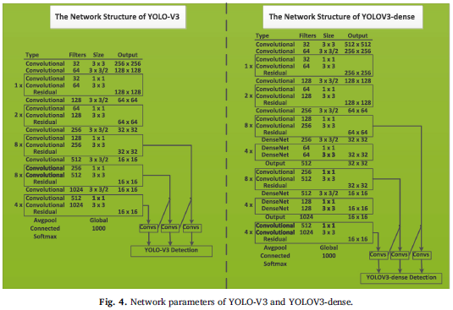
Apple detection during different growth stages in orchards using the improved YOLO-V3 model
Computers and Electronics in Agriculture 157 (2019) 417–426

