Slide 1
Android UI design
Jilin University

Slide 2
Main work
1、data processing

Slide 3
data processing
Work progress last week ：
（1）Identification of dominant hue
Identification of dominant hue
（1）Gets the image RGB value
（2）RGB converted to HSV spatial value
（3）K mean iteration in HSV spaces
（4）Convert the HSV value of the cluster to RGB display.

Slide 4
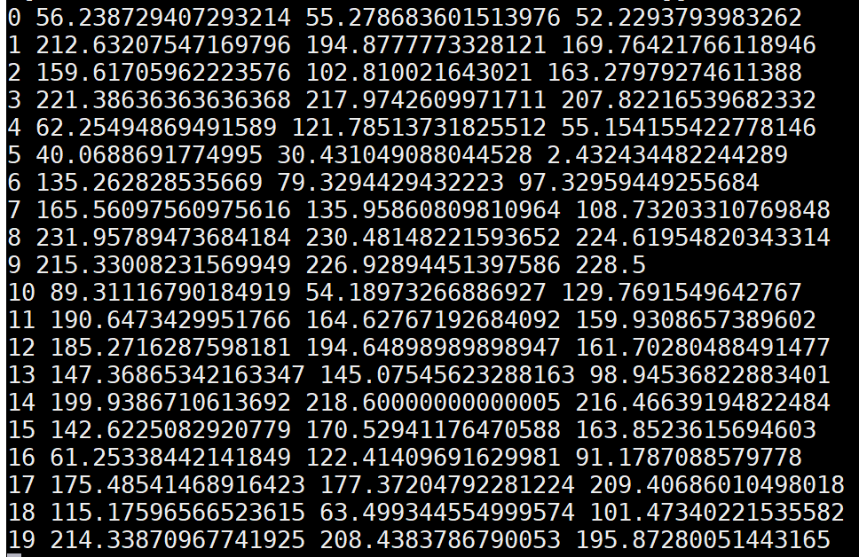
data processing
Work progress last week ：
  （1）Gets the image RGB value
Use PIL to intercept the image, then turn RGB to HSV to judge, judge the color, and finally output the RGB value.

Slide 5
data processing
Work progress last week ：
（2）RGB is converted to HSV spatial value.
By transformation formula

Slide 6
data processing
Work progress last week ：
（3） K mean iteration in HSV spaces
The initial point is based on the pixel size of the image to select the initial value of random.

Slide 7
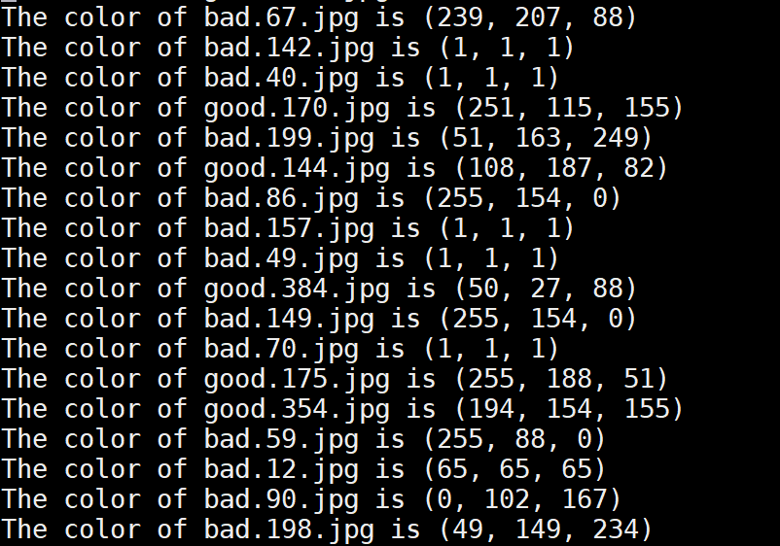
data processing
Work progress last week ：
（4）display picture
Convert the HSV value of the cluster to RGB display.

