Slide 1
Weekly work
shencz

Slide 2
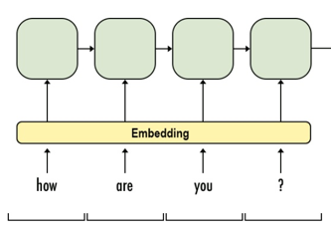
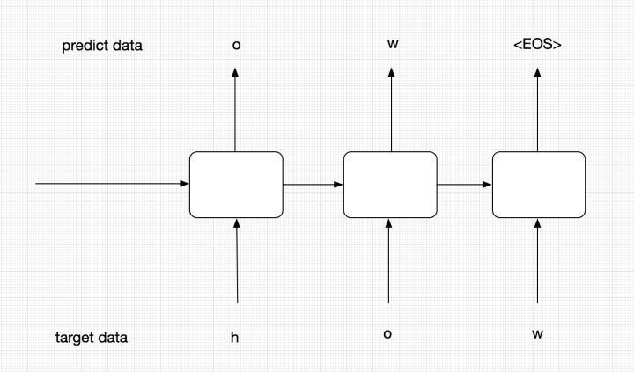
Model structure
joint

Slide 3
Result
Generates matrix with shape (2,50)
Embedding works with the similar name
Embedding methods in the same class, compute cos distance.
The vector is far away
Embedding methods in two classes, it doesn't differentiate in vector space

Slide 4
Problems
Connect the encoder state vector
Pad input data in each batch
In some case a method has no body or comments
In some case a class has only one method
The three encoder hyperparameters are the same

