Slide 1
工作汇报
吴 迪
2019.10.21

Slide 2

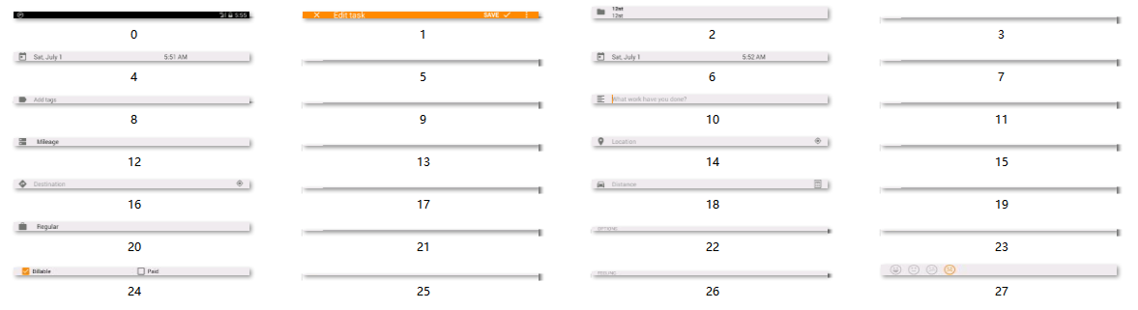
Hierarchy
Cut the image: first cut horizontally, then vertically, recursively.
1. cut horizontally

Slide 3




Hierarchy
2. cut vertically
cut horizontally

Slide 4
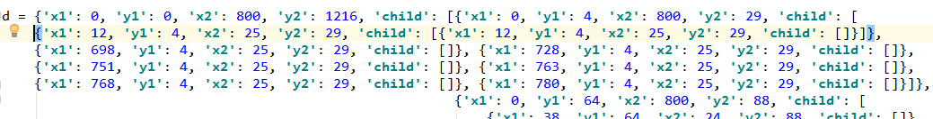
Hierarchy
Data storage format:

Slide 5
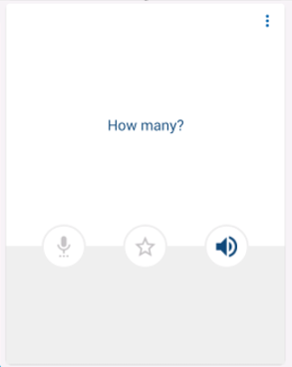



Next work
1.Padding
2.With a complicated background
3.Stop segmentation when you encounter text

