Slide 1
Weekly work
Shencz guosj

Slide 2
Sentiment analysis dictionary
negative
['avoid', 'bad', 'fails', 'least', 'redeeming', 'crap', 'only', 'awful', 'terrible', 'mess', 'half', 'stupid', 'not', 'save', 'nothing', 'like', 'have', 'disappointing', 'worse', 'money', 'any', 'footage', 'worst', 'pointless', 'uninteresting', 'waste', 'just', 'drags', 'horrible', 'plot', 'excuse', 'supposed', 'poorly', 'too', 'am', 'weak', '3', 'of', 'annoying', 'be', 'boring', 'problem', 'disappointment', 'attempt', 'unless', '1', 'seagal', 'why', 'lame', 'okay', 'the', 'no', 'ridiculous', 'oh', 'predictable', 'this', 'poor', 'sorry', 'sucks', 'looks', 'skip', "couldn't", 'given', 'minutes', 'forward', 'instead', 'even', 'original', 'lacks', 'director', 'dull', 'filmmakers', 'to', 'trying', 'unfortunately', '2', '4', 'sit', 'turkey', 'painful', 'wasted', 'disappointed', 'bother', 'hoping', 'badly', 'lousy', 'your', 'about', 'script', 'book', 'cover', 'acting', 'as', 'piece', "wouldn't", 'would', 'none', 'garbage', 'all', 'pretentious', 'pathetic', 'bunch', 'if', 'wood', 'bottom', 'looking', 'tries', 'at', 'beyond', 'uninspired', 'cheap', 'example', 'wonder', 'favor', 'interest', 'lack', 'neither', 'guess', 'laughable', 'below', 'suppose', 'make', 'cliché', 'a', 'reason', 'tried', 'ashamed', 'result', 'dreadful', 'on', 'tedious', 'cardboard', 'rented', 'insult', 'sucked', 'trash', 'nowhere', 'through', 'f', 'off', 'so', 'out', 'saving', 'point', 'might', 'crappy', 'interesting', 'rent', 'ok', 'grade', 'wooden', 'material', 'hard', 'rest', 'unintentional', 'mummy', 'total', 'wanted', 'should', 'i', 'disgusting', 'stinker', 'stay', 'disaster', "doesn't", 'hours', 'anything', 'thing', 'rip', 'could', 'complete', 'women', 'making', '0', 'enough', 'was', 'better', 'way', 'low', 'look', 'looked', 'away', 'bland', 'care', 'little', 'whole', 'stick', 'potential', 'far', 'shallow', 'actors', 'promising', "didn't", 'shoot', 'ruined', 'effort', 'dimensional', 'd', 'positive', 'walked', "sleeve's", 'synopsis', 'sadly', 'paid', 'premise', 'boredom', 'star', 'camera', 'disgrace', 'idea', 'rubbish', 'mildly', 'forgettable', 'embarrassing', 'old', 'appalling']
40/216

Slide 3
Sentiment analysis dictionary
positive
['loved', 'wonderful', 'favorite', 'thanks', 'kudos', 'excellent', 'best', 'great', 'is', 'a', 'joy', 'liked', 'funny', 'perfect', 'well', 'entertaining', 'fantastic', 'one', 'today', 'enjoyed', 'will', '10', '7', 'gem', 'classic', 'love', 'this', 'must', 'surprised', 'powerful', 'chance', 'bit', '8', 'change', 'our', 'recommend', 'brilliant', 'job', 'highly', 'life', 'performances', "it's", 'dvd', 'dirty', 'you', 'available', 'recommended', 'definitely', 'human', 'good', 'on', 'still', 'perfectly', 'funniest', 'moving', 'very', 'greatest', 'enjoyable', 'awesome', 'worth', 'amazing', 'notch', 'those', 'stewart', 'believable', 'emotions', 'it', 'superb', 'heart', 'incredible', 'fun', 'the', 'strong', 'realistic', 'my', 'first', 'beautiful', 'think', 'happy', 'easy', 'world', 'lot', 'hilarious', 'see', 'enjoy', 'time', 'masterpiece', 'edge', 'pleasantly', 'times', 'outstanding', 'appreciate', 'thoroughly', 'miss', 'captures', 'twists', 'and', 'to', 'symbol', 'impressed', 'of', 'way', 'paced', 'series', 'sarandon', 'true', 'dr', 'finest', 'adds', 'beautifully', 'makes', 'i', '9', 'solid', 'may', 'wonderfully', 'exciting', 'refreshing', 'treat', 'buy', 'matthau', 'terrific', 'thank', 'different', 'copy', 'favourite', 'movie', 'day', 'portrayal', 'especially', 'brilliantly', 'wait', 'always', 'seat', 'as', 'holds', 'he', 'shows', 'watch', 'touching', 'touched', 'fine', 'moved', 'little', 'plenty', 'subtle', 'rare', 'battle', 'show', 'right', 'sox', 'provoking', 'what', 'deserves', 'cried', 'unlike', 'delightful', 'also', 'though', 'simple', 'jackson', 'intense', 'nice', 'once', 'top', 'underrated', 'everyone', 'most', 'up', 'unique', 'subtitles', 'fortunate', 'every', 'fascinating', 'seen', 'heard', 'in', 'hooked', 'real', 'warming', 'favorites', 'come', 'flawless', 'images', 'tells', 'courage', 'glad', 'how', 'buffalo', 'own', 'know', 'matter', 'fu', 'works', 'surprisingly', 'war', 'an', 'kung', 'oscar', 'power', 'journey', 'tony', 'atmosphere', 'carries', 'thumbs', 'noir', 'surprise']
44/207

Slide 4
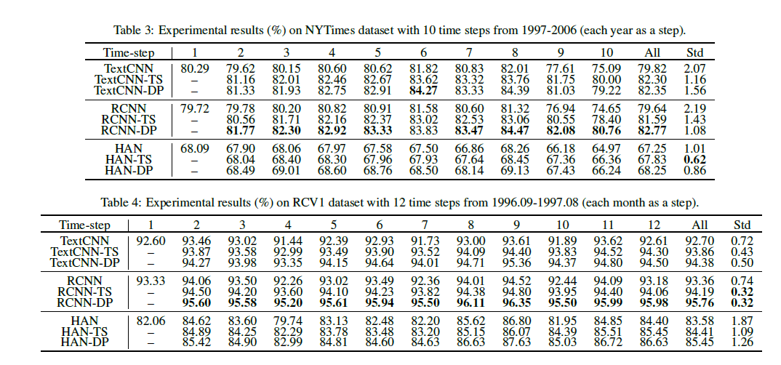
AAAI and IJCAI baseline
Time-evolving Text Classification with Deep Neural Networks

Slide 5
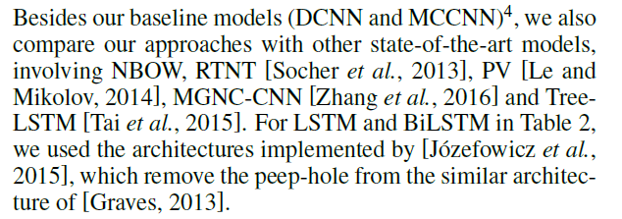
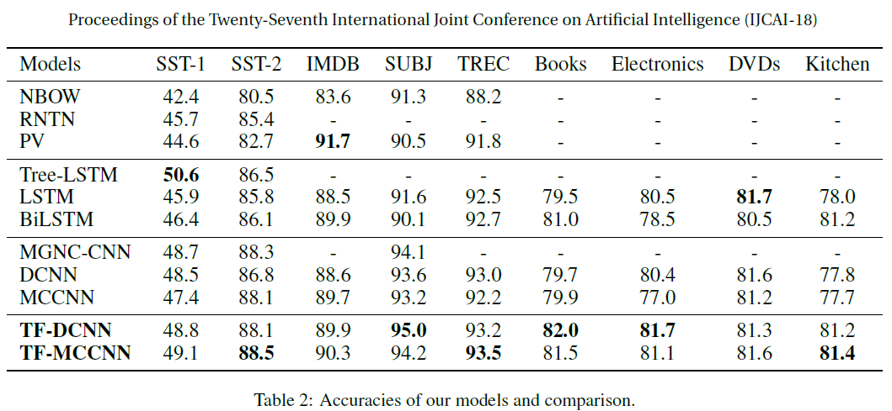
AAAI and IJCAI baseline
Transformable Convolutional Neural Network for Text Classification

Slide 6
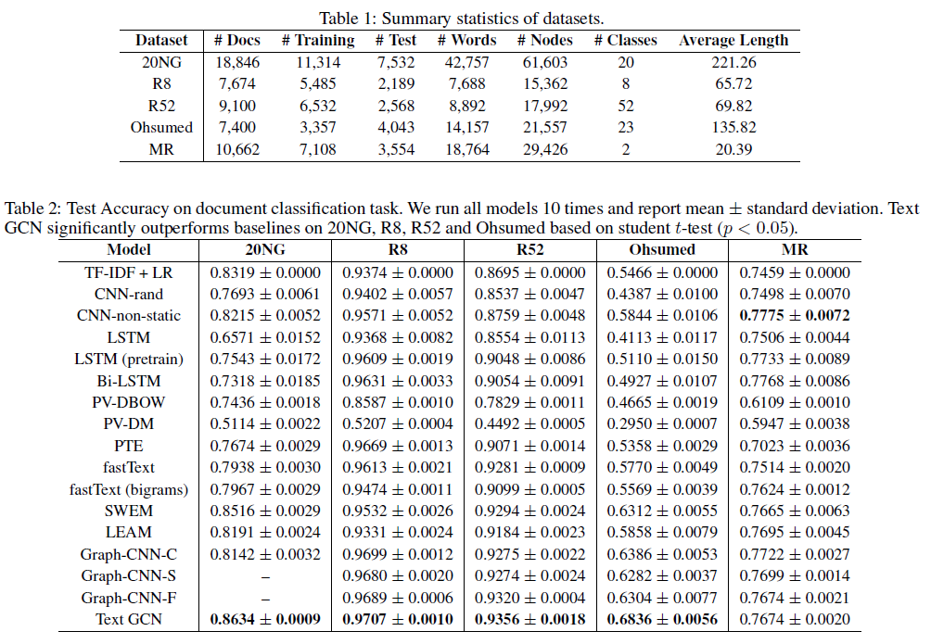
AAAI and IJCAI baseline
Graph Convolutional Networks for Text Classification

Slide 7
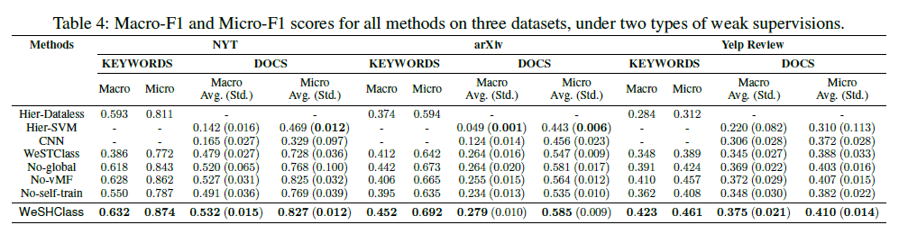
AAAI and IJCAI baseline
Weakly-Supervised Hierarchical Text Classification

Slide 8
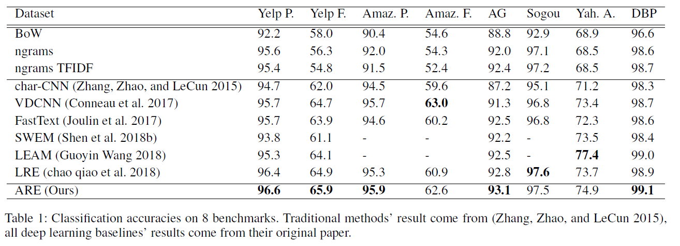
AAAI and IJCAI baseline
Adaptive Region Embedding for Text Classification

Slide 9
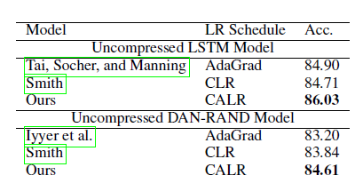
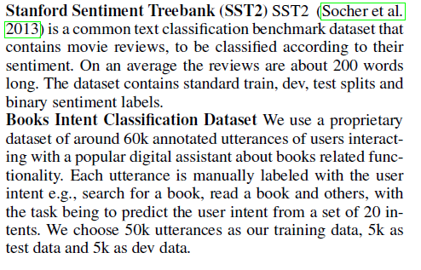
AAAI and IJCAI baseline
Online Embedding Compression for Text Classification using
Low Rank Matrix Factorization

Slide 10
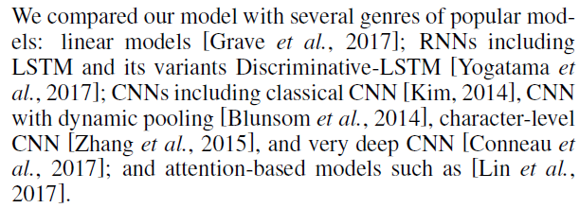
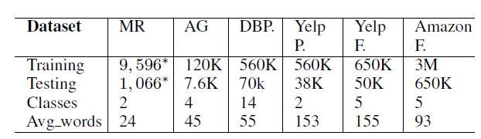
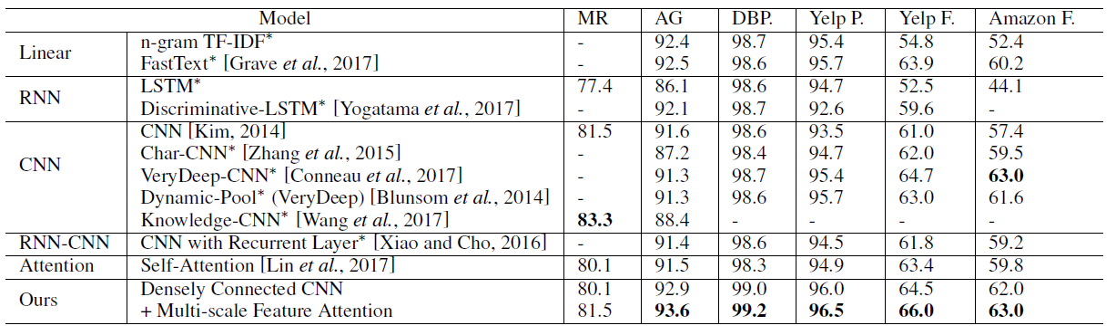
AAAI and IJCAI baseline
Densely Connected CNN with Multi-scale Feature Attention for Text Classification

Slide 11
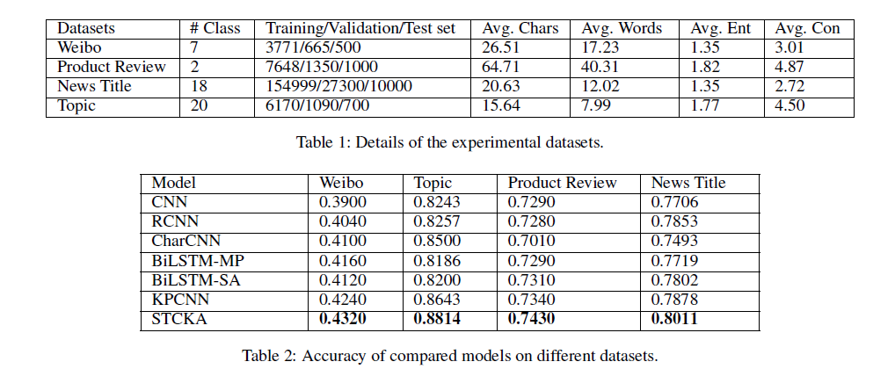
AAAI and IJCAI baseline
Deep Short Text Classification with Knowledge Powered Attention

Slide 12
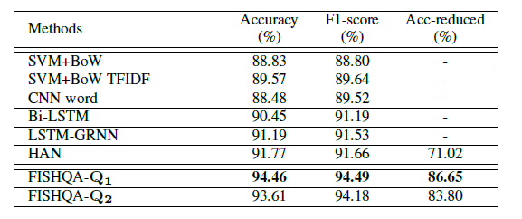
AAAI and IJCAI baseline
Beyond Polarity: Interpretable Financial Sentiment Analysis with Hierarchical Query-driven Attention

Slide 13
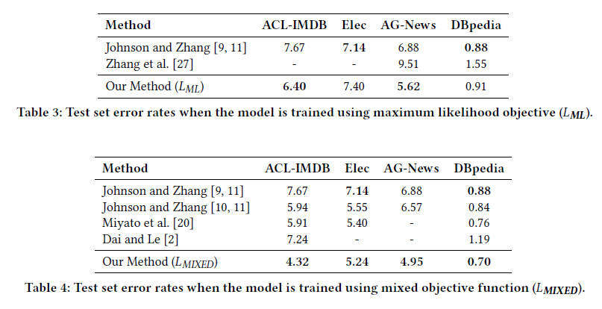
AAAI and IJCAI baseline
Revisiting LSTM Networks for Semi-Supervised Text Classification via Mixed Objective Function

Slide 14
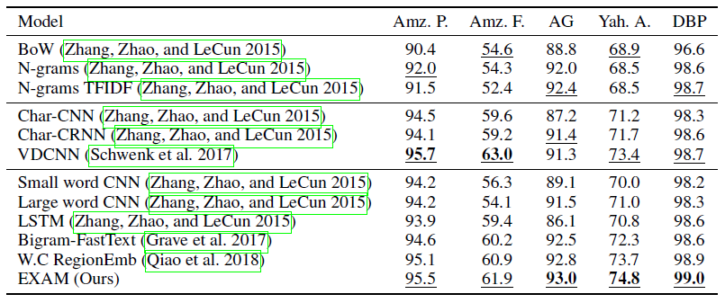
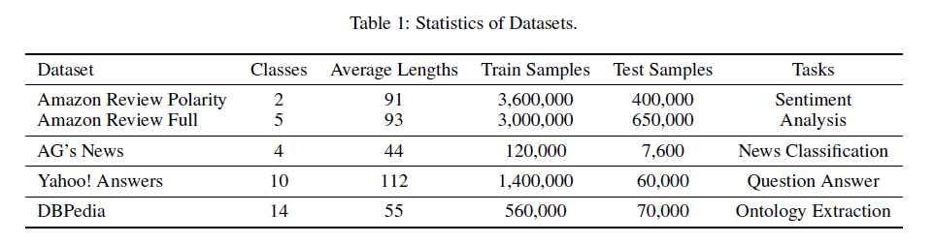
AAAI and IJCAI baseline
Explicit Interaction Model towards Text Classification

Slide 15
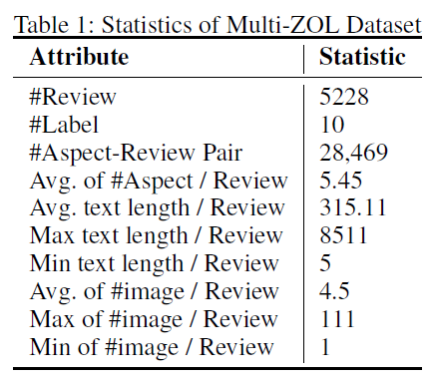
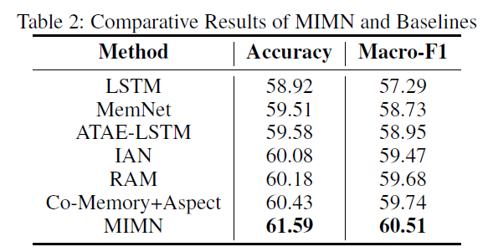
AAAI and IJCAI baseline
Multi-Interactive Memory Network for Aspect Based Multimodal Sentiment Analysis

Slide 16
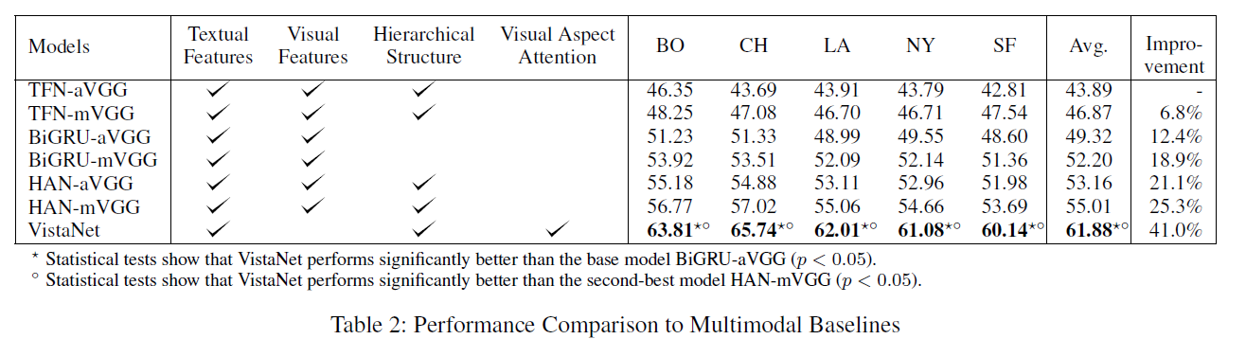
AAAI and IJCAI baseline
VistaNet: Visual Aspect Attention Network for Multimodal Sentiment Analysis

Slide 17
Attention based model
Attention based CNN
Attention based LSTM
Self-attention (transformer)
Hierarchical Attention Network

Slide 18
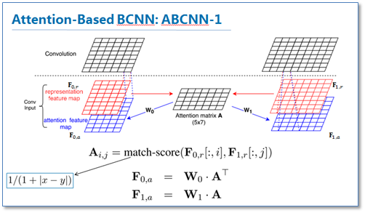
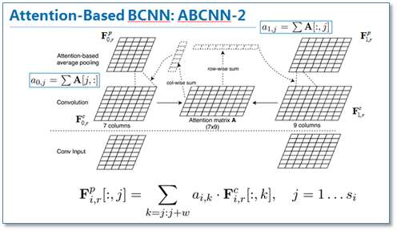
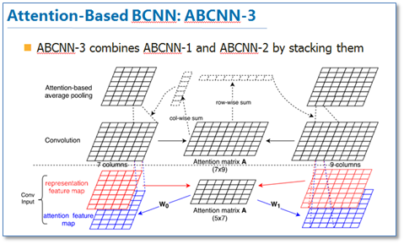
Attention based CNN

Slide 19
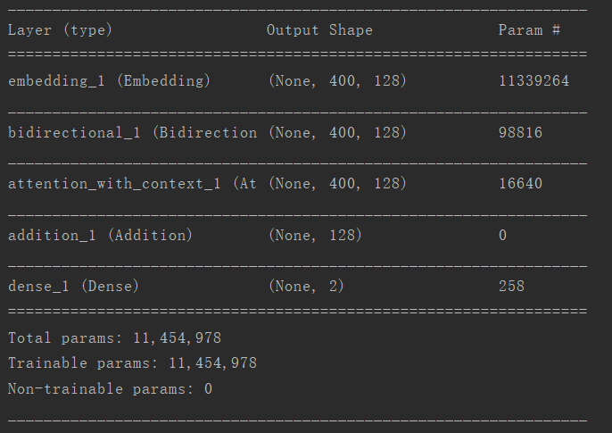
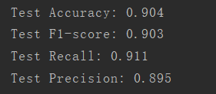
Attention based biLSTM

Slide 20
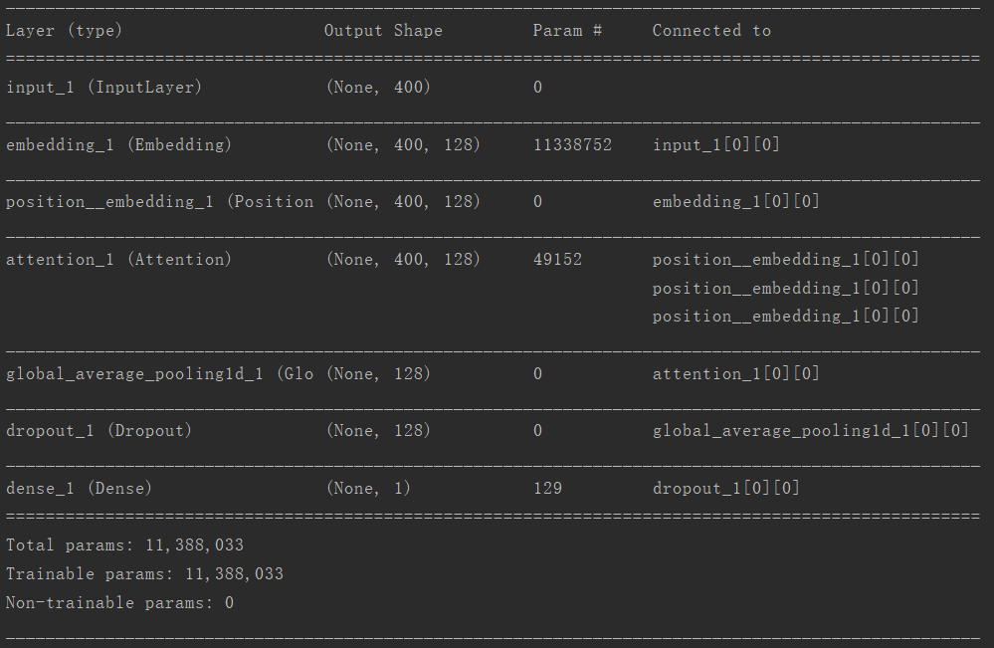

Attention is all you need

Slide 21
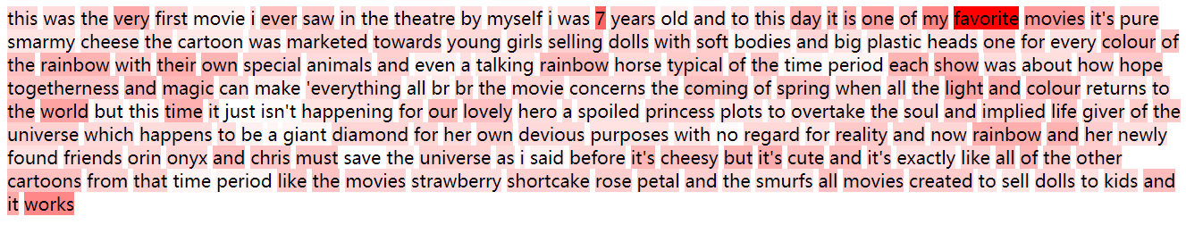
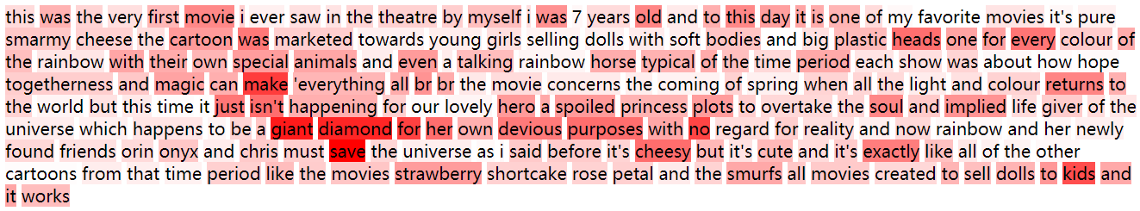
Fasttext：predict positive by sigmoid 0. 98868597, label is positive.
transformer：predict positive by sigmoid 0.9556986, label is positive.

Slide 22
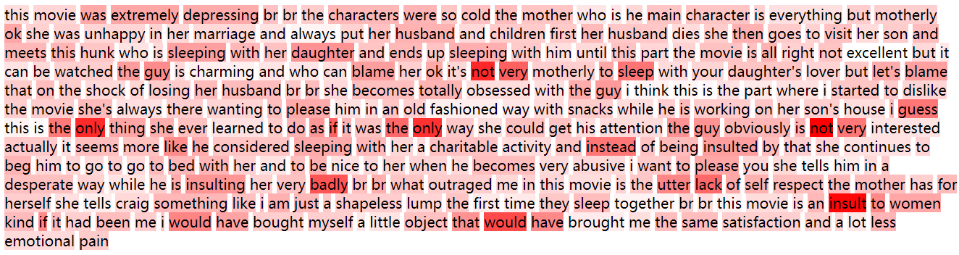
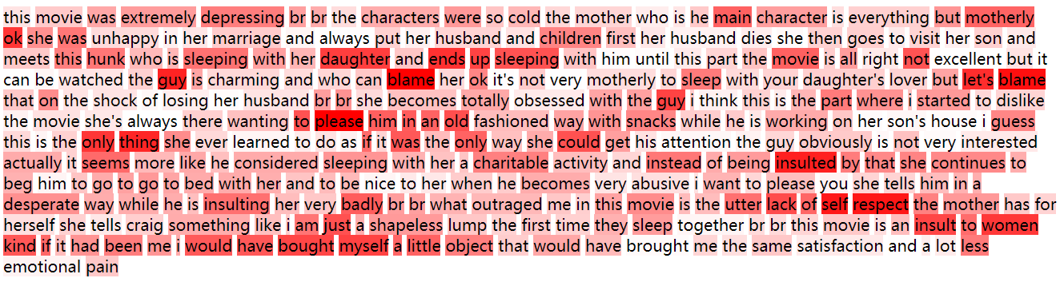

Slide 23
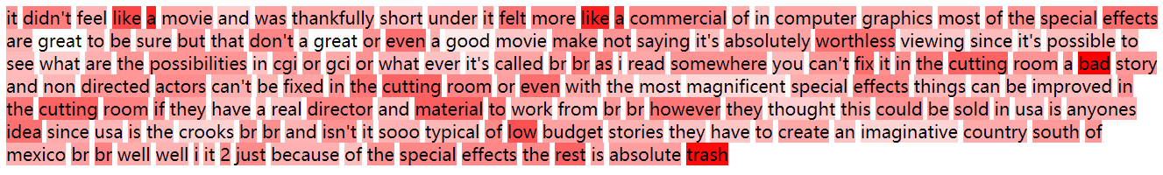
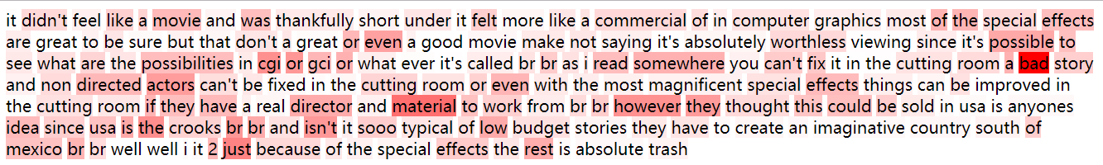
Fasttext：predict negative by sigmoid 0.1914635, label is negative.
transformer：predict positive by sigmoid 0.5118147, label is negative.

