Slide 1
工作汇报
吴 迪
2019.10.14

Slide 2
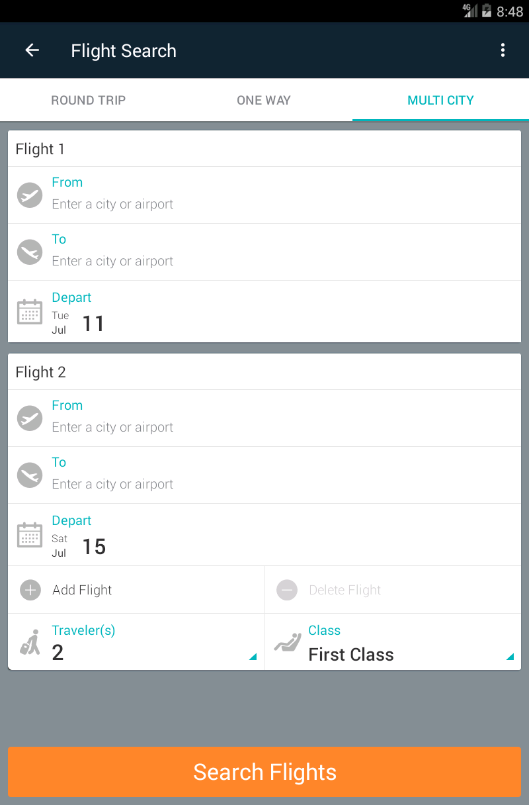
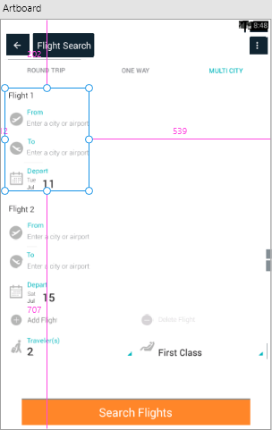
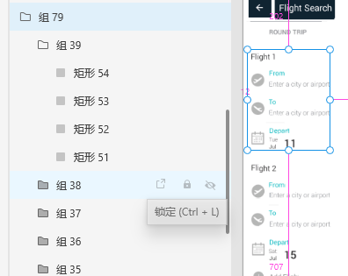
Hierarchy

Slide 3
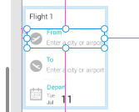
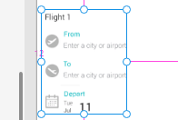
Hierarchy
1.First, the detected components are traversed from the top left corner to form a group that belongs to a line.
2.Find the color boundary of the picture, divide the picture into several parts, and combine the groups of each part together.

