Slide 1
工作汇报
吴 迪
2019.9.2

Slide 2
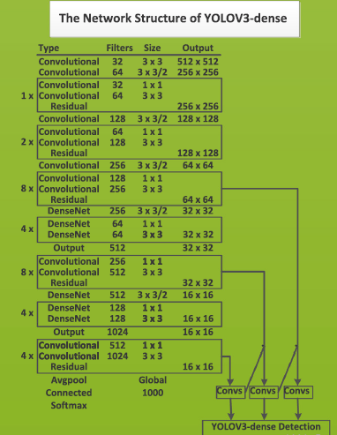
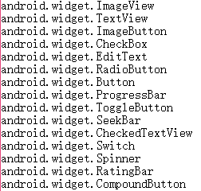
YOLOv3
input_image (608, 608)
DenseNet backbone
anchors = [202,27, 93,14, 49,32,
509,14, 152,106, 76,42,
33,17, 16,12, 576,36]
categories:

Slide 3
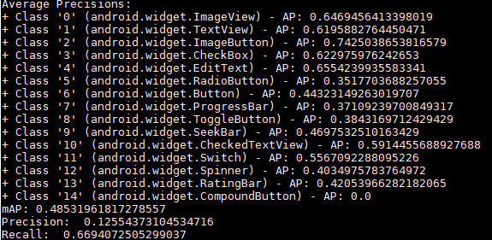
YOLOv3 testing result
DenseNet backbone
iou = 0.5 epoch-48

Slide 4
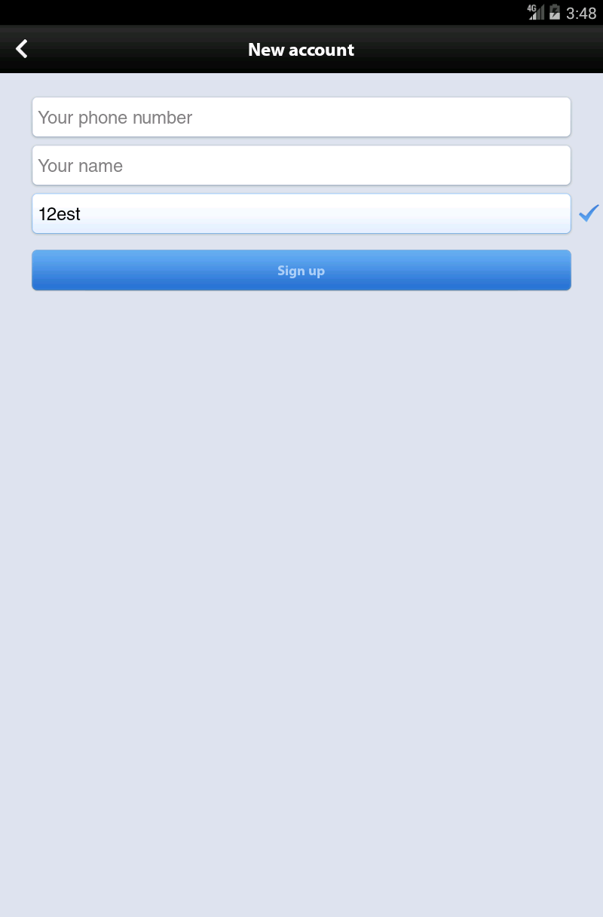

Text
Special case
DenseNet is the backbone network
EditText is similar to Text or Button
Some schemes:
1.Use OCR to process text in
an image, and filter the
incorrect text based on XML files
2.Reduce the character of the text
in some ways, and strengthen
image edges
Text
EditText
Button
EditText

Slide 5
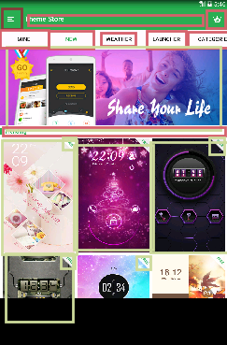
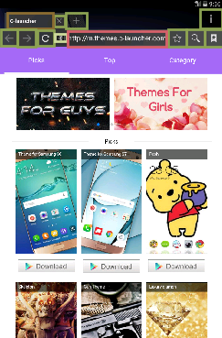
Special case
Editable text and picture text

Slide 6
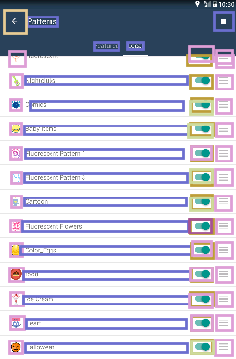
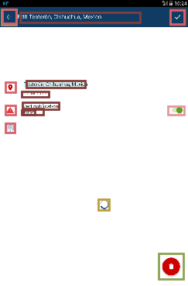
Examples

Slide 7
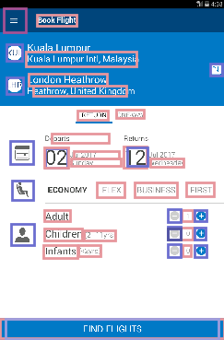
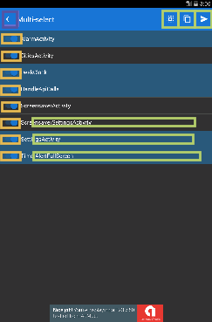
Examples

Slide 8
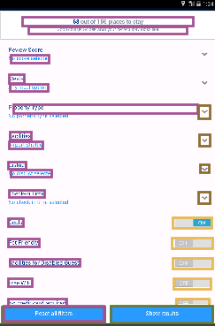
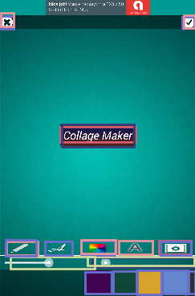
Examples

Slide 9
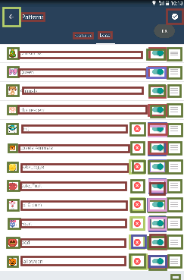
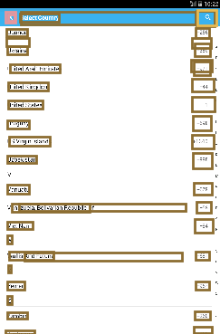
Examples

