Slide 1
工作汇报
吴 迪
2019.4.1

Slide 2
Photoshop
Image processing at pixel level, not vector processing
JavaScript or C++

Slide 3
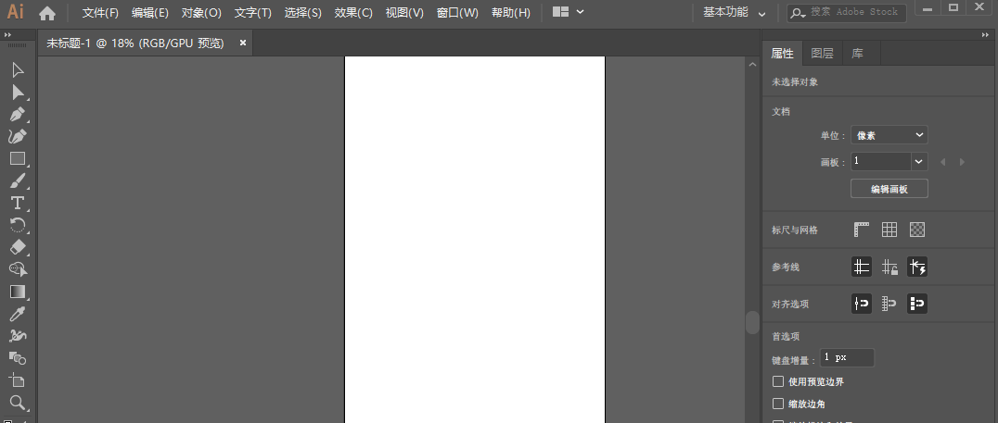
Adobe illustrator
C++ extension
Notes:
前两种使用不如sketch灵活，适用于制作海报、互联网网页等美化工作

Slide 4
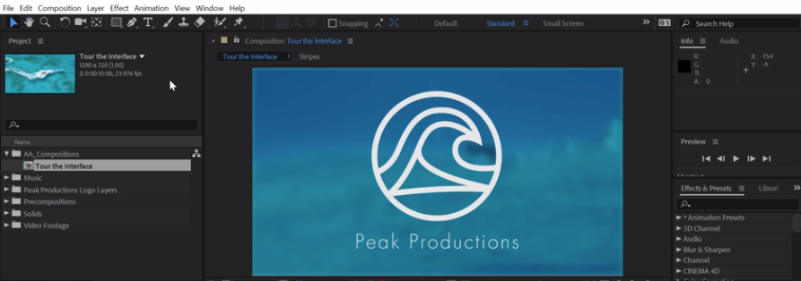
Adobe After Effects
C++ extension

Slide 5
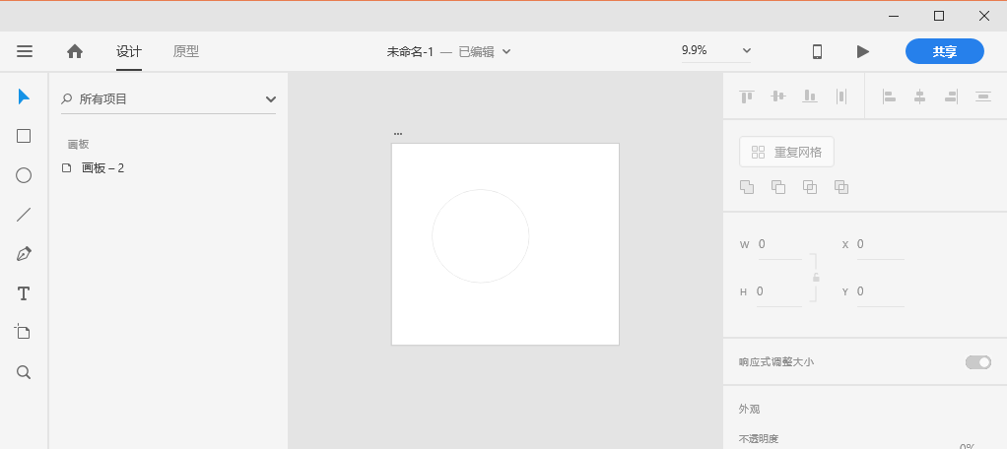
Adobe XD
XD plugin: Javascript HTML CSS
https://www.youtube.com/watch?v=o2XbClhH9tc

Slide 6
Problems
I want to shift the focus of my work, do the rest of the work, finish the algorithm experiment,finally write the pluin.
If this is not feasible, can we change to another project.

